Slide 1


Lag Time in the Multi-Aquifer System of Southeast Minnesota
Tony Runkel, Minnesota Geological Survey
https://displaylag.com/exposed-input-lag-vs-response-time/

Slide 2
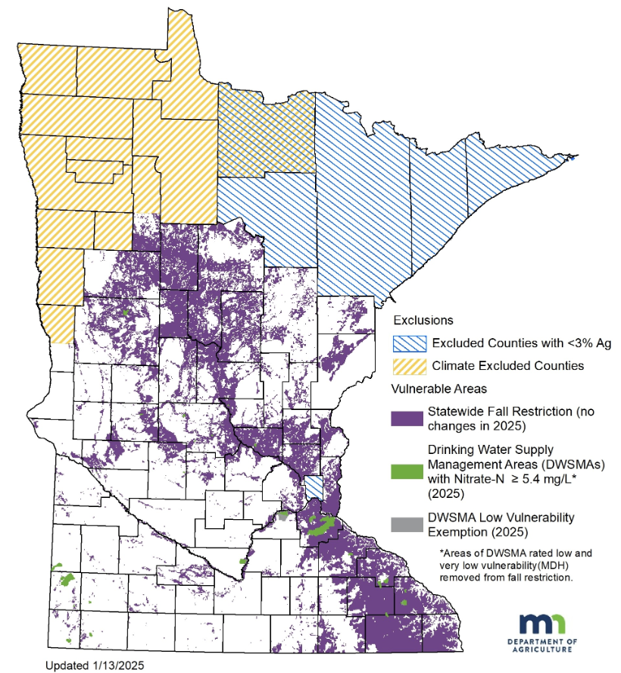
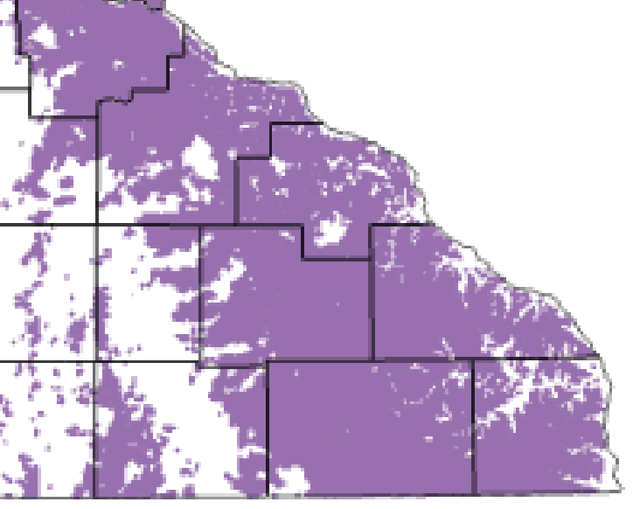
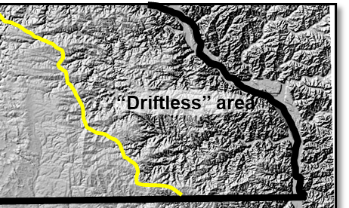
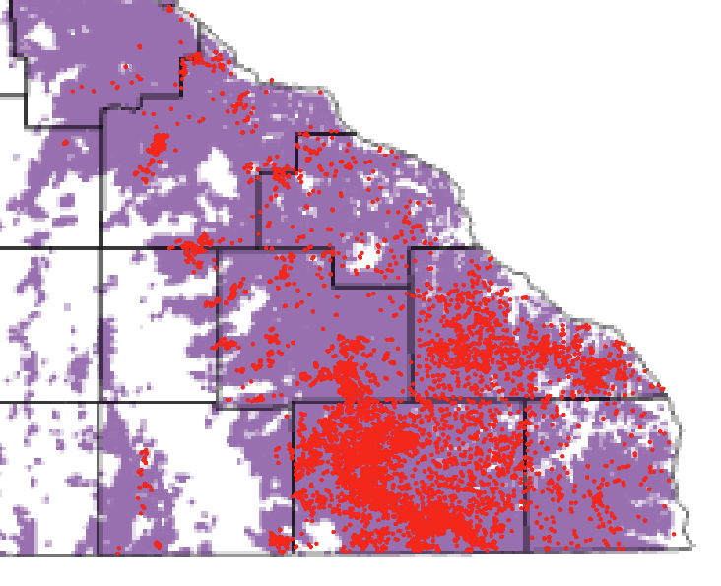
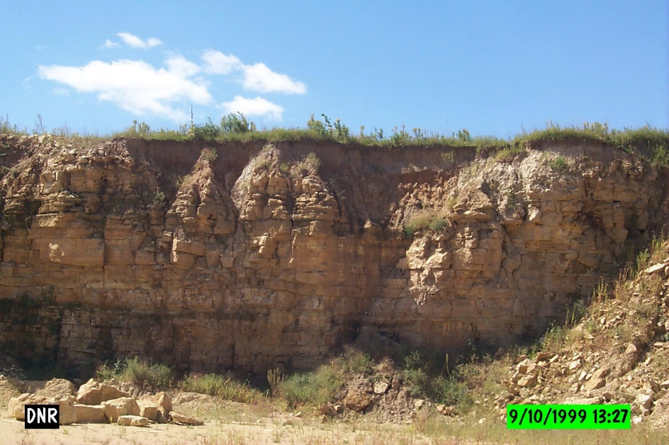
Hydrogeologic setting of southeast Minnesota “Driftless Area”
Incised, bedrock-dominated landscape with karstic carbonate plateaus
Rapid infiltration to the groundwater system
Karst-prone: carbonate bedrock within 50 ft of land surface
Sinkholes
Rapid water infiltration
Extensive clay cover
( i.e. glacial “drift”)
Fine Lake sediment
Karstic bedrock near or at land surface

Slide 3
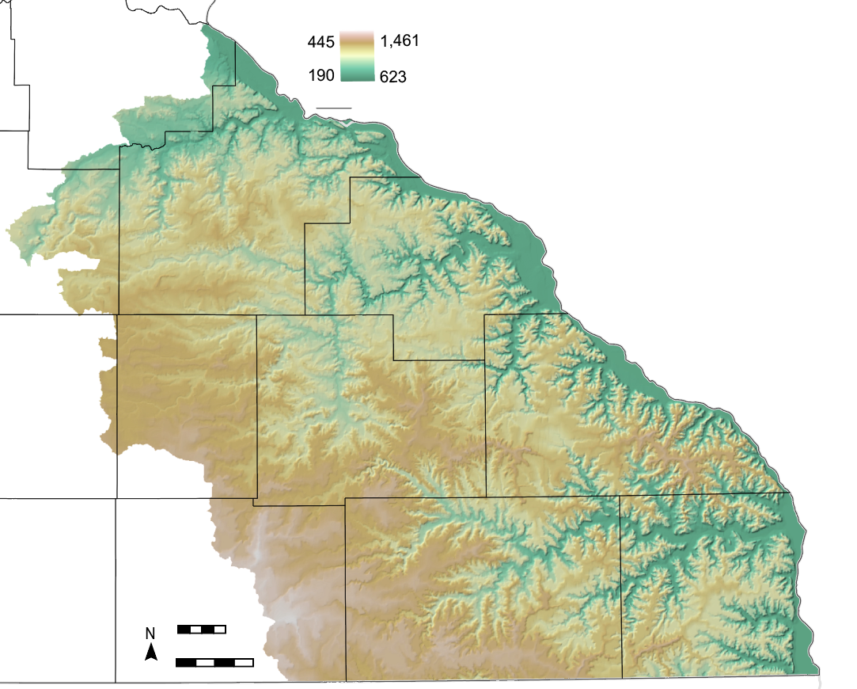
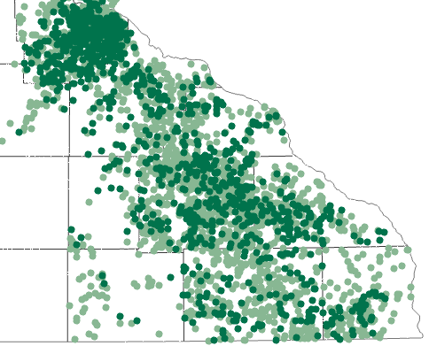

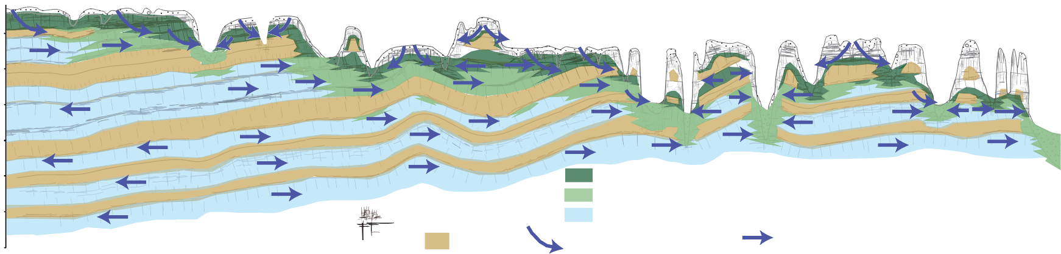
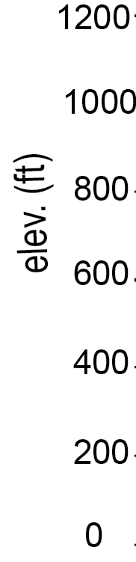
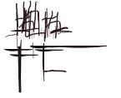




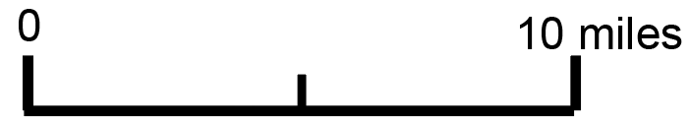
The Hydrogeologic System
Karst-prone: carbonate bedrock within 50 ft of land surface
Nitrate in well water and springs
Elev.
Sinkholes
NO3-N mg/l
>10 (Exceeds Health Risk Limit)
4-10
Lower Paleozoic Bedrock
A
B
10 km
10 mi
Data compiled by MN Geological Survey
A
B
Jordan
Aquifer
Fractures
High NO3-N
Water Well
Moderate NO3-N
0
Dominant flow
Recharge to WT
Aquitard/Aquitardifer
NO3-N <1 mg/l
10 miles
Stacked layers of aquifers (sandstone and karstic carbonate), aquitards (e.g. shale), and aquitardifers (Kh>>>Kv)
Rapid lateral flow that discharges to stream valleys and water wells

Slide 4

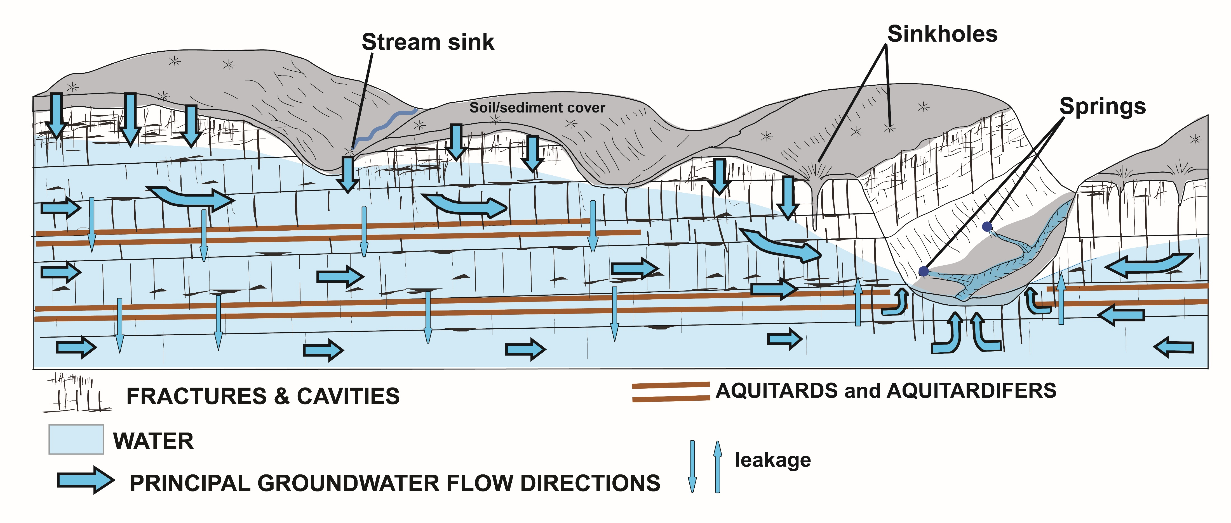
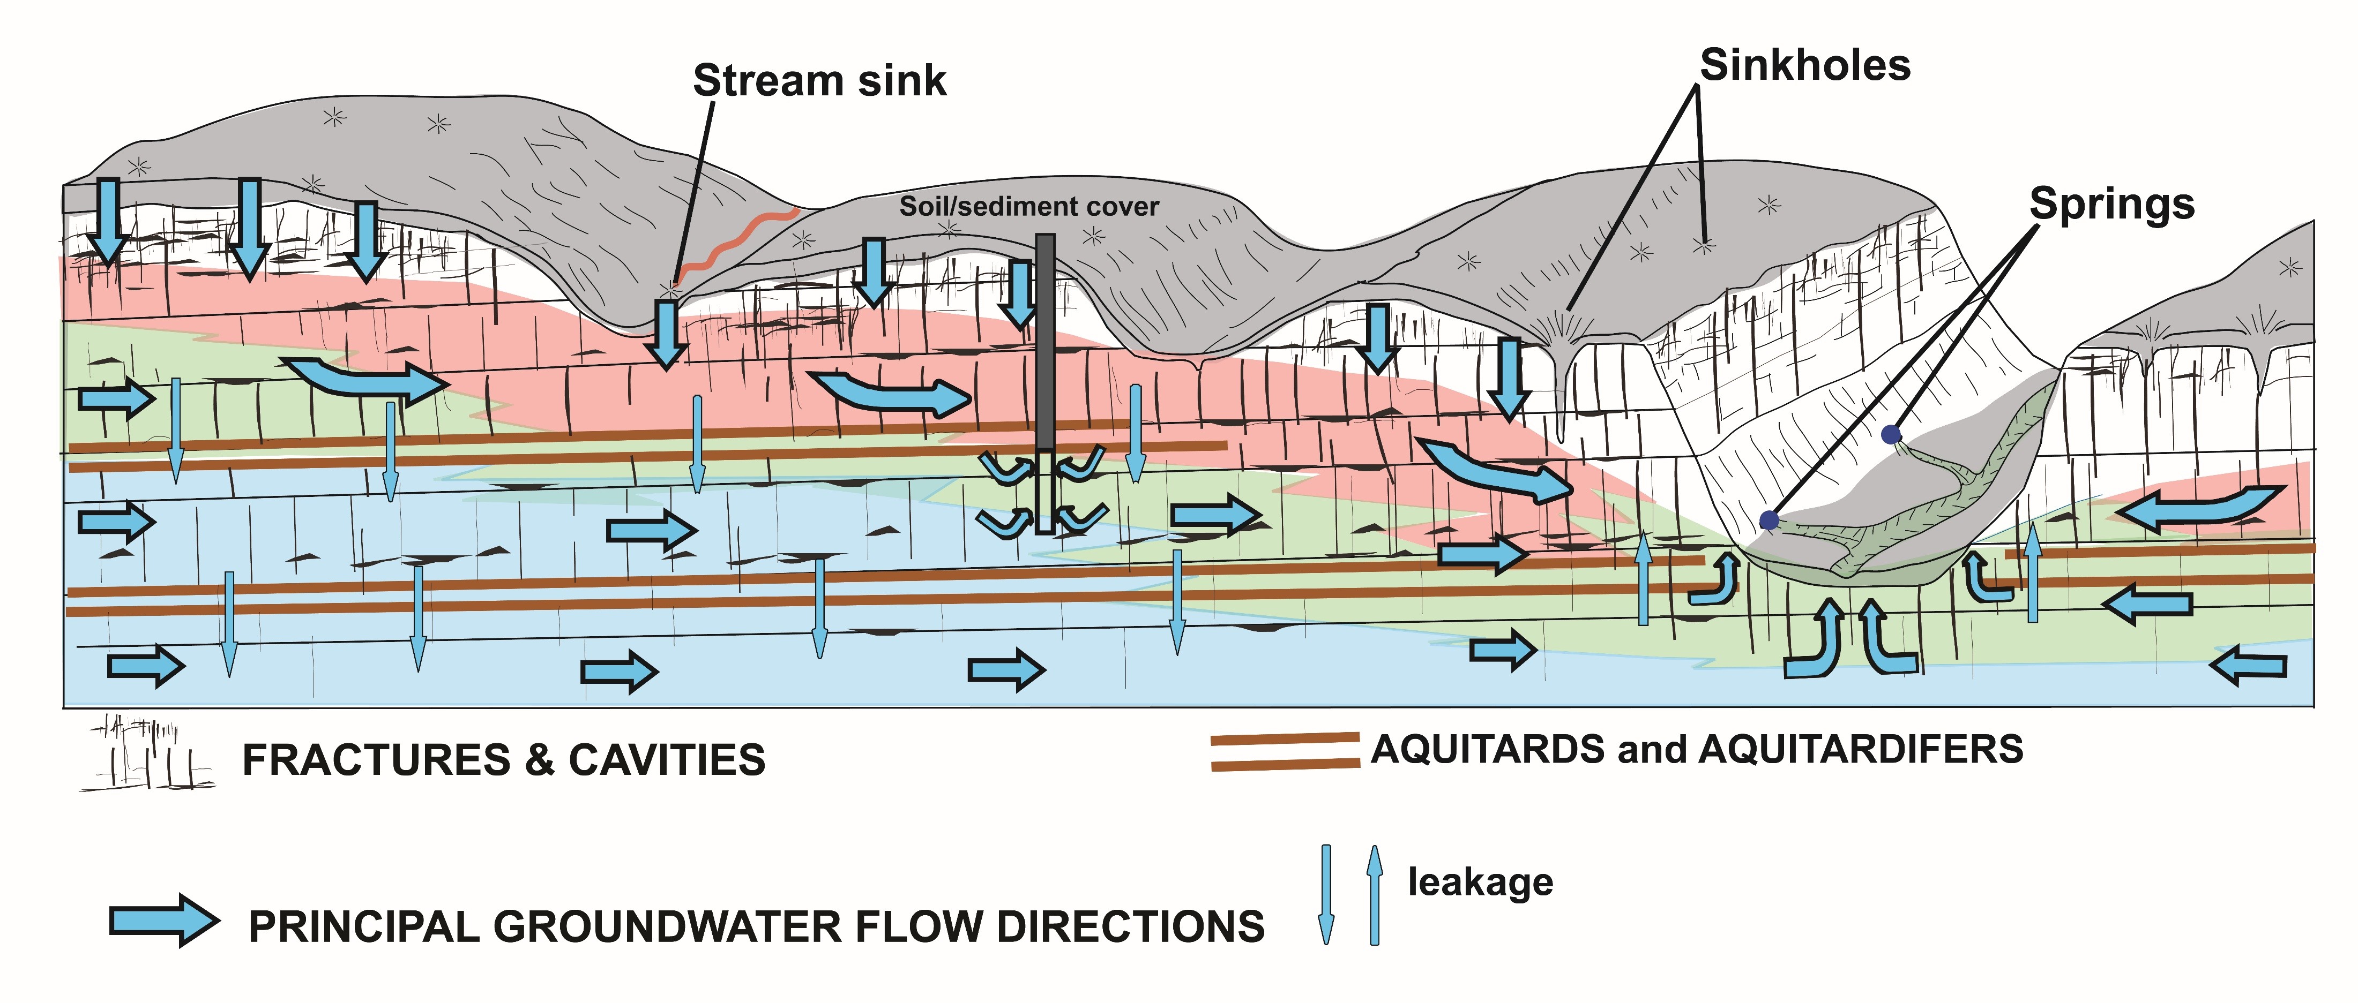
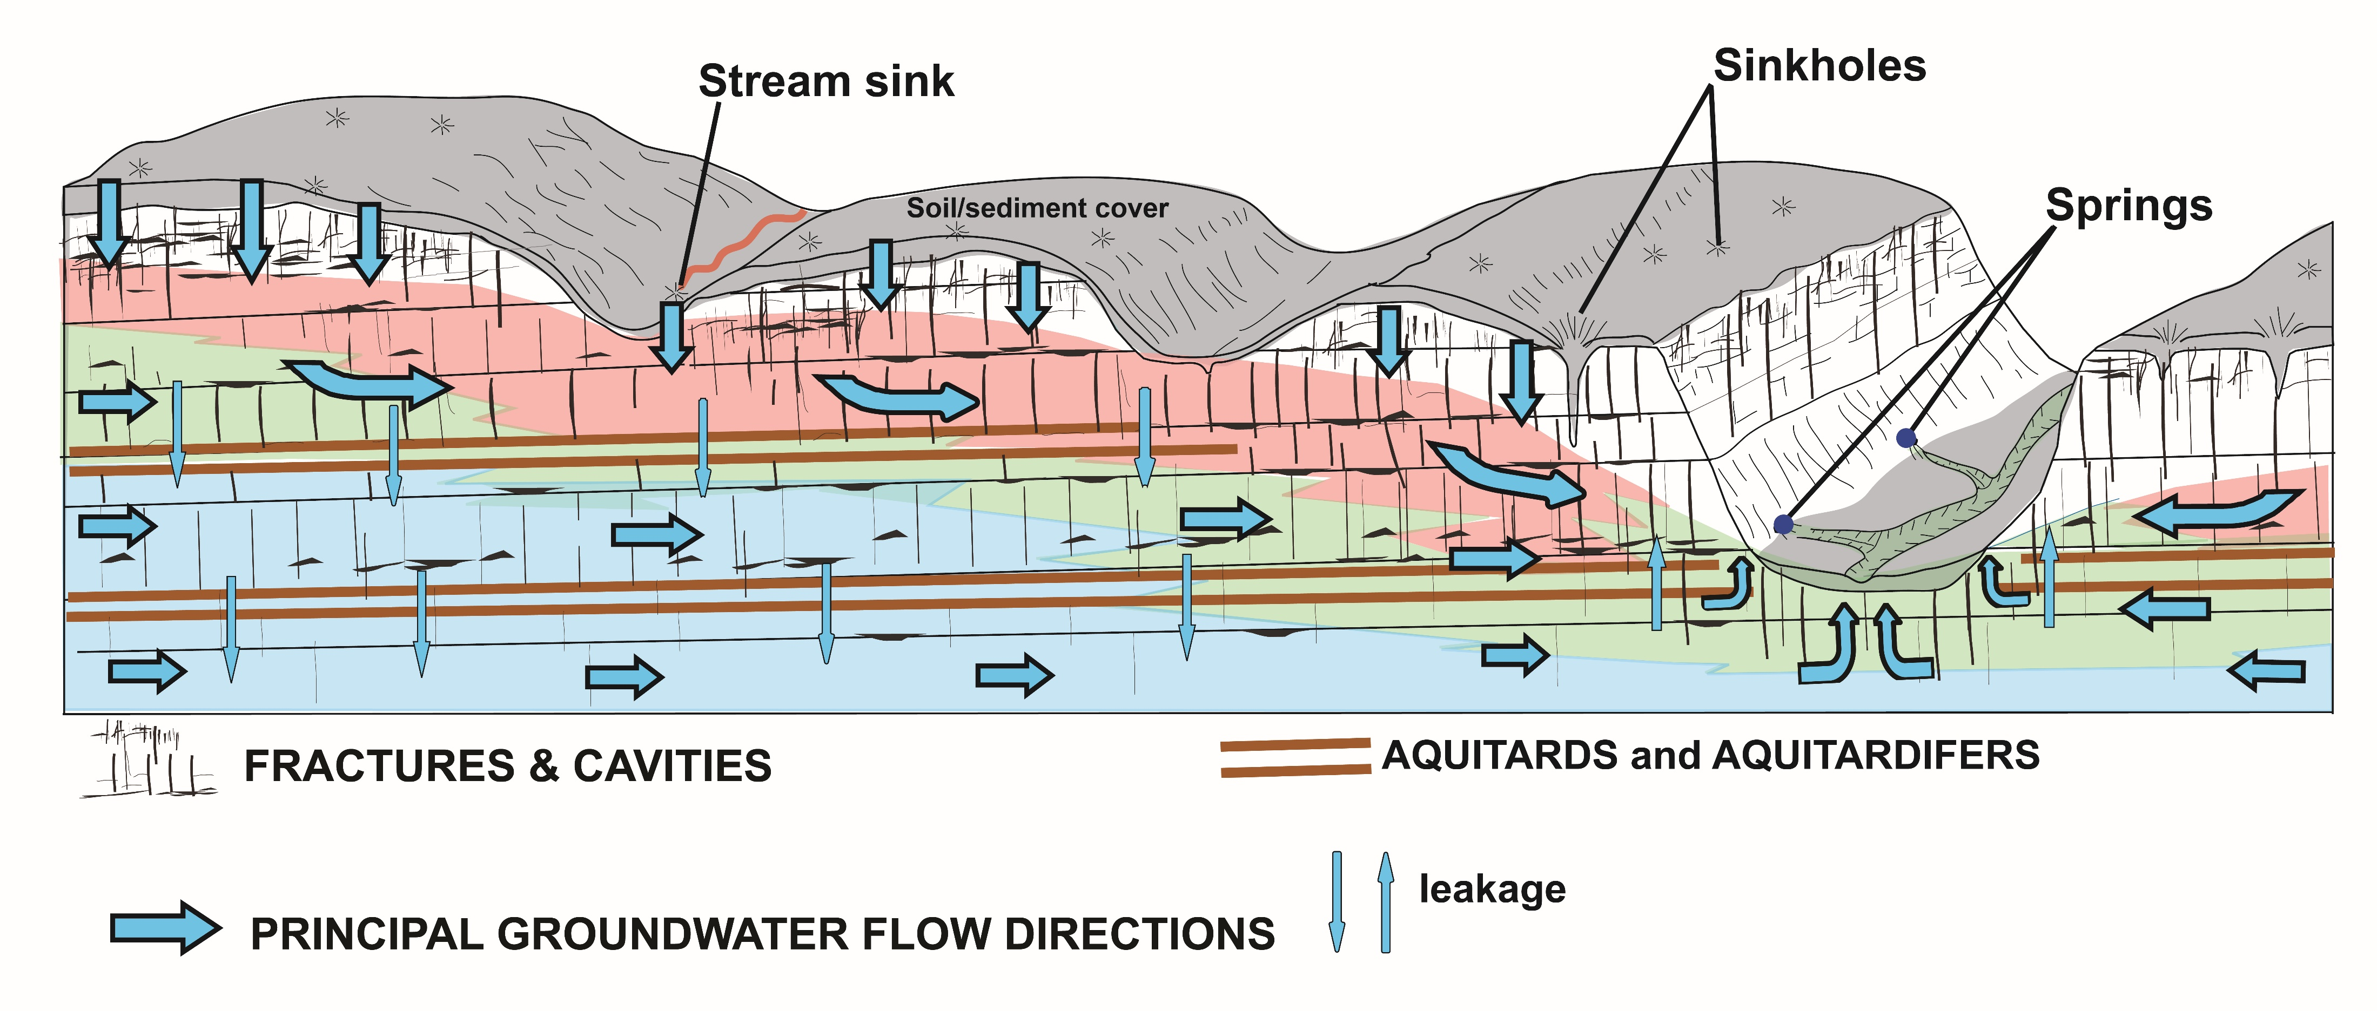

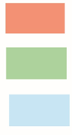
Groundwater age/ Lag time
Water Molecule
Discharge with mixed water ages
Typical SE MN well impacted by nitrate
Be Patient!
Jordan
Aquifer
Young water (minutes to years)
Older water (years to decades)
Oldest water (decades to 1000’s years)

Slide 5
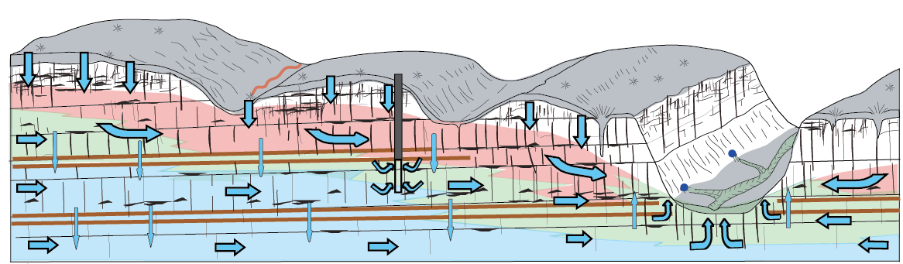
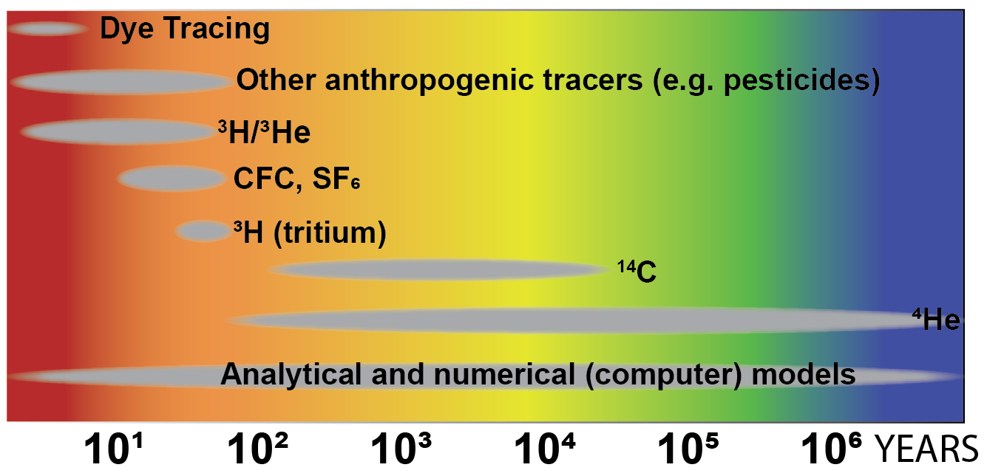
Lag Time?
Some methods for dating groundwater

Slide 6
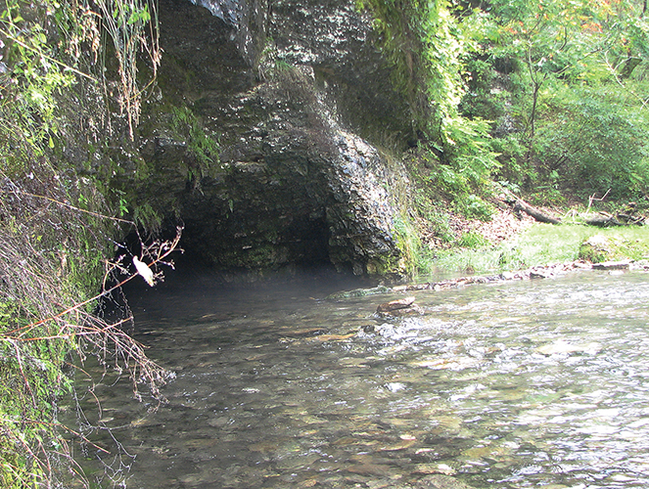
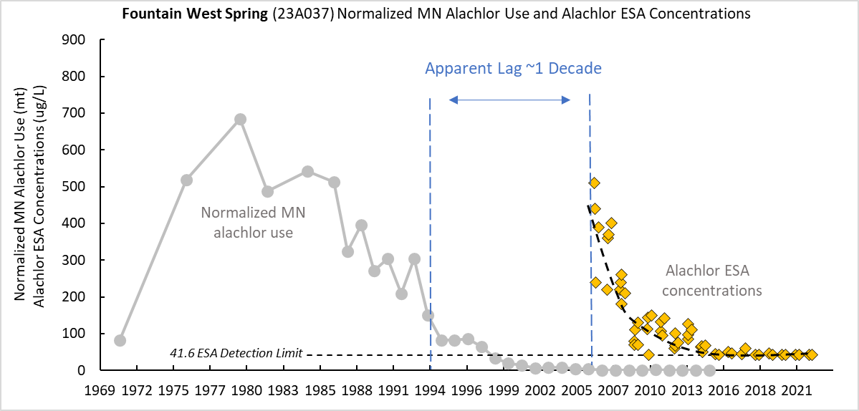
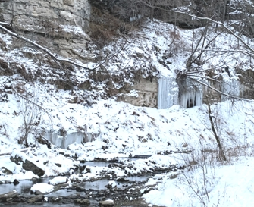
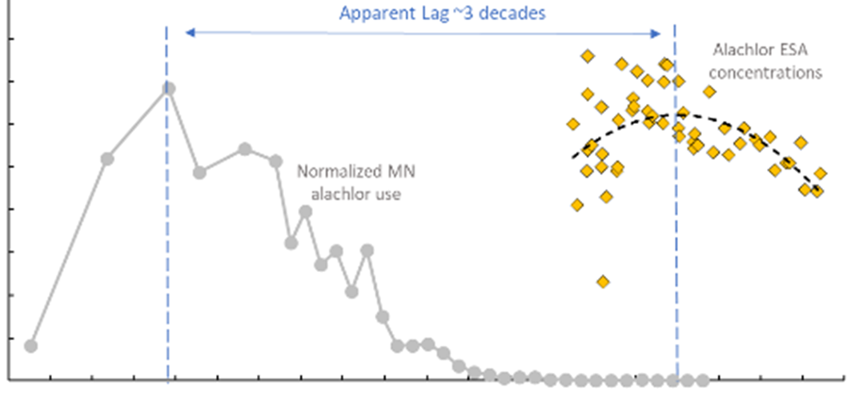
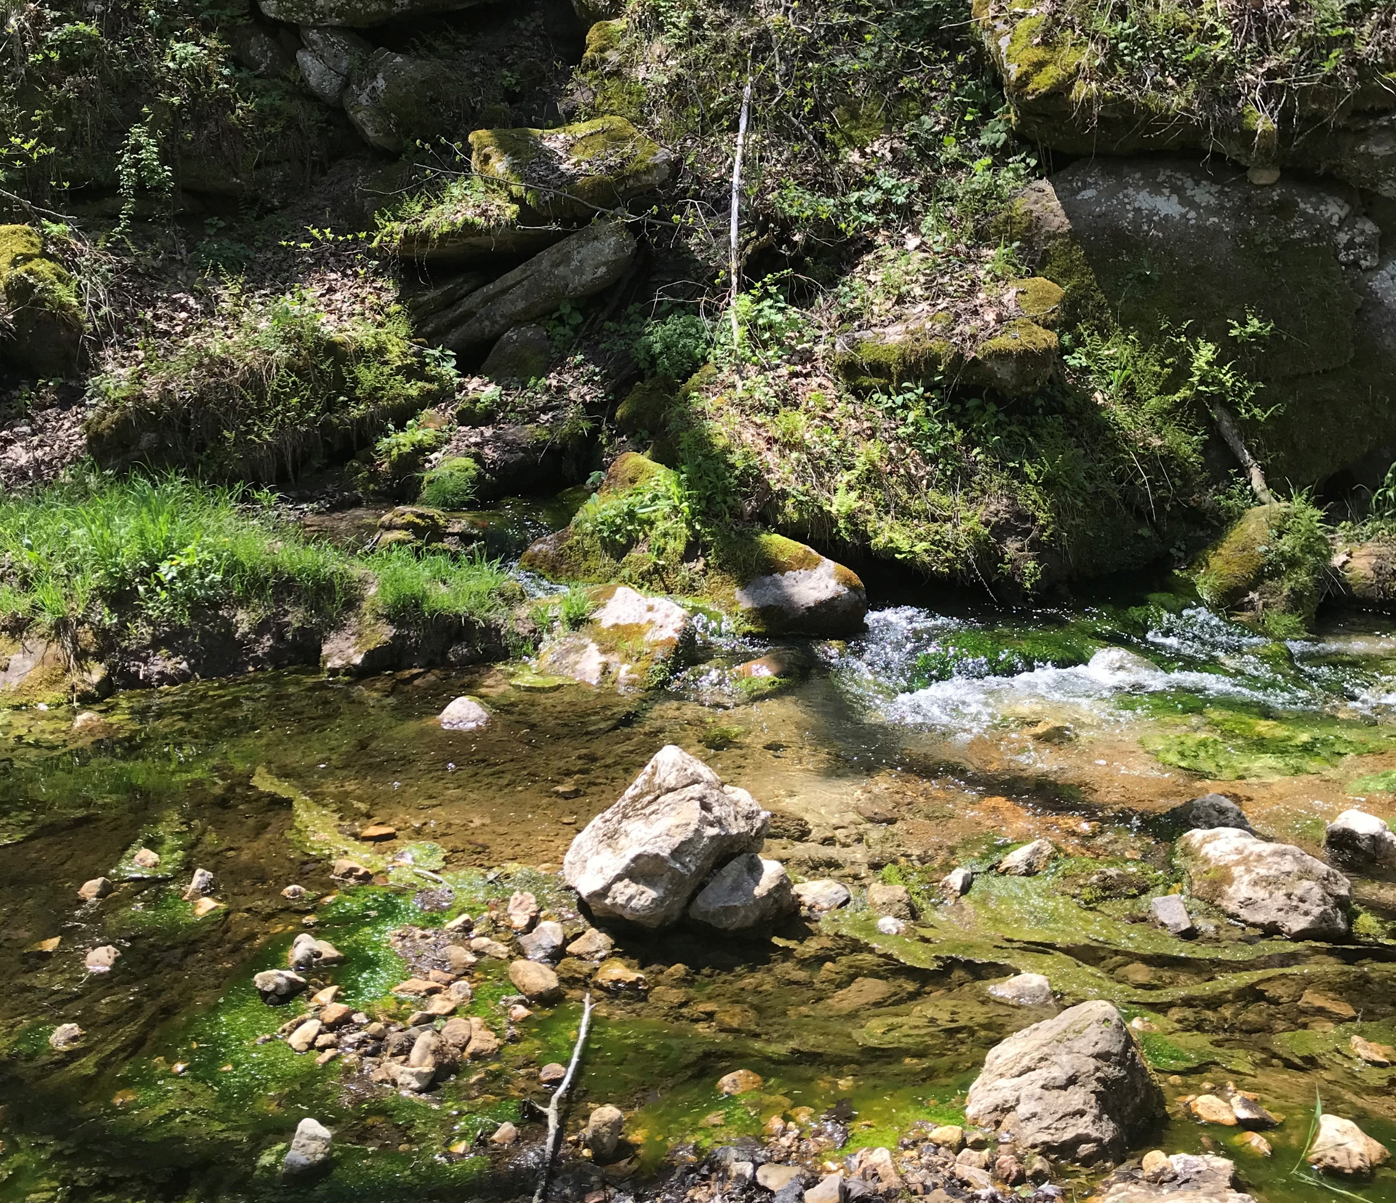
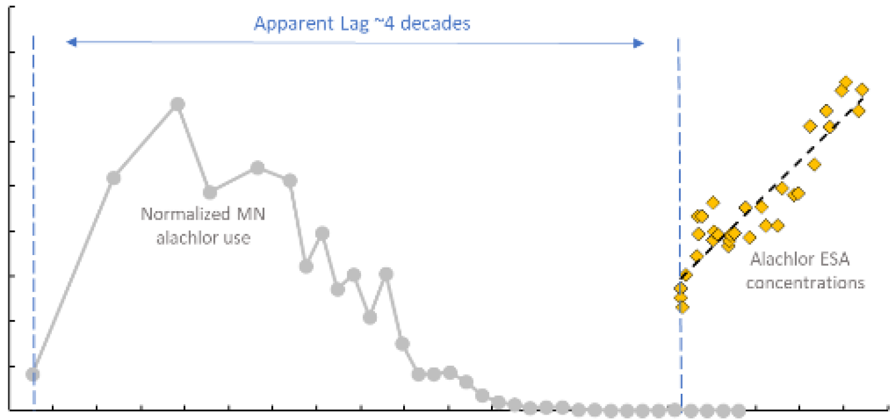
Example: Southeast MN groundwater age (modern component) estimates using Alachlor ESA
Kuehner, Runkel, and Barry (2025) Hydrogeology Journal
Fountain West Spring
FOUNTAIN WEST SPRING: SHALLOW
Alachlor ESA data from MN Dept of Ag
Apparent Lag ~1 Decade
~1 decade
BCVSP BIG SPRING: DEEP
Apparent Lag ~3 Decades
~3 decades
BCVSP Big Spring
HWY 76 SPRING: DEEPER
HWY 76 Spring
Apparent Lag ~4 Decades
~4 decades
DEEP SPRING

Slide 7

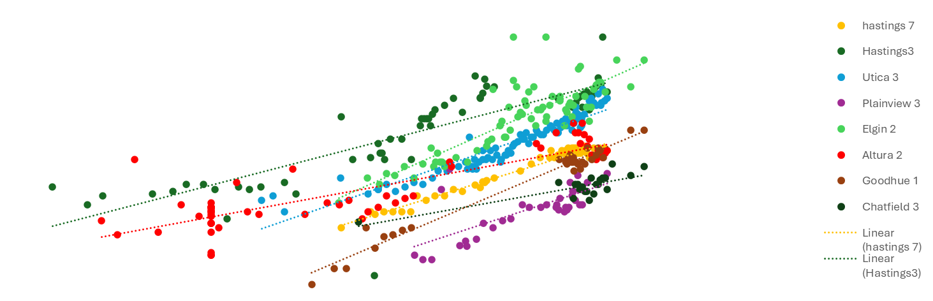
It is likely that most SE MN public supply wells with nitrate draw water with decadal lag times
Jordan Aquifer Wells
Hastings 7
Elgin 2
900
Hastings 3
Altura 2
Jordan
Aquifer
Utica 3
Goodhue 1
~30 yr lag time
Plainview 3
Chatfield 3
Year 2055
800
700
14
600
12
Sales
500
10
Nitrogen Fertilizer Sales
(thousands of metric tons)
Fertilizer
400
8
Nitrogen
NO3-N (mg/l)
300
6
200
4
100
2
~30-50 yr lag time
0
0
1950
1960
1970
1980
1990
2000
2010
2020
2030

