Slide 1

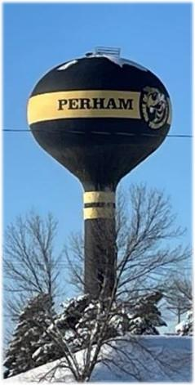
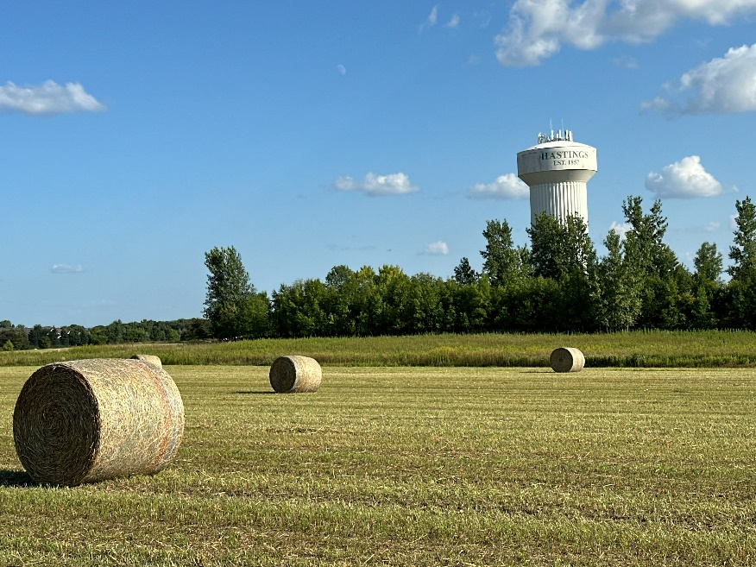
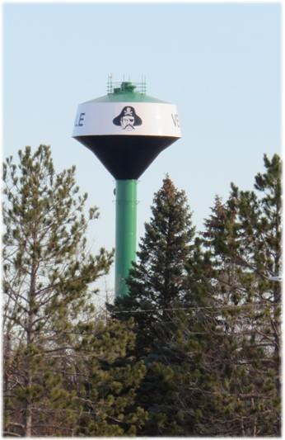


Understanding Groundwater Age for the
Implementation of the Groundwater Protection Rule
Science and Policy
Kimberly Kaiser and Margaret Wagner
Minnesota Department of Agriculture
MGWA Spring Conference
April 23, 2026

Slide 2
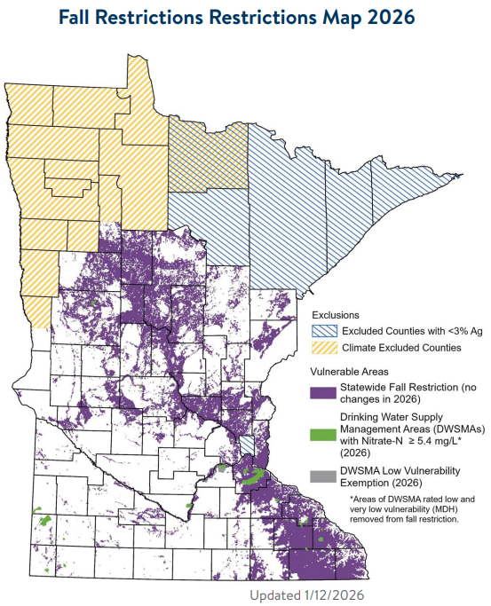
Minnesota’s
Groundwater Protection Rule Part 1
Restricts nitrogen fertilizer application
in fall and on frozen soils for:
  Areas with vulnerable groundwater
  Protection areas around community wells
  with high nitrate - called Drinking Water Supply Management Areas (DWSMAs)
Restrictions begin September 1 each year
Interactive Online Map:
www.mda.state.mn.us/vulnerableareamap

Slide 3
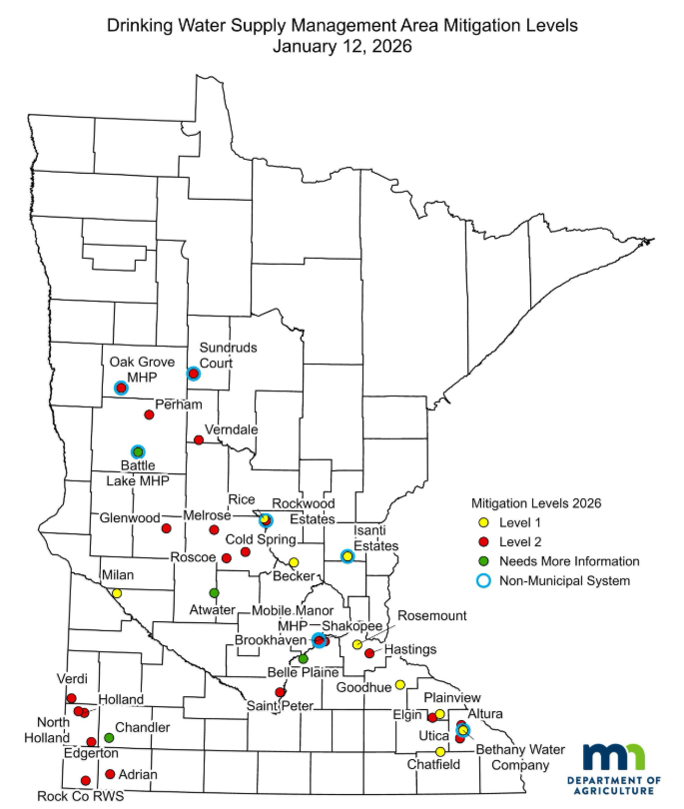
Minnesota’s
Groundwater Protection Rule Part 2
Drinking Water Supply Management Areas (DWSMAs) where community wells have high nitrate levels:
Level 1: Nitrate-N level is 5.4 to less than 8 mg/L in past ten years
    10 communities
Level 2: Nitrate-N level is 8 mg/L or greater; or is projected to exceed 10 mg/L in the next ten years
    23 communities
    18 Local Advisory Teams formed
Approximately 750 DWSMAs in Minnesota
Notes:
Note- all communities start in a voluntary phase with clear criteria on when a community move to a regulatory phase.

Slide 4
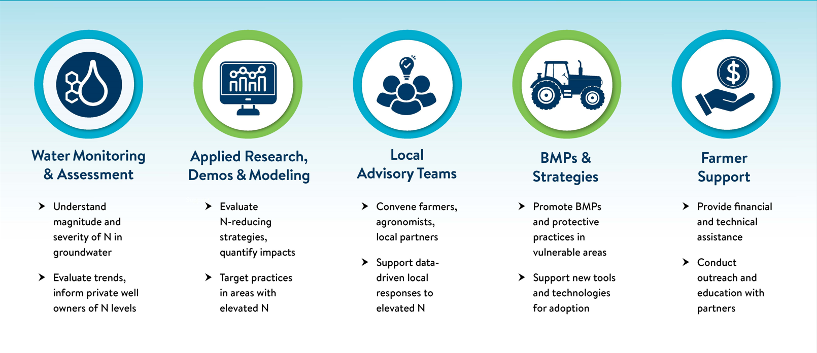
MDA’s Process to Protect Groundwater
Strategy within Nitrogen Fertilizer Management Plan and Groundwater Protection Rule
Notes:
Often people think about MDA”s work as a “plan” or a “rule” –something that is written and enforced- rather than a dynamic and current approach. Embedded in The MDA’ s Nitrogen Fertilizer Management Plan and Groundwater Protection rule is science-based strategy. This simple diagram illustrates technical work, engagement of the ag community though local teams, and coordination with other agencies to provide cost share for practice implementation.
(Animation) Three main areas of groundwater science at MDA are water monitoring and assessment, applied research and computer modeling, and BMP development and adoption. Outcomes from water monitoring, applied research and updates to BMP documents are used to make decisions under the Groundwater protection Rule.
After a brief overview of the Groundwater Protection Rule- we will discuss new information being generated and the type question we answer with that information.

Slide 5
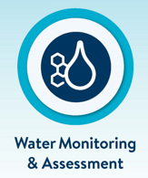

Water Monitoring and BMP Science in the
Groundwater Protection Rule
A level 2 drinking water supply management area (voluntary) can move to a mitigation level 3 (regulatory) if:
Statistical analysis indicates the nitrate–nitrogen concentration is increasing for the public well or groundwater monitoring network
Or
Nitrogen fertilizer best management practices are implemented on less than 80% of cropland in the drinking water supply management area.
Water monitoring other technical information is considered during evaluations:
Lag time
Age of groundwater
BMP effectiveness and adoption
Evaluations may occur after three growing seasons or the lag time
Notes:
Information used for water quality evaluation and BMP adoption evaluation
Public well and groundwater network nitrate data review
Water quality evaluation of public supply well
Annual water quality review
BMP list development and publication
Computer modeling tools to evaluate reductions in nitrate load

Slide 6








Water Quality Evaluation
-Public Water Supply Wells
Public Water Supply Nitrate Data (MDH)
DWSMAs in coarse textured soils and quaternary aquifers- use the best available tools and techniques to determine when (lag- time) we will see changes in water quality.
DWSMAs in the carbonate (karst) bedrock aquifer systems –continue to build knowledge of the lag time and the age of groundwater to ensure we are evaluating changes from recent practices.
Quaternary
Public Water Supply Well
Public Water Supply Well
Quaternary
Lag Time
Quaternary
Prairie Du Chien
Jordan
St. Lawrence
Notes:
The majority of the high nitrate DWSMAs will be evaluated with the data provided by MDH. The other considerations are the Lag time which is the time for water to travel to the aquifer being monitored. In the quaternary aquifers lag time has been estimated by calculating the vertical travel time of water using well log specific information. In the southeast the estimated lag time may be too soon to determine a nitrate trend change for an individual well. The age of the groundwater will also need to be considered to ensure we are evaluating recent water.

Slide 7
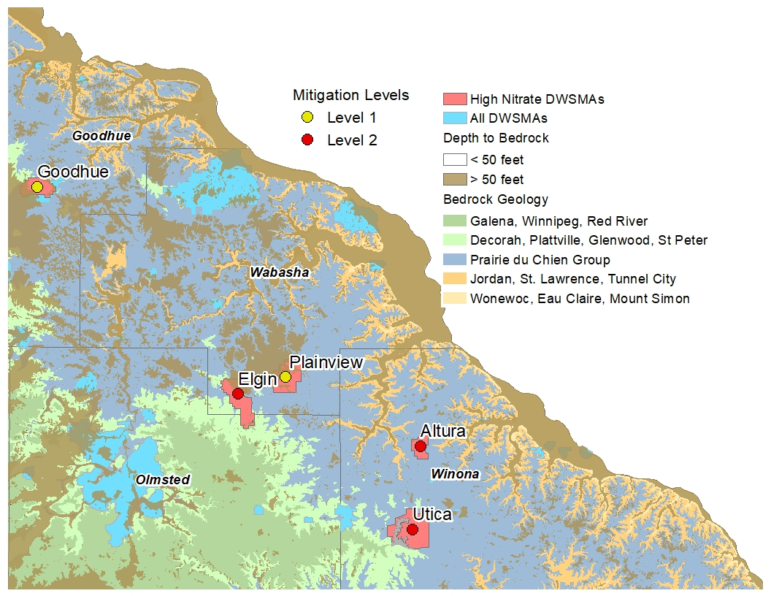
Southeast MN DWSMAs with high nitrate concentrations
HRL
GPR Level 2
GPR Level 1
Map data sources: Jirsa and others, 2011; Runkel and others, 2014; MDH, 2026
Notes:
Altura, Elgin and Utica are all level 2 DWSMAs, they’ve all gone over 8 mg/L in the last 10 years, while Plainview is a level 1 DWSMA. These DWSMAs are all located in the Prairie du Chien Plateau, which has limited geologic protection.

Slide 8
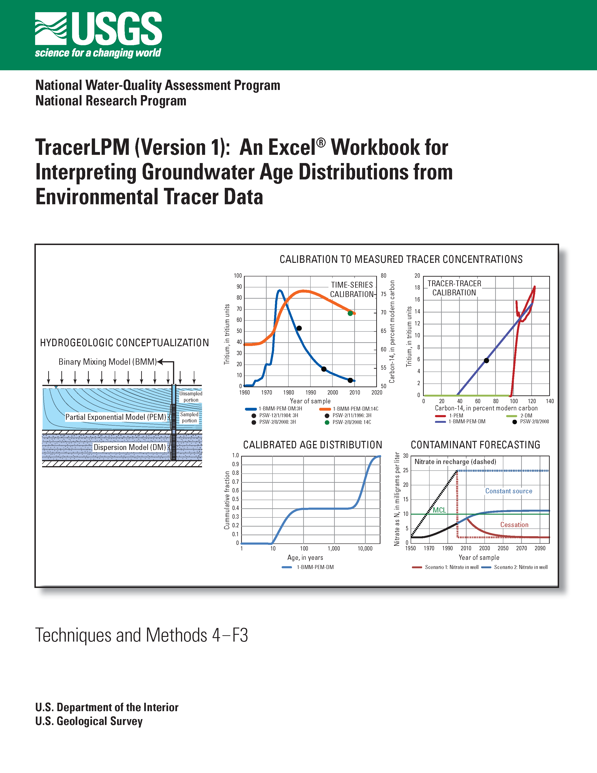
Southeast MN DWSMAs with high nitrate concentrations
MDA contracted with the USGS to determine groundwater age distributions for 6 municipal wells open to the Jordan aquifer.
Collect samples of atmospheric tracers with known histories to model the age distribution.
Mean ages of groundwater samples ranged from 35 to 63 years with an average of 52 years*
Take away
The southeast municipal well nitrate concentrations will not likely reflect recent practices. An assessment of BMPs will be key in these bedrock dominated systems.
Jurgens and others, 2012 . https://pubs.usgs.gov/tm/4-f3/
63 yrs
60 yrs
35-41yrs
*Sample age information published by USGS here: https://doi.org/10.5066/P9XVBIWP
47-63 yrs
Notes:
Following work from a LCCMR project
Tritium (³H)
Tritiogenic helium
Chloro-fluorocarbons (CFC-11, CFC-12, CFC-113)
Sulfahexafluoride (SF₆)

Slide 9

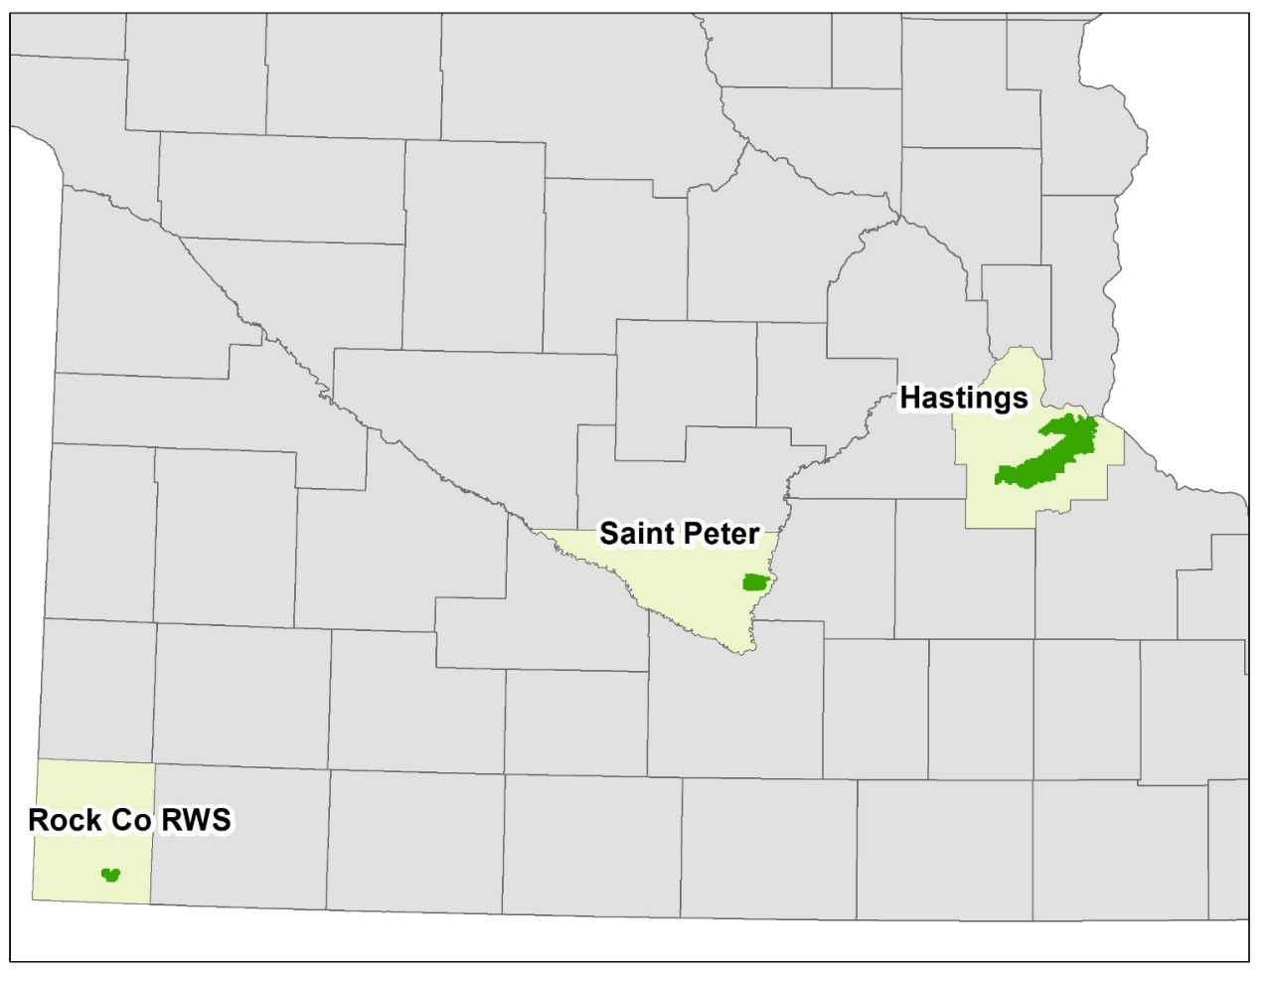
Water Quality Evaluation
-Monitoring Wells
2. Monitoring Well Nitrate Data (MDA)
3 DWSMAs were determined to have sufficient opportunities to install monitoring networks.
Row crop agriculture?
Coarse textured soils?
Willing property owners and local partners?
Can the water table be reasonably monitored?
Data Collected for Networks
Soil borings and geology logged at each well location
Water levels
Nitrate samples collected at least 3 times per year
Data is available in the Water Quality Portal and summary reports are available online in the Water Research Library.

Slide 10
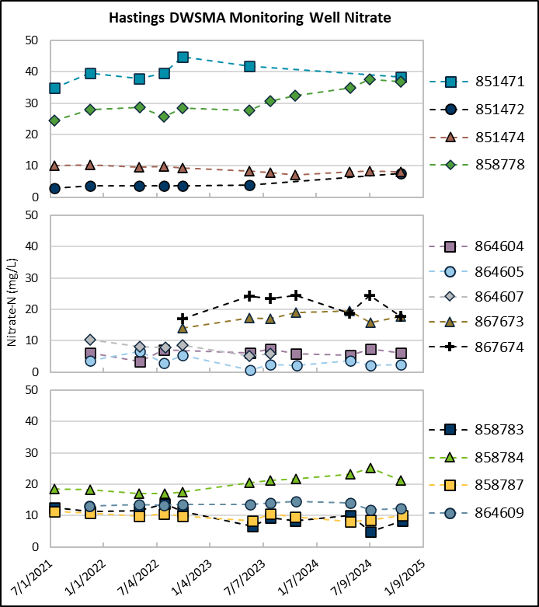
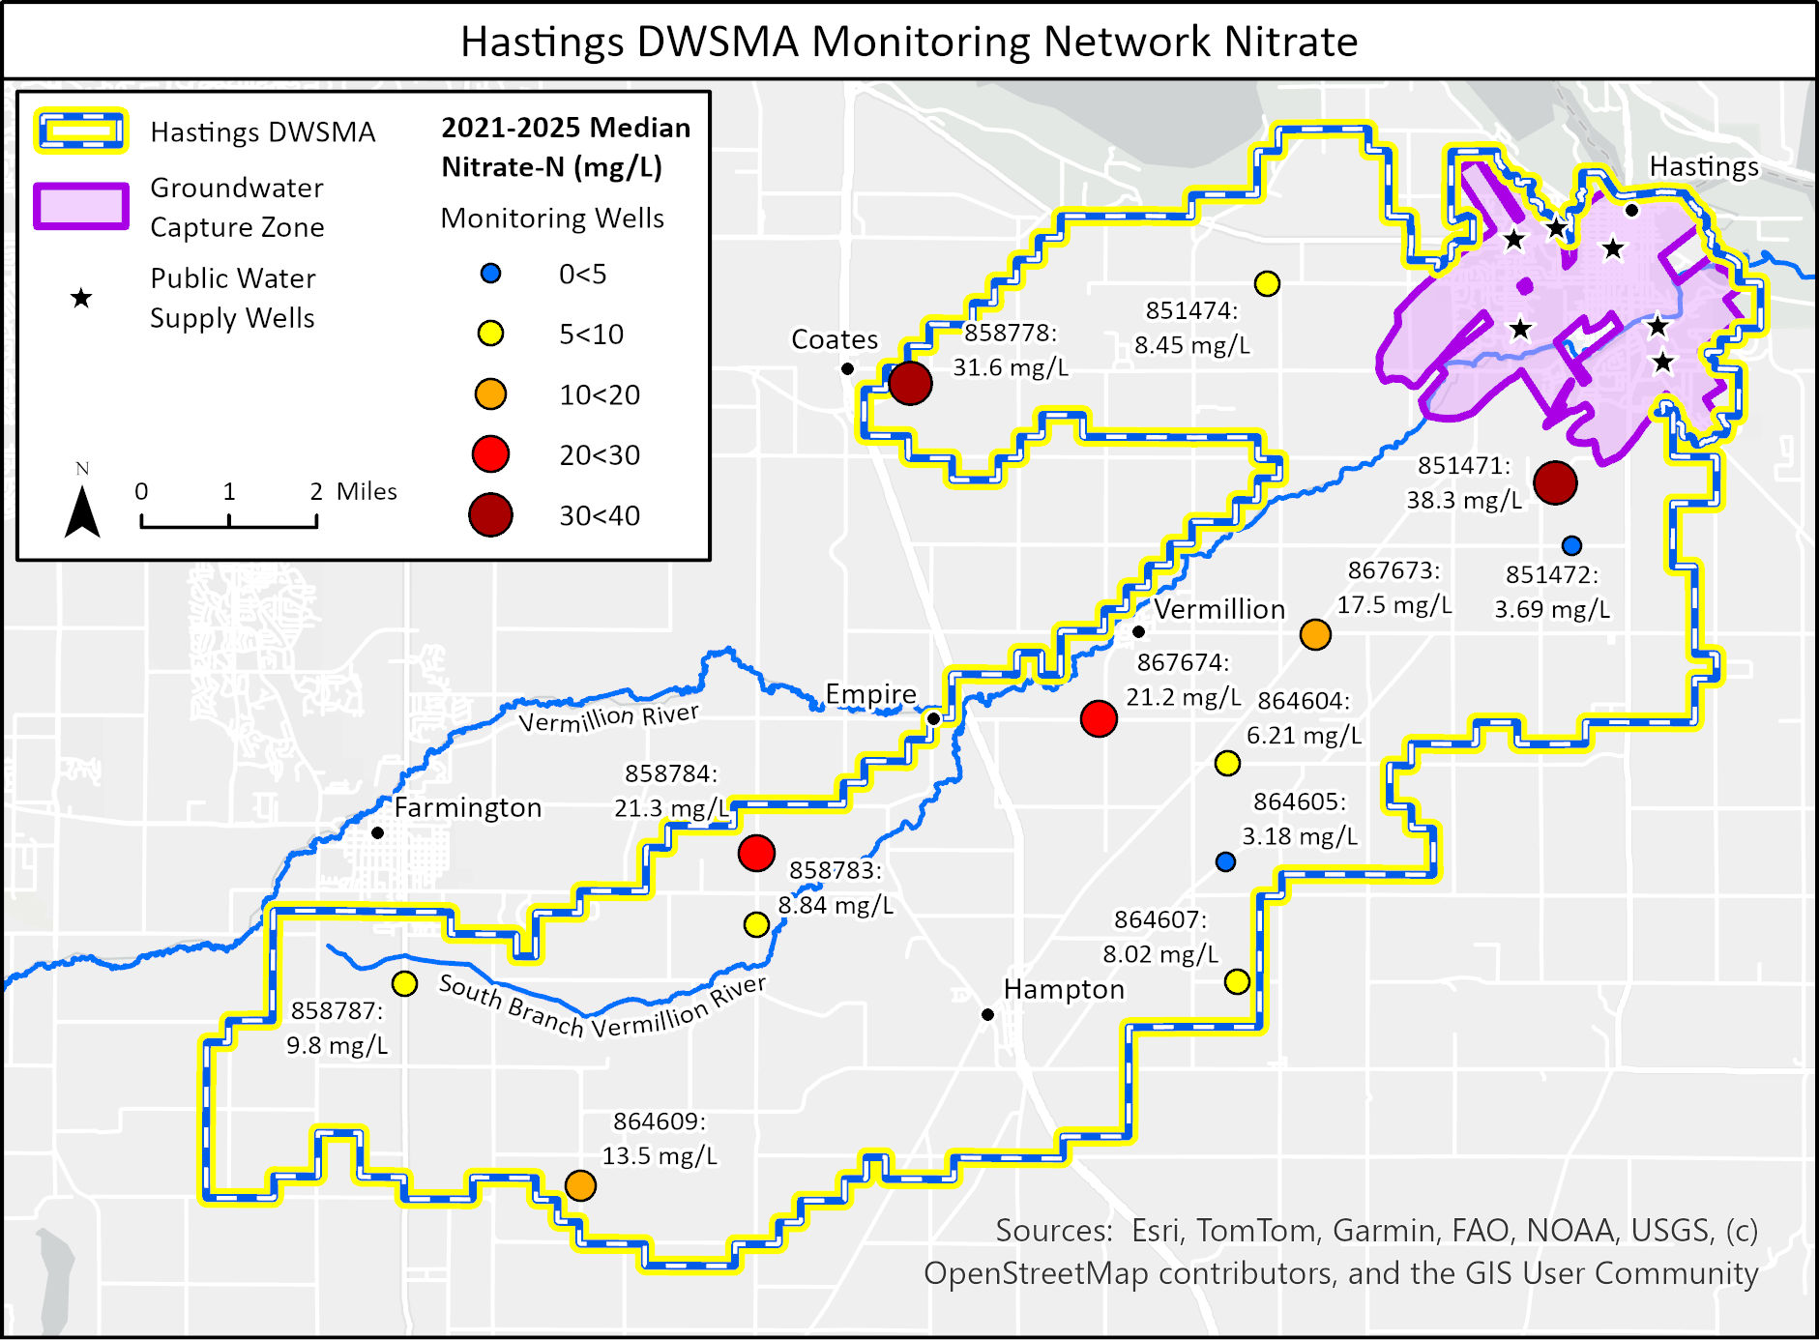
Hasting DWSMA Monitoring Network
Notes:
13 wells completed in the upper aquifer.
The nitrate results for individual wells ranged from 0.67 mg/L (864605 in the spring of 2023) to 44.8 mg/L (851471 in the fall of 2022). Nitrate concentrations were consistently highest at well 851471, immediately south of the Groundwater Capture Zone. Nitrate concentrations are also high and increasing at well 858778.
The median nitrate concentration across the monitoring well network per sampling event ranged from 8.41 to 12.5 mg/L, with the highest median recorded in the summer of 2021 and the fall of 2022.

Slide 11
Water Quality Evaluation
Take away
These evaluations will take time….. whether it’s the public water supply wells or monitoring network wells.
The southeast municipal well nitrate concentrations will not likely reflect recent practices. An assessment of BMPs will be key in these bedrock dominated systems.

Slide 12
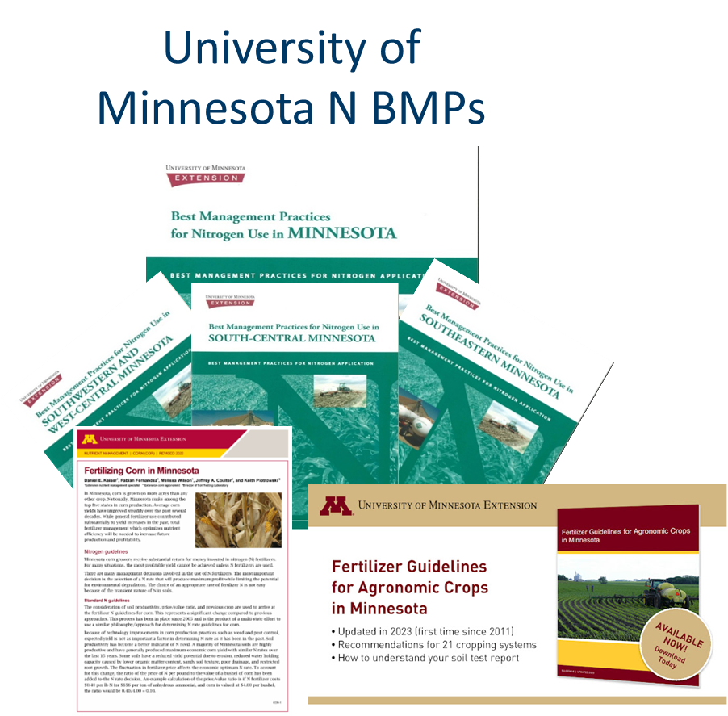
Nitrogen Fertilizer Best Management Practices (BMPs)
Nitrogen Fertilizer Best Management Practices
BMPs developed by University of Minnesota, adopted by the MDA
BMP lists developed for each Level 2 drinking water supply management area (DWSMA)
DWSMA specific BMP lists published in consultation with local advisory teams

Slide 13
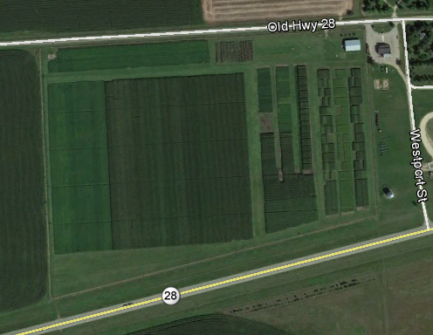
Science in support of Groundwater Protection Strategy
MDA supports:
Update of statewide Nitrogen Fertilizer BMPs
Two dedicated positions at UMN
Nitrogen rate and timing research trials in Southeast
Research and development of comprehensive Irrigation BMPs
Technical review and approval of nitrification inhibitors
Nitrogen Rate, Cover Crop
and Tillage Trials
Rosholt Farm
Westport , MN
Notes:
ADD: Minnesota Ag Weather Network (MAWN)?

Slide 14

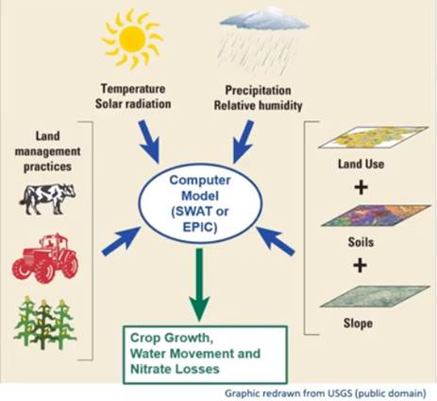

Science in support of Groundwater Protection Strategy
Advanced models (SWAT and EPIC) are used to predict:
  Effects of management decisions on soil, water, and nitrate-N movements below the root zone
  Impact of changes on soil, water and nutrient flux on water quality
Both models are calibrated and validated with MN specific research and edge-of-field monitoring
DWSMA specific nitrate-N leaching estimates for:
  Current agriculture management (baseline)
  Nitrate-N leaching reduction based on BMP and AMT adoption scenarios (changes to baseline)

Slide 15
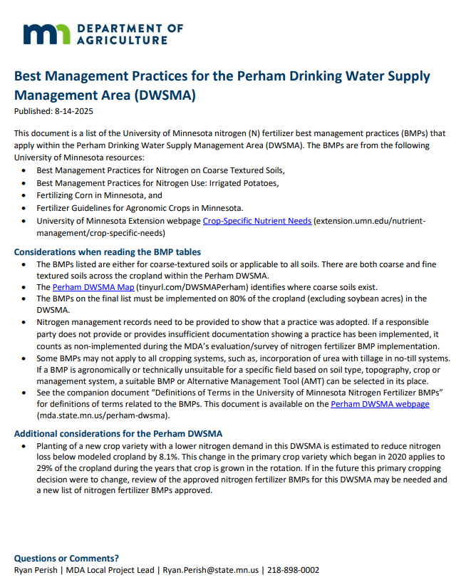

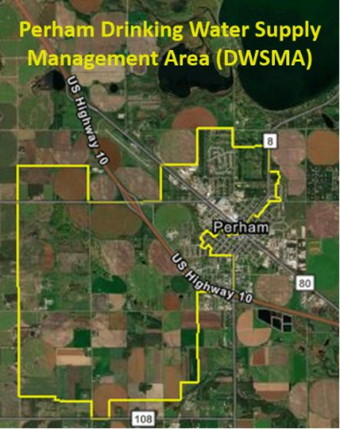
Science in support of Groundwater Protection Strategy
DWSMA specific BMP lists
Computer Modeling
Research Trials
Notes:
MN specific BMP research
Development and update of BMPs
Computer modeling to estimate nitrate leaching reductions
Develop of DWSMA specific BMP list
BMP must be adopted on 80% of cropland in DWSMA

Slide 16
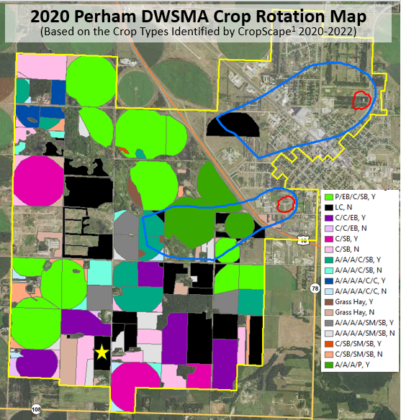
Perham DWSMA
Otter Tail County
Groundwater Protection Strategy:
N rates at or below 195 lbs./ac for C-Sb (irrig)
        205 lbs./ac for C-Eb (irrig)
140 lbs./ac for C-Sb (dry)
175 lbs./ac for C-C (dry)
N rates at or below 120 lbs./ac for edible beans
Split application of N on corn and edible beans on coarse textured soils
Rate, timing, and source BMPs for irrigated potatoes
Working with landowners to adopt:
  Planting of a new crop variety with a lower N demand
  Irrigation scheduling
  Use of nitrification inhibitor products

Slide 17
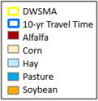
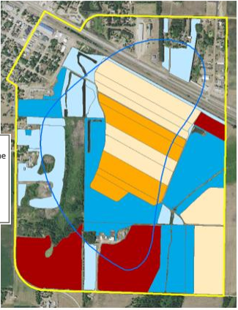
Verndale DWSMA
Wadena County
Groundwater Protection Strategy:
N rates at or below 135 lbs./ac for C-Sb
165 lbs./ac for C-C
Split application of N on corn and edible beans on coarse textured soils
Maintain existing perennial cover which accounts for 60-83% of cropland in the DWSMA
Working with landowners to adopt:
  40 additional acres of cover crops following soybeans
  14 additional acres of grass hay
  15 acres of A-A-A-C-C rotation, and
  14 acres of new perennials

Slide 18
BMP Evaluation
Take away
BMPs are unique to each area and based on soil type, cropping systems and management
  First 2 evaluations in 2026, 8 more in 2027, 4 in 2028...
Important BMP updates are underway including irrigation and manure management
Computer modeling is used to set expectations for nitrate leaching reductions and water monitoring is used to validate reductions over time
Notes:
DWSMA evaluations will continue on a 3-year interval to assure BMP adoption continues in each DWSMA.
Updates to published lists to include BMP updates will be made in coordination with evaluations.

Slide 19
MDA’s Process to Protect Groundwater

Slide 20

Thank You
Kimberly Kaiser
Hydrologist
Kimberley.kaiser@state.mn.us
Margaret Wagner
Manager
Margaret.Wagner@state.mn.us

