Slide 1

A Multi-Tracer Approach to Assessing Relative Groundwater Age and Aquifer Vulnerability in the Root River Watershed
Maya Gilchrist | Hydrologist

Slide 2
DWAMP: Watershed-scale characterization
Sampling at a selected group of private wells within target watersheds to identify areas and aquifers that are subject to recent recharge and are vulnerable to contaminants at the ground surface.
Data collection to fill gaps in existing monitoring programs, increased knowledge of vulnerable aquifers/regions at the watershed scale, data collected on private wells
Watersheds selected at midpoint of 1W1P planning process
Notes:
Tailored analyte list for each network separately, tested for general water chemistry at all networks
Technical advisory team, past MN detections

Slide 3
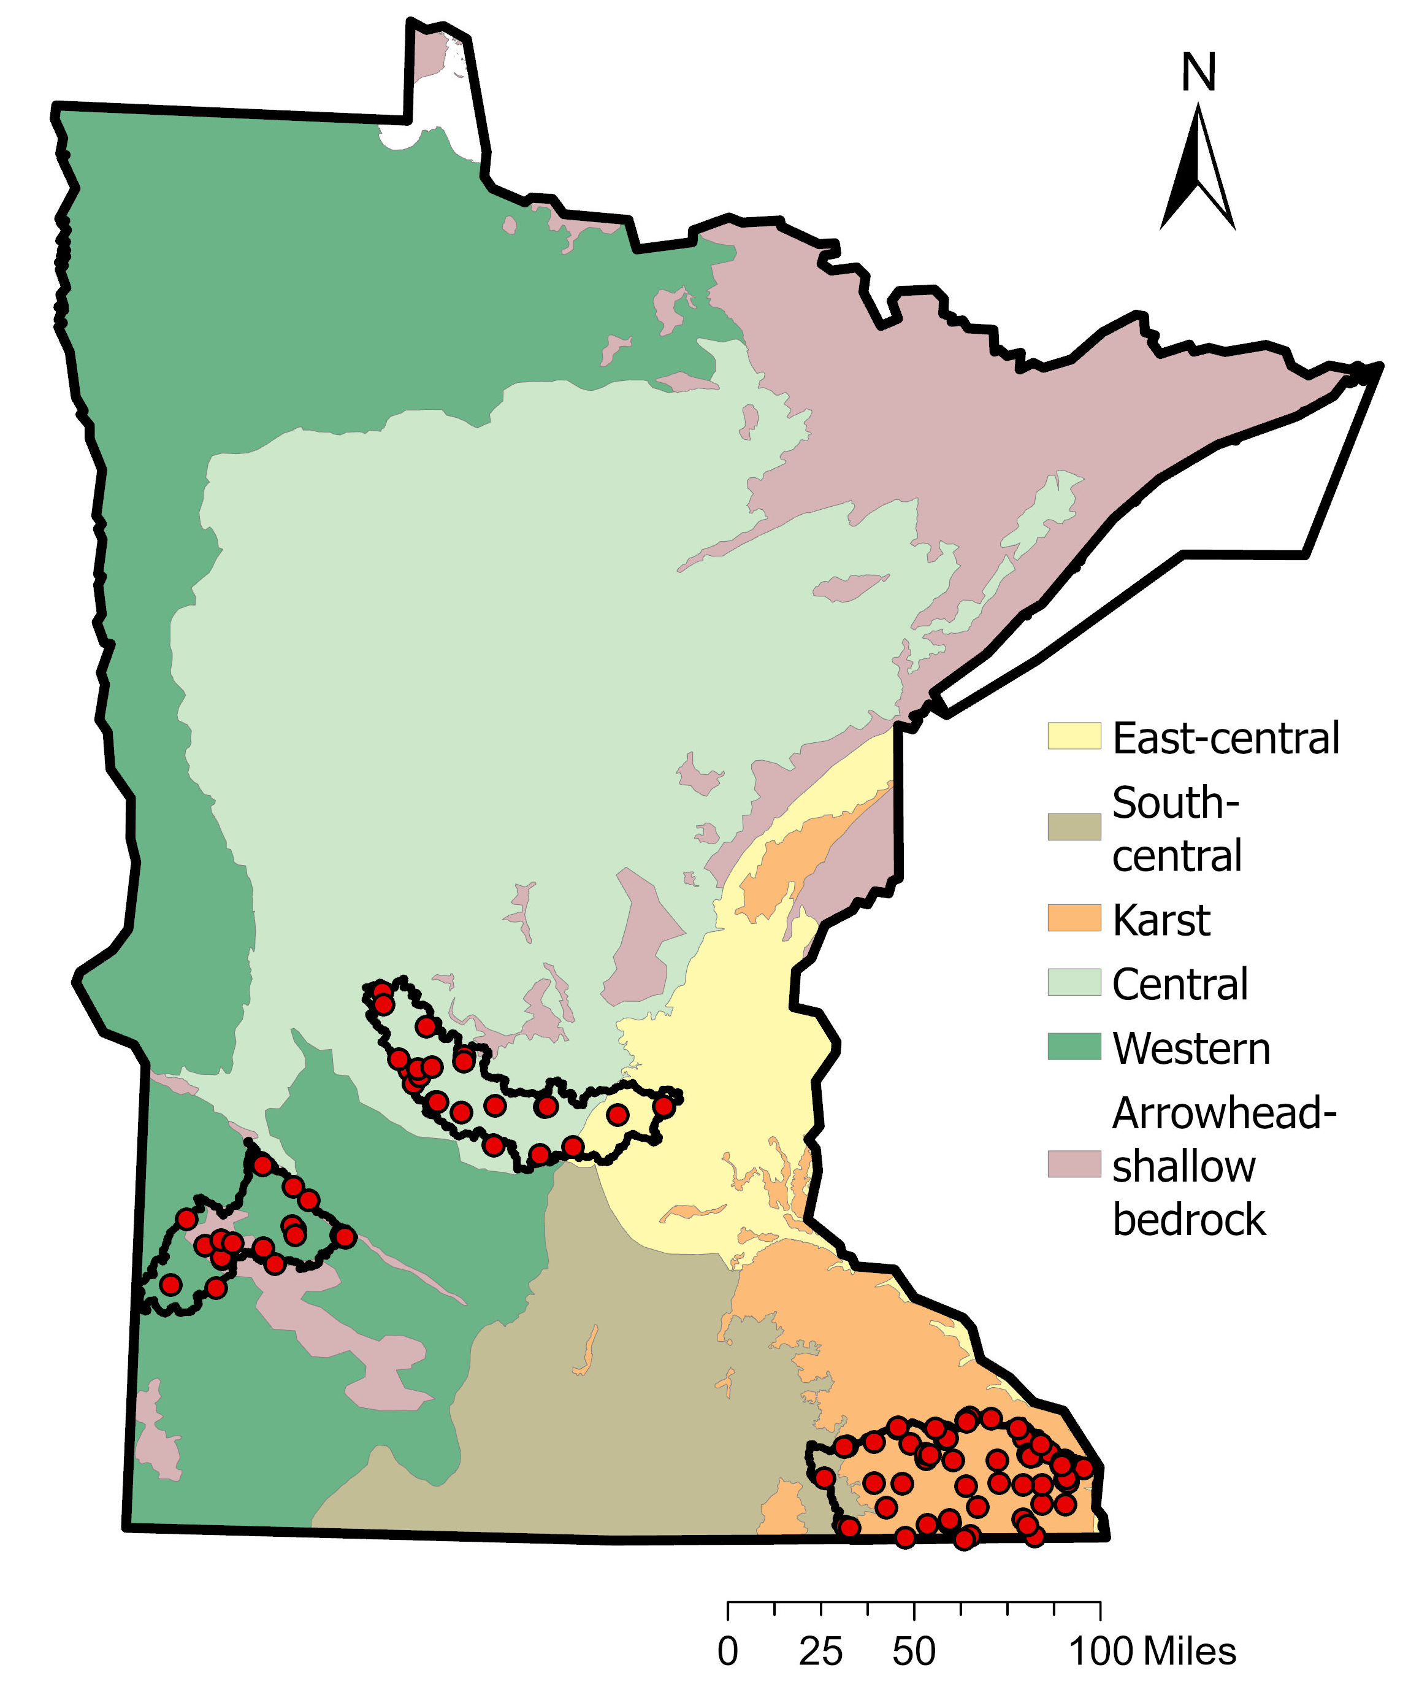
Watershed monitoring locations
5
6
Private well monitoring parameters:
Nitrate
Arsenic
Manganese
Lead
Total Coliform
Major cations/anions
Tritium
Stable isotopes
PFAS
4
North Fork Crow
"Basic 5" for private wells
1
Yellow Medicine
3
2
Root River
Notes:
Primarily private wells, with some PWS wells
Wells represent common drinking water aquifers and locations monitored in the past
*contaminants we interpret to be representative of plumbing and well construction quality, respectively, rather than aquifer conditions
Lead sampled at the point of use (typically kitchen sink tap) rather than untreated outdoor spigot, where all other parameters were sampled

Slide 4
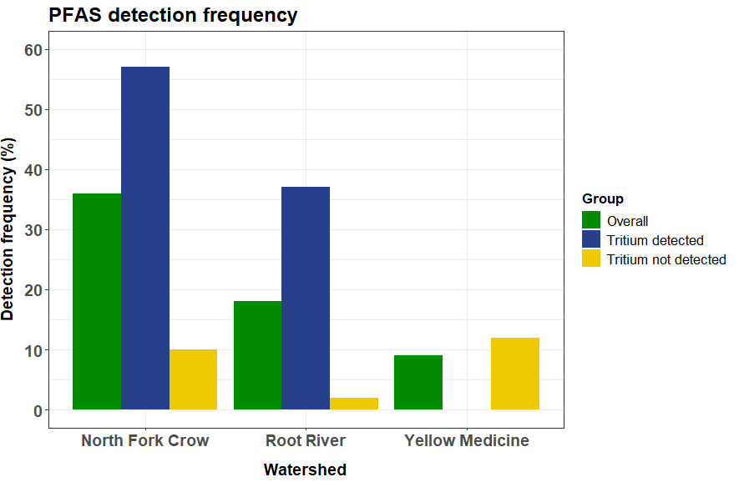
PFAS are more common in wells with tritium
Notes:
North Fork Crow and Root River show similar patterns; Yellow Medicine tends to be anomalous (low PFAS, nitrate detections, smaller sample size, very different geology)
Green bars show overall PFAS detection frequency, blue bars show PFAS detection frequency in just wells with detectable tritium, yellow bars show PFAS detection frequency in just wells without detectable tritium
PFAS are not truly “ubiquitous”; depends on the age of the GW you’re sampling
Note PFAS and bomb tritium are approximately the same age (PFAS industrial use began in 1951)
Tritium detection vs. Nondetection: cutoff to be pre-modern groundwater is 0.28 TU (mixed = 0.28 - 2.89 TU). So reporting limit of 0.8 TU is the best threshold we have, below that is considered "mostly premodern" in MN

Slide 5
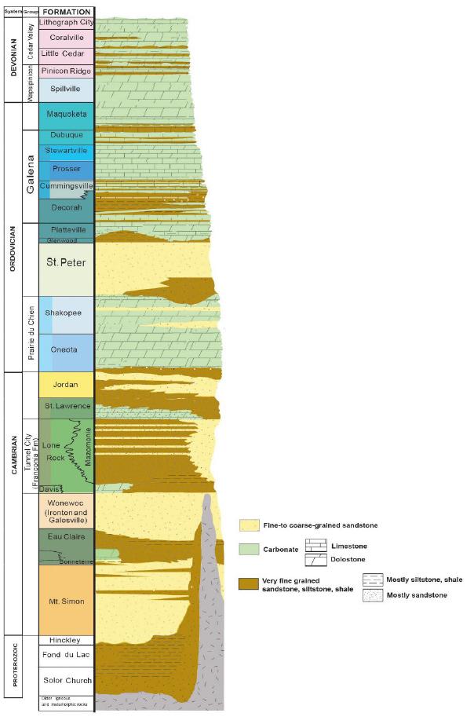
Generalized stratigraphy of SE MN
n = 2
n = 2
n = 1
To the right are the DWAMP sample sizes for each aquifer
Well selection criteria:
  Participation in 1990s groundwater monitoring program (GWMAP)
  2) 1 mile from GWMAP well and same aquifer
  3) 1 mile from GWMAP well and different aquifer
  4) Well has a “common” aquifer for its township
n = 9
n = 12
n = 8
n = 9
n = 21
n = 7
n = 1
From Runkel et al., 2013
Notes:
GWMAP = Groundwater Ambient Monitoring Program; the original iteration of MPCA’s current ambient GW monitoring network. GWMAP sampling happened in the 90s.

Slide 6
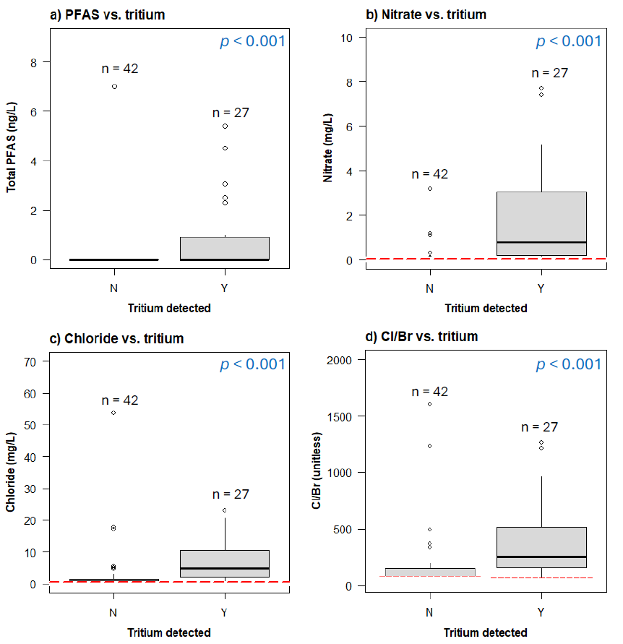
Anthropogenic contaminants vs. tritium
Red line = censoring limit
P-value = result of statistical test of differences between the two groups
Notes:
The following slides are all just for the Root River data
Peto-peto one factor test – statistical test for comparing distributions of data in two groups that contain censored data
Red line = censoring limit
Concentrations of PFAS, nitrate, Cl, and Cl/Br are higher in wells with detectable tritium (0.8 TU) than in wells without detectable tritium.

Slide 7
Chemical criteria for recent recharge
Tritium detected (> 0.8 T.U.)
PFAS detected (> 0.2-0.7 ng/L)
Nitrate > 1 mg/L
Cl/Br > 300
Notes:
Tritium threshold: https://files.dnr.state.mn.us/waters/groundwater_section/mapping/gw/gw-05-minnesota-tritium-age.pdf - mixed is 0.28 -2.89 TU
PFAS: https://onlinelibrary.wiley.com/doi/full/10.1002/ajim.23362
Nitrate threshold:
Cl/Br threshold: https://www.mgwa.org/documents/whitepapers/impacts_of_stormwater_infiltration_on_chloride_in_minnesota_groundwater.pdf

Slide 8
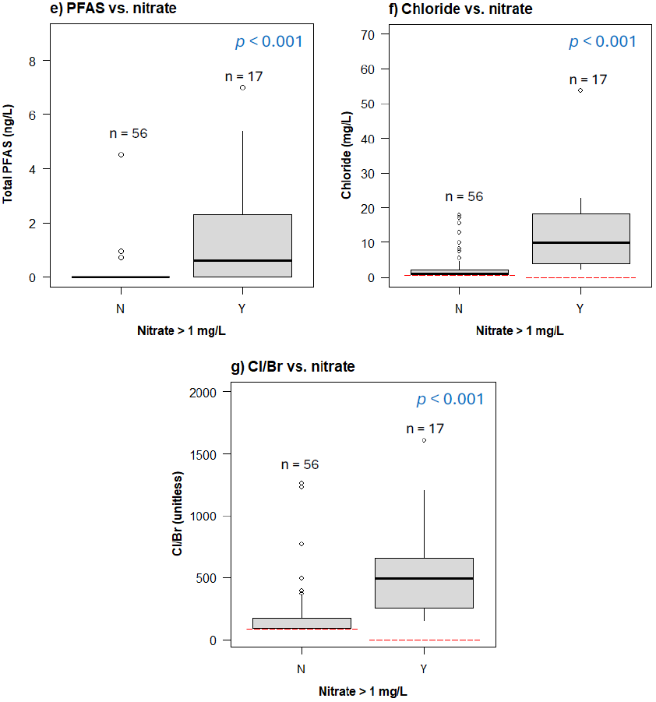
Anthropogenic contaminants vs. nitrate
Red line = censoring limit
P-value = result of statistical test of differences between the two groups
Notes:
Peto-peto one factor test – statistical test for comparing distributions of data in two groups that contain censored data
Red line = censoring limit
Concentrations of PFAS and chloride, and Cl/Br ratios, are significantly higher in wells with nitrate > 1 mg/L than in wells with nitrate < 1 mg/L.

Slide 9
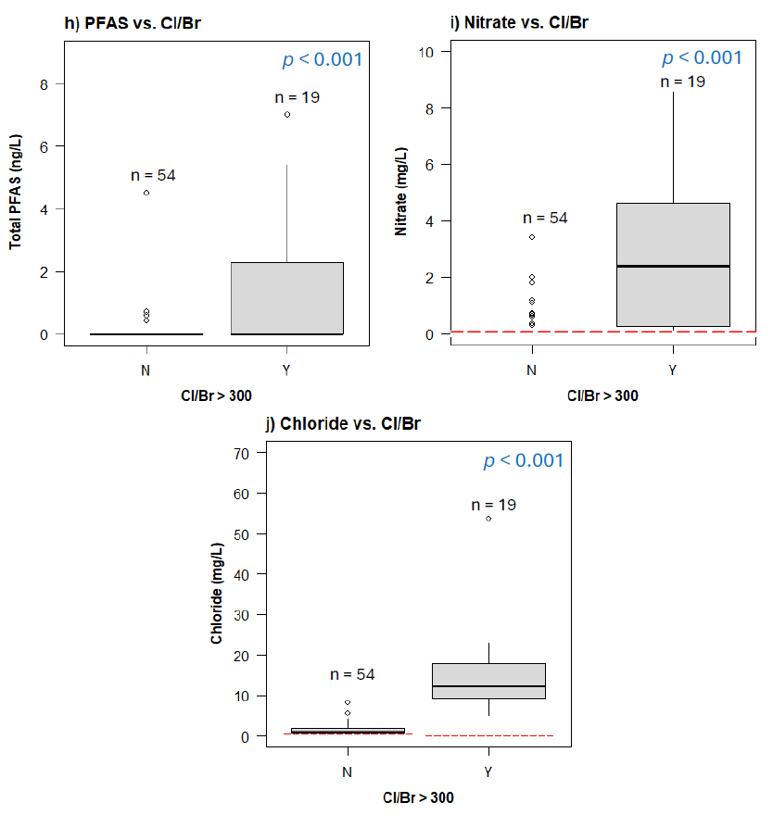
Anthropogenic contaminants vs. Cl/Br
Red line = censoring limit
P-value = result of statistical test of differences between the two groups

Slide 10
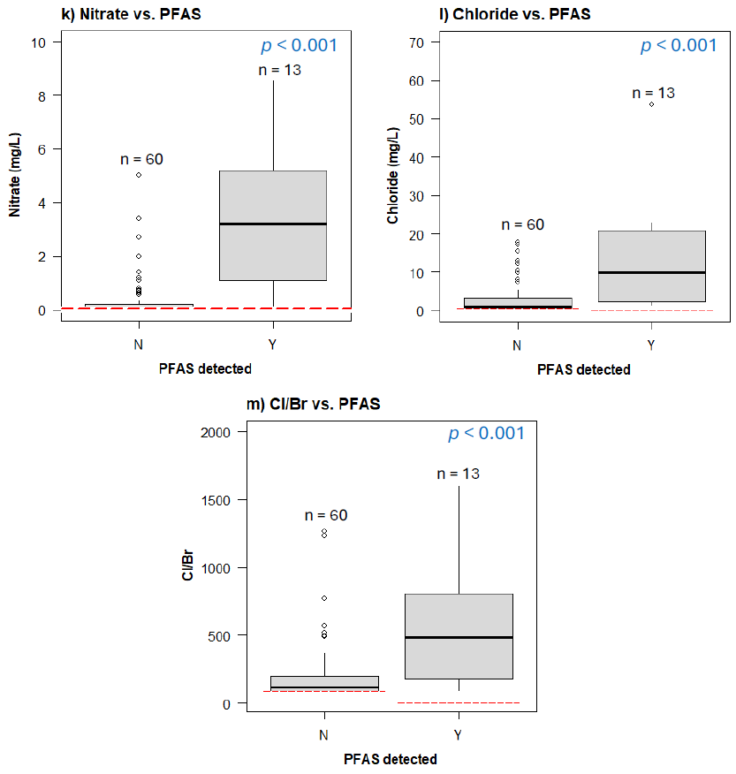
Anthropogenic contaminants vs. PFAS
Red line = censoring limit
P-value = result of statistical test of differences between the two groups

Slide 11
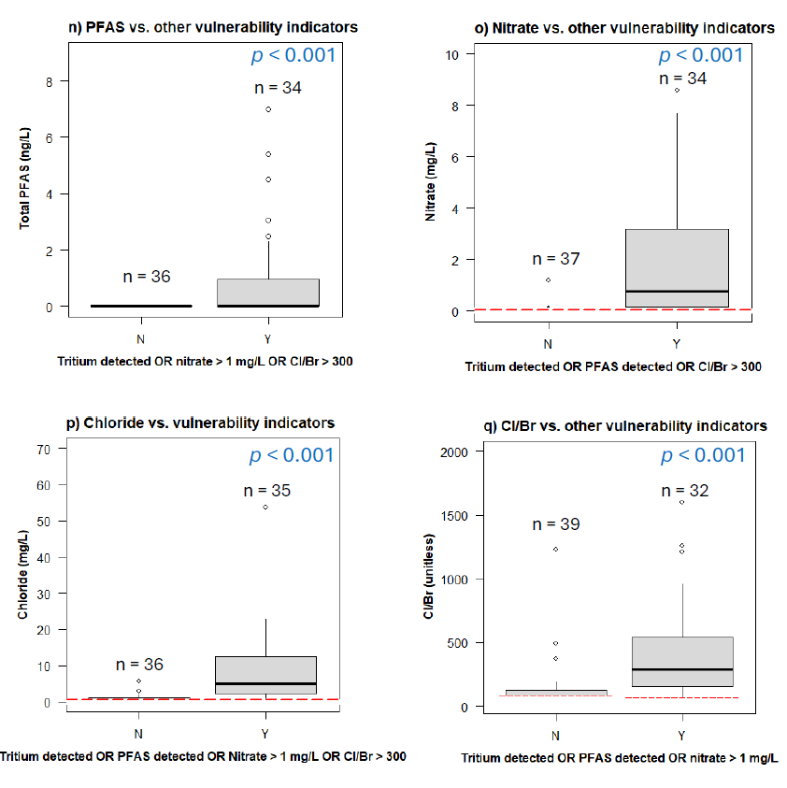
Anthropogenic contaminants vs. multiple lines of evidence
Red line = censoring limit
P-value = result of statistical test of differences between the two groups
Notes:
Using multiple lines of evidence helps reduce the spread in concentrations of the individual contaminants in the “not vulnerable” group. For example, all detections of PFAS can be accounted for in the group of wells that contain tritium or contain nitrate > 1 or contain Cl/Br > 300; whereas not all the PFAS detections could be accounted for in just the group of wells that have detectable tritium, or just have nitrate > 1…..

Slide 12
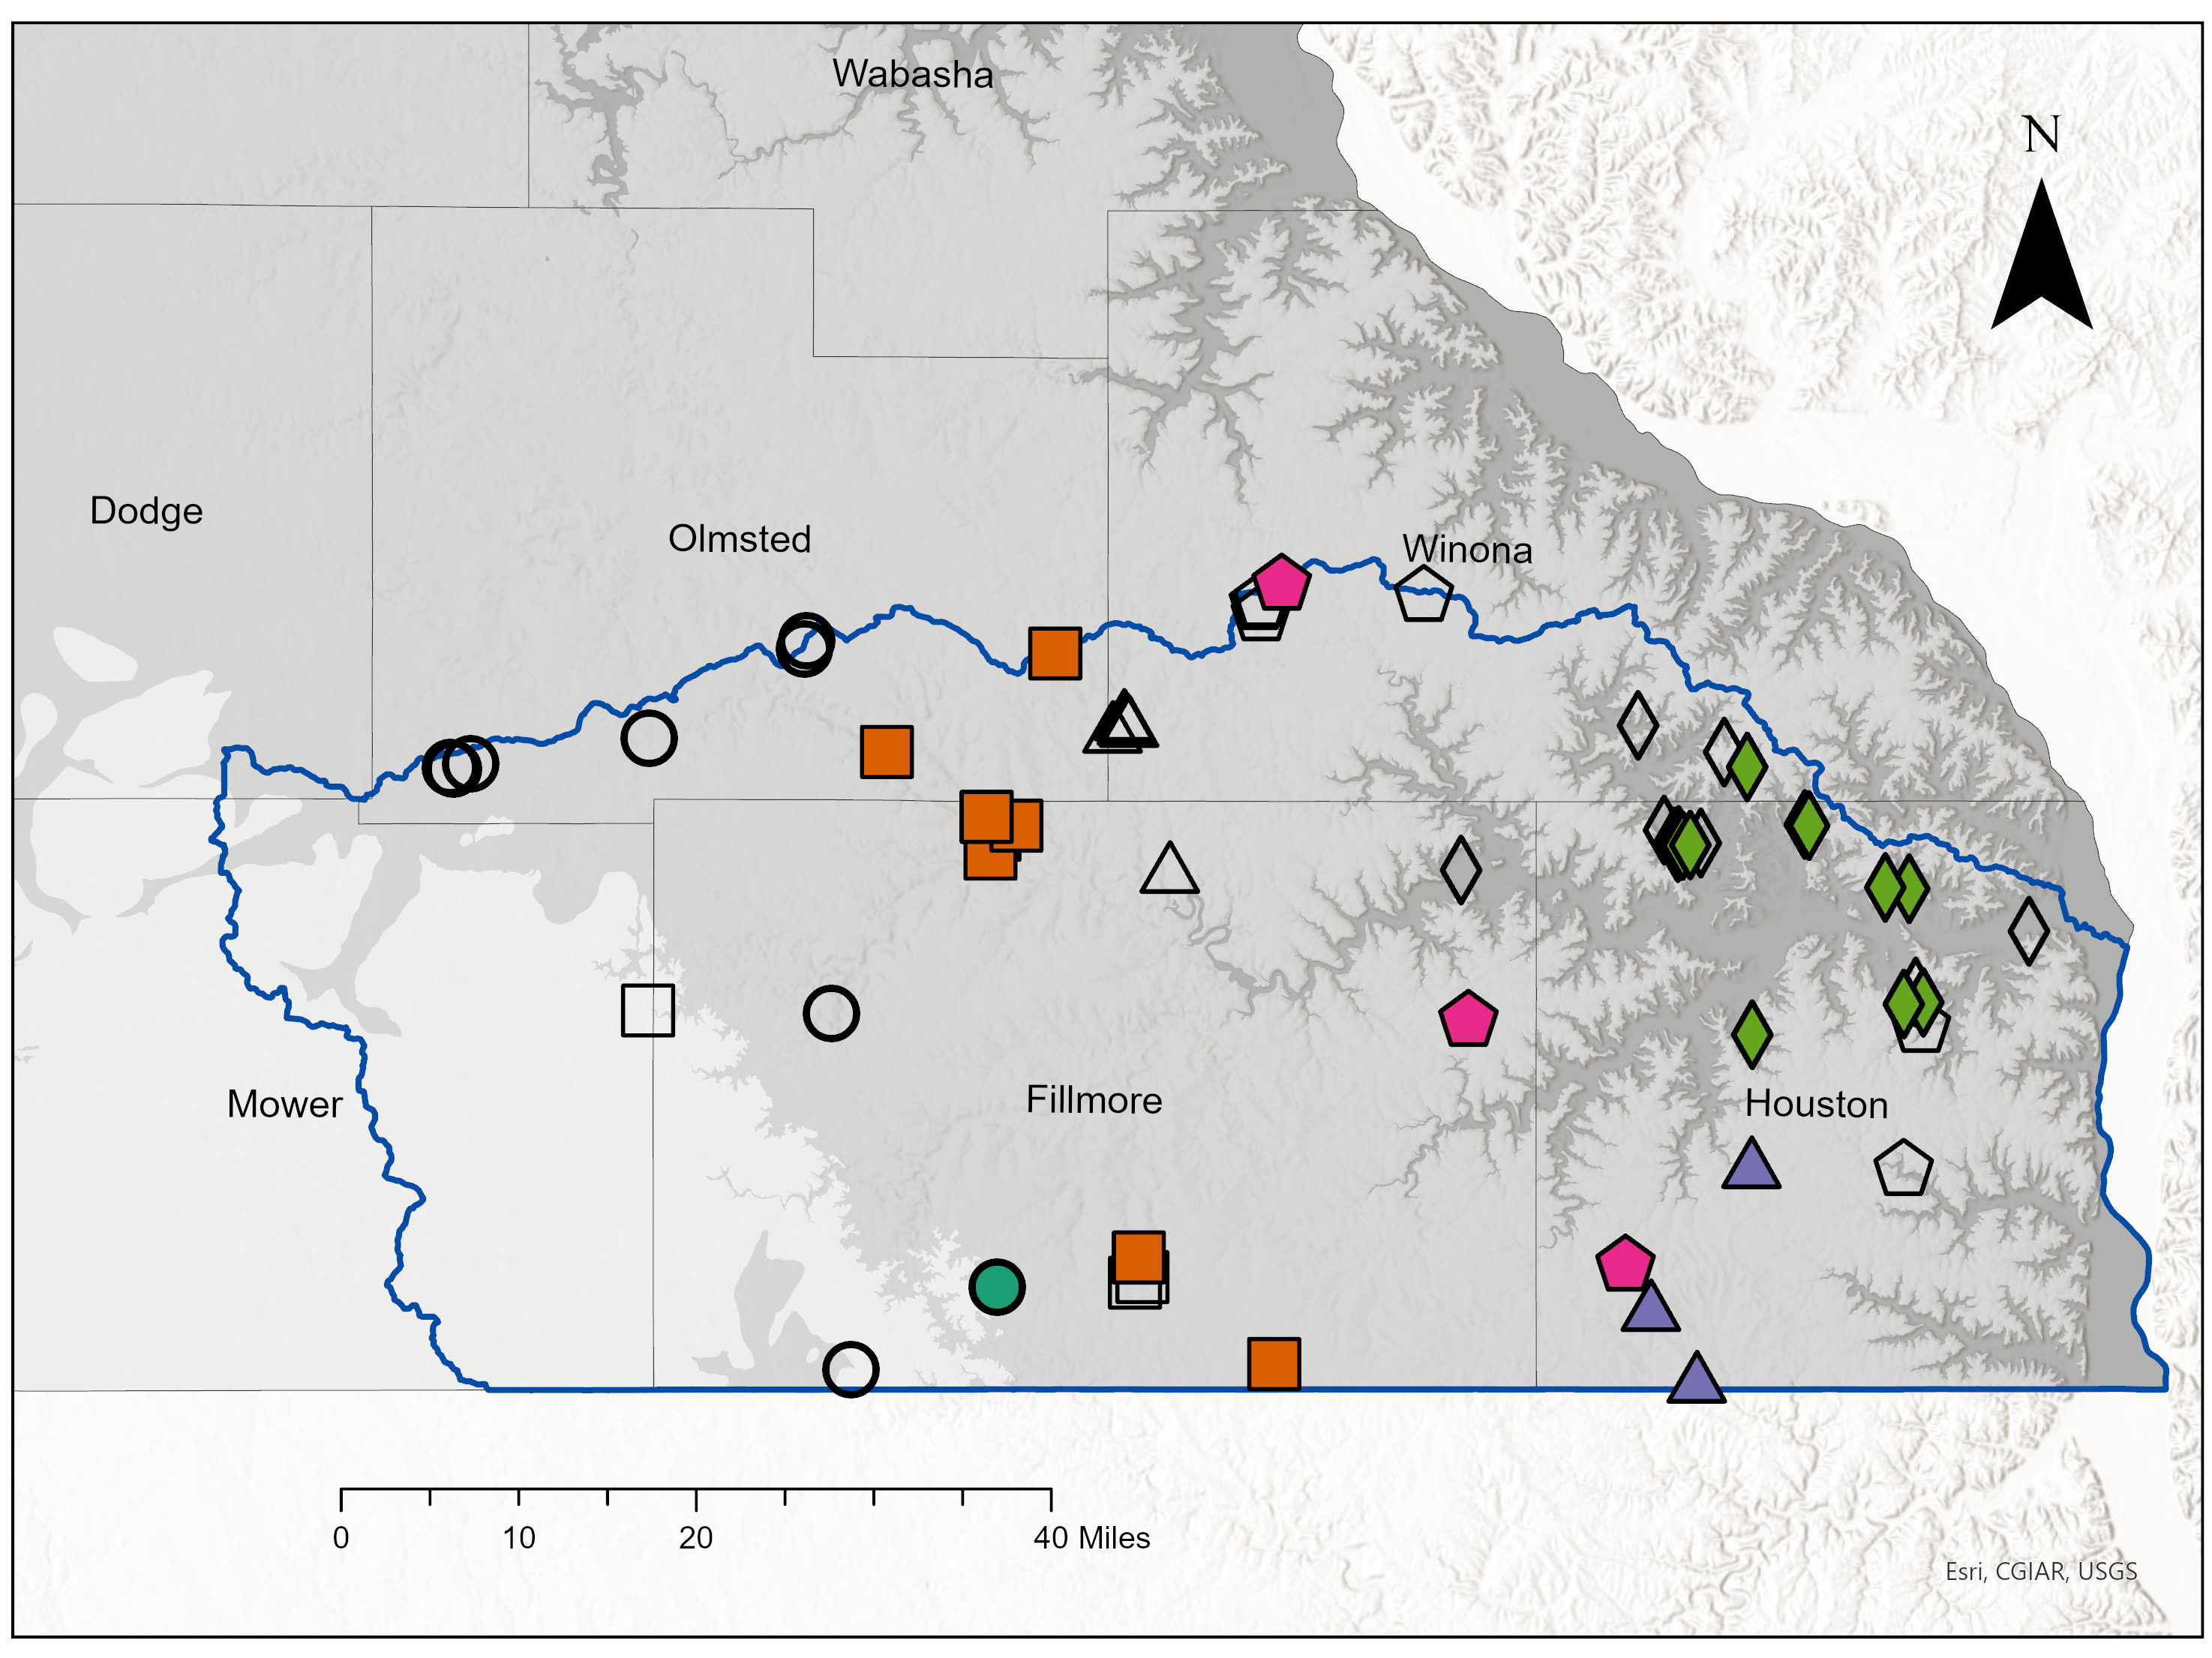
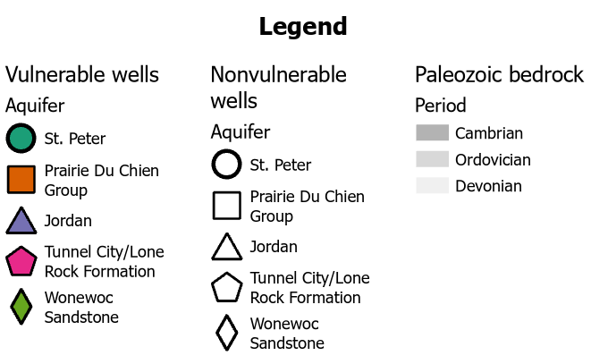
DWAMP wells with chemical evidence of recent recharge
Notes:
We have CGA Part Bs for Houston, Winona, Mower, Fillmore, Dodge
Missing Part B for Olmsted

Slide 13
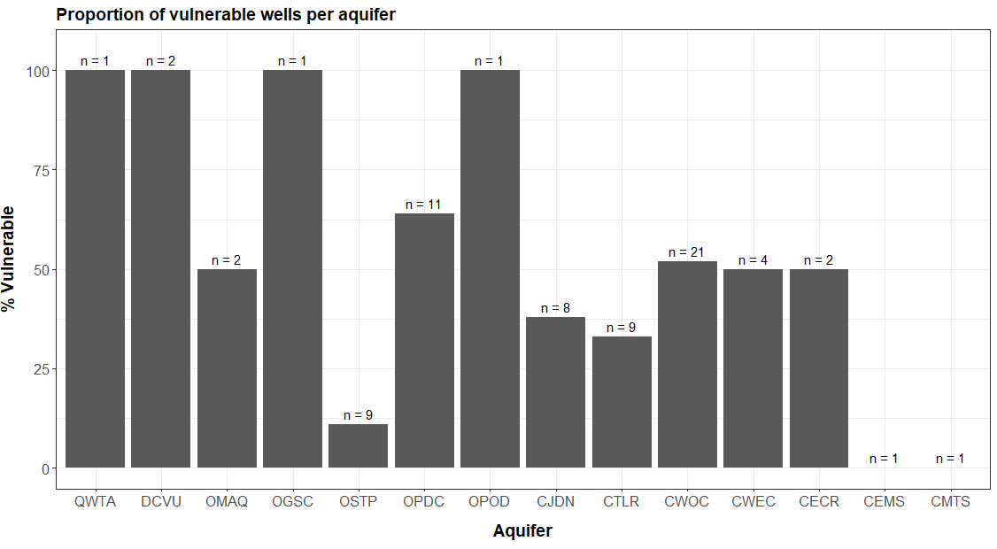
DWAMP aquifers with chemical evidence of recent recharge
Notes:
Using multiple lines of chemical evidence gives us a more complete picture of aquifers that are vulnerable to recent recharge/anthropogenic contamination, when compared to using individual chemical indicators alone (next 4 slides). The purple circled aquifers are those that we would not register as vulnerable using only one line of evidence. However, this figure shows that all aquifers except for the Eau Claire/Mt Simon (CEMS ) and Mt. Simon (CMTS) had some indicator of vulnerability.

Slide 14
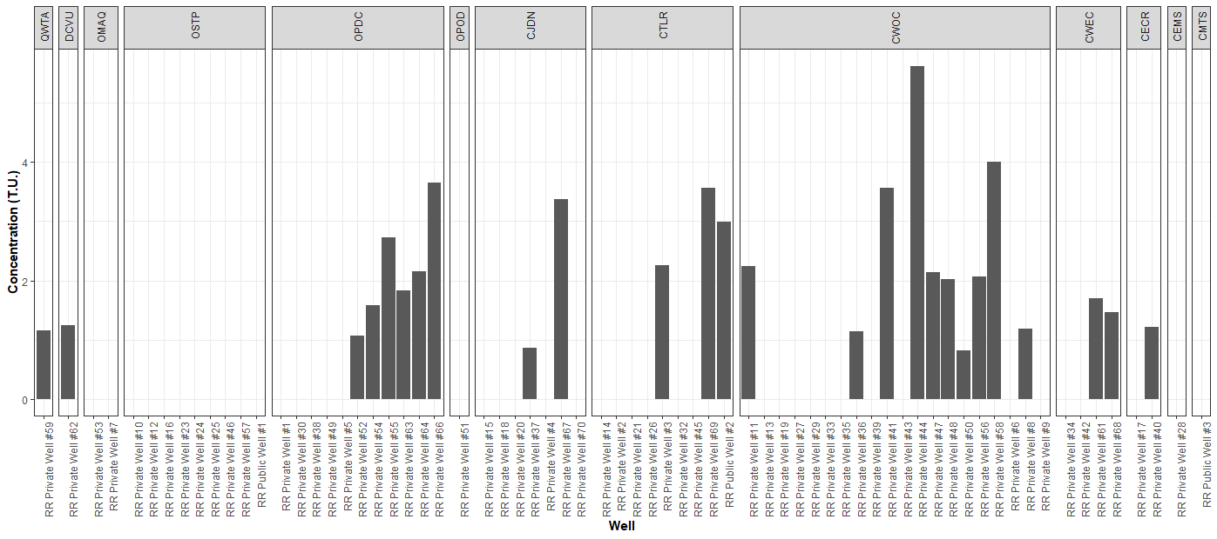
Tritium
Notes:
*1 TU is used as the vulnerability threshold for SWP – this is the threshold in statute (2003). However, we’re using detect vs nondetect at 0.8 TU as the threshold for the purpose of this report; the cutoff for waters that are mixed in age has decreased since the time of the statute.
https://www.revisor.mn.gov/rules/4720.5550/

Slide 15
Takeaways
Using multiple lines of chemical evidence provides a stronger basis for determining well vulnerability compared to tritium alone
In the Root River, the multi-tracer approach identified an aquifer and several individual wells vulnerable to recent recharge that would not have been identified by tritium
Nontraditional lines of chemical evidence like PFAS may be useful in supplementing tritium age classification as atmospheric tritium declines

Slide 16
Thank you!
Maya Gilchrist
Maya.Gilchrist@state.mn.us
651-201-4651

Slide 17
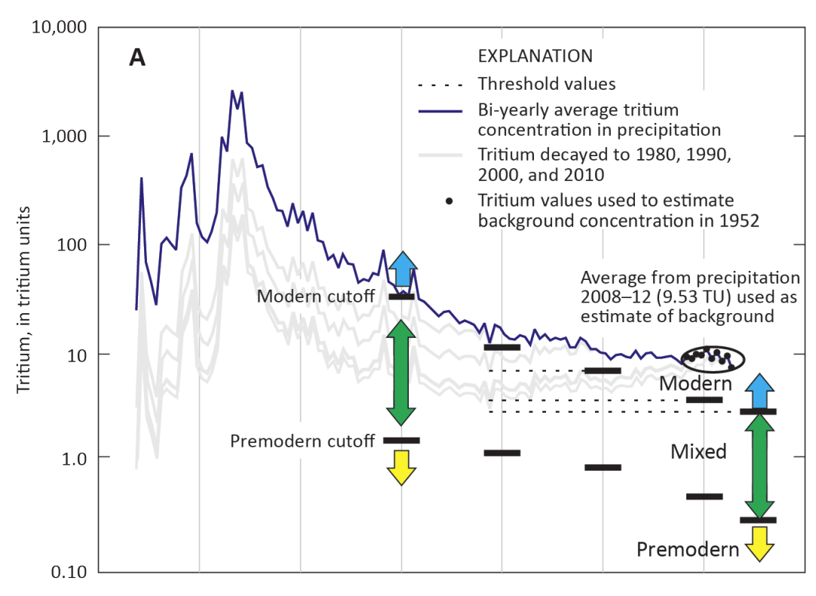
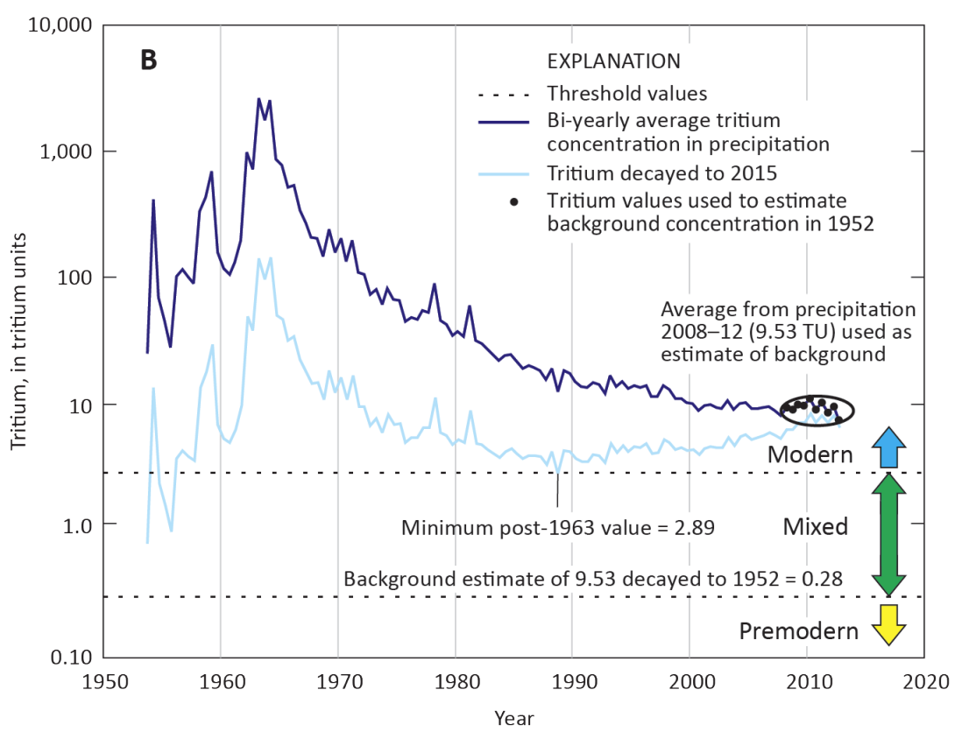
Lindsey et al. 2019

