Slide 1
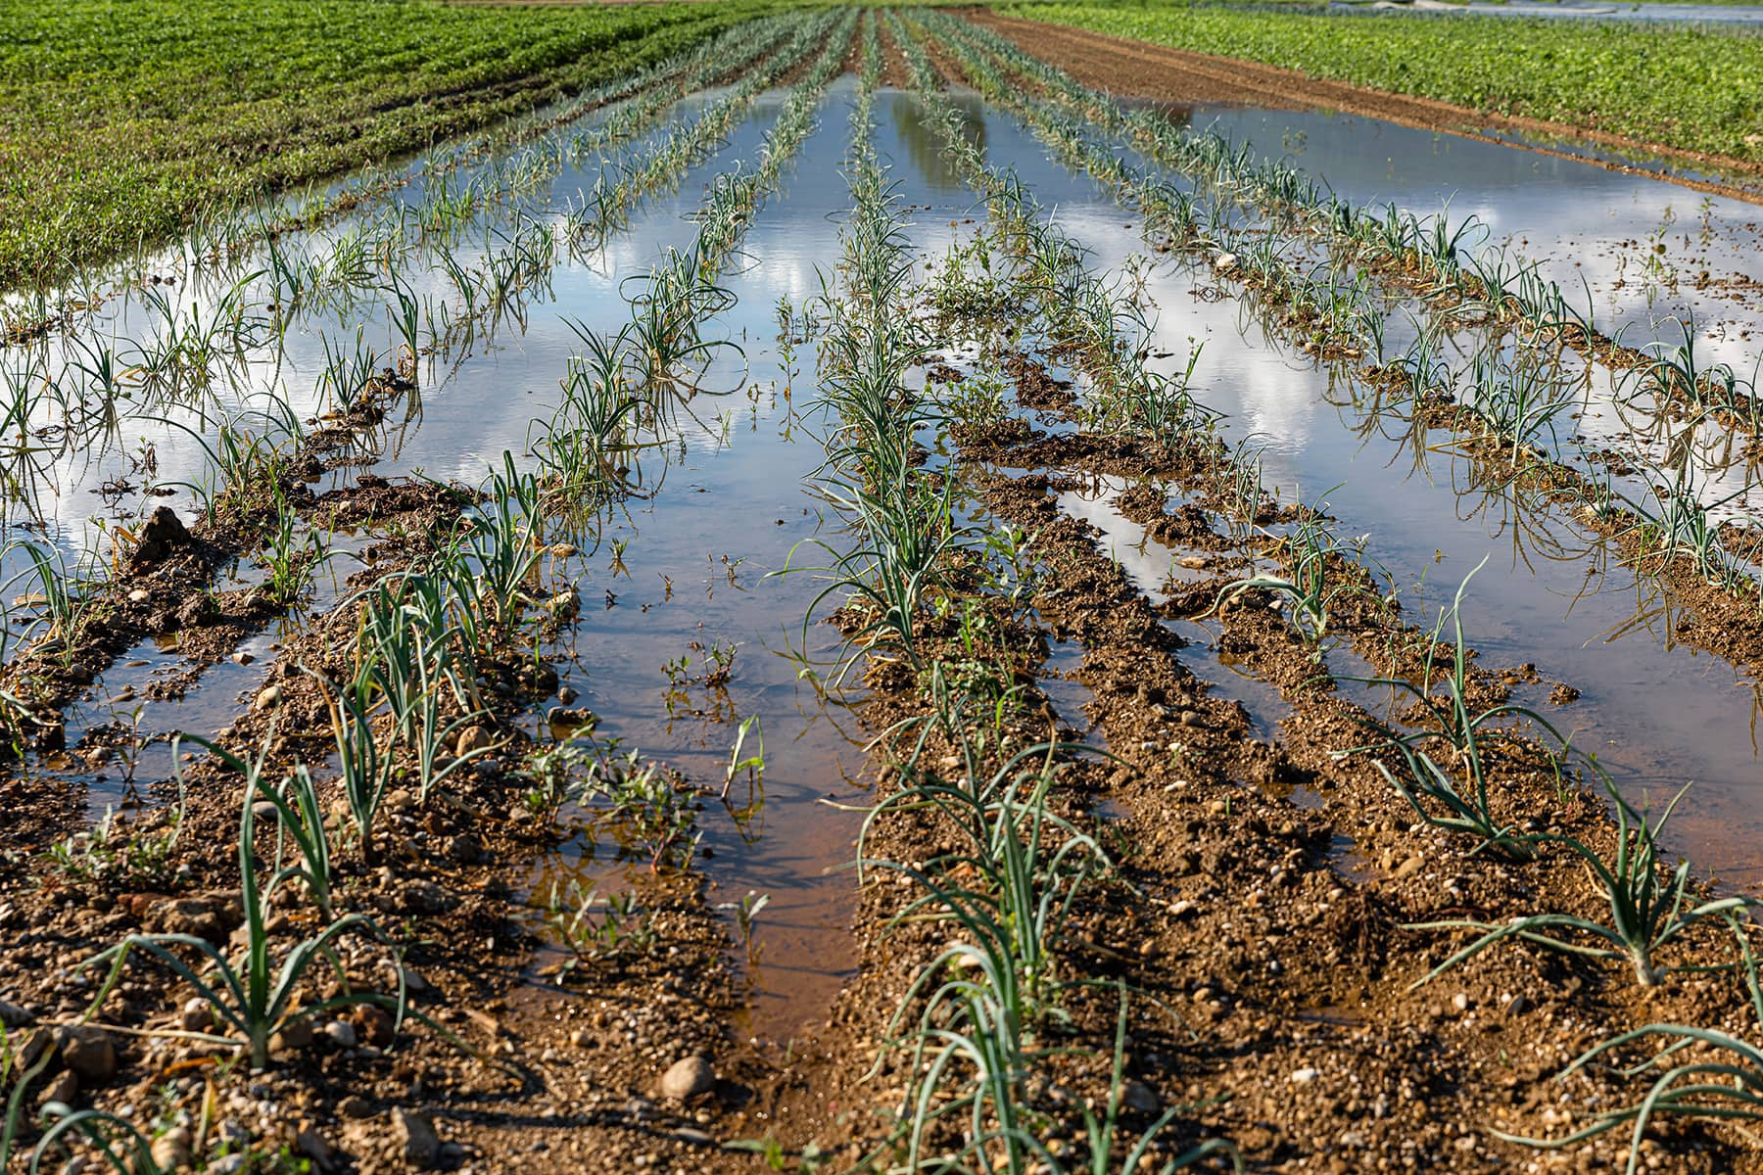



A Groundwater-Nitrate Decision Support Tool for wells
Laura Schachter, Paul Juckem, Nick Corson-Dosch, Chris Green, Leon Kauffman
U.S. Geological Survey
Kelsie Ferin, Eric Booth, Chris Kucharik
U.W. Madison
Brian Austin, Carla Romano, Beth Finzer
Wisconsin Dept. of Natural Resources
This information is preliminary and is subject to revision. It is being provided to meet the need for timely best science. The information is provided on the condition that neither the U.S. Geological Survey nor the U.S. Government shall be held liable for any damages resulting from the authorized or unauthorized use of the information.
Notes:
Thank you for the opportunity to present. Today I will be discussing the USGS Groundwater Nitrate Decision Support Tool for wells.
My name is Laura Schachter, a hydrologist with the US Geological Survey Upper Midwest water science center in Madison, Wisconsin.
Paul Juckem is the project lead on this work, and all of this would not be possible without our other collaborators, both across the USGS, and at UW Madison and the Wisconsin Department of Natural Resources

Slide 2
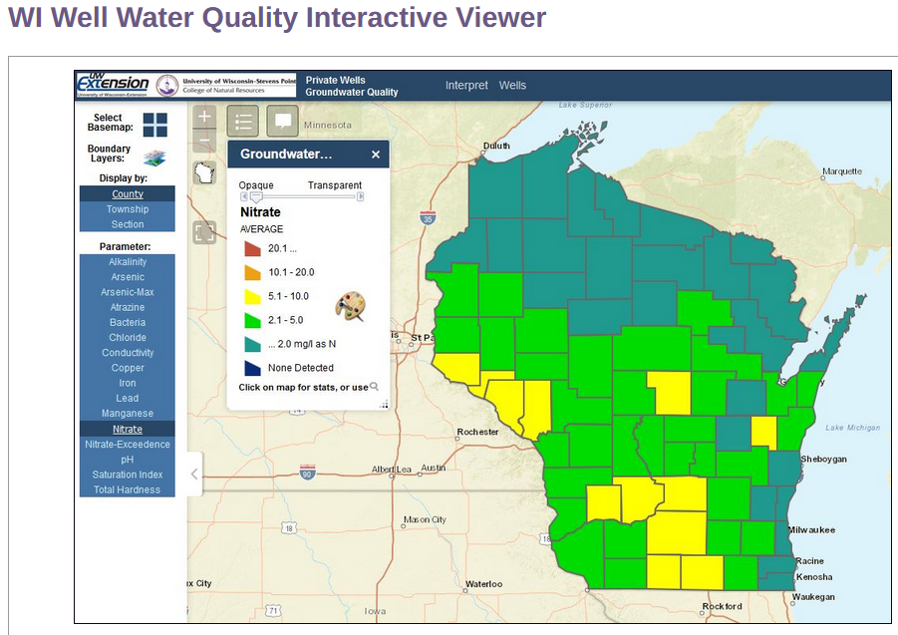
Why Nitrate?
Nitrate: Health & Environmental Issues
  Methemoglobinemia (blue baby syndrome; 10mg/L-N MCL)
  Linked to thyroid disease & some cancers (e.g., colon)
  Wisconsin: $23 to $80 Million per year in medical costs
  Minnesota: $745 Million per year in medical and quality of life costs
  Linked to toxin production from HABs (N-based toxins; HABs may be worse if only reduce Phos.)
What to do about Nitrate Exceedances
  Not enough funding to cover all wells exceeding MCLs
  Other solutions besides “drill deeper”?
  Which wells might respond to land management changes?
Notes:
nitrate is the most wide-spread groundwater contaminant in WI and Minnesota, as well as many other states,
and has been regulated to be below 10 mg/L in drinking water across the country since the 1970s primarily in response to Blue Baby Syndrome
However, there is evidence that prolonged exposure to lower levels of nitrate in drinking water can be linked to other diseases like thyroid disease and some cancers like colon cancer
Recent studies have calculated the medical costs associated with nitrate exposure to be up to $80 million a year in Wisconsin, and over $700 million per year in Minnesota (including quality of life costs)
(click) In Wisconsin, as well as other states like Minnesota, there are state-funded grants to help replace private wells with nitrate exceedances,
however there is never enough money in the pot to replace every affected well with a deeper well
So we need to think not just about drilling deeper wells, but also about changes that can be made in land management practices to keep the drinking water safe
We know where the nitrate is (map), but we need a tool to help us make decisions based on that information

Slide 3
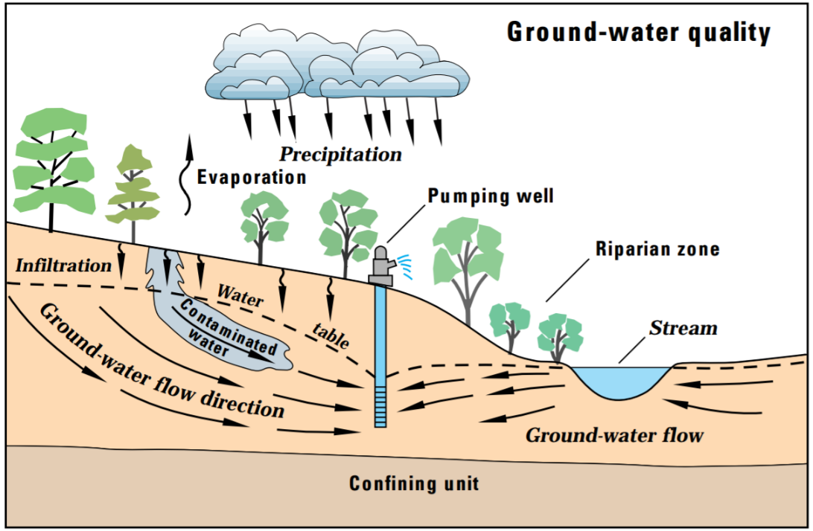
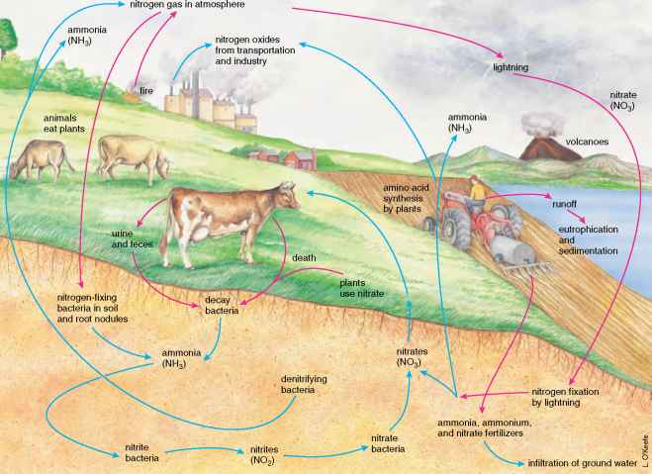
Forecasting NO₃ concentrations in wells
A tool to forecast nitrate concentration response to nutrient management changes (leaching):
  How much nitrate leaching reduction is needed to meet X concentration at this well?
  How long will it take to meet X concentration target?
  Where should nitrate leaching reduction be targeted?
Based on convolution approach
Sources
Travel times
Forecasts
Reaction
rates
mass
frequency
λ
concentration
time
age
time
Notes:
So, we made a tool to forecast how nitrate concentrations in wells respond to nutrient management changes at the land surface
More specifically, our tool aims to help answer questions such as “how much…?” and “How long…?”
Those are the two main questions that our currently published tool can address, but we have new methods that I will present today that allow us to address questions about “where…?”
This diagram of the nitrogen cycle can help with understanding the scope of our tool. This tool is focused on transporting nitrate from below the root zone through the saturated zone to wells.
We use a model from UW that handles the part above the land surface, and pass the leached nitrate to our tool.
(click) The math behind our tool is conceptually relatively simple. (click) We need to know the amount, or flux of nitrate leached over time; that comes primarily from UW’s agro-IBIS model
We also need to know the age of the groundwater in the well, or the travel time. And we recognize that it’s not a single value for age. Water pumped from a well includes a range of ages from quite young, to very old.
(click) We also need to account for denitrification.
(click) Finally, we combine all these factors through a method called mathematical convolution to generate the output, which is a forecast of the nitrate concentration in the well at a certain time

Slide 4
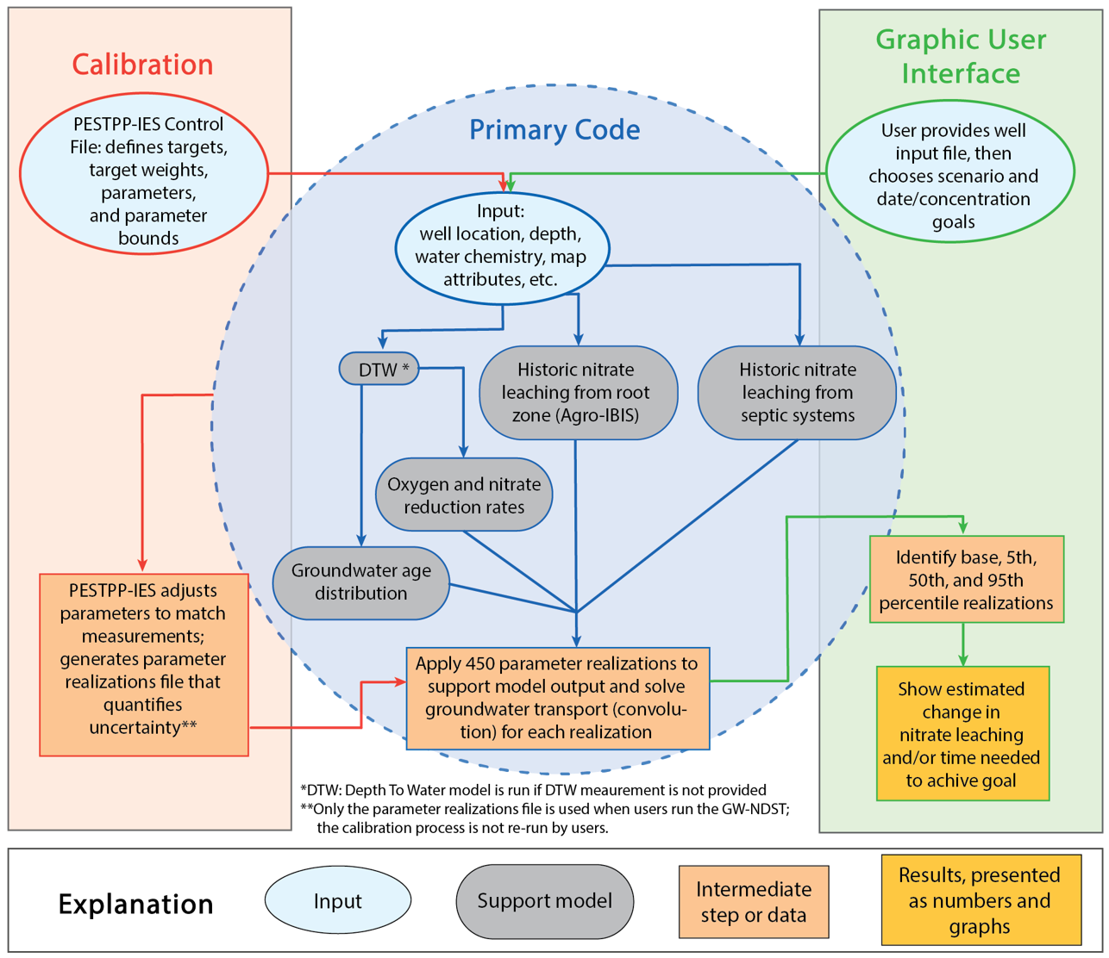
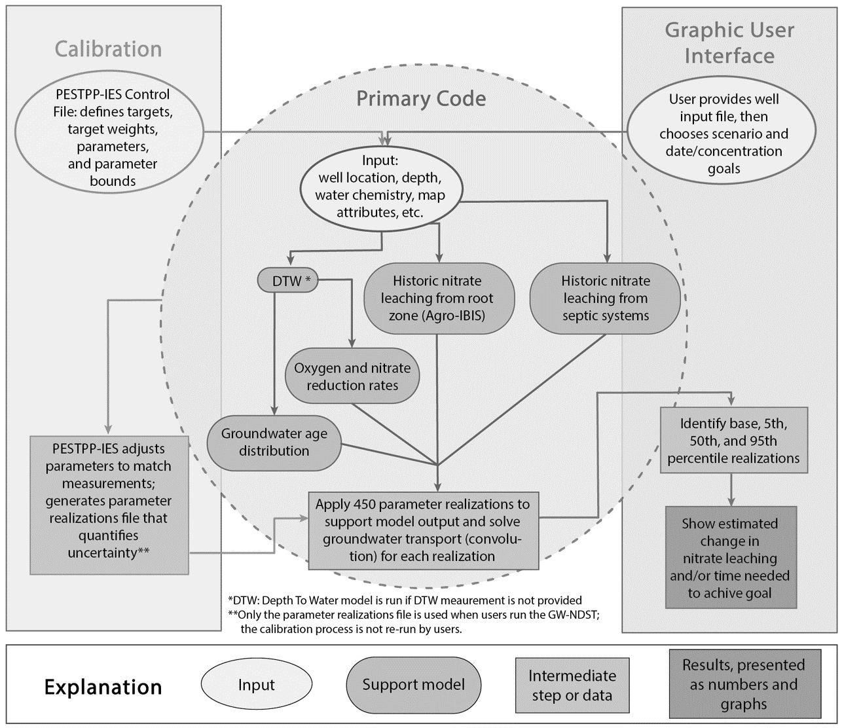

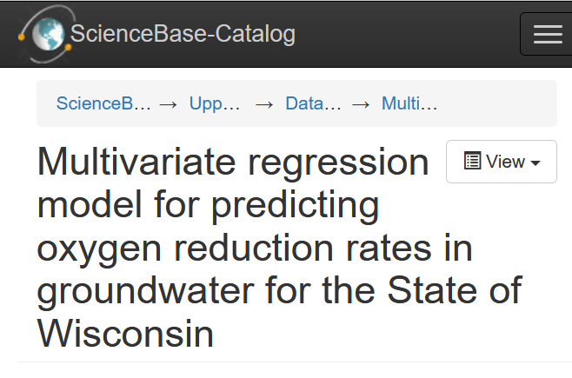
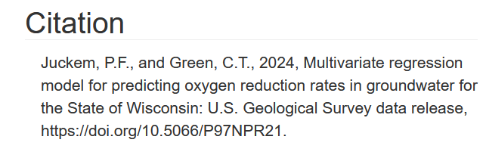
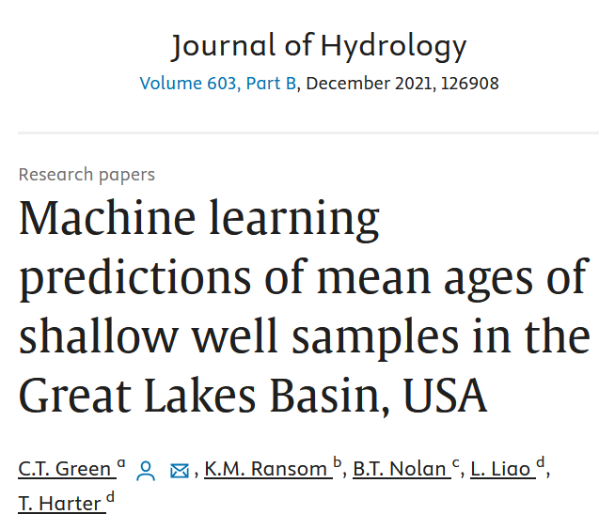
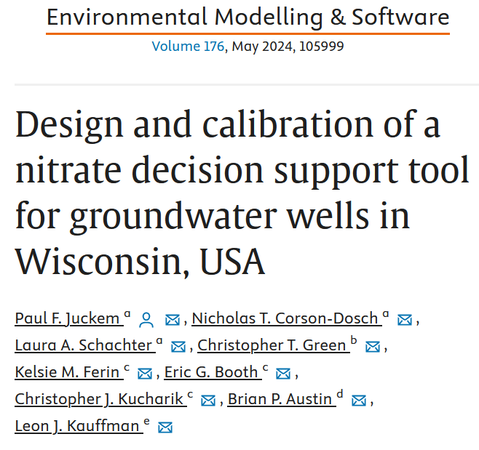
Groundwater - Nitrate Decision Support Tool (GW-NDST) merges multiple “support models”
Reactions
Sources
Travel times*
Forecasts
Notes:
This flow chart helps gain a broad perspective for how the tool functions.
First, there are 3 main components of the tool: the graphical user interface or GUI, the primary code behind the scenes, and a calibration step before publishing.
User starts with an excel file, filling in information about their well, particularly the location and depth, and then feeds that into the several “support models” of our tool
These include models for nitrate leaching source information, travel times, and reaction rates
Each of these support models is great at what it does, but they were never designed to work together to compute nitrate concentrations as we’re doing here
So instead of calibrating just one “best” model, we used a calibration constrained monte carlo method, where each ensemble member has good matching statistics to our over 30,000 historical nitrate measurements from across the state
We then use those calibrated models, or “realizations”, to visualize uncertainty when generating results.
So, the key lies with these support models, each of which has been published. And then we calibrated our methods to statewide nitrate concentrations.
I think it’s best illustrated by looking at some examples…

Slide 5
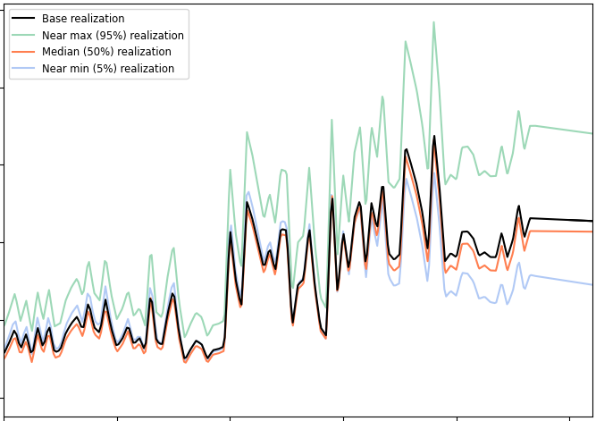
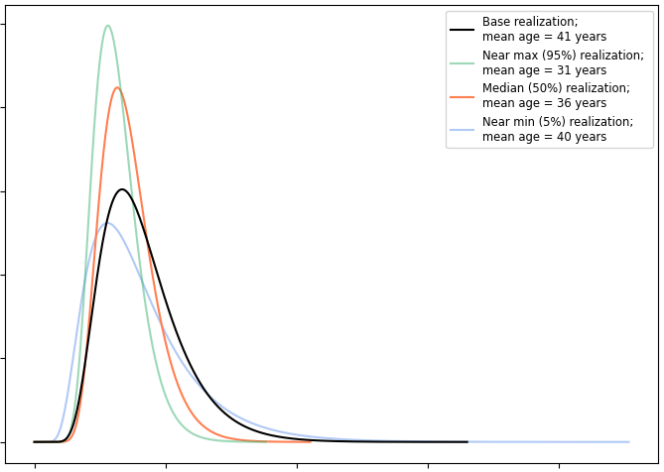
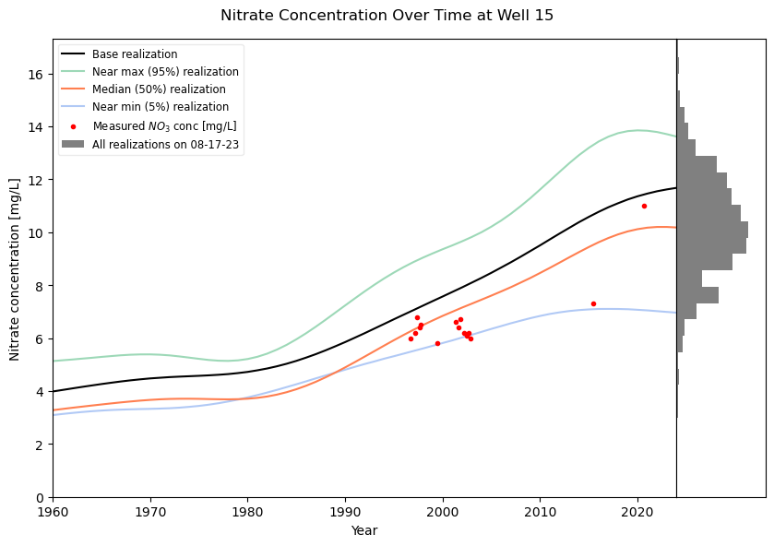

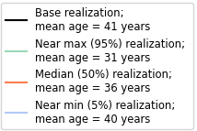
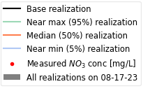
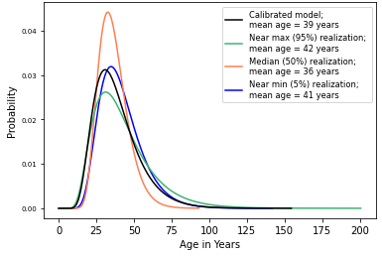
Example:
Historical Trends from Legacy Nitrogen
Nitrate leaching (ag + septic)
Groundwater age distribution
Nitrate concentration in well
50
16
40
14
12
30
10
Nitrate Leached [lb/ac]
Frequency (unitless)
Nitrate Concentration [mg/L]
20
8
6
10
4
2
1920
1940
1960
1980
2000
2020
0
50
100
150
200
1960
1970
1980
1990
2000
2010
2020
Age (years)
Leaching rates from support-models adjusted by calibrated multipliers from specific realizations
Ages from ageML support-model adjusted by calibrated multipliers from specific realizations
Most measurements are within the range of uncertainty from the realizations;
Black and orange are central tendencies
Note: Rankings (5th, 50th, 95th percentile) are based on the “current” well concentration.
Notes:
Let’s look at running an example well in Wisconsin through our tool:
First we have the historical nitrate leaching near this well for the past century and GW age distributions from a machine learning model (mean age about 30-40 years, and ages distributed around that)
(click) we then combine this with denitrification (which is not shown) and generate simulated nitrate concentrations through to the current date (or any specified date; 8-17-23 in this case).
First notice the grey histogram on the far right – this is the simulated nitrate concentration from all of the calibrated realizations on the specified date. We use those concentrations to rank the realizations and identify the individual realizations that match the 5th, 50th (median), and 95th percentiles of that histogram. Note that 5th & 95th (the blue and green lines) are the boundary to outliers, so the black and orange lines represent central tendencies, and we should focus on the orange line, the median, the most.
The red dots are measured nitrate concentrations at this example well, which you can see fall within the bounds of the min and max lines here
Note that the orange line show concentrations creeping up toward the MCL of 10mg-N/L, so there may be concern about where this well is heading…

Slide 6

Forecasting Scenarios
Notes:
And forecasting is where tool really shines…because like I said, we know where the nitrate already is, but we want to know what we can do about it

Slide 7
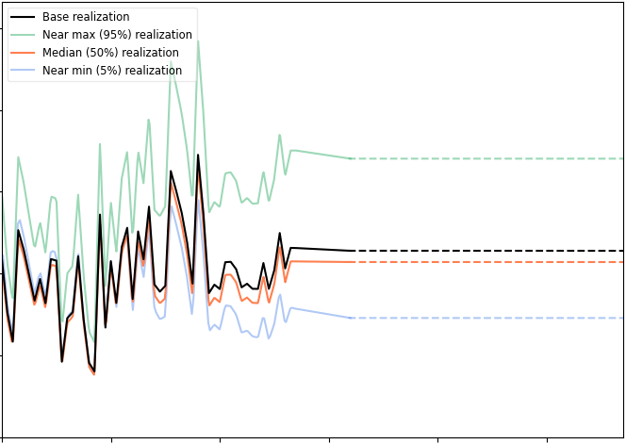
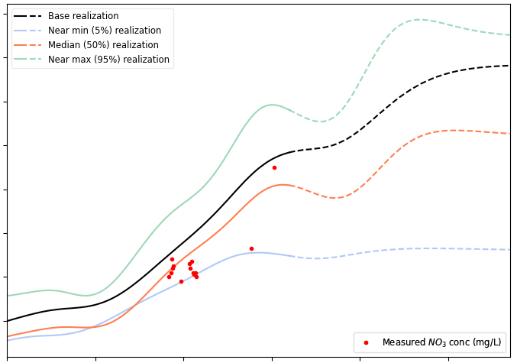

Current Leaching Rates into Future
At current leaching rate, concentration would increase from ~10 to ~13 mg-N/L in 50 years.
Nitrate leaching (ag + septic)
Groundwater age distribution
Nitrate concentration in well
50
18
16
40
14
30
12
Nitrate Leached [lb/ac]
Frequency (unitless)
Nitrate Concentration [mg/L]
10
20
8
10
6
4
1960
1980
2000
2020
2040
2060
0
50
100
150
200
1960
1980
2000
2020
2040
2060
Age (years)
All realizations, except 5th percentile, exceed the Maximum Contamination Level of 10 mg-N/L
Future leaching rates are projected as constants based on 2022 rates
Notes:
We have 6 types of forecasts, or questions, available for use with the tool. The simplest is to just ask what would happen if nitrogen leaching stays constant for some amount of time.
(click) In 50 years, holding the current nitrate leaching rate constant, we can see the simulated concentration for the median (orange line) increases from about 10mg/l to about 13mg/l.
In fact, you can see that all but the 5th percentile scenario show increasing concentrations above 10 mg/L.
So what could be done about that? One option would be to specify a new lower future leaching rate to see how the well would respond.
Or you could specify a percent reduction in leaching. But another option is to specify a goal concentration that you’d like to observe in the well by a certain date, and then let the tool determine the amount of leaching reduction needed to meet that goal. Let’s take a look at that example…

Slide 8
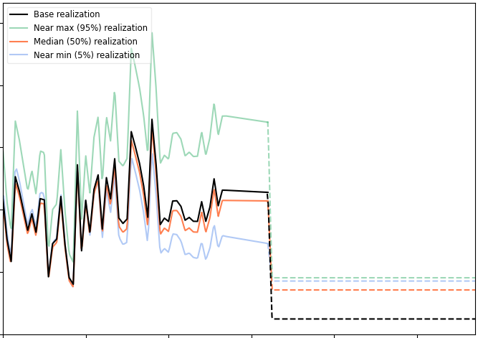
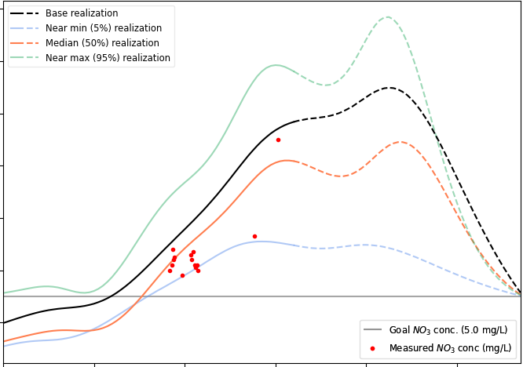

Future Goal Concentration
To reach 5 mg-N/l in 50 years, nitrate leaching would need to drop ~15 lb/ac starting today.
(~70%)
Nitrate leaching (ag + septic)
Groundwater age distribution
Nitrate concentration in well
50
16
40
14
12
30
10
Nitrate Leached [lb/ac]
Frequency (unitless)
Nitrate Concentration [mg/L]
20
8
6
10
4
1960
1980
2000
2020
2040
2060
0
50
100
150
200
1960
1980
2000
2020
2040
2060
Future leaching rates are instantaneously reduced to optimized rate for each realization
Age (years)
All realizations can meet the goal, but improvement is delayed by many years
Notes:
For this scenario, I chose a nitrate concentration goal of 5mg/L in 50 years.
5mg/L is half the MCL, but there is increasing evidence to suggest that some conditions of the thyroid and some forms of cancer may be linked to chronic exposure to nitrates as low as 5mg/l, so it’s not an unwarranted goal.
And I chose 50 years because the mean age of water in this well is about 40 years old, so we know it will take some time to see changes at the land surface manifest in the well.
The first result is that the model affirms, that yes, meeting this goal is possible, though it will be delayed by several decades.
The second result (click) is that leaching within the source area will need to decrease substantially for all cases to reach that goal;
by about 15 lb/ac or 70% for the median realization (orange).
That sounds like a big reduction, and it is substantial. But the question is whether that’s even feasible….

Slide 9

Common Responses
Is that amount of reduction
feasible?
  How does it relate to crop
  management?
That’s too long to wait. “Can you speed it up?”
  New development: Manage “young” vs “old” areas differently
The Positivity Blog
Notes:
So at this point in this presentation, we often get 2 responses:
First: is that feasible? Which is essentially asking how does that drop in leached nitrogen relate to actual crop management?
And second, 50yrs! That’s too long! We’ve even been asked “can you speed that up?”. Well, no, we can’t speed up groundwater in a natural aquifer.
However, these questions have prompted us to pursue other methods that can help users evaluating management of “young” and “old” areas differently.
Essentially targeting higher levels of leaching reductions in areas that will affect the well water sooner.
So first, let’s consider whether a 15 lb/ac reduction in nitrate leaching is feasible…

Slide 10
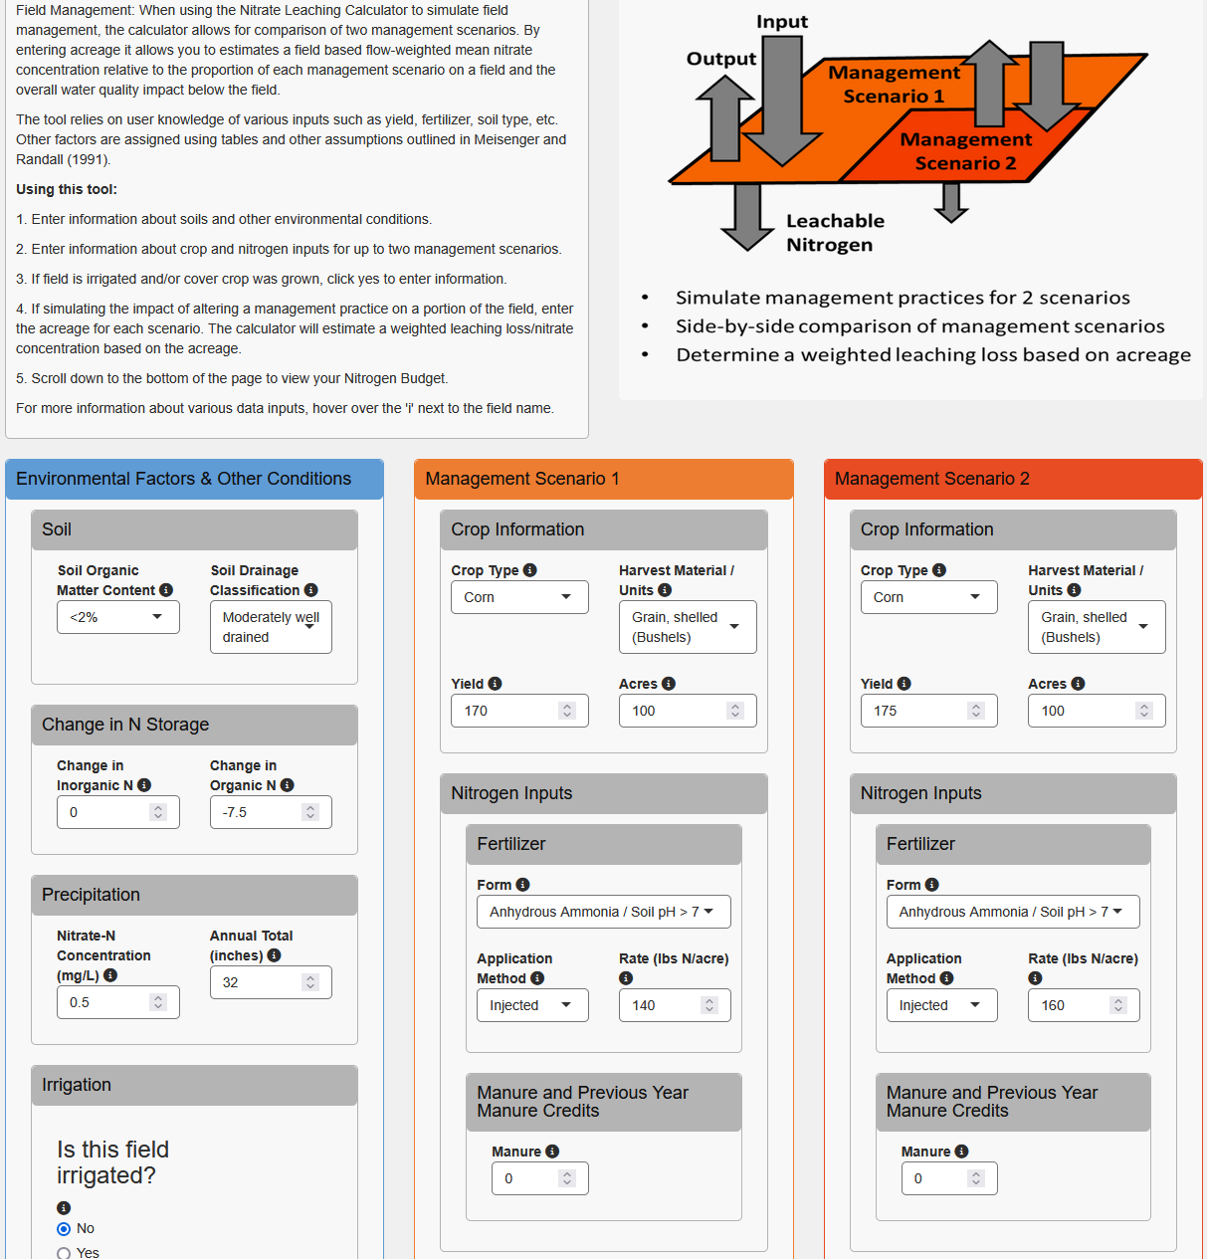
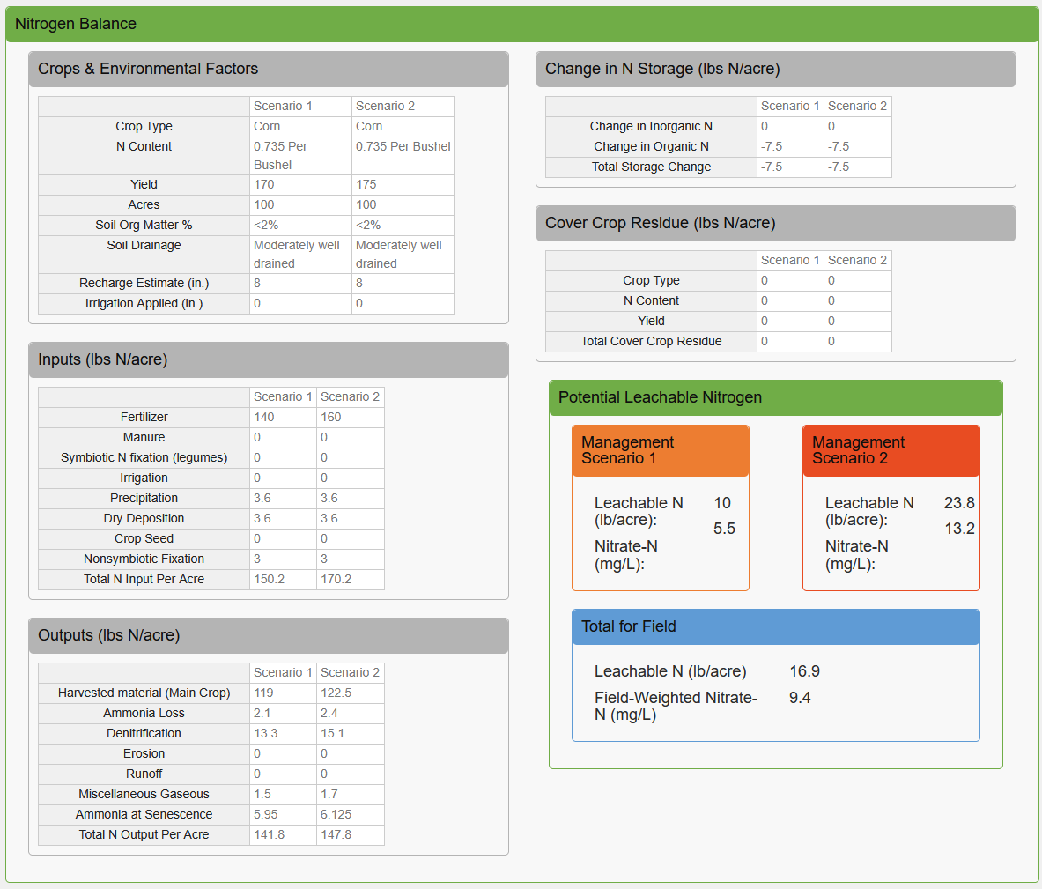
UW Extension’s Nitrate Leaching Calculator (beta)
http://68.183.123.75/wisconsinwater/BETA_VERSION_1.2/
Based on: Meisinger, J.J., Randall, G.W., 1991. Estimating Nitrogen Budgets for Soil-Crop Systems. Managing Nitrogen for Groundwater Quality and Farm Profitability, pp. 85-124.
Notes:
UW Extension has developed an online nitrate leaching calculator based on a simple nitrogen budget method published in 1991.
While this isn’t part of NDST, it’s easy to use and helps us with relating nitrate leaching rates back to nutrient management.
So for this example, I chose a moderately well drained sandy soil to grow 100 acres of corn.
(click) In the first scenario, I plan to use 140lb of nitrogen fertilizer, which is a reasonable WI and national average.
This produces a yield of 170 bushels per acre; again a reasonable state and national average.
For the second scenario, I increased fertilizer to 160 lb/ac, which I’m estimating will result in an increase in yield to 175 bushels/acre.
But when we look at how that affects nitrate leaching (click), we see that in scenario 1, 10lb/ac is leached below the root zone
Compare that to the second scenario where despite higher yield, leached nitrogen increased to about 24 lb/ac, or just about that additional 15lb/ac we were seeking to reduce in our scenario.
So the point is that while this exercise isn’t anything like “precision agriculture”, for example, it doesn’t consider timing of applications or cover crops, it still illustrates that WI and national average yields CAN be achieved while reducing leaching rates meaningfully
But of course, it will take time to see that in the well…

Slide 11
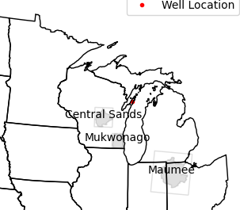
“Can you speed it up?”
Spatial Management Areas
Using 3D models (MODFLOW/MODPATH) for GW age
Method:
  Vet existing MODFLOW models (IFACE, IBOUND, IPHDRY, etc.)
  MODPATH particle tracking to map source areas
New capabilities
  How much reduction? How long?
  Where to target land management change? (source area)
  Manage “young” vs “old” source areas differently
Preliminary Information-Subject to Revision.
Notes:
Now, to address the “speed” of clean up issue, we’re swapping out the machine learning GW age support model with 3D GW models and particle tracking with MODPATH
To more properly determine where groundwater in a given well is originating
But you can’t just throw any MODFLOW model at it that you want. First we need to vet the model to make sure it has the proper settings and whether it’s appropriate for this application.
But once it’s linked, we then use MODPATH to determine both the groundwater age and the source area to pull out the nitrate leaching history from,
rather than assuming all the water comes from the area immediately surrounding the well.
(click) This offers new capabilities. We can still estimate how much reduction is needed and how long it would take to meet a goal concentration. But now we can also assess WHERE specifically to target land management changes.
We can break that area up into “young” and “old” source areas so they can be managed differently.
But, again, I think it’s easiest to show this with an example…

Slide 12
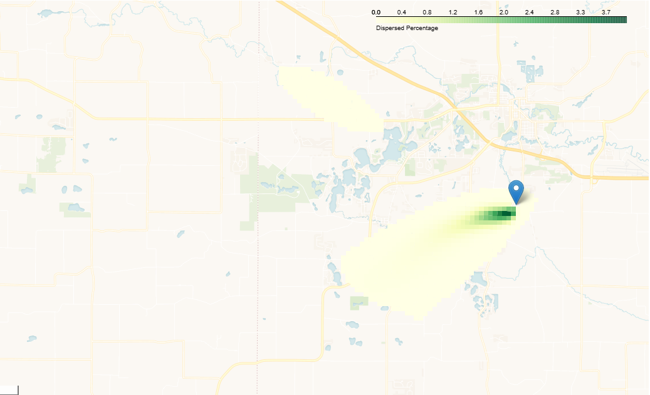
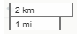
Example contributing area:
Percent of particles entering the well from each cell
0
1
2
3
4
Preliminary Information-Subject to Revision.
Notes:
So here’s the simulated contributing area for a well in central WI, generated via running backwards particle tracking in MODPATH
What the colors are showing is the percent of particles that enter the well from each cell.
The darker green colors highlight that most of the water entering the well is from nearby – just to the south and west of the well.
Now to illustrate how this helps us manage young and old areas, let’s switch to a map showing GW age, or particle travel times….

Slide 13
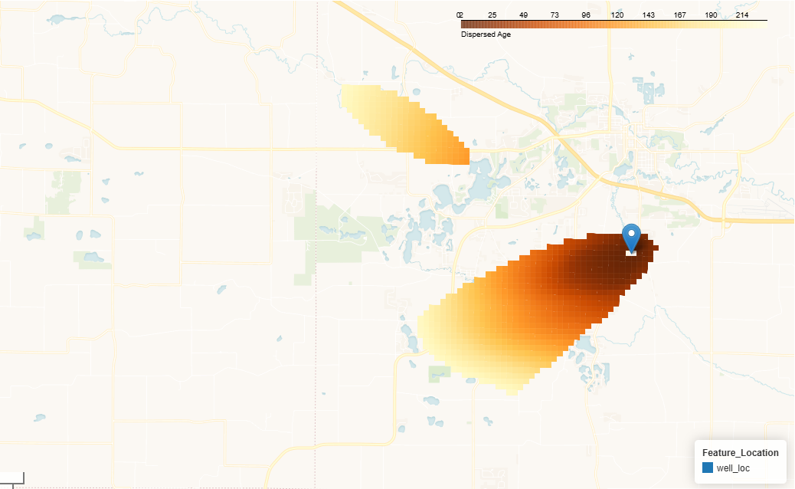
Example contributing area:
Groundwater age (travel time, years)
2
25
50
75
100
125
150
175
200
225
Preliminary Information-Subject to Revision.
Notes:
So this is showing that same output from MODPATH, but showing mean groundwater age or travel time for the particles originating in each cell.
Remember from the previous slide that most of the water is coming from very close to the well, and we see here that most of that close water is relatively young – on the order of <50 years or so.
This gives us hope that perhaps we could focus our actions AND generate a response in the well faster
Let’s zoom in …

Slide 14
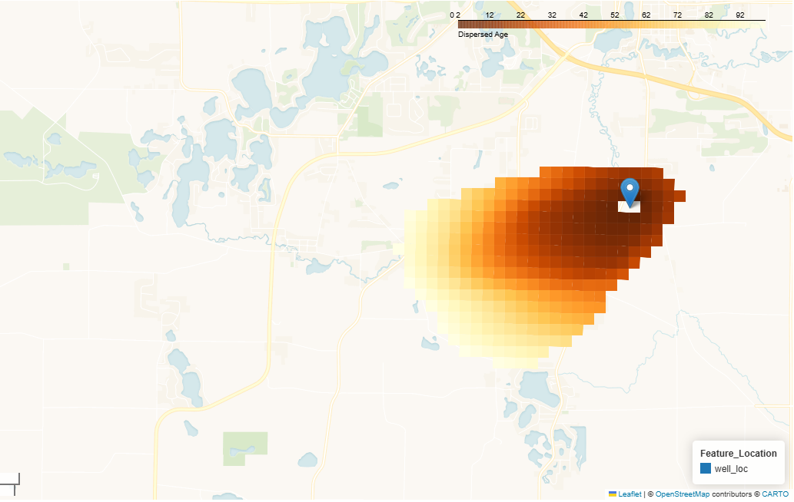

Example contributing area:
Groundwater age (travel time, years)
Zoom to <100 years
2
25
50
75
100
Preliminary Information-Subject to Revision.
Notes:
And focus on just the area contributing water less than 100 yrs. Again, most of that source area is relatively young. So let’s zoom in even more to look at just the area less than 10 years…

Slide 15
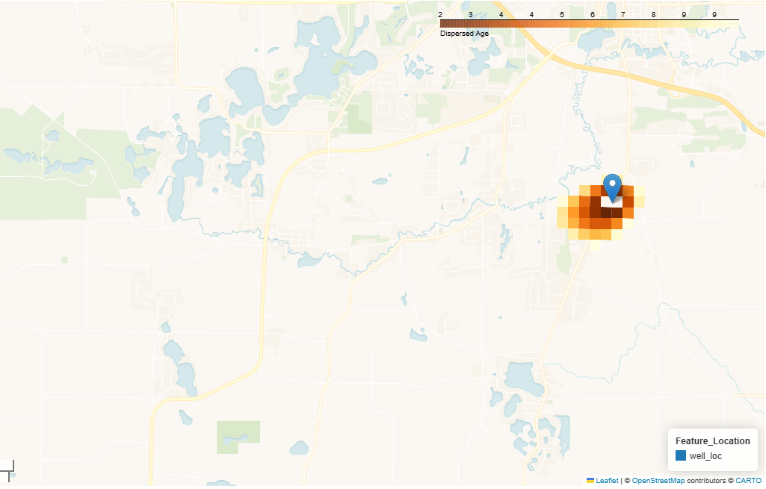
Example contributing area:
Groundwater age (travel time, years)
Zoom to <10 years
4
8
10
2
6
Preliminary Information-Subject to Revision.
Notes:
Now this is a rather manageable area to work with! Note the scale bar – it’s now 1k.
So this “young” contributing area is a little over a square kilometer that we want to manage differently.
So, is it big enough to see a response in the well?

Slide 16
Managing by travel-time areas
2
25
50
75
100
Source Area can be split into “young” & “old” management areas
  User defines break between “young” and “old”
  User manages age-based source areas separately in the forecasting scenarios
< 10 years
> 10 years
Preliminary Information-Subject to Revision.
Notes:
We can test that with the tool by essentially “splitting” the management areas into “young” (<=10) and “old” (>10) sections, and assign different future leaching reductions to each...

Slide 17
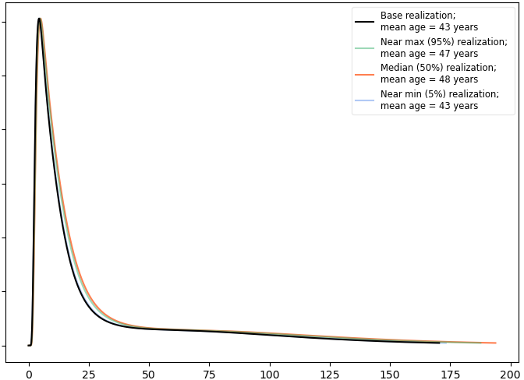
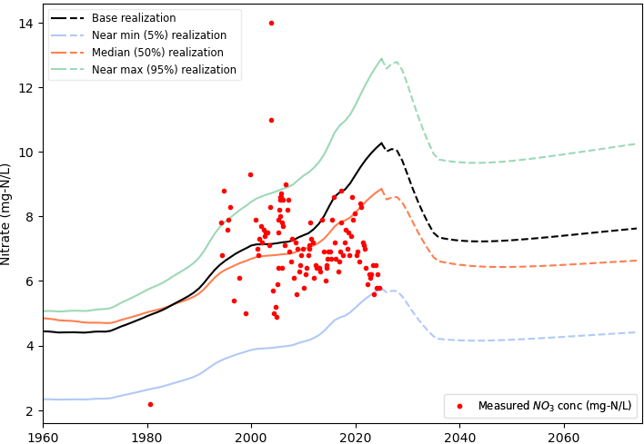
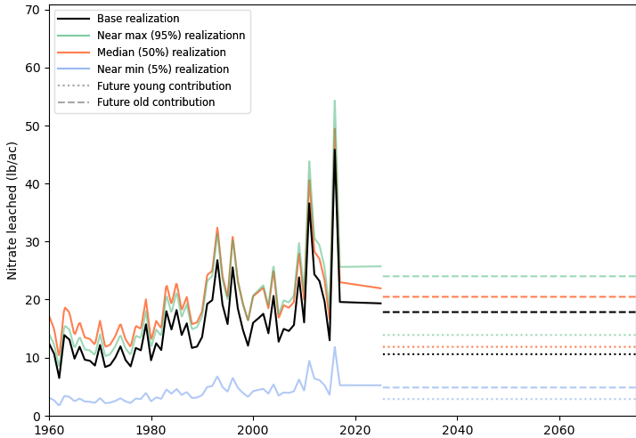

“Young” & “Old” Source Area Management
Reduce leaching from “young area” (<= 10 years) by 50%
Keep leaching from “old area” (>10 yrs) same as current rates
Nitrate leaching (ag + septic)
Groundwater age distribution
Nitrate concentration in well
70
14
60
12
50
10
40
“Old” status quo
Nitrate Concentration [mg/L]
Nitrate Leached [lb/ac]
Frequency (unitless)
8
30
6
20
4
10
“Young” reduced by 50%
2
1960
1980
2000
2020
2040
2060
0
25
50
75
100
125
150
175
200
1960
1980
2000
2020
2040
2060
10 yrs
Age (years)
Future leaching rates are instantaneously reduced for each realization
Rapid decrease, then steady long-term.
Preliminary Information-Subject to Revision.
Notes:
In this example, we’ll reduce the leaching in the young area by 50% and leave the older area as is.
In the plot, you can see the thinner dotted lines showing the dropped “young” leaching rate and the old area are dashed lines holding steady with the current rate.
Note that the dashed lines do appear to be a bit lower in the future, but that’s only because we are comparing them with the solid historical lines that are a composite of both young and old source areas
Now the mean GW age for this well, when using the MODFLOW/MODPATH method, is around 45 years, but (click) you’ll notice it has a peak of younger water, under 10yrs.
So there’s hope that this well may indeed respond quickly to changes in leaching.
And yes, (click), we see that while there’s a small bump up in the near term, the nitrate concentration in all realizations drops quickly over 10 years and then stabilizes at a new lower concentration.
So this gives us hope that such an approach could work.
And from what we know about this particular well, the folks in charge of it were faster that we were – they’ve already worked with local land owners and you can see in those red dots that the recent concentrations have already started to drop.
Those recent changes are not accounted for in our model, but the fact that our model shows a similar decline is possible gives us confidence in the method and approach!

Slide 18
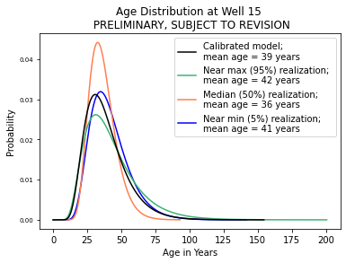
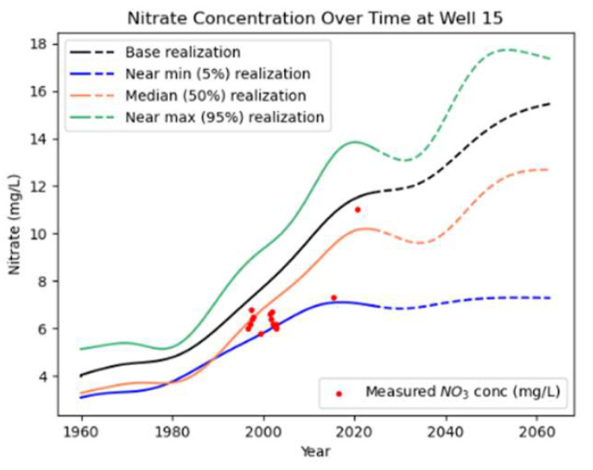


GW-NDST Summary
Groundwater lag time
  Both legacy and future practices matter
  Expect delayed responses
Ongoing work
  Publish MODFLOW/MODPATH integration
  Enhanced GUI (“more web like”)
  Easier installation
  Expand coverage (more MODFLOW models)
    Expanding into Illinois River Basin (MODFLOW 6)
    Where else?
Probability
Age
NO₃⁻
Year
lschachter@usgs.gov
pfjuckem@usgs.gov
Notes:
In summary, nitrate concentrations are affected by legacy nitrate in the groundwater system as well as future land use practices, and we should expect delayed responses to those changes in practices
Numerical methods like MODPATH allow us to answer questions of “where” and manage areas differently in future scenarios
This work is still very much ongoing. In the near term we hope to publish this MODFLOW/MODPATH integration method in a few journal articles
As well as develop a more user-friendly graphical user interface and installation process (it’s a bit of a headache right now)
We are also expanding coverage to include more MODFLOW models
Specifically we now have funding to incorporate a soon-to-be published MODFLOW 6 model of the Illinois River Basin
Where else could we use this method? Anywhere with a suitable MODFLOW model (NWT or 6), good data on nitrate leaching,
and a need for understanding how to handle nitrate management at the land surface and its lag time to wells or streams
Hopefully I have time to take any questions, but I also encourage you to reach out to my project lead, Paul Juckem at the USGS

Slide 20

Using Local Knowledge to build Trust & Understanding
Our primary escape route: User Interaction
“The application of model results depends on trust.”
“We do not need to have the best possible answer, only a reasonable one.”
“The adequacy of a model has as much to do with how well it aids one’s thinking as with its raw predictive capability.”
Notes:
Erica Thompson came out with a great book recently that talks about how models are everywhere in our lives (this was before AI too), and how we can sometimes fixate too much on the model & its results, and not enough on how that relates to the real world. She encourages modelers to search for “escape routes”. She has a lot of great quotes, and I think the last one nicely combines them all: That it’s as much about how a model can improve understanding as it is about the model’s pure accuracy. This helped me realize allowing users to more fully interact with the underlying models could be an “escape route”, and help build trust via increased understanding. Here’s an example…

Slide 21
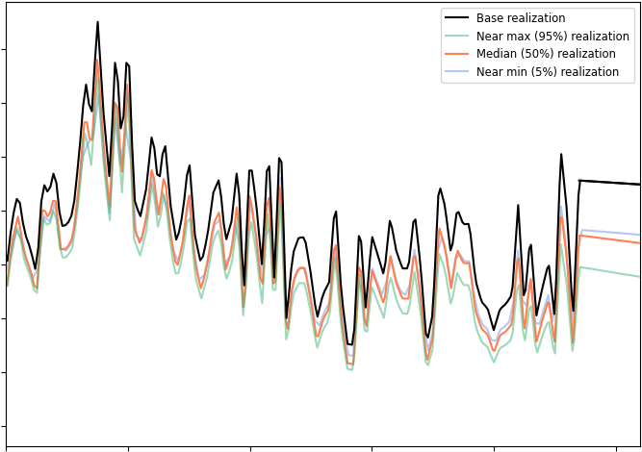
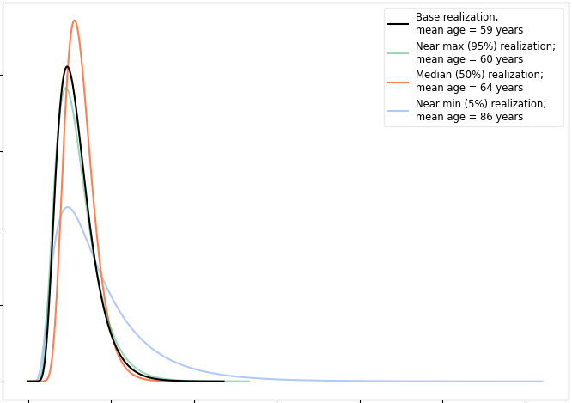
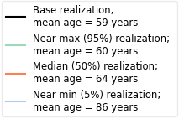
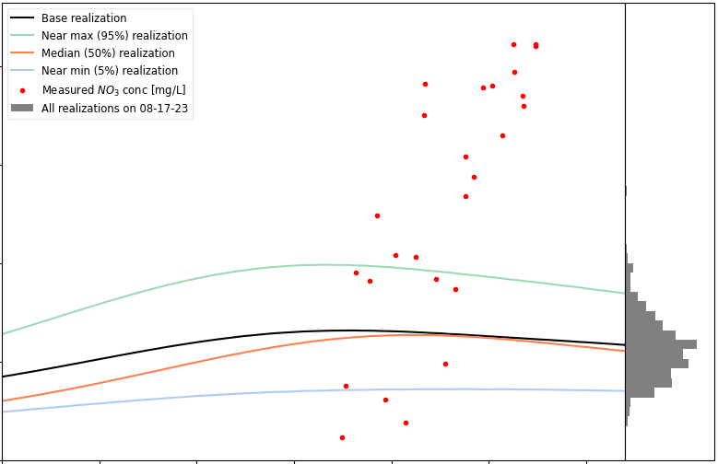
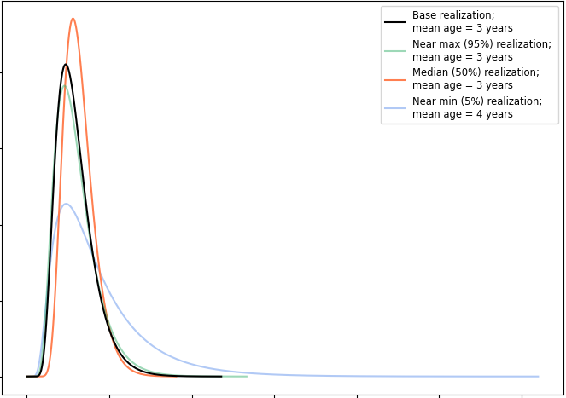
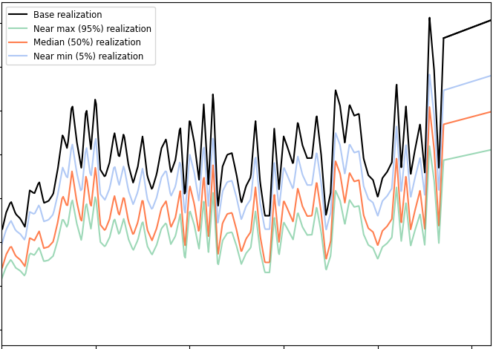
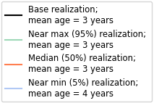
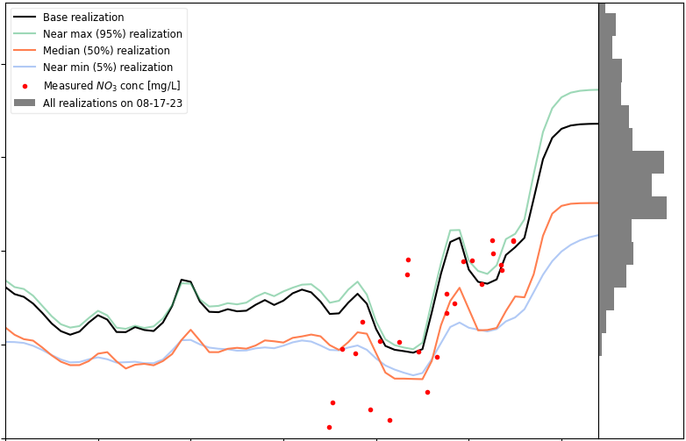
Measured Nitrate is Increasing!
ORIGINAL RESULTS PRIOR TO…
Attempt to match trend via User Multipliers
Nitrate leaching (ag + septic)
Groundwater age distribution
Nitrate concentration in well
17.5
20
15.0
12.5
15
Calibrated Multipliers
Frequency (unitless)
10.0
Nitrate Leached [lb/ac]
Calibrated Multipliers
Nitrate Concentration [mg/L]
7.5
10
5.0
5
2.5
0
How does this affect forecasts?
1920
1940
1960
1980
2000
2020
0
100
200
300
400
500
600
1960
1970
1980
1990
2000
2010
2020
Age (years)
35
30
40
25
User-adjusted Multipliers
30
20
Frequency (unitless)
Nitrate Leached [lb/ac]
Nitrate Concentration [mg/L]
15
Younger Water
20
10
5
Steeper Slope
10
0
0
5
10
15
20
25
30
1920
1940
1960
1980
2000
2020
Age (years)
1960
1970
1980
1990
2000
2010
2020
Notes:
Here’s a different example well. Leaching is fairly steady; perhaps decreasing. Mean GW age around 60yrs. And I’d argue that our model generally overlaps with the middle of the data points.
But if you look closely, you may notice a trend in the data. A very very steep trend! On the order of 1mg/l per year!! None of our realizations come close to hitting that trend.
But I’d mentioned the calibration multipliers when describing the flow chart. Well, there are also “user multipliers”. So what actually happens is that the support models do their thing, their results get adjusted by the calibration multipliers, and then…that result gets adjusted by user multipliers. In all the previous examples, the user multipliers were set at the default of 1.0.
But (animation), in this second case, I pushed them to the extreme. Beyond what I would normally recommend, but I wanted to illustrate an extreme example.
So I increased the slope of the leached nitrate (there are limits to what’s possible with the user multipliers), and I really really reduced the GW age – by 20x! In response, the models are able to capture some of the variability and increasing concentrations during the past 20 years.
But also notice that the histogram is much more spread out. It’s important to point out that the colored lines still represent the exact same individual realizations as in the above example; we didn’t want to show different realizations because then it’s harder to directly compare. But realize that the best and worst case lines no longer represent the border with outliers. The range of results have expand beyond what the colored lines are showing.
So where this really becomes a potential concern is with forecasting. How do my extreme outliers affect the forecasts for this example?...

Slide 22
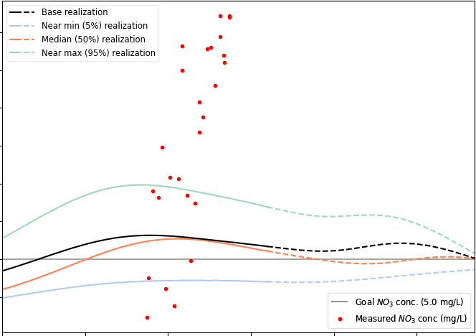
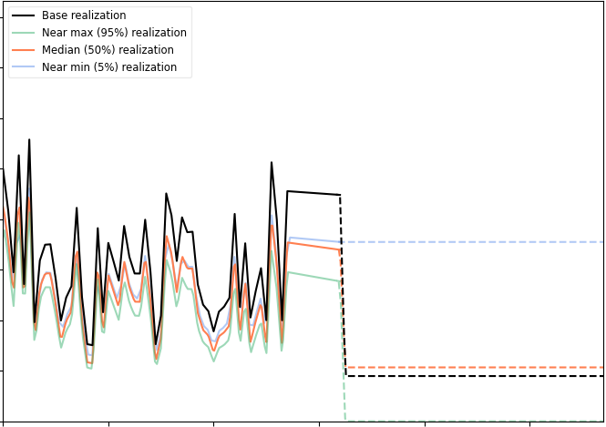
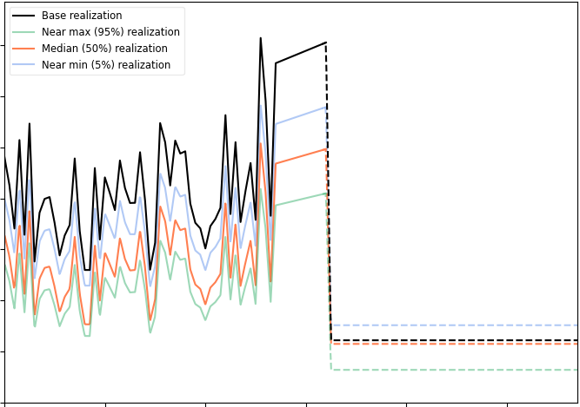
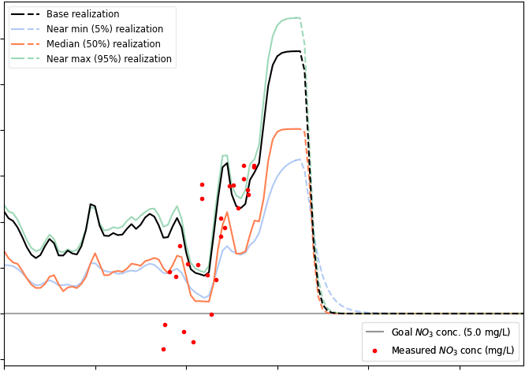
The Solution is the “Same”
Calibrated: To reach 5 mg/l in 50 years, nitrate leaching would need to drop ~70% asap.
User-matched: To reach 5 mg/l in 50 years, nitrate leaching would need to drop ~72% asap.
Nitrate leaching (ag + septic)
Groundwater age distribution
Nitrate concentration in well
20.0
20.0
17.5
17.5
15.0
15.0
Calibrated Multipliers
12.5
Frequency (unitless)
12.5
Nitrate Leached [lb/ac]
Nitrate Concentration [mg/L]
10.0
Calibrated Multipliers
10.0
7.5
7.5
5.0
5.0
2.5
2.5
1960
1980
2000
2020
2040
2060
0
100
200
300
400
500
600
1960
1980
2000
2020
2040
2060
Age (years)
35
35
30
30
25
User-adjusted Multipliers
25
20
Frequency (unitless)
20
Nitrate Leached [lb/ac]
Nitrate Concentration [mg/L]
15
Younger Water
15
10
10
5
5
1960
1980
2000
2020
2040
2060
0
5
10
15
20
25
30
1960
1980
2000
2020
2040
2060
Age (years)
Notes:
Using the same scenario as before: target 5 mg/l in 50 years, we see that the calibrated version with requires about a 70% reduction for the median; it just takes a long time for the well concentration to slowly drop and then stay there.
For the user-intervention example, the drop occurs almost immediately, and then stays at the lower concentration. But that example also requires about a 70% reduction. In other words, the solution to the problem is essentially the same.
Now it may not work out so nicely in all cases, but this example does illustrate what I think is an important point – that even in the face of uncertainty, working toward the goal of reducing leaching rates will provide a benefit. If a more confident forecast is needed, fine, that can be worked on. But in the mean time, any reduction in leaching will aid with achieving concentration goals sooner.

Slide 23
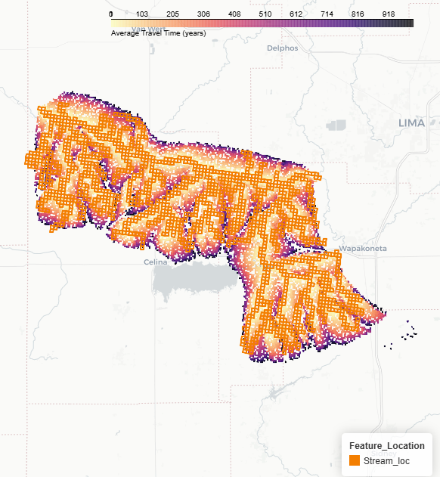
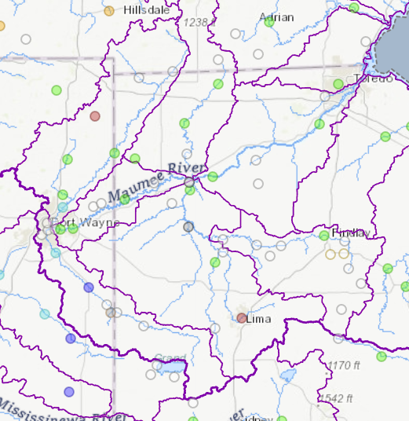
GLRI/Maumee River Example: St Mary’s River at Willshire, OH
gage
Only <1000 years
gage
Take home:
Most young water is sourced near the streams

Slide 24
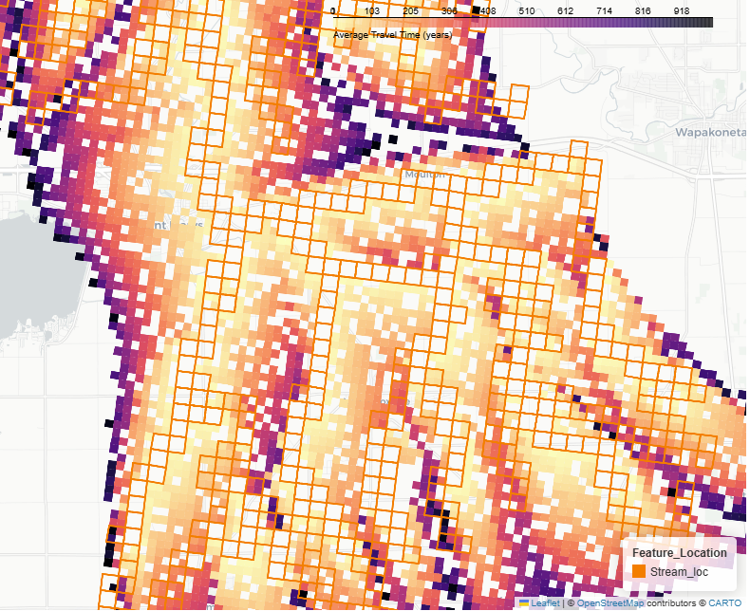
River Example: St Mary’s River at Willshire
gage
Tributary 1
Tributary 2
Take home:
Super-position of local and regional GW flow systems
8
Preliminary Information-Subject to Revision. Not for Citation or Distribution.

Slide 25
What’s Next?
FY26: Proof-of-Concept
Nitrate leaching source
  TRENDS? Empirical?
  Evaluate longer-term options: USGS run Agro-IBIS? SWAT?
Groundwater transport (age distribution)
  Update MODFLOW-checking code for MODFLOW6 (ILRB model)
  Update core code for MODFLOW6 and PRT package
FY27: Calibrate
Oxygen and nitrate reduction rates
  Reassess redox model? (is there dissolved oxygen and age tracer data available?)
Nitrate concentration data in wells
  Quality and quantity of data?
  Well pumping rate data? Does it match the MODFLOW model?
Beyond: analyze, publish, enhancements

Slide 26
What’s Possible?
GUI Enhancements
  Modernize GUI (if RISK grant denied)
  Online tool / self-installing executable
  GIS capabilities to ID stream segments/reaches
  Website (Github with documentation, groundwater education resources, etc.)
  Add flow direction arrows for Phase 1 using DEM and DTW ML results.
Method Enhancements
  Pull out MF/MP into a separate Py Library (bonus publication)
  Pathline-based curvilinear dispersion
  Link age distributions to resolution of NO₃ source (currently ave. over full source area)
  Random-walk for more robust dispersion
  LAK compatibility
  Tile drain captured groundwater (sub-year transport)
  Tile drain capture of infiltration / transient GSFLOW?
  Integrate w/ standardized well construction report (WCR) DB to improve MF model depths/layering
  Low, Med, High/Custom resolution options (re-run w/ autogenerated inset models)
Transferability
  How coarse is too coarse (model size vs resolution)?
  Build scale/resolution-appropriate GW models across Midwest
  Generalized models (possibly linked to GlacKmaker via standardized WCR DB)
  Run Agro-IBIS in-house
    UW collaboration while build USGS expertise
    Match Agro-IBIS recharge with MODFLOW recharge
    Joint inversion (calibration) of Agro-IBIS and MODFLOW
  SWAT for leaching and recharge instead of Agro-IBIS? Other model?
Patent? • Workshops/outreach? • Groundwater Classes? • Collaborations?

Slide 27
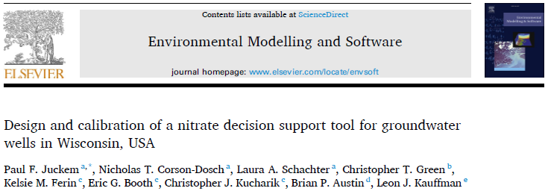
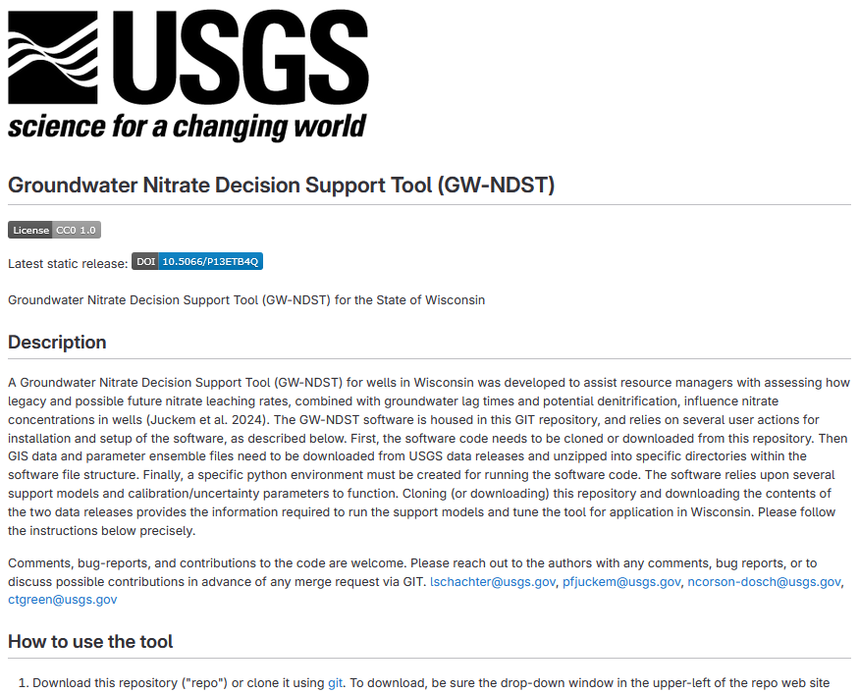



https://doi.org/10.1016/j.envsoft.2024.105999
pfjuckem@usgs.gov
Notes:
Instructions on how to install the software, python environment (computer programming language), and obtain the required data is available on the software website (see “How to use the tool…”). Of course, please reach out to me with questions or if you encounter any difficulties with the installation or operation.

