Slide 1



Watershed-scale Water Resource Planning
The Role of Groundwater Residence Time
Bob Tipping – Minnesota Geological Survey
College of Science and Engineering
MGWA Spring Conference - 2026
Notes:
I would like to wrap up this morning’s talks by expanding our discussion out to the HUC-08 watershed scale, and discuss the role of residence time in water-resource planning.
This talk is SE Minnesota-centric, as that is what I am most familiar with, but the tools and methods highlighted are meant to apply statewide;
This approach is based largely on County Geologic Atas work, so I want to acknowledge the support to that program by the Environmental and Natural Resources Trust fund, and the Clean Water Fund, along with our DNR CGA partners, and the support, advice and council provided by the MDH Source Water Protection unit.

Slide 2
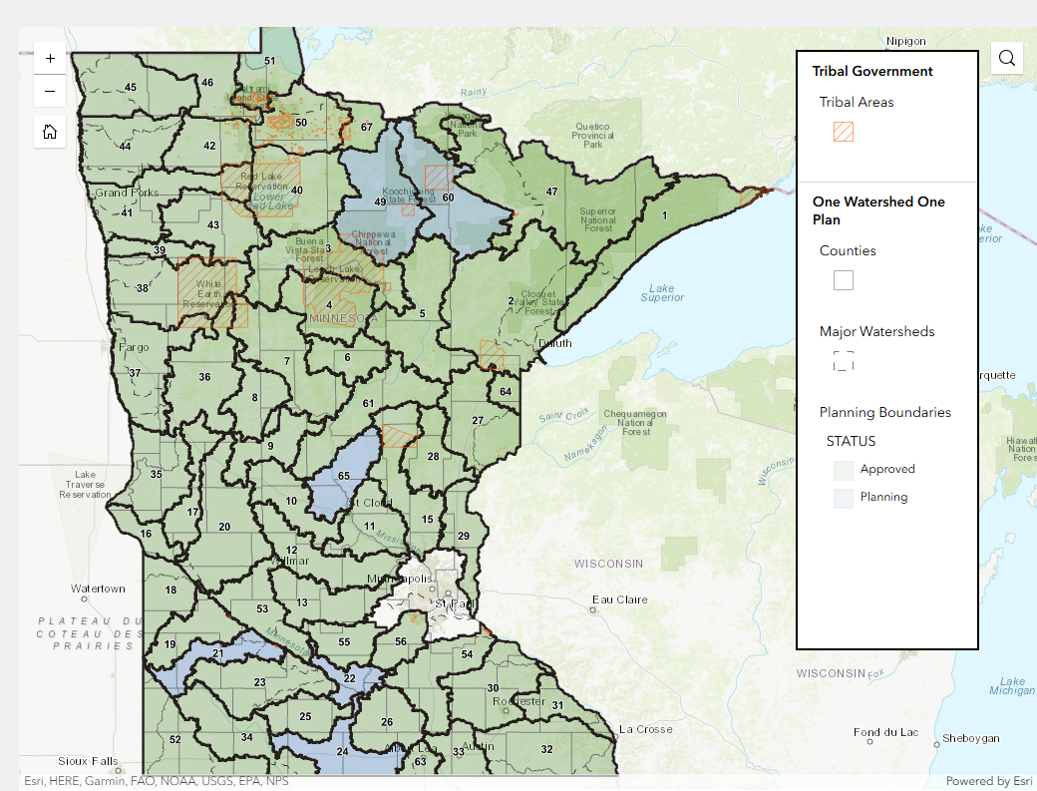
https://bwsr.state.mn.us/one-watershed-one-plan-participating-watersheds
Notes:
The watershed scale I am referencing this morning is HUC-08. One Watershed, One Plan Participating Watersheds

Slide 3
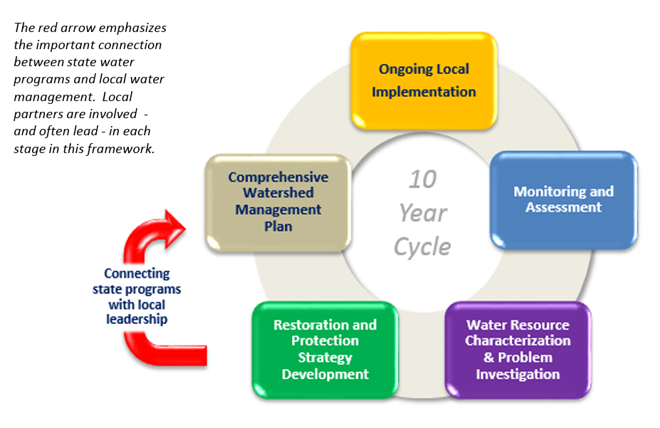
https://www.mda.state.mn.us/sites/default/files/inline-files/h20framework.pdf
Notes:
Current framework outlines an iterative approach of data collection, analysis, local and state strategy development and local implementation.
By design it is set up to revisit each watershed over a 10-year cycle.

Slide 4
The Current Challenge

Slide 5
State watershed planning operates on a 10-year cycle
On this time scale, data monitoring, analysis, strategy development, comprehensive planning, and local implementation steps are well-designed for state-supported management of lakes, streams and rivers.
Groundwater residence times – time from recharge to discharge in streams, rivers or wells, are longer than that
A minimum 20-year travel time is longer than many legislative terms and all legislative appointments
How best to manage groundwater resources without knowing what’s around the next bend?
Groundwater resources are a fundamental part of watershed-scale water budgets, with application to drinking water, agricultural and industrial use, baseflow to surface water bodies and ecosystems. Changes in that budget impact both groundwater quantity and groundwater quality
The Current Challenge

Slide 6
State watershed planning operates on a 10-year cycle
On this time scale, data monitoring, analysis, strategy development, comprehensive planning, and local implementation steps are well-designed for state-supported management of lakes, streams and rivers.
Groundwater residence times – time from recharge to discharge in streams, rivers or wells, are longer than that
A minimum 20-year travel time is longer than many legislative terms and all legislative appointments
How best to manage groundwater resources without knowing what’s around the next bend?
Groundwater resources are a fundamental part of watershed-scale water budgets, with application to drinking water, agricultural and industrial use, baseflow to surface water bodies and ecosystems. Changes in that budget impact both groundwater quanity and groundwater quality
The Current Challenge

Slide 7
State watershed planning operates on a 10-year cycle
On this time scale, data monitoring, analysis, strategy development, comprehensive planning, and local implementation steps are well-designed for state-supported management of lakes, streams and rivers.
Groundwater residence times – time from recharge to discharge in streams, rivers or wells, are longer than that
A minimum 20-year travel time is longer than many legislative terms and all legislative appointments
How best to manage groundwater resources without knowing what’s around the next bend?
Groundwater resources are a fundamental part of watershed-scale water budgets, with application to drinking water, agricultural and industrial use, baseflow to surface water bodies and ecosystems. Changes in that budget impact both groundwater quanity and groundwater quality
The Current Challenge

Slide 8
State watershed planning operates on a 10-year cycle
On this time scale, data monitoring, analysis, strategy development, comprehensive planning, and local implementation steps are well-designed for state-supported management of lakes, streams and rivers.
Groundwater residence times – time from recharge to discharge in streams, rivers or wells, are longer than that
A minimum 20-year travel time is longer than many legislative terms and all legislative appointments
How best to manage groundwater resources without knowing what’s around the next bend?
Groundwater resources are a fundamental part of watershed-scale water budgets, with application to drinking water, agricultural and industrial use, baseflow to surface water bodies and ecosystems. Changes in that budget impact both groundwater quanity and groundwater quality
The Current Challenge

Slide 9
State watershed planning operates on a 10-year cycle
On this time scale, data monitoring, analysis, strategy development, comprehensive planning, and local implementation steps are well-designed for state-supported management of lakes, streams and rivers.
Groundwater residence times – time from recharge to discharge in streams, rivers or wells, are longer than that
A minimum 20-year travel time is longer than many legislative terms and all legislative appointments
How best to manage groundwater resources without knowing what’s around the next bend?
The Current Challenge

Slide 10
Consider changing the speed
Groundwater resources are a fundamental part of watershed-scale water budgets, with application to drinking water, agricultural and industrial use, baseflow to surface water bodies and ecosystems. Changes in that budget impact both groundwater quantity and groundwater quality
The Current Challenge
?

Slide 11
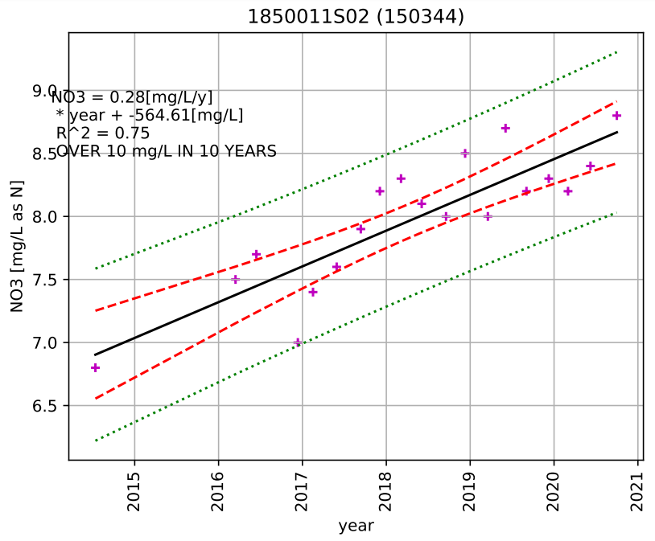
Notes:
Utica 3 NO3-N data

Slide 12
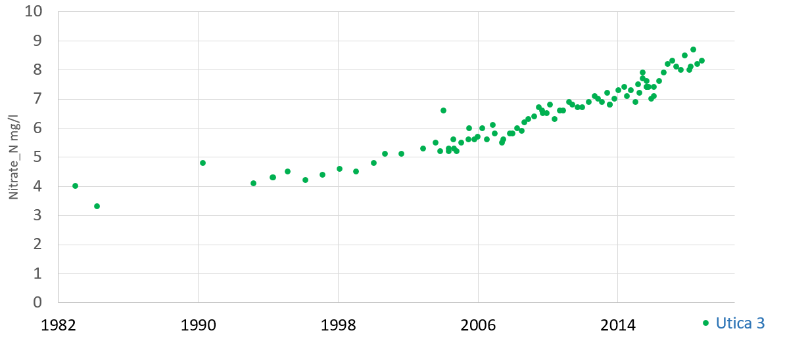
Notes:
Utica 3 NO3-N data

Slide 13
Groundwater modeling
Groundwater models calibrated to hydraulic head alone do not provide a unique solution
Chemical and isotopic composition
The Current Toolbox

Slide 14
Groundwater modeling
Groundwater models calibrated to hydraulic head alone do not provide a unique solution
Chemical and isotopic composition
What’s in groundwater says something about where it has been; chemical and isotopic composition provides a tracer of groundwater movement
“If water from one area gets to another area, it must be hydraulically and hydrologically possible for it to get there regardless of what the models predict” (Carol Kendall – USGS, 2005 MGWA Fall Conference)
The Current Toolbox

Slide 15
Groundwater modeling
Groundwater models calibrated to hydraulic head alone do not provide a unique solution
Chemical and isotopic composition
What’s in groundwater says something about where it has been; chemical and isotopic composition provides a tracer of groundwater movement
“If water from one area gets to another area, it must be hydraulically and hydrologically possible for it to get there regardless of what the models predict” (Carol Kendall – USGS, 2005 MGWA Fall Conference)
Groundwater age distribution based on indicators of recent recharge helps refine conceptual framework for numeric modeling
The Current Toolbox

Slide 16
Establish baseline chemical and isotopic composition groundwater in different parts of the state, including both near-surface and deeper aquifers
Baseline composition provides the means to identify changes in water composition with time. These changes can differ with depth.
Map the distribution of recent and vintage waters with depth
The DNR County Groundwater Atlas Program (CGA Part B) does this, as do others, e.g. Dakota County Environmental Services;
  in addition to data collected by these programs, there is a wealth of historic data than can be used to identify changes in these distributions with time
Compare age distributions with fluxes calculated from numeric modeling
Work on this step is also underway, both in Minnesota and Wisconsin
Workflow

Slide 17
https://bwsr.state.mn.us/one-watershed-one-plan-participating-watersheds
Notes:
One Watershed, One Plan Participating Watersheds

Slide 18
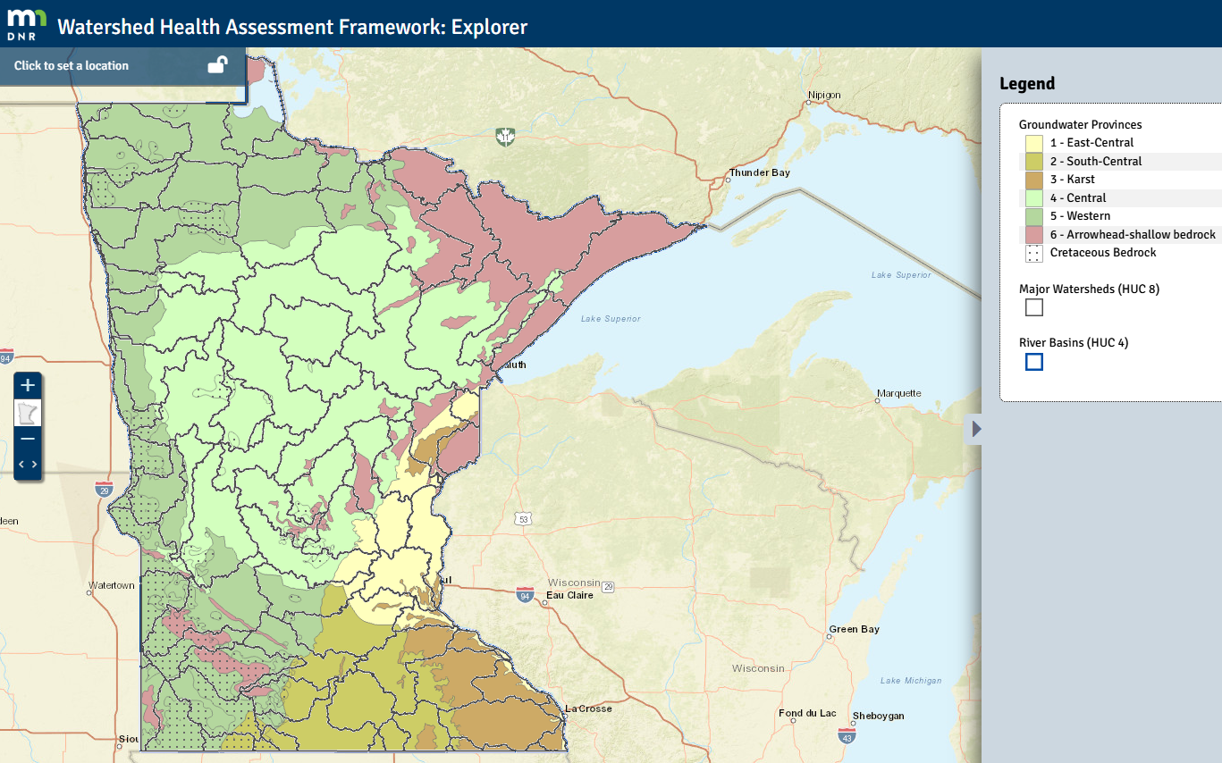
https://whaf-explorer.dnr.state.mn.us/
Notes:
Establish baseline chemistry – not one size fits all. Chloride, for example. Also higher sulfate, sodium to the west. What would a “standard” Piper diagram look like for different parts of the state? What about pH?

Slide 19
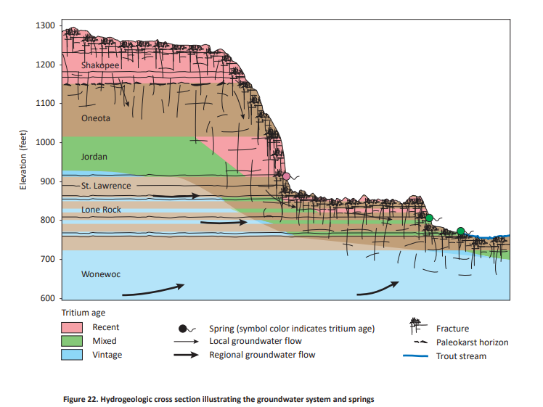
Some examples of what these distributions look like
DNR CGA (Part B) – Winona County, Report

Slide 20
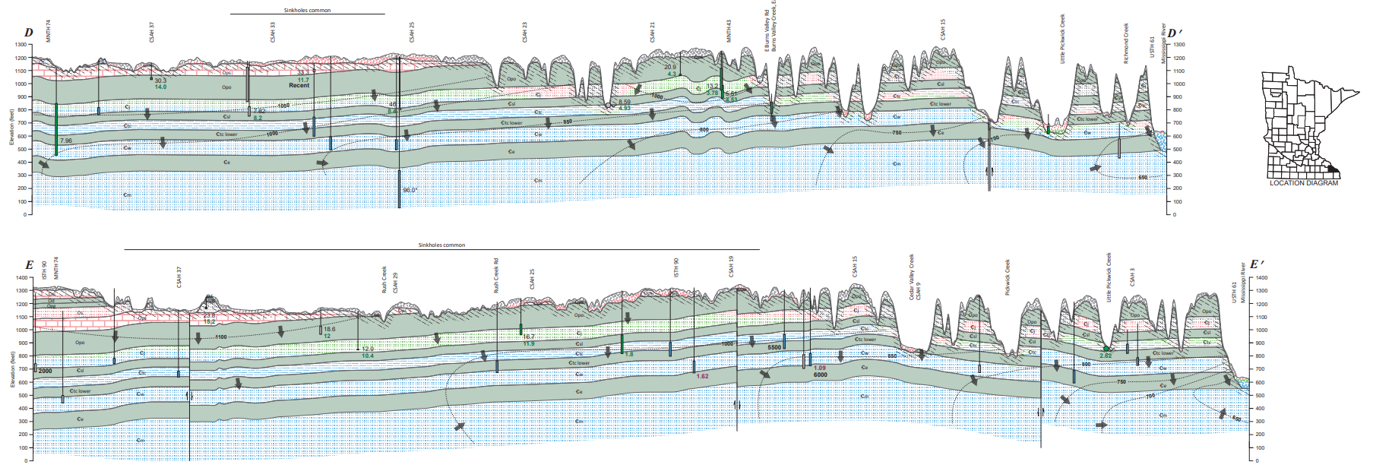
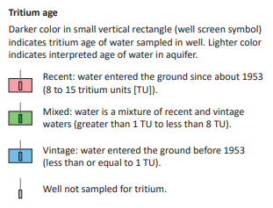
Some examples of what these distributions look like – DNR CGA Part B
DNR CGA (Part B)– Winona County, plate 6

Slide 21
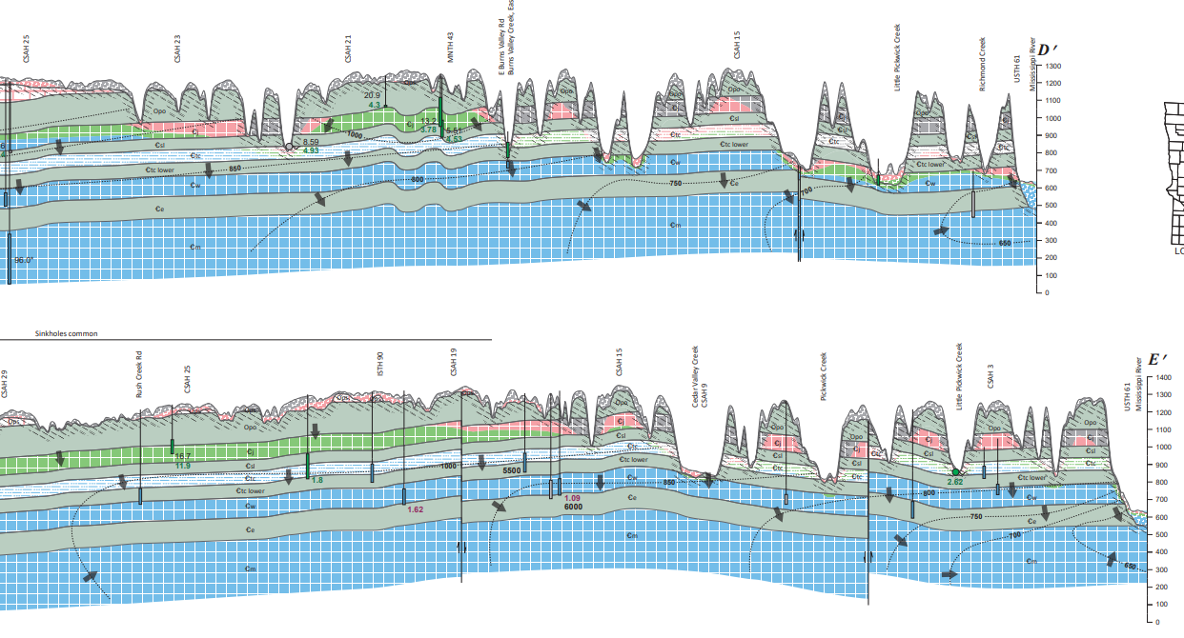
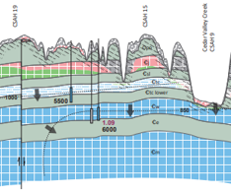
Some examples of what these distributions look like – DNR CGA Part B
DNR CGA (Part B)– Winona County, plate 6

Slide 22
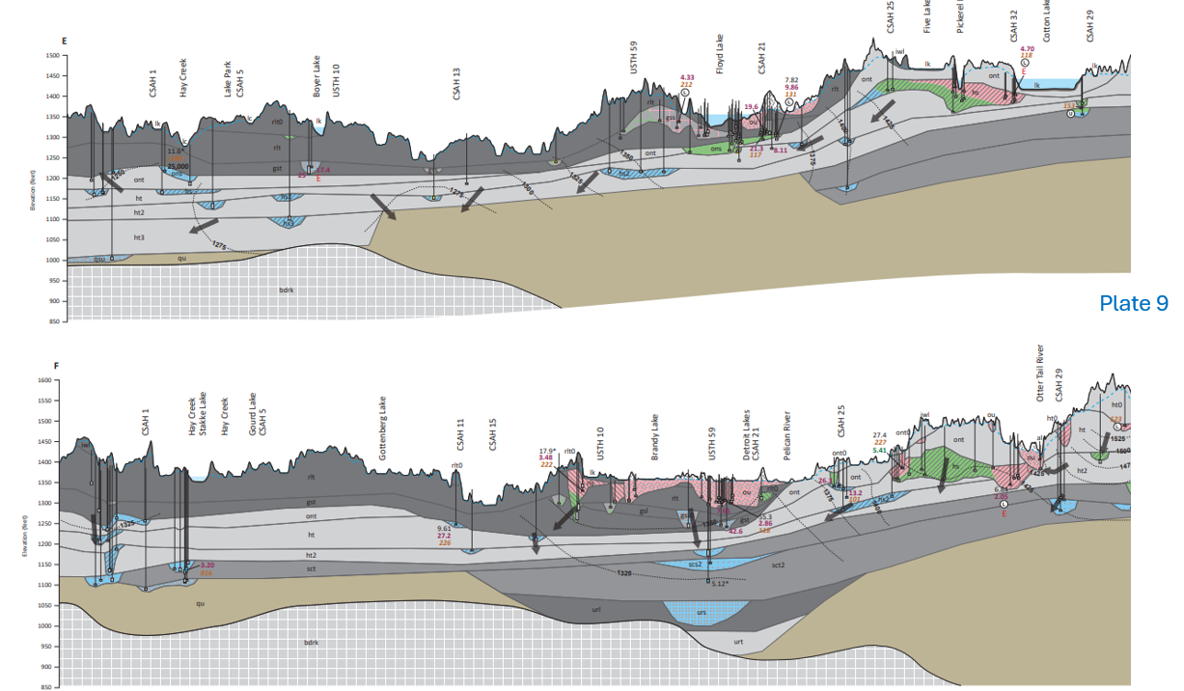
Some examples of what these distributions look like – DNR CGA Part B
DNR CGA (Part B)– Becker County, plate 9

Slide 23
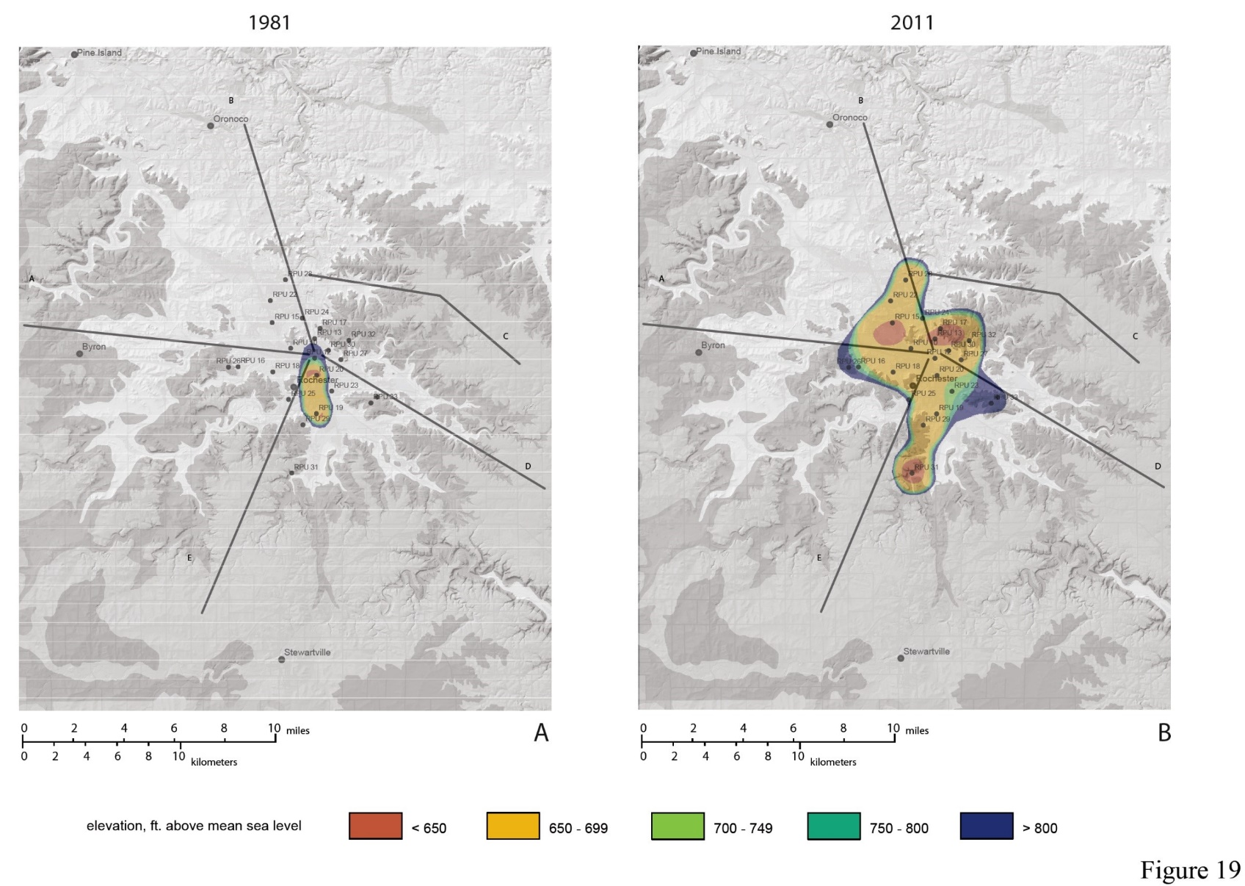
Impact of Vertical Hydraulic Gradient on Distribution of Recent Waters Over Time
https://conservancy.umn.edu/items/e727a8a4-1e3e-43e3-8365-1f584daa38ea
Notes:
Impact of vertical hydraulic gradient on distribution of recent waters over time – Rochester Minnesota.

Slide 24
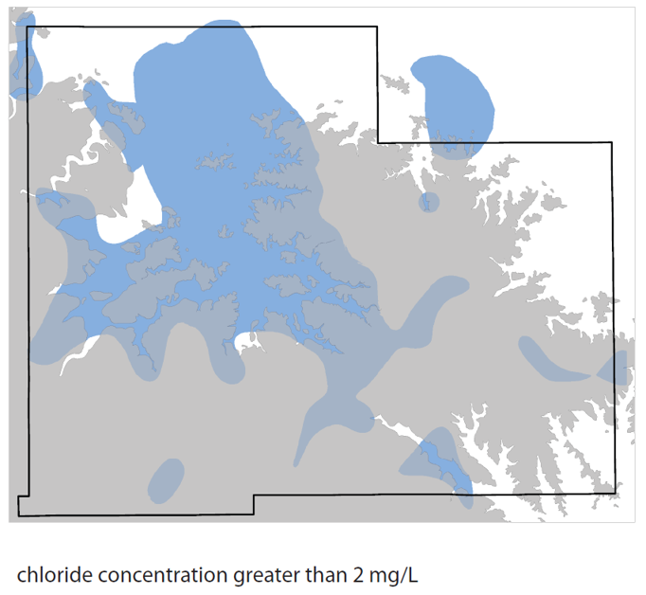
Presence of Recent Waters Underneath Decorah Shale Indicative of Lateral Flow and Leakage through Confining Units
https://conservancy.umn.edu/items/e727a8a4-1e3e-43e3-8365-1f584daa38ea
Notes:
3-dimensional distribution of recent waters in Olmsted County, based on chloride concentrations above natural background level of 2 mg/L. Presence of recent waters underneath Decorah Shale indicative of lateral flow and leakage through confining units

Slide 25
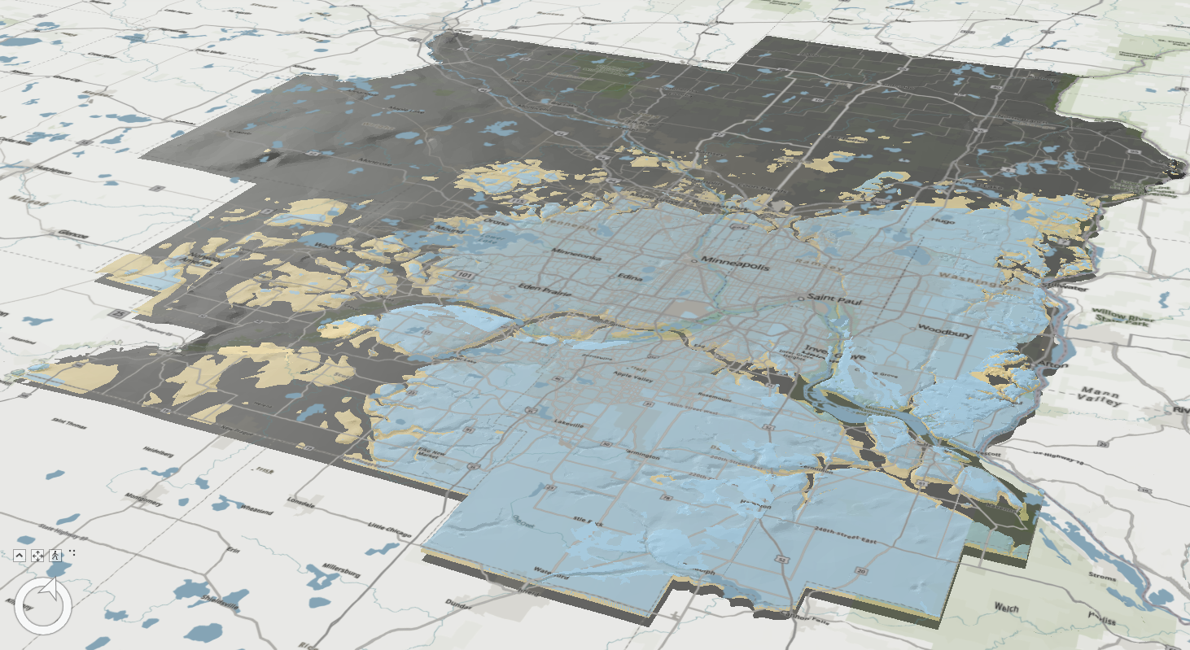

Slide 26
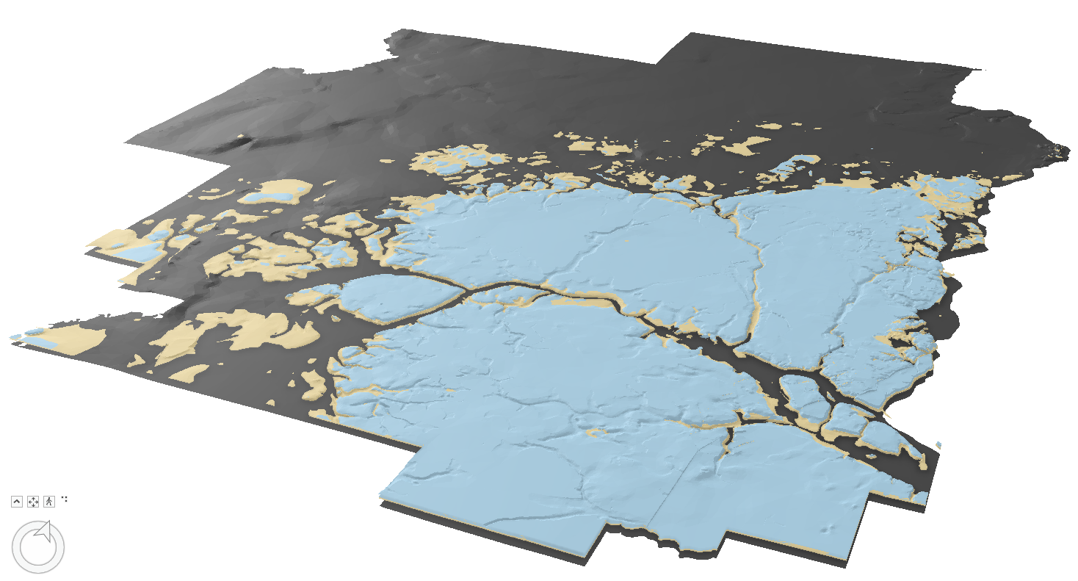

Slide 27
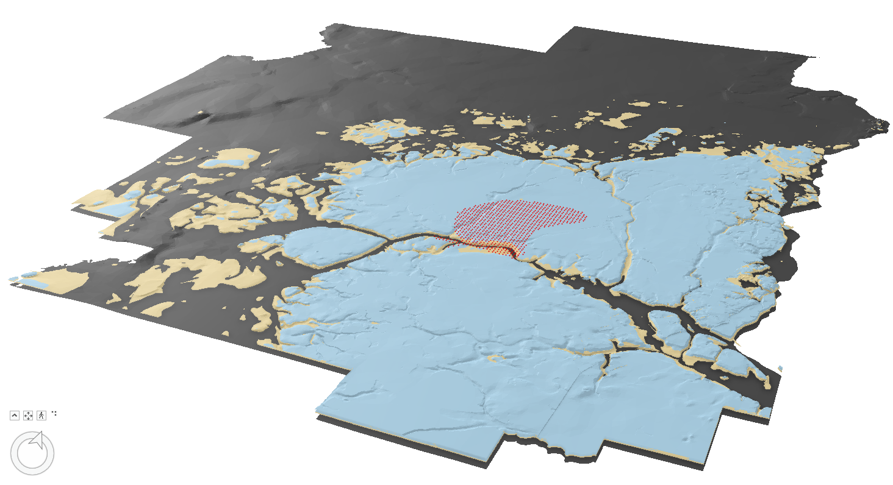

Slide 28
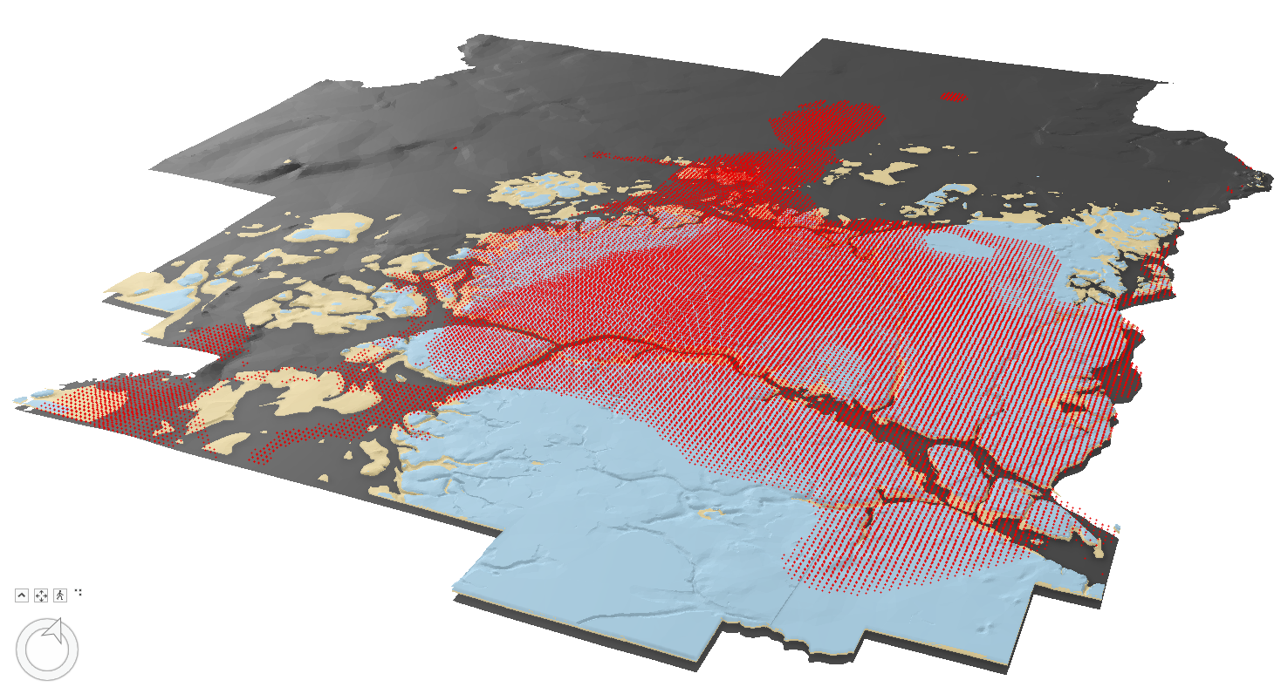

Slide 29
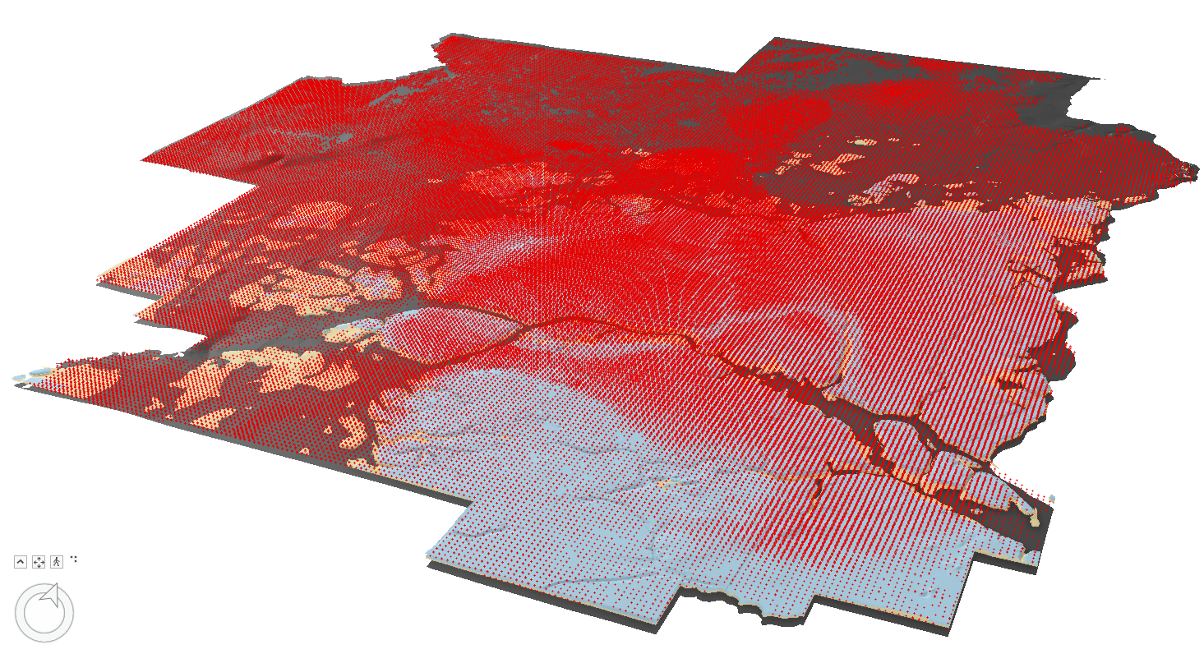

Slide 30
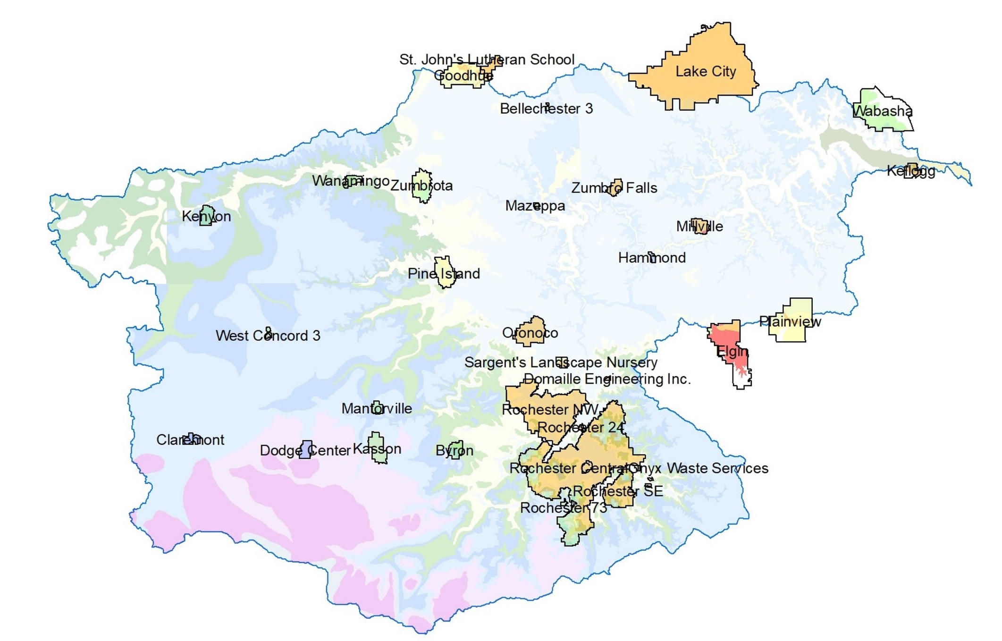
Drinking Water Quality in Areas Between DWSMAs not Currently Assessed
Notes:
DWSMAs within the Zumbro river watershed. Drinking water quality in areas between DWSMAs not currently assessed.

Slide 31
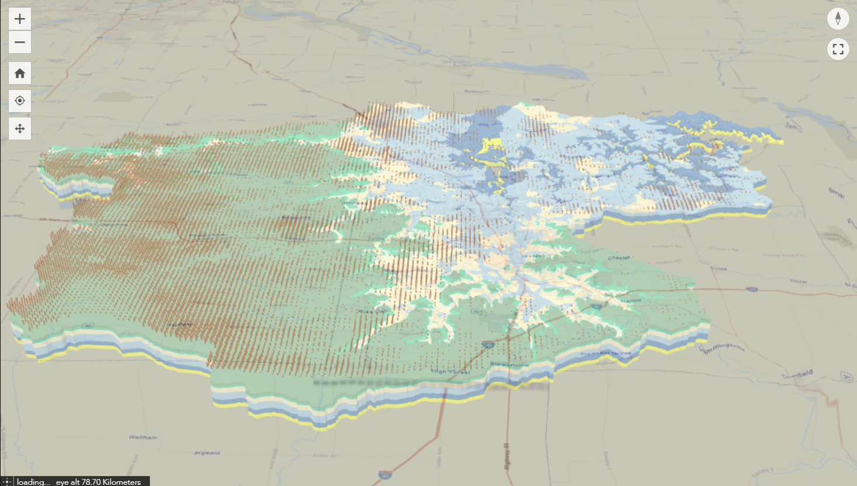
3-Dimensional Geologic Model of Unconsolidated and Bedrock Aquitards Helps Explain Watershed-Scale Differences in Drinking Water Quality
Notes:
Model components discussed earlier important to groundwater flow and impacting nitrate distribution: Brown dots show unconsolidated clay deposits above bedrock layers thickening to the west; green layer shows Decorah shale, separating upper aquifers (Galena Group and above) from lower aquifers (Prairie du Chien Group – blue, and Jordan Sandstone – yellow). Higher nitrates are present in upper aquifers where clay layer is thin, and in the Prairie du Chien and Jordan aquifers where Decorah Shale is absent.

Slide 32
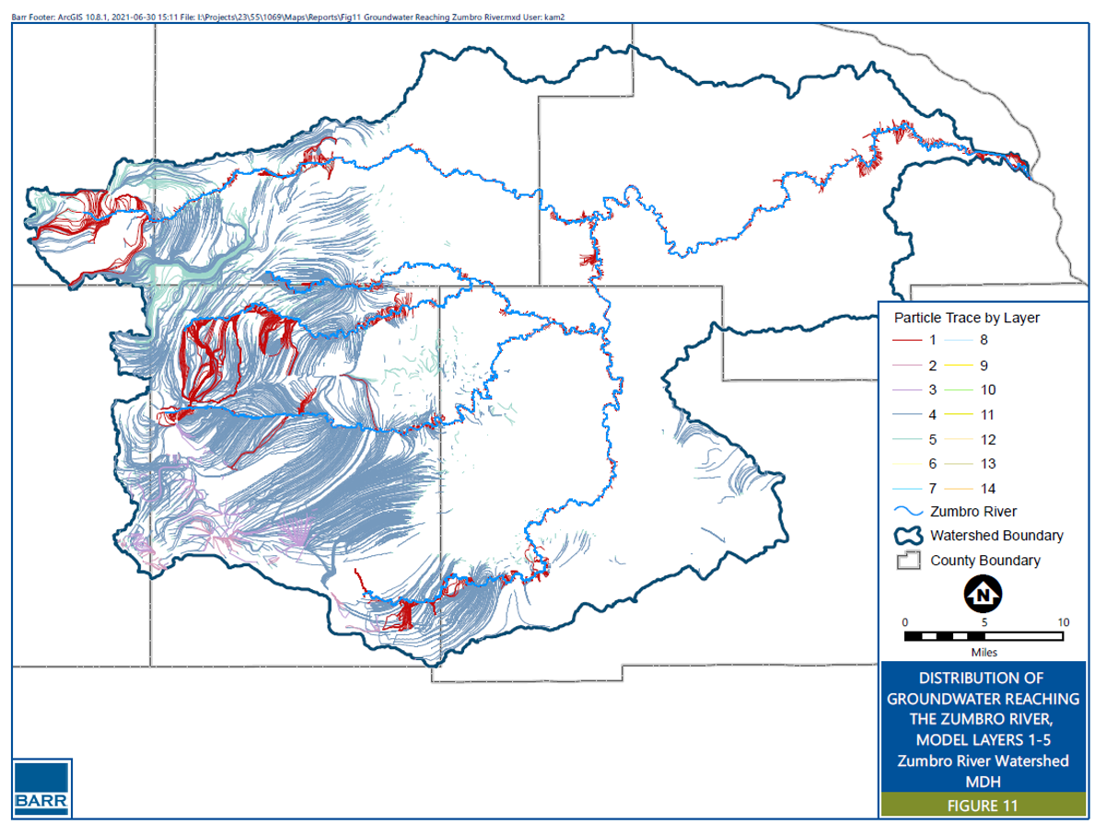
Uppermost Aquifers Have Hydrologic Boundaries that Most Closely Correspond to Watershed Boundaries
Notes:
Groundwater flow paths for uppermost aquifers in the Barr model, from landsurface to the Zumbro River branches. These uppermost aquifers have hydrologic boundaries that most closely correspond to watershed boundaries, providing better estimates of this groundwater component to overall watershed hydrologic budget.

Slide 33
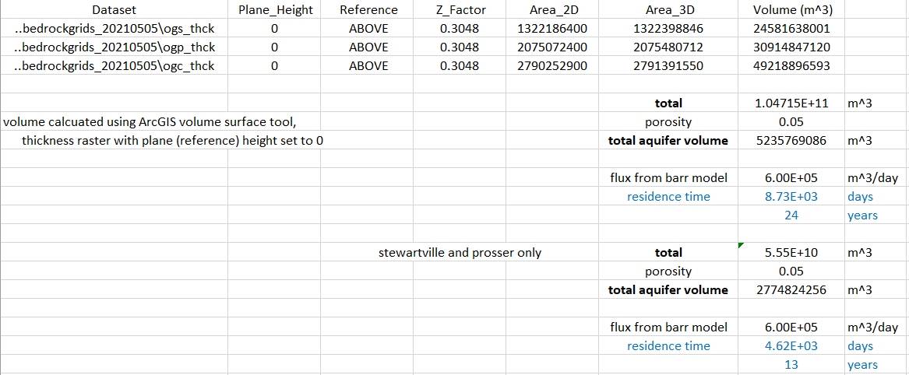

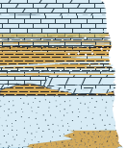

Slide 34
Apply these methods to uppermost aquifer systems
These are the aquifers whose maximum extent and/or hydraulic boundaries most likely corresponds to HUC-08 watershed boundaries
Reset our expectations on when we will see changes in water quality
.
Application of these tools highlights residence time differences in shallow versus deep aquifers
.
How will we know if this works?

Slide 35
Apply these methods to uppermost aquifer systems
These are the aquifers whose maximum extent and/or hydraulic boundaries most likely corresponds to HUC-08 watershed boundaries
.
.
How will we know if this works?

Slide 36
Apply these methods to uppermost aquifer systems
These are the aquifers whose maximum extent and/or hydraulic boundaries most likely correspond to HUC-08 watershed boundaries
.
.
How will we know if this works?

Slide 37
Apply these methods to uppermost aquifer systems
These are the aquifers whose maximum extent and/or hydraulic boundaries most likely corresponds to HUC-08 watershed boundaries
Reset our expectations on when we will see changes in water quality
Examples from today’s talks show that residence times in these aquifers are multi decadal at a minimum
How will we know if this works?

Slide 38
Apply these methods to uppermost aquifer systems
These are the aquifers whose maximum extent and/or hydraulic boundaries most likely corresponds to HUC-08 watershed boundaries
Reset our expectations on when we will see changes in water quality
Examples from today’s talks show that bulk residence times in these aquifers are several decades at a minimum
How will we know if this works?

Slide 39
Apply these methods to uppermost aquifer systems
These are the aquifers whose maximum extent and/or hydraulic boundaries most likely corresponds to HUC-08 watershed boundaries
Reset our expectations on when we will see changes in water quality
Examples from today’s talks show that bulk residence times in these aquifers are several decades at a minimum
Application of these tools highlights residence time differences in shallow versus deep aquifers
Not all groundwater, but the “front lines” of where we can sustainably manage groundwater quantity and quality over twenty-to-forty-year time scales.
How will we know if this works?

Slide 40
Apply these methods to uppermost aquifer systems
These are the aquifers whose maximum extent and/or hydraulic boundaries most likely corresponds to HUC-08 watershed boundaries
Reset our expectations on when we will see changes in water quality
Examples from today’s talks show that bulk residence times in these aquifers are several decades at a minimum
Application of these tools highlights residence time differences in shallow versus deep aquifers
Not all groundwater, but the “front lines” of where we can sustainably manage groundwater quantity and quality over twenty-to-forty-year time scales.
How will we know if this works?

Slide 41
MDH Mission – Protecting, maintaining and improving the health of all Minnesotans
Recognition that private well owners are not afforded the same protection as people on public water supplies. This applies to both human-sources contaminants, e.g. PFAS, and geogenic contaminants such as arsenic and manganese.
There is a time component to both water quantity and water quality
Where you are in the state matters
  aquifer and aquitard extent, competing water use and changing climate all uniquely impact individual watersheds
Why now?

Slide 42
Conclusions
Transition from Wellhead Protection to Source Water Protection
  What WHP and SWP have in common
    The goal of protecting drinking water sources
    MDH role is similar in each
  Drinking Water Ambient Monitoring Program (DWAMP)
    Contaminants of Emerging Concern – watershed-scale monitoring of uppermost vulnerable aquifers
    Not all groundwater, but provides sentinel monitoring of most recent recharge
  Groundwater Restoration and Protection Strategies (GRAPS)
Residence times extend our attention to aquifer scales, beyond a 10-year time of travel

Slide 43
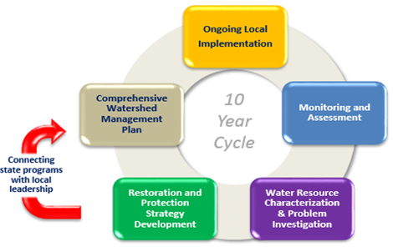
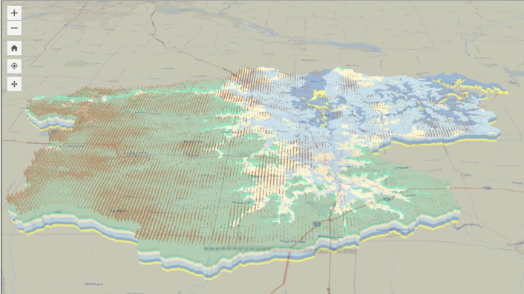
Questions?

Slide 44
3-Dimensional Geologic Model of Unconsolidated and Bedrock Aquitards Helps Explain Watershed-Scale Differences in Drinking Water Quality
Notes:
Model components discussed earlier important to groundwater flow and impacting nitrate distribution: Brown dots show unconsolidated clay deposits above bedrock layers thickening to the west; green layer shows Decorah shale, separating upper aquifers (Galena Group and above) from lower aquifers (Prairie du Chien Group – blue, and Jordan Sandstone – yellow). Higher nitrates are present in upper aquifers where clay layer is thin, and in the Prairie du Chien and Jordan aquifers where Decorah Shale is absent.

Slide 45
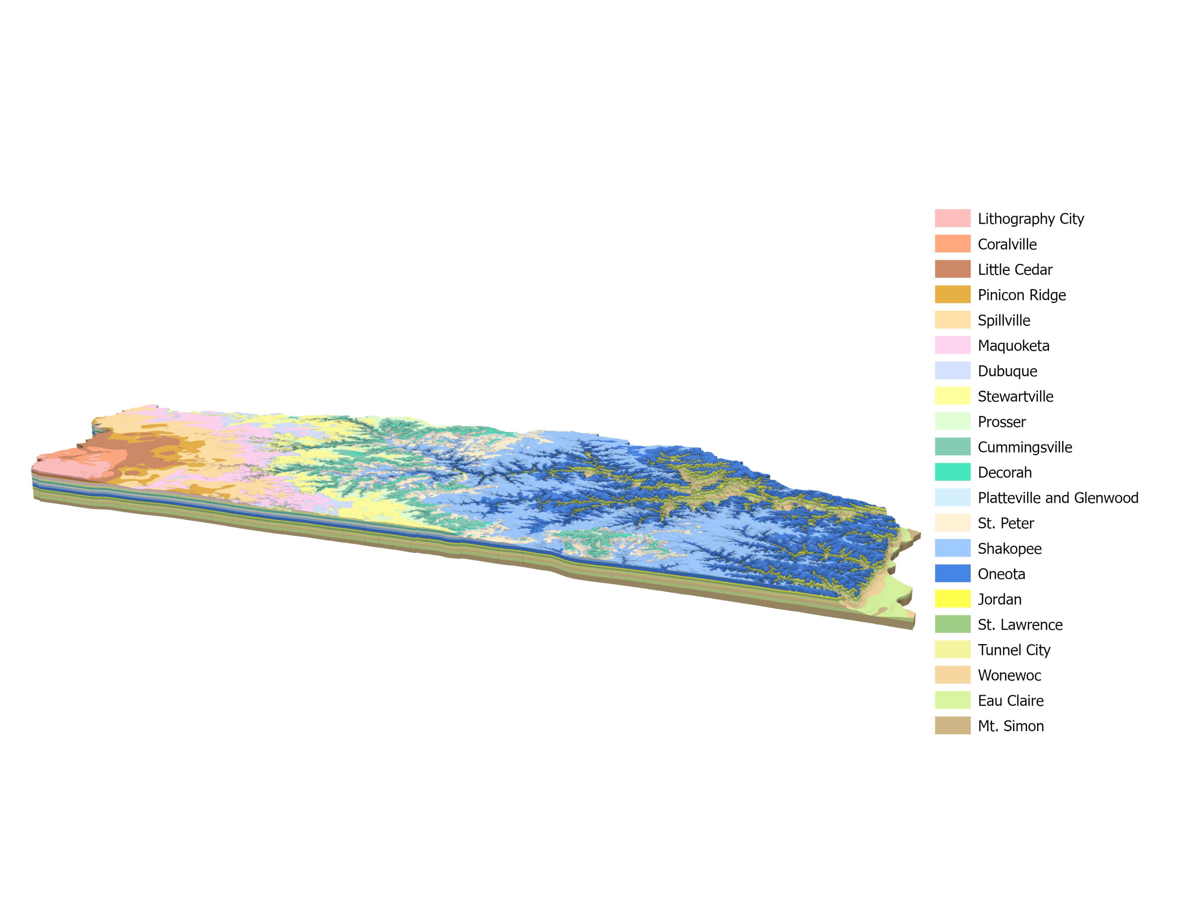

Slide 46
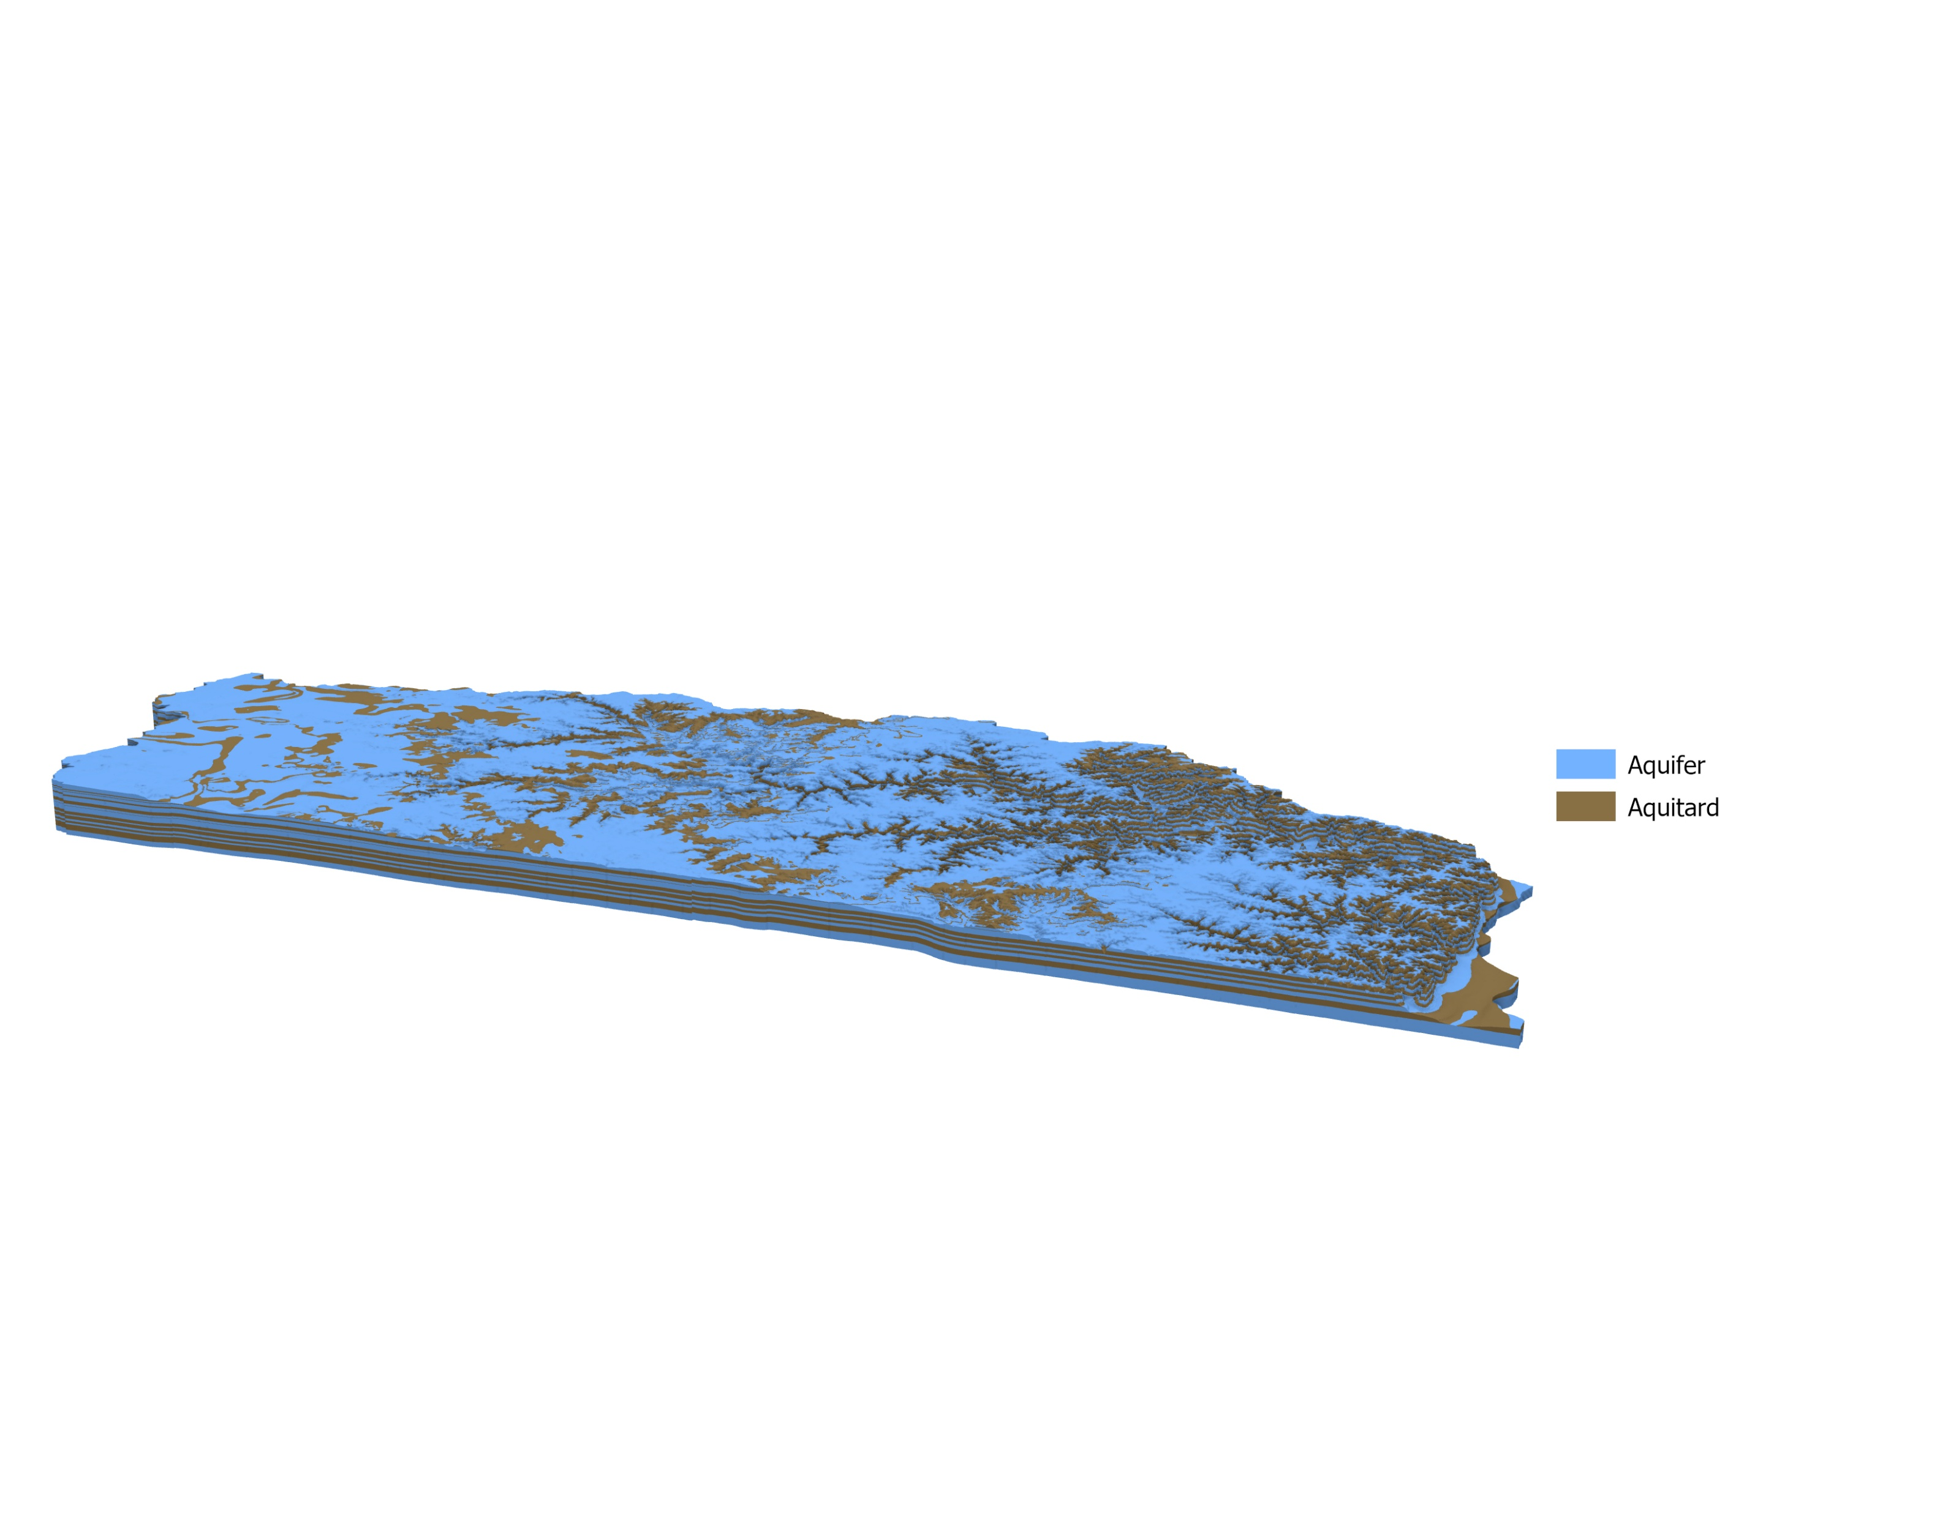

Slide 47
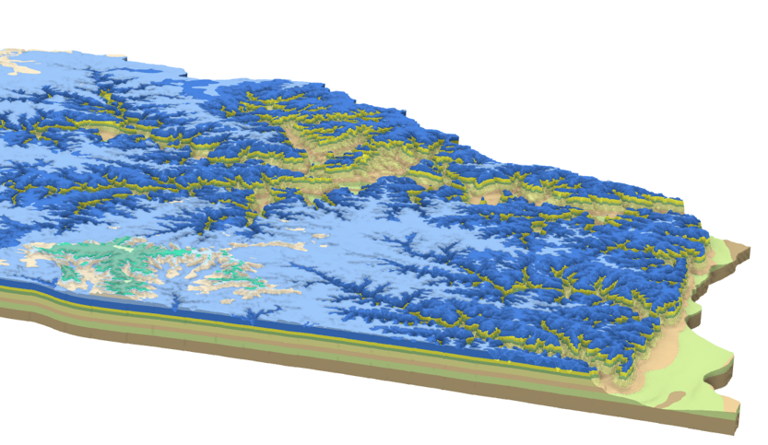

Slide 49
