Slide 1

How Scandals Have Shaped Ethics in the Minerals Industry
Dr. George J. Hudak, P.Geo., P.G.
Principal/economic geologist
George Hudak Geosciences P.L.L.C.
Duluth, mn

Slide 2
Outline
What is “ethics”?
The importance of ethic in the minerals industry and beyond – Profession codes of ethics
A brief review of some major scandals in the minerals industry, focusing on Bre-X
How have scandals in the minerals industry help shape current practices – regulatory responses
Are there still scandals in the minerals industry?
Some new and interesting ideas
Summary

Slide 3
What is Ethics?
A set of moral principles; a theory or system of moral values¹
The principles of conduct governing an individual or a group¹
A consciousness of moral importance¹
A guiding philosophy¹
A set of moral issues or aspects (such as rightness)¹
The discipline dealing with what is good and bad and with moral duty and obligation ¹
¹https://www.merriam-webster.com/dictionary/ethic

Slide 4
“Ethics” and “Morals”
Ethics
  “Rules of conduct in a particular culture or group recognized by an external source or social system”¹
  Refers to a social system and deals with what is right and what is wrong and promotes human welfare or “the good”²
  Implications: peer/societal pressure (e.g. lose job, lose license)²
Morals
  “Principles or habits relating to right or wrong conduct based on an individual’s own compass of right or wrong”¹
  Refers to one’s own beliefs in right or wrong conduct²
  Implications: personal and varied (e.g. remorse, uncomfortable, embarrassed)²
¹https://www.oxfordcollege.ac/news/ethics-versusmorals/#:~:text=Ethics%20%E2%80%93%20Rules%20of%20conduct%20in,compass%20of%20right%20and%20wrong.)
²(https://examnightslive.wordpress.com/2017/05/06/morals-values-and-ethics/
Notes:
Ethics are external, standardized codes of conduct enforced by groups or professionals (e.g. medical ethics), while morals are personal, internal beliefs regarding right or wrong.
Ethics are typically mandatory rules provided by society or institutions, wheareas morals are subjective, personal, and shaped by culture or religion.
Both are often used interchangeably to guide behavior, buth ethics represents societal rules and morals represents personal conscience.

Slide 5
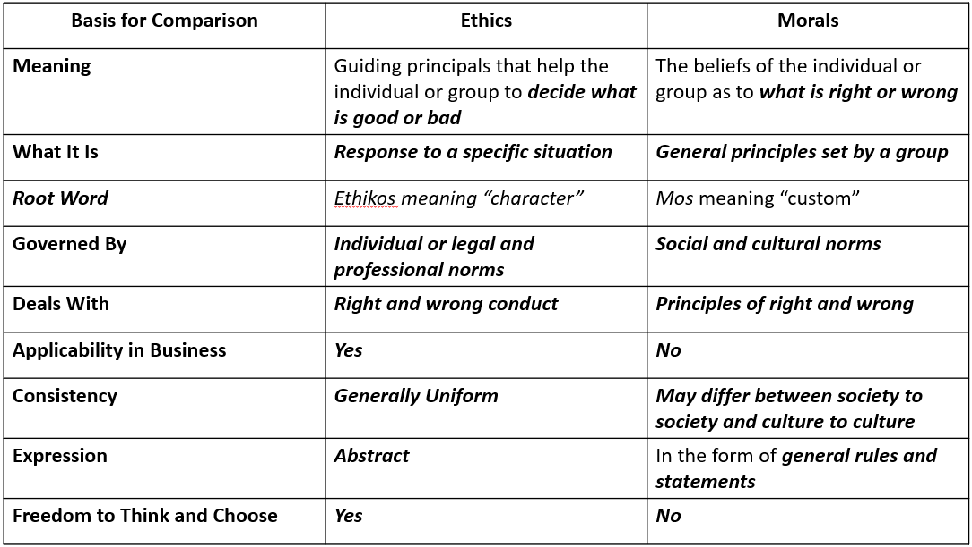
Comparing “Ethics” and “Morals”
(modified from Sivasubramaniam et al., 2021; Surbhi, 2015)

Slide 6
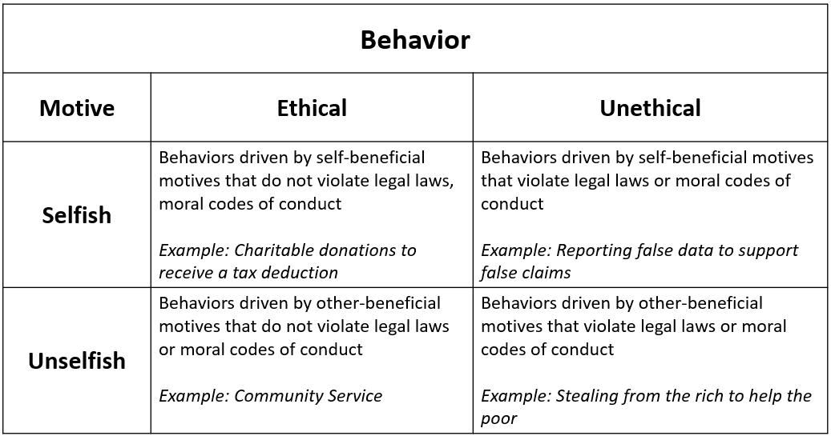
Distinguishing Between Ethical/Unethical and Selfish/Unselfish Behaviors
(modified from Lu et al., 2018)

Slide 7
Code of Ethics - NSPE
Fundamental Canons
Hold paramount the safety, health, and welfare of the public
Perform services only in areas of one’s competence
Issue public statements only in an objective and truthful manner
Act for each employer and client as faithful agents or trustees
Avoid deceptive acts
Conduct oneself honorably, responsibly, ethically, and lawfully so as to enhance the honor, reputation, and usefulness of the profession
(https://www.nspe.org/sites/default/files/resources/pdfs/Ethics/CodeofEthics/NSPECodeofEthicsforEngineers.pdf)

Slide 8
Code of Ethics - NSPE
Rules of Practice
Engineers shall hold paramount the safety, health and welfare of the public
Engineers shall perform services only in the areas of their competence
Engineers shall issue public statements only in an objective and truthful manner
Engineers shall act for each employer or client as faithful agents and trustees
Engineers shall avoid deceptive acts
(https://www.nspe.org/sites/default/files/resources/pdfs/Ethics/CodeofEthics/NSPECodeofEthicsforEngineers.pdf)

Slide 9
Code of Ethics - NSPE
Professional Obligations
Engineers shall be guided in all their relations by the highest standards of honor and integrity
Engineers shall at all time strive to serve the public interest
Engineers shall avoid all conduct or practice that deceives the public
Engineers shall not disclose, without consent, confidential information concerning the business affairs or technical processes of any present or former client or employer, or public body on which they serve
Engineers shall not be influenced in their professional duties by conflicting interests
(https://www.nspe.org/sites/default/files/resources/pdfs/Ethics/CodeofEthics/NSPECodeofEthicsforEngineers.pdf)

Slide 10
Code of Ethics - NSPE
Professional Obligations (continued)
Engineers shall not attempt to obtain employment or advancement or professional engagements by untruthfully criticizing other engineers, or by other improper or questionable methods
Engineers shall not attempt to injure, maliciously or falsely, directly or indirectly, the professional reputation, prospects, practice, or employment of other engineers. Engineers who believe others are guilty of unethical or illegal practices shall present such information to the proper authority for action.
(https://www.nspe.org/sites/default/files/resources/pdfs/Ethics/CodeofEthics/NSPECodeofEthicsforEngineers.pdf)

Slide 11
Code of Ethics - NSPE
Professional Obligations (continued)
Engineers shall accept personal responsibility for their professional activities, provided, however, that engineers may seek indemnification for services arising out of their practice for other than gross negligence, where the engineer’s interest cannot otherwise be protected
Engineers shall give credit for engineering work to those whom credit is due, and will recognize the proprietary interests of others
For Minnesota AELSLAGID licensed professionals, see Minnesota Rules Chapter 1805, Rules of Professional Conduct
(https://www.nspe.org/sites/default/files/resources/pdfs/Ethics/CodeofEthics/NSPECodeofEthicsforEngineers.pdf)
(https://www.revisor.mn.gov/rules/1805/full)

Slide 12
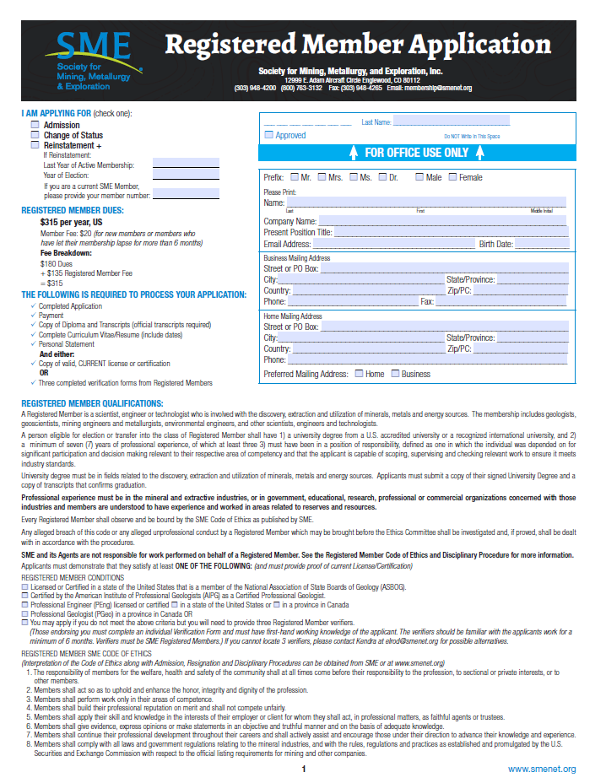
Code of Ethics - SME
REGISTERED MEMBER SME CODE OF ETHICS
(Interpretation of the Code of Ethics along with Admission, Resignation, and Disciplinary Procedures can be obtained from SME or at www.smenet.org)
The responsibility of members for the welfare, health and safety of the community shall at all times come before their responsibility to the profession, to sectional or private interests, or to other members.
Members shall act so as to uphold and enhance the honor, integrity, and dignity of the profession
Members shall work only in their areas of competence
Members shall build their professional reputation on merit and shall not compete unfairly
Members shall apply their skill and knowledge in the interests of their employer or client for whom they shall act, in professional matters, as faithful agents or trustees
Members shall give evidence, express opinions or make statements in an objective and truthful manner and on the basis of adequate knowledge
Members shall continue their professional development throughout their careers and shall actively assist and encourage those under their direction to advance their knowledge and experience
Members shall comply with all laws and government regulations relating to the mineral industries, and with the rules, regulations and practices established and promulgated by the U. S. Securities and Exchange Commission with respect to the official listing requirements for mining and other companies.
(https://www.smenet.org)

Slide 13
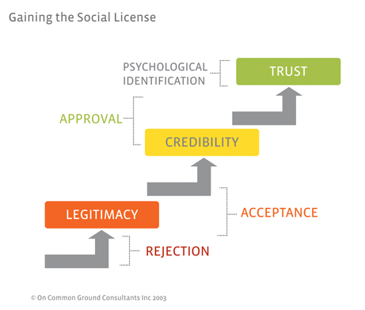
The Social License
The “Social License to Operate” refers to the level of acceptance or approval by local communities and stakeholders of organizations and their operations.
(https://learningforsustainability.net/social-license; Moffat et al., 2016)
(https://www.socialicense.com)

Slide 14
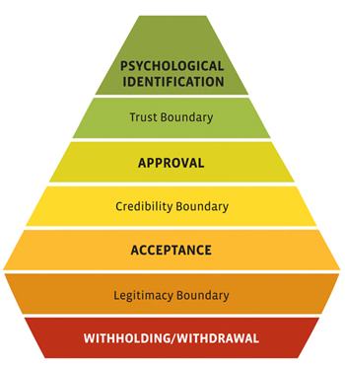
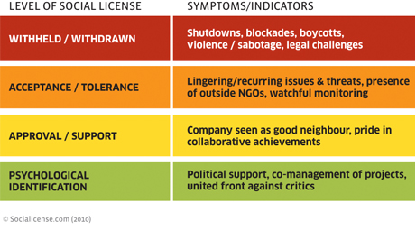
The Social License
(https://www.socialicense.com)

Slide 15
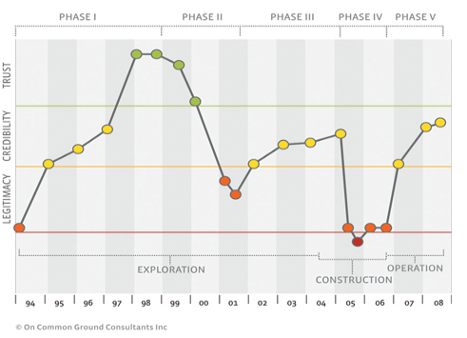
The Social License
The evolution of the Social License may take many twists and turns
(Example from San Cristobal Zn-Pb-Ag Mine, Bolivia)
(https://www.socialicense.com)

Slide 16
Historic Mining Scandals
Scandals in the “minerals industry” have likely taken place ever since humankind realized they could obtain wealth via mineral extraction and production
Scandals have been varied – fraud seems to be the most common
Scandals have led mining to have a bad reputation
“A mine is a hole in the ground. The discoverer of it is a natural liar. The hole in the ground and the liar combine and issue shares and trap fools.”
Detroit Free Press, 1881¹
¹https://quoteinvestigator.com/2015/07/19/gold-mine/#:~:text=You%20have%20heard%20Mark%20Twain's,(Laughter.)&text=The%20old%20adage%20that%20a,remarkably%20large%20proportion%20of%20cases.

Slide 17
Historic Mining Scandals
Why do scandals work?
  The personality of the scammer – they gain investors trust (recall “Social License”)
  Greed
  Optimism
  Investors lack of knowledge of the complexity of the industry
“The problem with future cash flows is that humans are very confident yet extremely poor when it comes to forecasting.” ¹
“Mining is an unpopular industry and it is unpopular for very valid reasons. Management teams have collectively earned their reputations as destroyers of capital. Geopolitical risk is rising, costs are rising, and remaining reserves often now reside in politically unfriendly locals. The chemistry, engineering, and geology have become increasingly complex.” ¹
¹ https://www.forbes.com/sites/daveiben/2020/10/05/was-mark-twain-right-about-miners/?sh=27a123aa206e
Notes:
Google “Arizona Geological Survey – Mining Scams”
Arizona Geological Survey: Investors need to be aware of many factors, including
Title
Sampling and Assaying Methods
What is/are the commodity/commodities
What will the mining method be?
Where is the mill site? When is the mill site being built?
What is the design of the recovery process? Proprietary and black box methods should be questioned.
Permitting and Reports – Permits needed from many entities; interal reports need to be timely, accurate and factual
Security and safety: During development, During Operation (including transportation), Post Operation
Marketing: Review marketing of mine, mill products, credits for by-products,
Profit Distribution: liens, ownership royalties, loan payments, rental fees, operating expenses; cash? Stock? In-kind payments?
Taxes: Be aware of accelerated tax write-offs
Sequence of development: Evaluate the completion of phases…do they make sense (processing plant before ore?)
Professional Evaluation – Utilize engineering reports (professional engineers, geologists, mining engineers, metallurgists) – independent reports from those with no financial ties

Slide 18
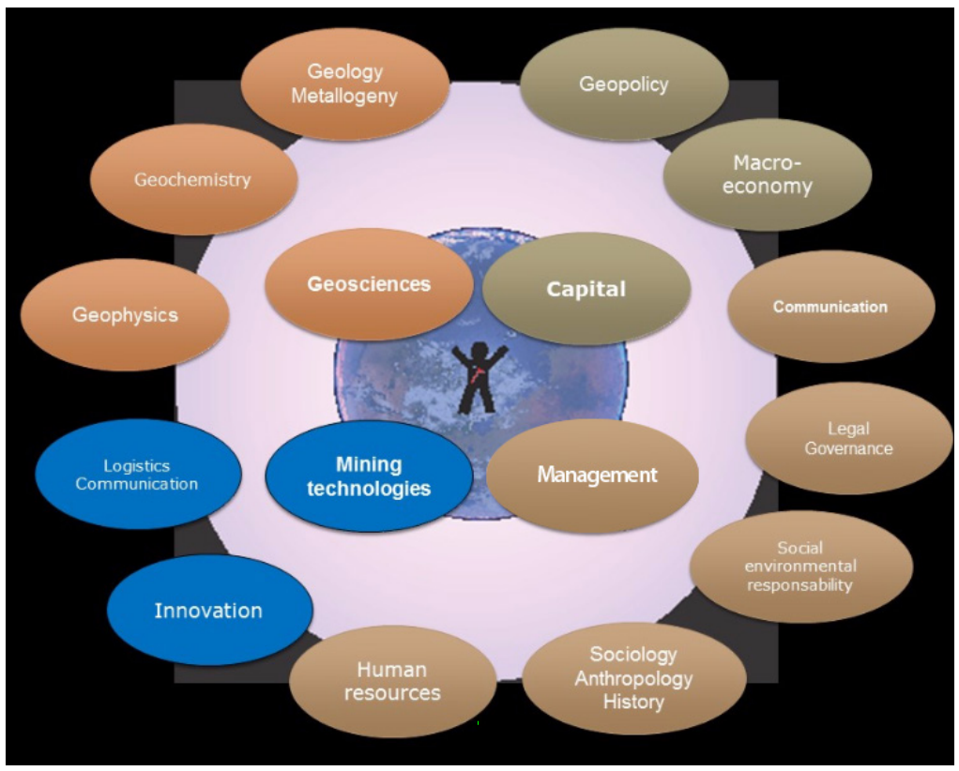
Complexity in Minerals Development
Some things to consider….
Notes:
Google “Arizona Geological Survey – Mining Scams”
Arizona Geological Survey: Investors need to be aware of many factors, including
Title
Sampling and Assaying Methods
What is/are the commodity/commodities
What will the mining method be?
Where is the mill site? When is the mill site being built?
What is the design of the recovery process? Proprietary and black box methods should be questioned.
Permitting and Reports – Permits needed from many entities; interal reports need to be timely, accurate and factual
Security and safety: During development, During Operation (including transportation), Post Operation
Marketing: Review marketing of mine, mill products, credits for by-products,
Profit Distribution: liens, ownership royalties, loan payments, rental fees, operating expenses; cash? Stock? In-kind payments?
Taxes: Be aware of accelerated tax write-offs
Sequence of development: Evaluate the completion of phases…do they make sense (processing plant before ore?)
Professional Evaluation – Utilize engineering reports (professional engineers, geologists, mining engineers, metallurgists) – independent reports from those with no financial ties

Slide 19
The Bre-X Scandal (1993 - 2003)
The largest minerals industry-related scam in history
Related to a purported gold discovery in Bornio (Indonesia)
Between 1993 and 1994, company indicated gold reserves of approximately 8 million ounces – by 1997 analysts claimed the discovery had reserves of 200 million ounces
By 1997, Bre-X penny stock rose to a value of $209US/share and had a market cap of ~$4.4 billion US¹
Fraud was exposed in 1997 – Indonesian and American miners failed to find gold independently – it was later found that previously processed gold was “salted” into the assay samples
Bre-X shares crashed – it is estimated that investors around the globe lost ~$3.3 billion US²
¹https://www.mining-technology.com/features/mining-scandals-four-incidents-that-shook-the-industry/
²https://www.cbc.ca/new/Canada/Calgary/bre-x-court-battles-come-to-an-end-1.1320776

Slide 20
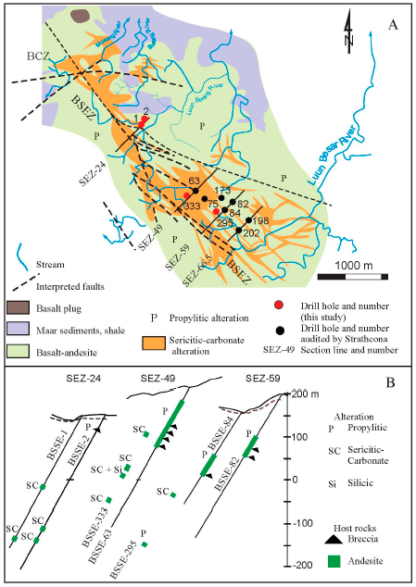
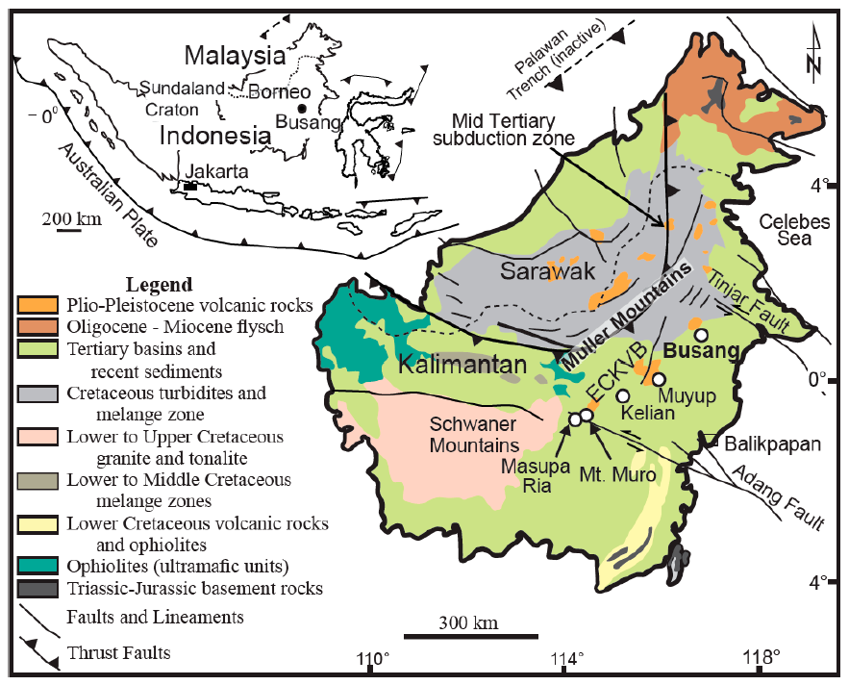
The Bre-X Scandal
(from Slater et al., 2020)
Notes:
Propylitic alteration is a low-temperature (<200°C to ~350°C), hydrothermal process affecting volcanic and plutonic rocks, characterized by the greenish mineral assemblage of chlorite, epidote, calcite, and albite. It often represents the distal, outermost zone of porphyry copper-gold deposits, serving as a "halo" or guide for mineral exploration.

Slide 21
The Bre-X Scandal – An Abbreviated Timeline^{1,2}
1989: David Walsh founds Bre-X Minerals Ltd.
1993: Walsh buys property near Busang River in Borneo
1994: Initial drilling results are encouraging – however, it is much later found that Project Manager Michael de Guzman is filing gold from his wedding ring into the assay samples – the assay results look realistic for a new discovery
1994 – 1996: de Guzman buys $61K US in panned gold from locals to continue his salting exercise
1994 – 1996: Bre-X stock thrives, going from $0.30US to $209US per share
1992
May contain
2M oz
1993
Contains
8M oz
1995
Contains
10M Oz
1995
May Contain
30M oz
1996
Contains
60M Oz
1997
Contains
70M oz
1997
May Contain
200M oz
¹https://www.mining.com/web/bre-x-scandal-a-history-timeline
²https://www.visualcapitalist.com/bre-x-scandal-history-timeline/
Notes:
Peak valuation of Bre-X in 1997 = $4.4 billion US

Slide 22
The Bre-X Scandal – An Abbreviated Timeline^{1,2}
1996: Bre-X exploration permits are revoked by the Indonesian Government
1997: Sample records are destroyed at a fire at the Busang prospect
1997: Joint venture reached – Indonesian Government (40%), Bre-X (45%), Freeport-McMoRan (15%)
1997: Freeport conducts due diligence drilling – “minor amounts of gold” are found
1997: de Guzman “falls to his death” from a helicopter – ruled a suicide
1997: Shares of Bre-X crash in March to below $10US/share ($21US to $1.96 in one day)
1997: Independent report confirms lack of gold at Busang prospect
1997-2003: Investor lawsuits (Ontario Municipal Employees Retirement Board ($45M CAN); Quebec Public Sector Pension Fund ($70M CAN); Ontario Teachers Pension Fund ($100M CAN))
2003: Bre-X court battle ends – investors agree to compensation of $5.2M CAN
¹https://www.mining.com/web/bre-x-scandal-a-history-timeline ²https://www.visualcapitalist.com/bre-x-scandal-history-timeline/
³https://www.cbc.ca/news/Canada/Calgary/bre-x-court-battles-come-to-an-end-1.1320776

Slide 23
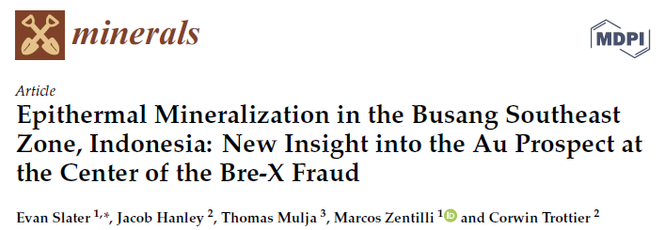
The Bre-X Scandal
(DOI:10.3390/min10080698)
Slater et al. (2020) conclusions:
  Busang SE Zone contains many characteristics common to epithermal deposits occurring in the Kalimantan Gold Belt
  The presence of pyrite, sphalerite, chalcopyrite, galena, and copper-bearing sulfosalt minerals reflects derivation from an intermediate sulfidation epithermal system; however:
    The zone does not contain vein textures indicative of efficient boiling or fluid mixing that would effectively precipitate gold from the hydrothermal system
    Fluid inclusions from minerals in the zone also lack evidence indicative of efficient boiling or fluid mixing that would effectively precipitate gold from the hydrothermal system
  Key ore-forming processes were entirely absent in the area
  The current geological interpretation is that the region comprises poorly-developed zones of base metal mineralization that commonly occurs below a potential precious metal-bearing horizon (now eroded?)

Slide 24
Where did Bre-X Fail Ethically?
REGISTERED MEMBER SME CODE OF ETHICS
(Interpretation of the Code of Ethics along with Admission, Resignation, and Disciplinary Procedures can be obtained from SME or at www.smenet.org)
The responsibility of members for the welfare, health and safety of the community shall at all times come before their responsibility to the profession, to sectional or private interests, or to other members.
Members shall act so as to uphold and enhance the honor, integrity, and dignity of the profession
Members shall work only in their areas of competence
Members shall build their professional reputation on merit and shall not compete unfairly
Members shall apply their skill and knowledge in the interests of their employer or client for whom they shall act, in professional matters, as faithful agents or trustees
Members shall give evidence, express opinions or make statements in an objective and truthful manner and on the basis of adequate knowledge
Members shall continue their professional development throughout their careers and shall actively assist and encourage those under their direction to advance their knowledge and experience
Members shall comply with all laws and government regulations relating to the mineral industries, and with the rules, regulations and practices established and promulgated by the U. S. Securities and Exchange Commission with respect to the official listing requirements for mining and other companies.

Slide 25
The Bre-X Scandal
“If someone is simply lying, in a huge and stupendous fashion, as appears to be the case with Bre-X, all the disclosure rules in the world will not protect either the gullible investor or, it seems, even the most sophisticated one”
Quote from former Toronto Stock Exchange President Rowland W. Fleming, 1997 as reported by Howard Schneider, Washington Post, Sunday, May 18, 1997, p. H01

Slide 26


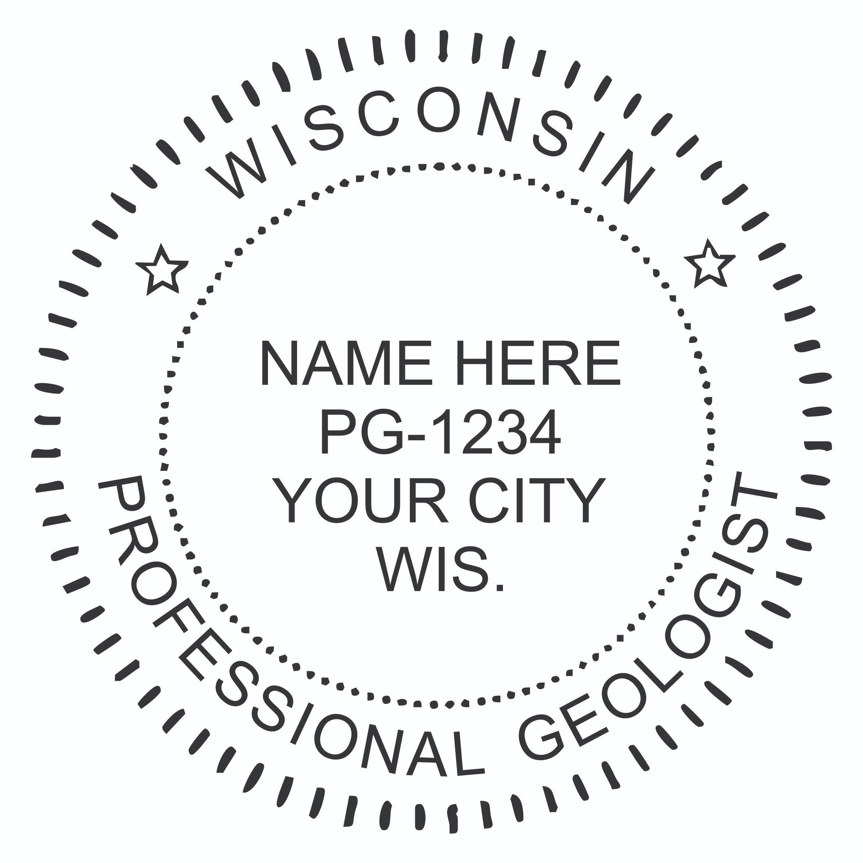
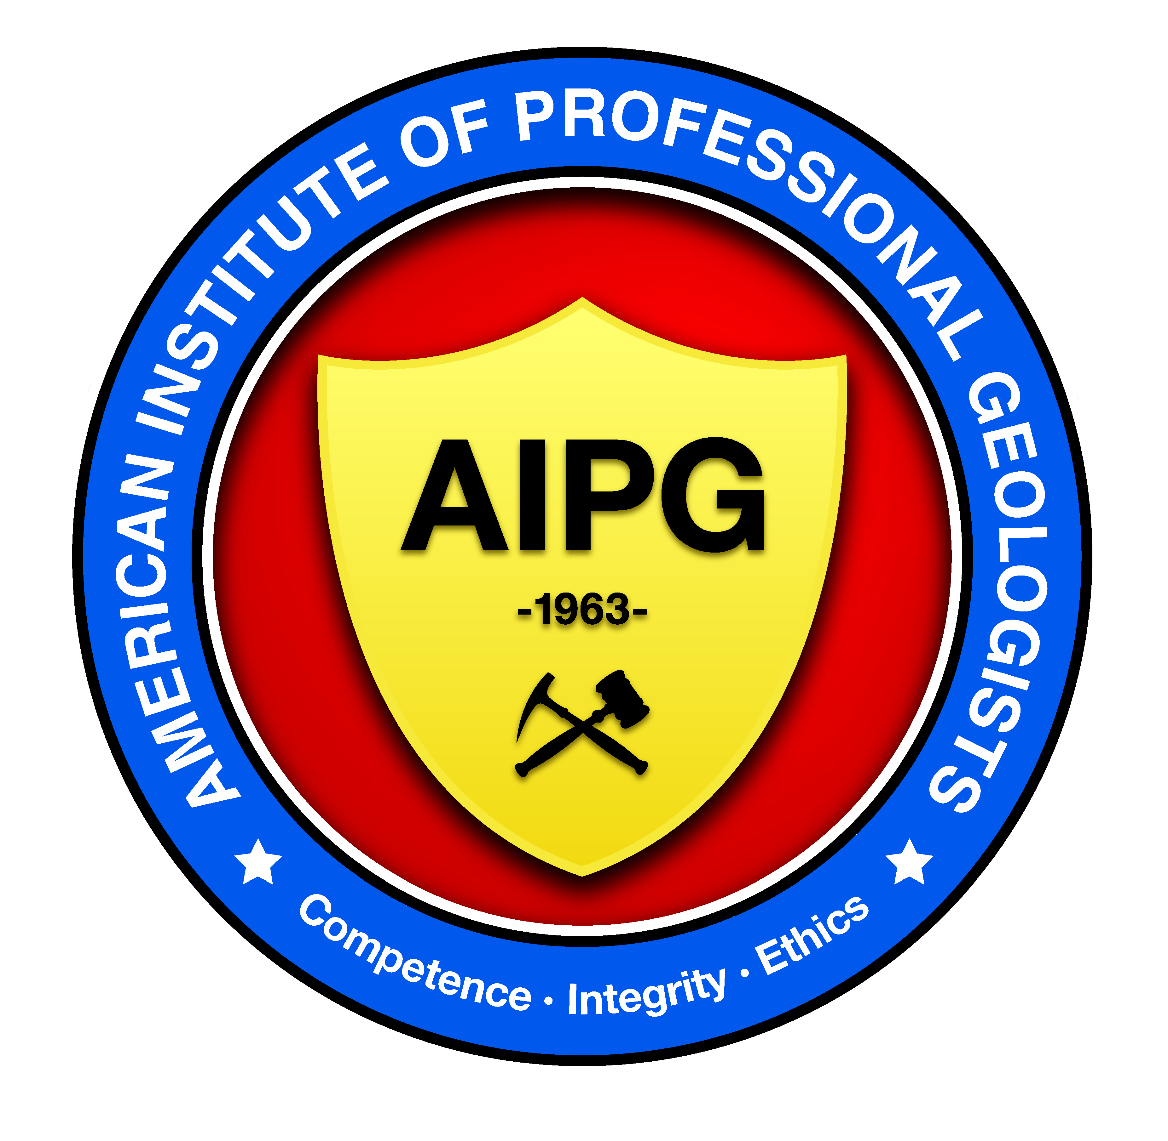
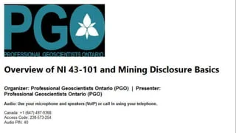
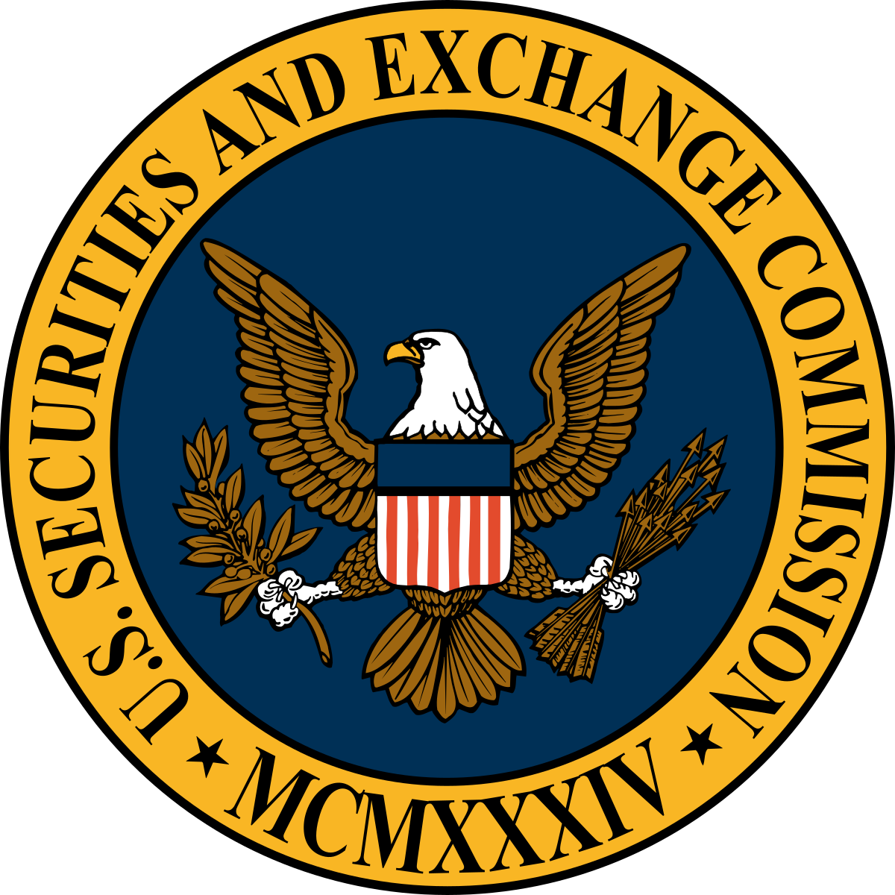

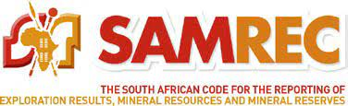
Regulatory Advances
Licensure for Professional Geologists/Engineers
  Professional Geologist (P.G.) in many states (Minnesota, Wisconsin)
  Professional Geoscientist in Canada (PGEO)
  American Institute of Professional Geologists Certified Professional Geologist (CPG)
Public Reporting of Exploration Data
  Canada – NI 43-101
  Australia – JORC
  South Africa – SAMREC
  U.S. Security and Exchange Commission 17 CFR Parts 229, 230, 239, and 249
Notes:
The need for transparency and accountability within the mining industry led to the development of many national mineral resource reporting standards. According to Camisi-Calzolari (2004) “it is essential that financial institution and investors be properly advised on mining projects by reporting mineral project information in a transparent and responsible way with the relevant public disclosures being compiled by professionals that take full responsibility for their submissions”. One of the results of the Bre-X scandal was to strengthen securities regulations related to the disclosure of information associated with minerals-related projects. National Instrument 43-101 was the result. A wide variety of international standards are now in place that regulate.
SEC Rule (adopted January 1, 2021) are 406 pages long.
The SEC Rules ARE NOT identical to NI 43-101. While the SEC’s new rules are intended to be substantially similar to those of other CRIRSCO-based codes, they are not identical to any single CRIRSCO-based code. Some differences relate to terminology. For example, the SEC’s new rules use the term “technical report summary” instead of NI 43-101’s “technical report”, and the term “initial assessment” instead of NI 43-101’s “preliminary economic assessment”. Other differences relate to substantive requirements, and are in some cases subtle. SEC registrants that are subject to other CRIRSCO-based codes should compare such codes to the SEC’s new rules and determine whether the differences have any material implications for the registrant. (https://www.dorsey.com/newsresources/publications/client-alerts/2019/02/new-mining-disclosure-rules-2019#Instrument).

Slide 27

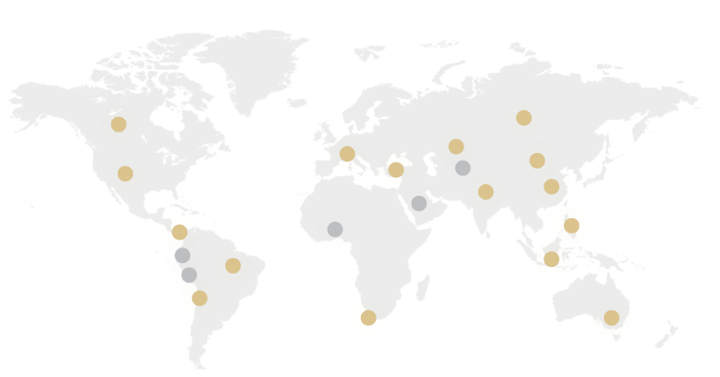
International Reporting Standards
The aim of CRIRSCO (Committee for Mineral Reserves International Reporting Standards) is to contribute to earning and maintaining that trust by promoting high standards of reporting of mineral deposit estimates (Mineral Resources and Mineral Reserves) and of exploration.
16 members including Australasia, Brazil, Canada, Chile, China, Columbia, Europe, India, Indonesia, Kazakhstan, Mongolia, Phillippines, Russia, South Africa, Turkey and the United States
(https://crirsco.com/)

Slide 28
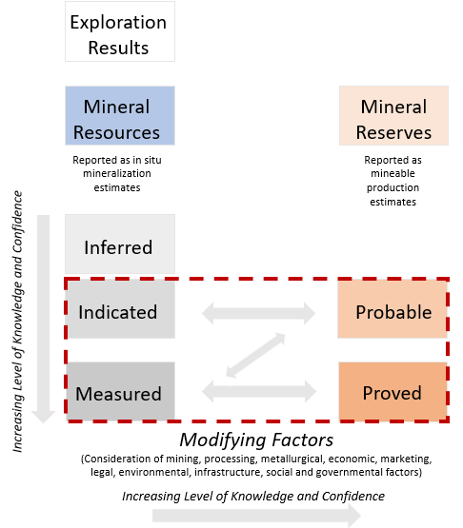
International Reporting Standards
The general relationships between Exploration Results, Mineral Resources, and Mineral Reserves.
These relationships are similar amongst the several regulatory standards and follow the standard definition of mineral resources and mineral reserves developed by CRIRSCO
(CRIRSCO, 2024)
Notes:
Modifying Factors are considerations used to assess and estimate Exploration Targets, Mineral Resources and/or Mineral Reserves. These include, but are not limited to, mining, processing, metallurgical, infrastructure, economic, marketing, legal, environmental, social and governance (ESG) and regulatory factors.

Slide 29
Why Reporting Standards?
Gives minimum standards for the reporting of exploration results, mineral resources, and mineral reserves
Increases the credibility to claims made by promoters, and allows comparisons based on standards
Provides guidance to professionals
Assists the Competent Person to show the legitimacy of the declaration and provides credibility to the report
Promotes high reporting standards
Maintains trust of investors and other interested parties
(modified from Lomberg and Rupprect (samcode.co/za/samcode-ssc/samrec))

Slide 30
CRIRSCO Template
Table 1: Check List of Assessment and Reporting Criteria
Table 2: Guidelines for Technical Studies
Section 1: Project Outline
Section 2: Geologic Setting, Deposit, Mineralization
Section 3: Exploration and Drilling, Sampling Techniques and Data
Section 4: Estimation and Reporting of Exploration Results and Mineral
Resources and Mineral Reserves
Section 5: Technical Studies
Section 6: Estimation and Reporting of Mineral Reserves
Section 7: Audits and Reviews
Section 8: Other Relevant Information
Section 9: Competent Person
(https://crirsco.com/wp-content/uploads/woocommerce_uploads/2024/06/CRIRSCO_International_Reporting_Template_June2024_Update_Approved_for_Release_20240627-dl8515.pdf)

Slide 31
CRIRSCO Template (continued)
APPENDIX 1 – GENERIC TERMS AND EQUIVALENTS
APPENDIX 2 – CERTIFICATE OF COMPETENT PERSON
APPENDIX 3 – REPORTING OF MINERALISED FILL, PILLARS, LOW GRADE MINERALIZATION, STOCKPILES, DUMPS AND TAILINGS
APPENDIX 4 – REPORTING OF COAL EXPLORATION RESULTS, RESOURCES AND RESERVES
APPENDIX 5 – REPORTING OF DIAMOND AND OTHER GEMSTONE EXPLORATION RESULTS, MINERAL RESOURCES AND MINERAL RESERVES
APPENDIX 6 – REPORTING OF EXPLORATION RESULTS, MINERAL RESOURCES AND MINERAL RESERVES FOR INDUSTRIAL MINERALS, CEMENT FEED MATERIALS AND CONSTRUCTION RAW MATERIALS
APPENDIX 7 – REPORTING OF EXPLORATION RESULTS, MINERAL RESOURCES AND MINERAL RESERVES FOR DIMENSION STONE, ORNAMENTAL AND DECORATIVE STONE
(https://crirsco.com/wp-content/uploads/woocommerce_uploads/2024/06/CRIRSCO_International_Reporting_Template_June2024_Update_Approved_for_Release_20240627-dl8515.pdf)

Slide 32
Recent Minerals Industry Scandals
Today (early 2026), major mining issues revolve around environmental failures, illegal mining expansion, deep-sea mining disputes, toxic waste failures at nickel mines, organized crime financing in the minerals industry, and contract breaches by deep sea mining companies.
Deadly Indonesian Nickel Waste System Failures: A 2026 landslide in Indonesia's Morowali nickel hub has highlighted severe risks in "dry stack" waste systems, with critics calling for a halt to new, improperly managed tailings facilities.
Peru Illegal Mining Expansion: Illegal gold mining has expanded from the Amazon into new regions of Peru, such as Loreto and Ucayali, resulting in widespread environmental damage, toxic mercury use, and violence.
Deep-Sea Mining Violations: Greenpeace and regulatory observers have raised alarms about potential breaches of exploration contracts by deep-sea mining companies (e.g., The Metals Company), pressuring the International Seabed Authority to act against premature exploitation.
B2Gold Operational and Management Issues: B2Gold is facing criticism for slow, over-budget, and delayed operations at its Goose mine, alongside tax disputes in Mali and CEO changes.
Rise of Organized Crime (OCG): Control Risks lists the involvement of organized crime groups (OCGs) in mining as a major global risk for 2026, leading to increased violence, extortion, and security threats to personnel.
US Critical Mineral Vulnerability: Experts are warning that the US is lagging in the, "critical minerals race" due to a lack of skilled personnel and poor processing capacity, risking the success of national security goals in the mining sector.
(goggle search April 19, 2026 - “2026 Mining Scandals”)
Notes:
https://africa.businessinsider.com/search?q=scandal

Slide 33
Recent Minerals Industry Scandals
AGO names Ombudsman Chief suspect in mining bribery scandal
(April 16, 2026)
Chinese mining giant accused of poisoning Congo in toxic mine scandal linked to BMW, Mercedes, Peugeot, and VW
(March 16, 2026)
Jakarta (ANTARA) - The Indonesian Attorney General’s Office has named Hery Susanto, the Chairman of the National Ombudsman for the 2026–2031 term, as a suspect in a corruption case involving nickel mining governance between 2013 and 2025.
Director of Investigation for the Assistant Attorney General for Extraordinary Crimes, Syarief Sulaeman Nahdi, said on Thursday that the alleged crimes occurred while Susanto was serving as an Ombudsman Commissioner during his previous 2021–2026 term.
Prosecutors allege that Susanto accepted bribes from a private firm, PT TSHI, in exchange for manipulating non-tax state revenue (PNBP) calculations to benefit the company.
The report, titled Toxic Transition, alleges that a large-scale cobalt operation in southern Democratic Republic of Congo is exposing nearby communities to hazardous emissions, resulting in illness and displacement.
The Tenke Fungurume mine, owned by China’s CMOC Group, is among the world’s leading sources of cobalt, a key mineral used in lithium-ion batteries for electric vehicles, smartphones and renewable energy storage.
According to environmental watchdogs, operations at the site are contaminating surrounding areas and displacing thousands, even as its output feeds into global supply chains linked to some of the world’s largest carmakers.
(https://en.antaranews.com/news/412564/ago-names-ombudsman-chief-suspect-in-mining-bribery-scandal)
(https://africa.businessinsider.com/search?q=scandal)
Notes:
https://africa.businessinsider.com/search?q=scandal

Slide 34
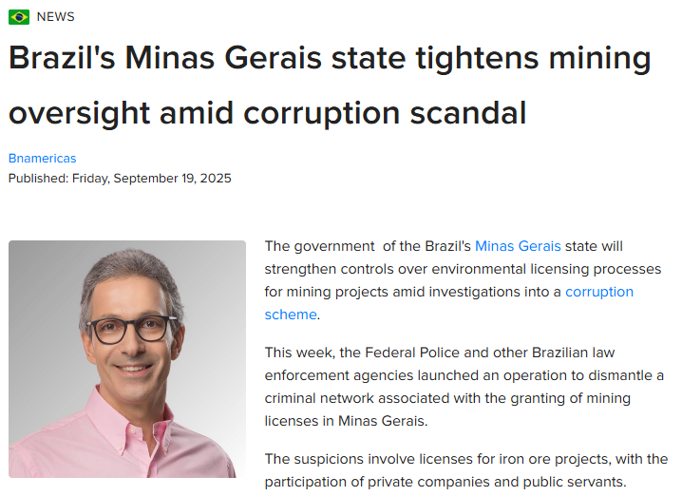
Recent Minerals Industry Scandals
(https://www.bnamericas.com/en/news/brazils-minas-gerais-state-tightens-mining-oversight-amid-corruption-scandal)

Slide 35
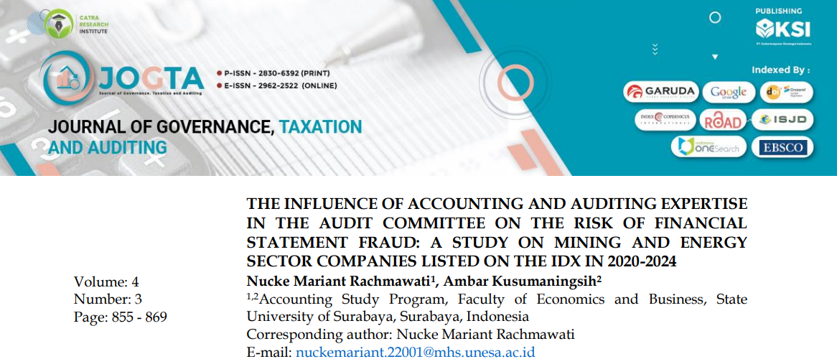
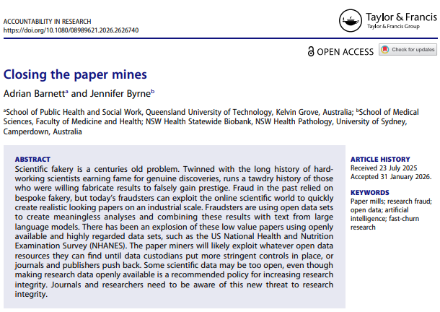
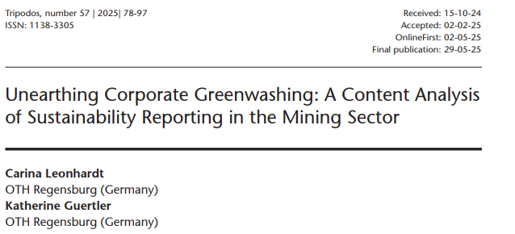
Recent Journal Publications – Ethical Improprieties
Financial Fraud
Incomplete/Dishonest Reporting
Scientific
Research Fraud
Notes:
Financial Fraud, Incomplete or Dishonest Reporting, Scientific Research Fraud

Slide 36
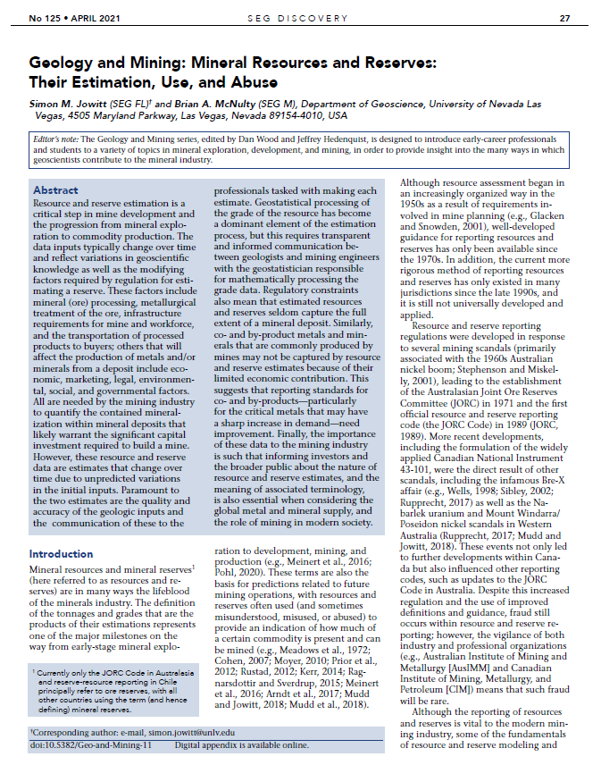
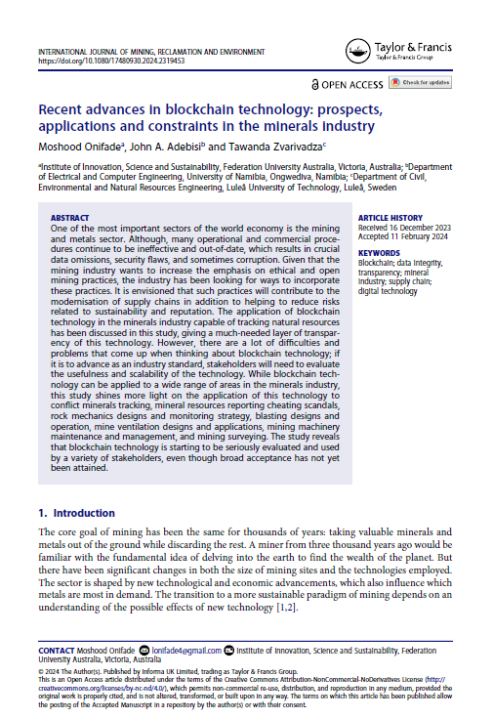
Some Interesting Ideas
Transparent and informed communication between geologists, engineers, geostatisticians to provide best estimates
Reporting of co- and by-product needs improvement
Conflict Minerals
Tracking
Mineral Resource
Reporting
Cheating Scandals
DOI:10.5382/Geo-and-Mining-1l
DOI:10.1080/17480930.2024.2319453

Slide 37
Summary
Mining scandals commonly result from poor ethical behavior
Critical components that foster integrity within the industry and our personal careers include:
  Independent Verification
  Strong Regulations
  Due Diligence
  Transparency
  Ethical Behavior
Ethical behavior will promote professionalism and assist companies in obtaining the Social License to Operate, which is required to allow the minerals industry to provide the world with the raw materials needed for a sustainable future.

Slide 38
Thank You
DR. GEORGE J. HUDAK, PGEO, P.G.
PRINCIPAL / ECONOMIC GEOLOGIST
GEORGE HUDAK GEOSCIENCES P.L.L.C.
DULUTH, MN 55804
hudak.george@yahoo.com

Slide 39
CRIRSCO Members
16 Countries From Around the World
Country | Member Organization | Country | Member Organization
Australia | JORC | Brazil | CBRR
Canada | CIM | Kazakhstan | KAZRC
Europe | PERC | Indonesia | KOMBERS-KCMI
South Africa | SAMCODES | Columbia | CCRR
USA | SME | Turkey | UMREK
Chile | Comision Minera | India | NACRI
Russia | OERN | Phillipines | PMRCC
Mongolia | MPIGM | China | CAMRA
(https://www.crirsco.com/members/)

Slide 40
International Reporting Standards

