Slide 1
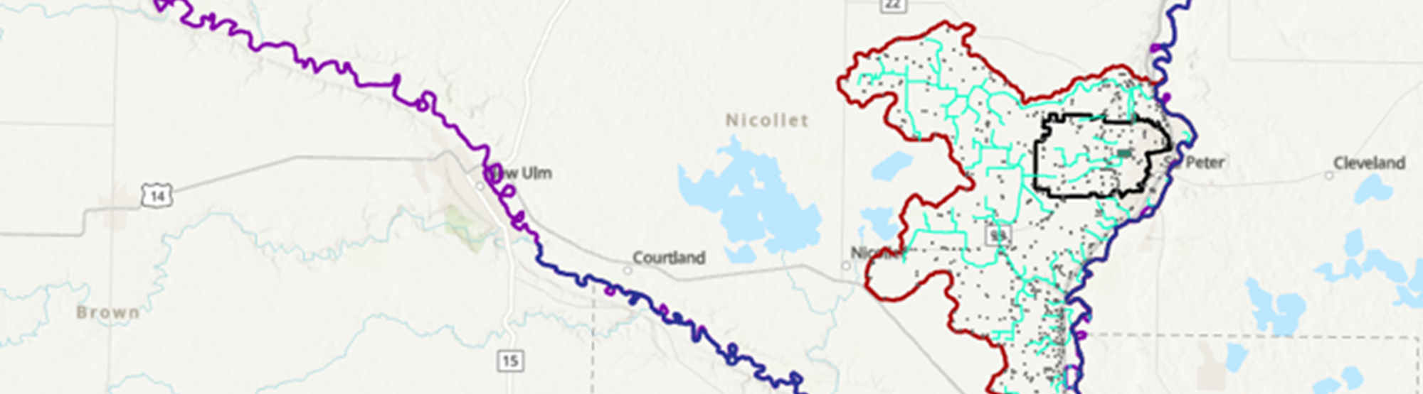
Direct groundwater age simulation as a tracer to tag fluid masses, flow paths and travel times within the capture area of St Peter Well fields
Cliford Ndiweni (MPCA)
Notes:
The St. Peter Drinking Water Supply Management Area (DWSMA) is located in Nicollet County, Minnesota. Agriculture dominates the DWSMA at 68% of the land use, with most fields planted to either corn or soybeans. The 2nd highest land use is “developed” at 20%, as the DWSMA extends into the city of St. Peter.

Slide 2
Introduction
The solution of groundwater age, lifetime expectancy and exit probability is used to perform specific diagnoses on a flow field, such as the analysis of the flow dynamics and mixing processes, the estimation of outlet vulnerability, or the evaluation of outlet capture zones and the origin of water.
The simulation of groundwater age is based on the forward-in-time solution of the transport equation while for lifetime expectancy and exit probability the backward-in-time transport equation is used.

Slide 3
Groundwater Age: Is there such a thing?
Misleading due to its inherent connection to the general understanding of human age.
‘Age’ as in the understanding of human age cannot be determined for groundwater.
Age is the “time difference between the birth and the moment in question” – this is a floating number (i.e. constantly changing!).
Birth of groundwater and the moment we ask the question – endpoint is straight forward – location and timing of the birth is ambiguous (less straight forward).
Science is certainly not able to uniquely determine groundwater age and certainly in the state of ‘measuring’ as is often assumed/expressed
Notes:
Mixing is ignored, or assume no mixing of different ages, assume knowledge of mixing of ages or try to numerically determine it. Age: endpoint straight forward (when the sample is taken out of well or spring). Birth is less straight forward (mostly use the moment when the water reaches the groundwater surface) – sound straightforward (for a human being an individual to be assigned age exists, no such “parcel” exists in the case of groundwater).

Slide 4
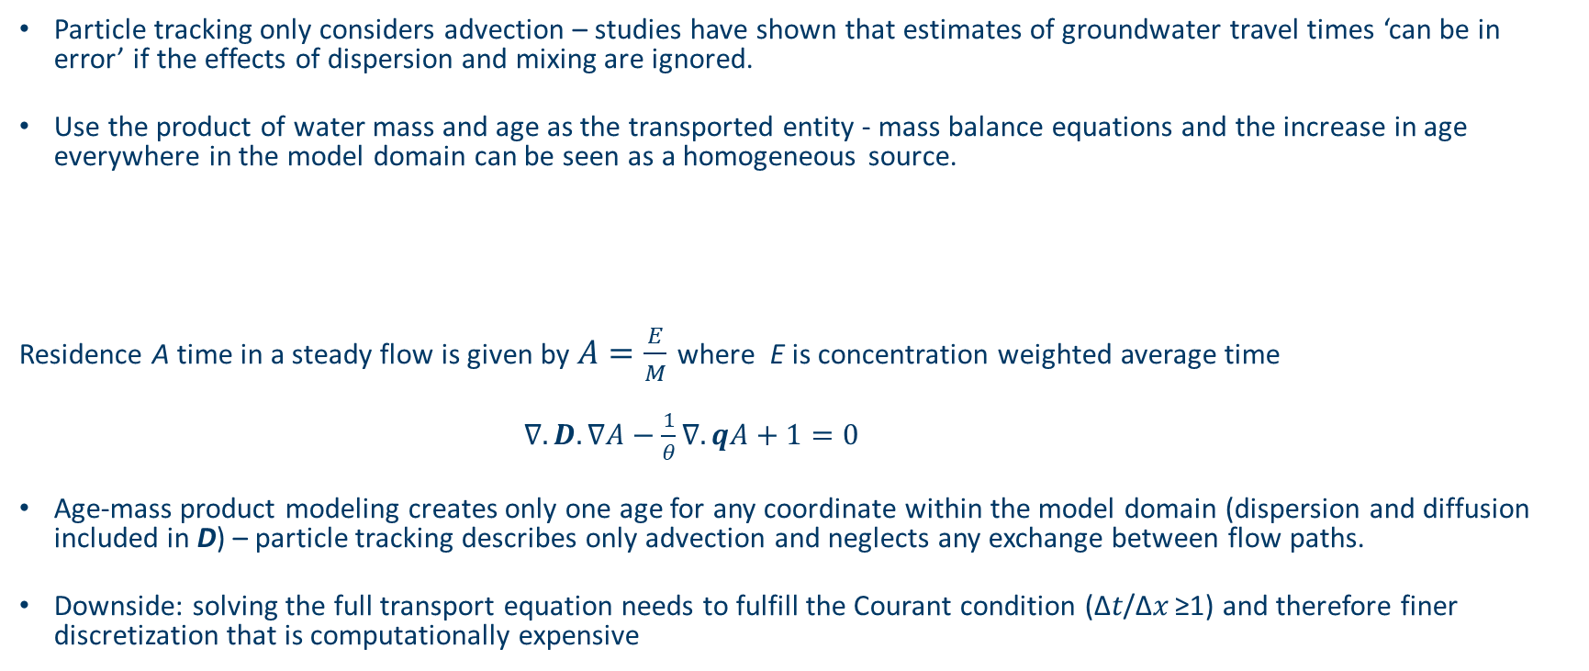

Direct Simulation Approach
Particle tracking only considers advection – studies have shown that estimates of groundwater travel times ‘can be in error’ if the effects of dispersion and mixing are ignored.
Use the product of water mass and age as the transported entity - mass balance equations and the increase in age everywhere in the model domain can be seen as a homogeneous source.
Residence A time in a steady flow is given by $A=\frac{E}{M}$ where E is concentration weighted average time
$∇.D.∇A−\frac{1}{θ}∇.qA+1=0$
Age-mass product modeling creates only one age for any coordinate within the model domain (dispersion and diffusion included in D) – particle tracking describes only advection and neglects any exchange between flow paths.
Downside: solving the full transport equation needs to fulfill the Courant condition (∆𝑡/∆𝑥 ≥1) and therefore finer discretization that is computationally expensive
$$\frac{∂c}{∂t}=∇.θD.∇c−∇qc$$
Notes:
Assume that the mean age of mixed water masses is a mass weighted average, then the mean age is analogous to conservation of solute concentration. Groundwater age is not a directly measurable quantity and cannot be experimentally verifiable. However, it is reasonable to assume when two water masses mix, the mean age of the mixture is the mass-weighted age of the mixed components. So, a given mass of water can be assumed to be characterized by its ‘age-mass’

Slide 5
Background
The St. Peter Drinking Water Supply Management Area (DWSMA) is located in Nicollet County, Minnesota. Agriculture dominates the DWSMA at 68% of the land use, with most fields planted to either corn or soybeans. The 2nd highest land use is “developed” at 20%, as the DWSMA extends into the city of St. Peter.
In 2021, the Minnesota Department of Agriculture (MDA) established a network of monitoring wells throughout the St. Peter Drinking Water Supply Management Area (DWSMA).
The MDA's monitoring aims to evaluate nitrate-nitrogen levels in the shallow groundwater within the DWSMA.
As part of this effort, the MDA also initiated monitoring of three small ditches that drain from the western part of the DWSMA and contribute to groundwater recharge within it.
Data from these ditches understanding of nitrogen transport within DWSMA. In the spring of 2022, water level monitoring and nitrate sampling were added for a small pond located downstream of the south/middle ditch.

Slide 6
Some Terms
Mean Groundwater Age: Represents the average elapsed time spent in the aquifer since groundwater has entered the model domain, i.e., it indicates the travel time from the inflow boundary to the current location.
Mean Life Expectancy: Lifetime expectancy is defined as the average time still needed for groundwater before exiting the domain via an outlet. Corresponds to the expected travel time from the current location to an outflow boundary.
Exit Probability: Probability relative to a specific outlet(s), used to calculate at any point what is the probability for a water parcel to exit the domain at the targeted locations (e.g. abstraction well or spring).
Notes:
Mean age solutions provide information on underground travel times and mixing processes and the results on mean groundwater age can be used for calibration purposes if age data are available, e.g., from isotope analyses.
To determine the total travel time from inlet to outlet, Mean age and Mean lifetime expectancy need to be summed up.
Results for lifetime expectancy can be used for risk-vulnerability assessments and the analysis of groundwater dynamics. Summing up age and lifetime expectancy yields to the prediction of mean total travel time from recharge to discharge.
The exit probability process variable is relative to a specific outlet (or group of) and is used to calculate at any point what is the probability for a water parcel to exit the domain at these targeted locations. The distribution of exit probability represents the capture zone of the target which in our example is the pumping well. The typical limit for capture-zone delineation is the 0.5-probability contour.

Slide 7
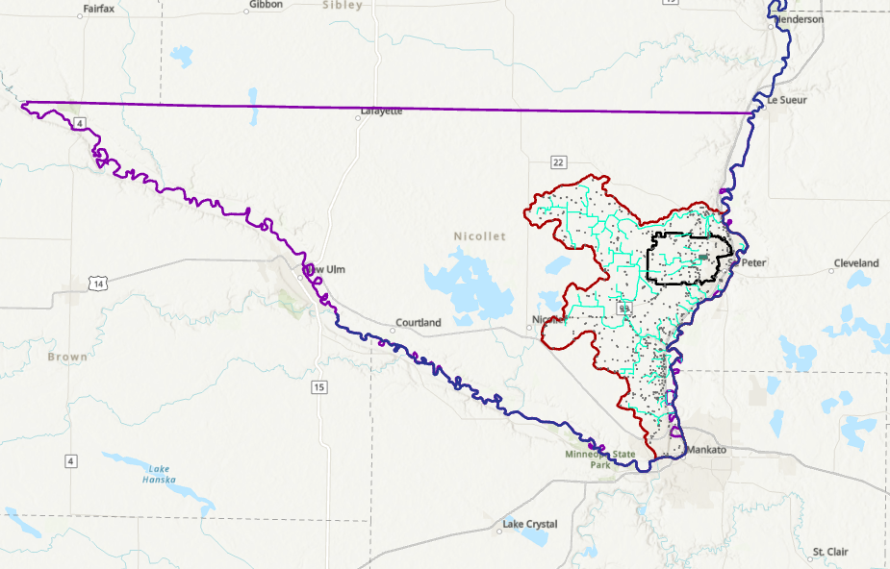
Location of our Model domain
Notes:
Nicollet County boundary showing the location of the model domain (red outline on the western boundary is Mn river watershed boundary and the blue is the Mn River which acts as the eastern boundary the model domain) and the DWSMA in black. The light green shows the creeks and ditches that fall within the model domain.

Slide 8
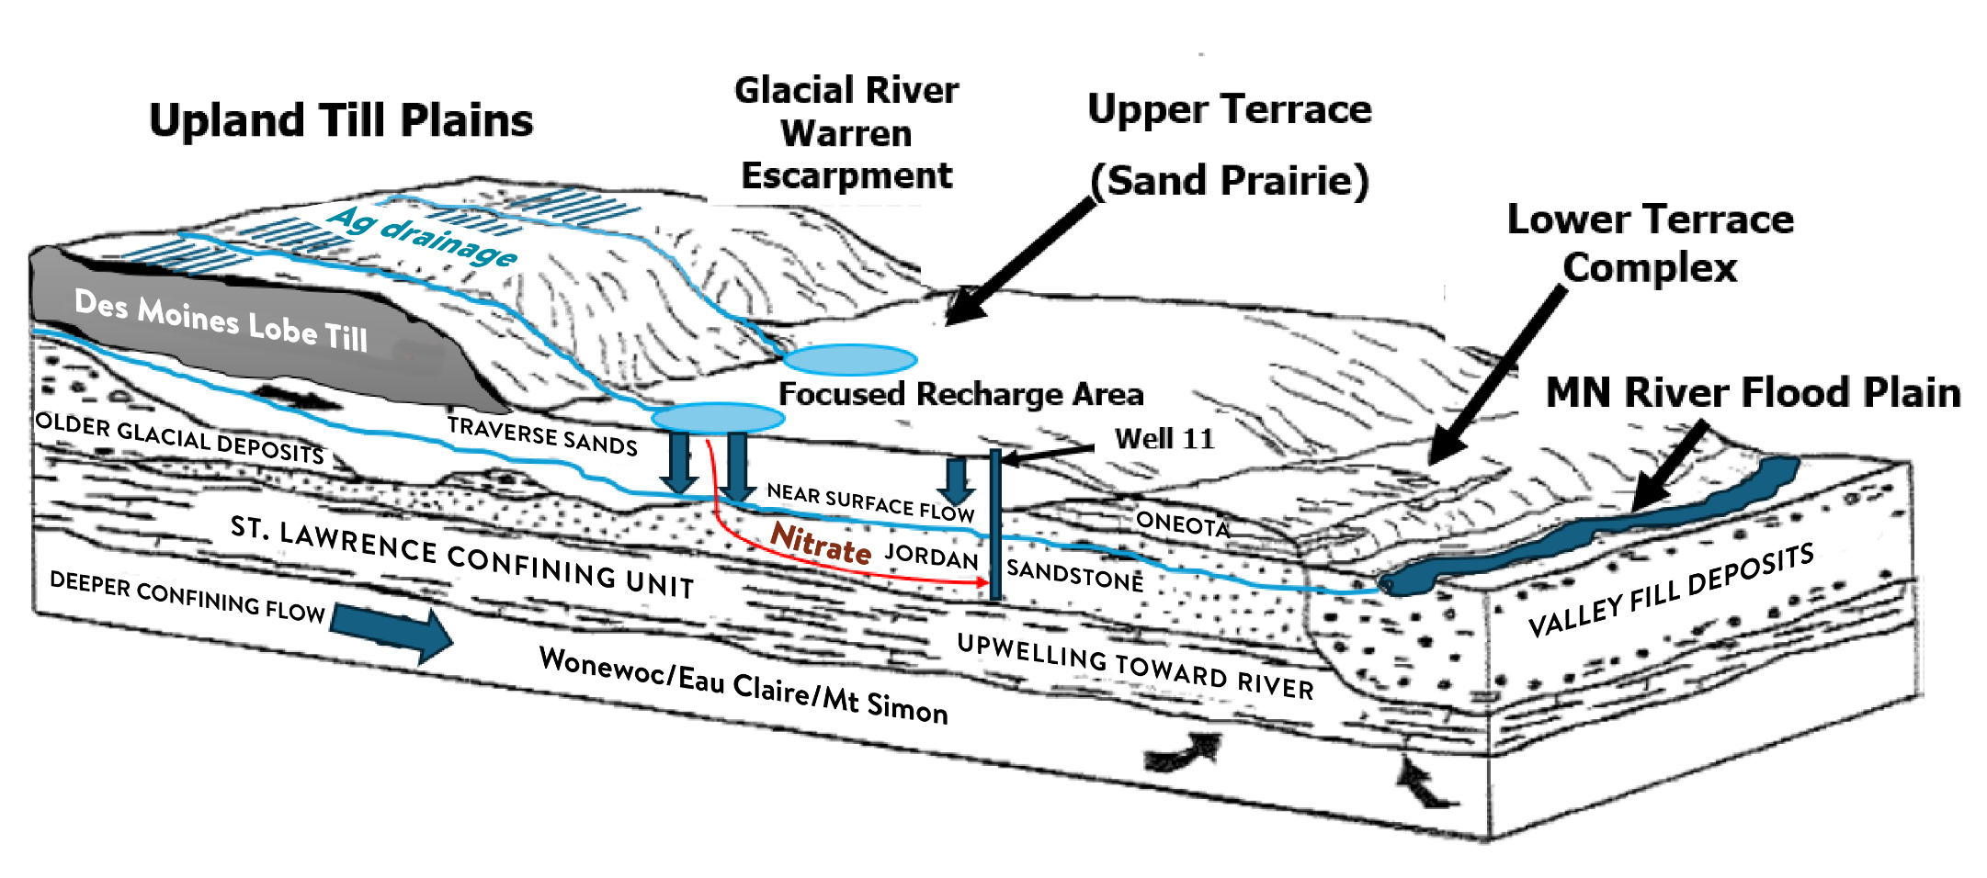
Conceptual Model of the St Peter DWSMA

Slide 9
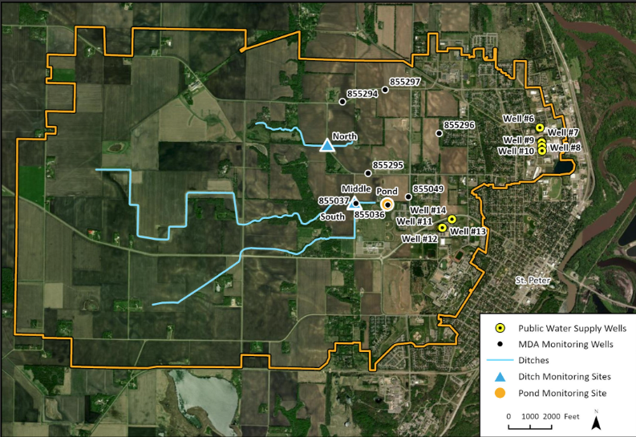
Plan view of the DWSMA
Notes:
For the purposes of this presentation, we considered 3 wells (6, 11 and 12) and the South pond……………flip back to explain the choice of wells.

Slide 10
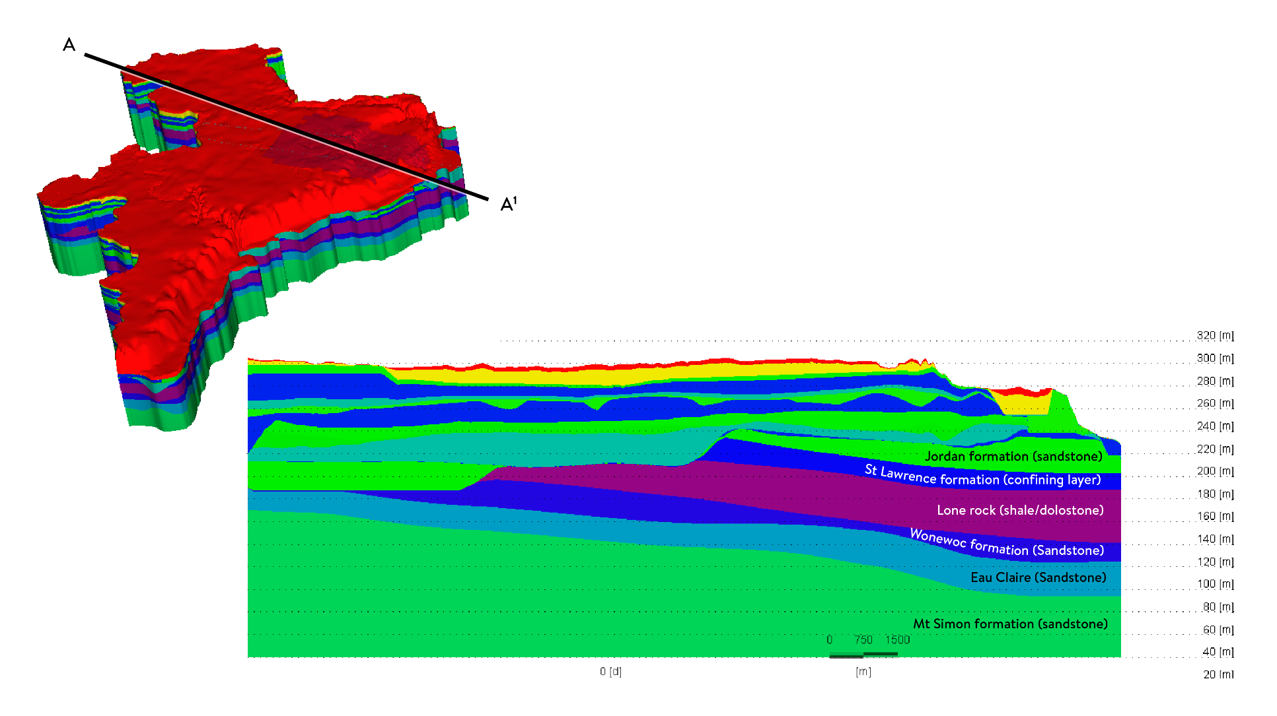
Hydro-stratigraphy
Jordan formation (sandstone)
St Lawrence formation (confining layer)
Lone rock (shale/dolostone)
Wonewoc formation (Sandstone)
Eau Claire (Sandstone)
Mt Simon formation (sandstone)

Slide 11
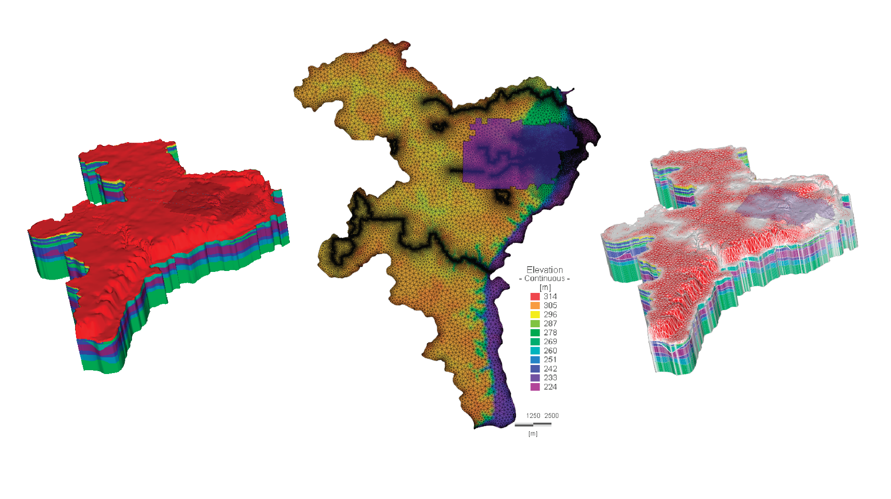
3D Geologic to 3D Numerical model

Slide 12
Boundary Conditions
Assume that groundwater “life” starts at inflow into the model domain we assign Dirichlet BC of 0 days for Age at all inflow boundaries.
Groundwater is assumed to “die” at outflow boundaries, a LTE concentration BC of 0 days is applied at these locations
As the probability of exit is 100% at and outflow (e.g. pumping well), a Probability BC of 1 is assigned there and a probability of 0 for all other BCs.
This is in addition to flow BCs which we won’t touch on in the interest of time.
Notes:
Assigning a probability boundary condition of 1 at a pumping-well location allows to delineate the capture zone of the well and also to determine the origin of the pumped water.

Slide 13
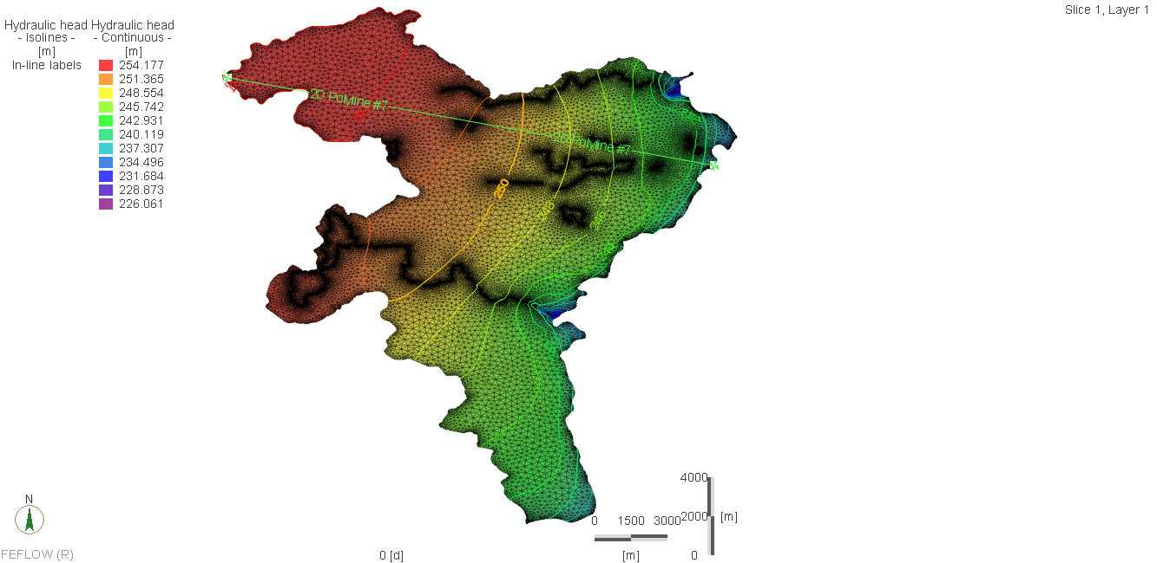
Solution: Flow Direction

Slide 14
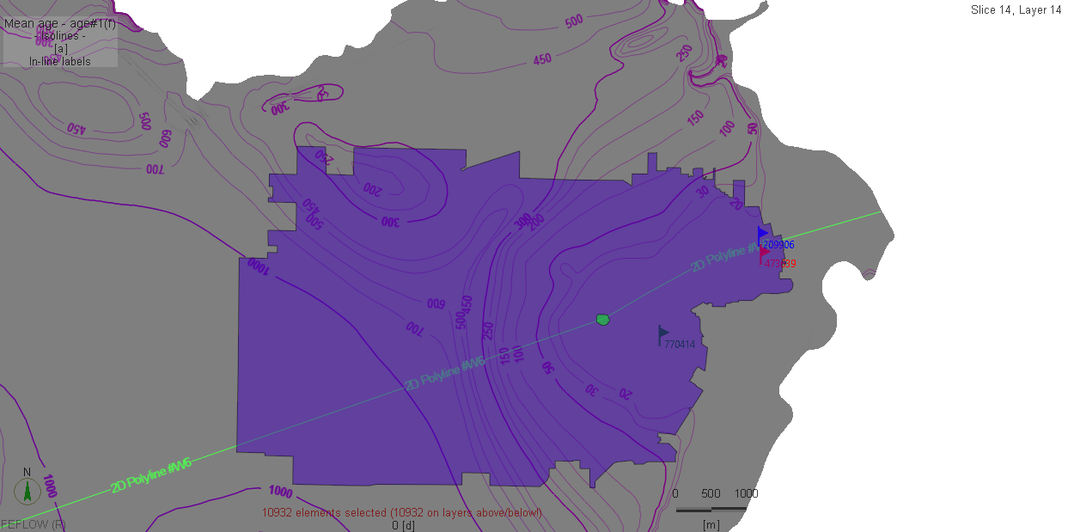
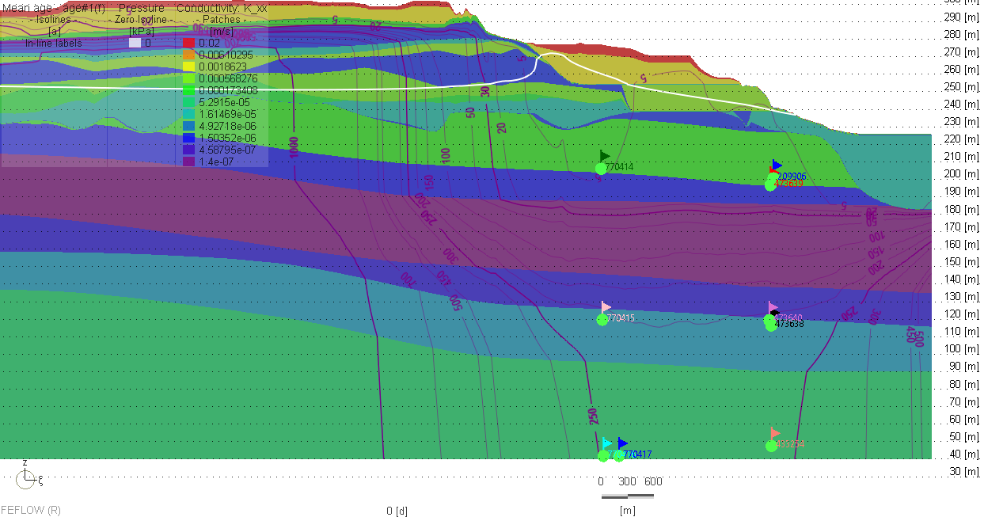
Mean Groundwater Age: w6
Notes:
Water enters the model domain with an age of zero and locations close to inflow boundaries therefore show short travel times.

Slide 15
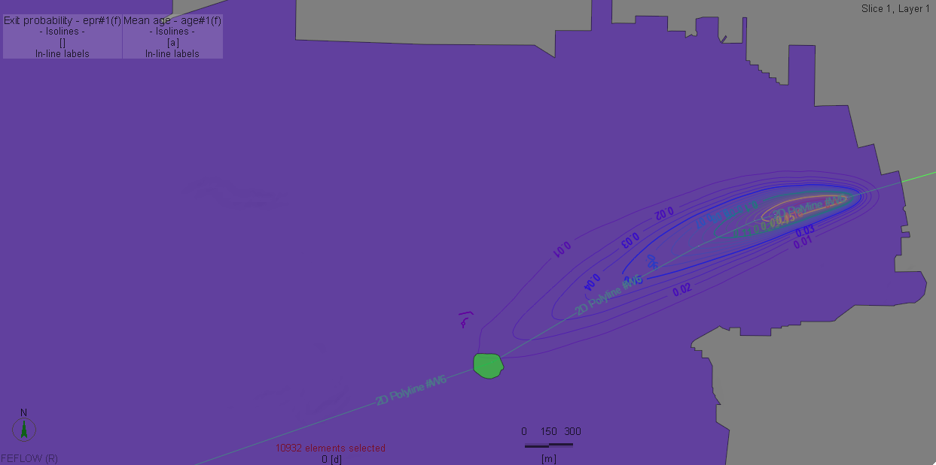
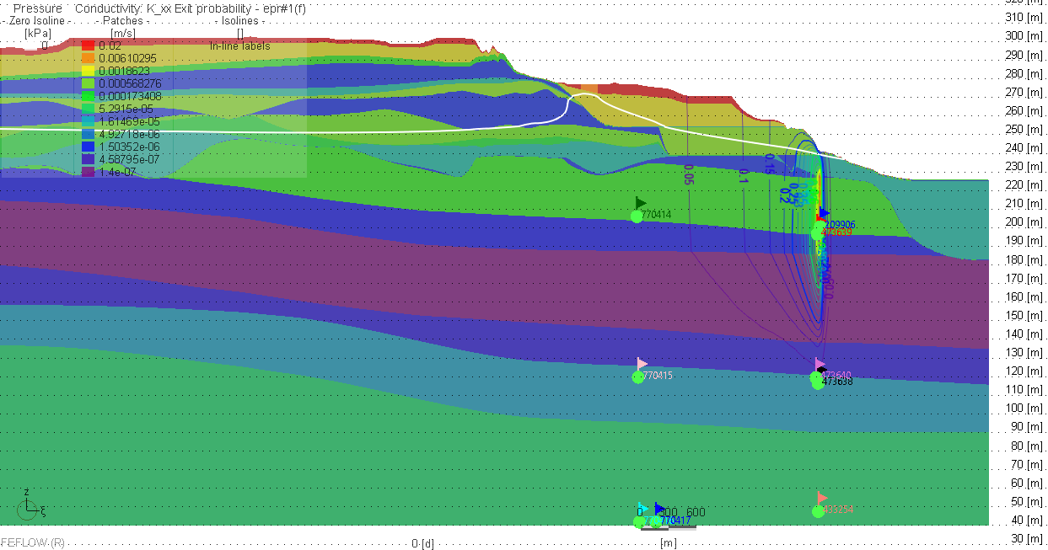
Exit Probability relative to w6 (Capture zone of)
Notes:
The distribution of exit probability represents the capture zone of the target which in our example is the pumping well. The typical limit for capture-zone delineation is the 0.5-probability contour.

Slide 16
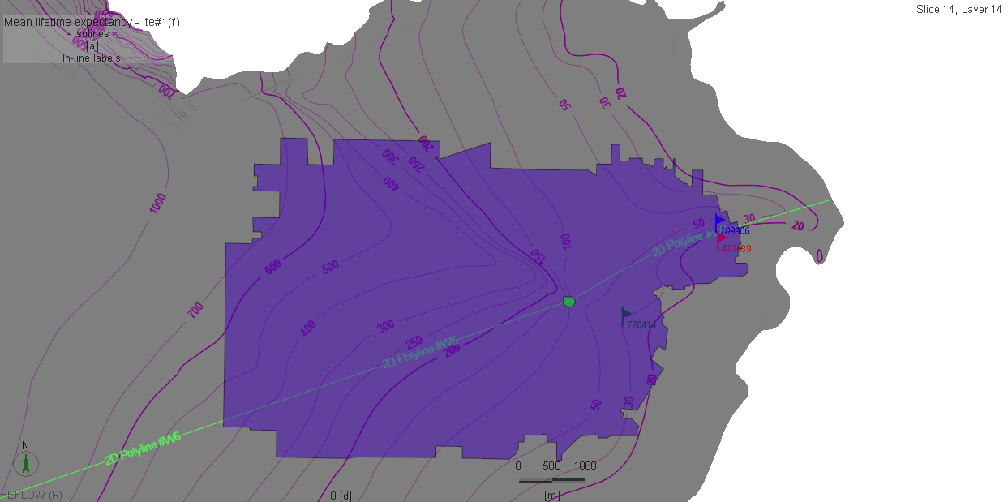

Mean Life-time Expectancy w6

Slide 17
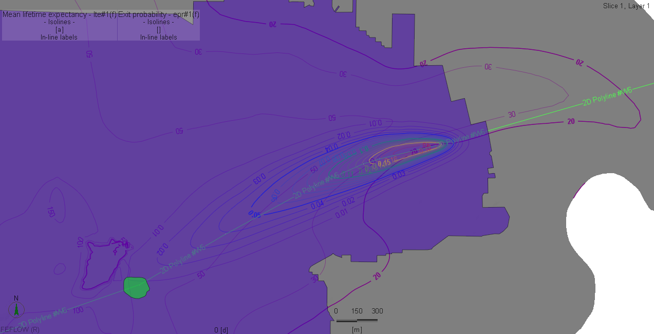
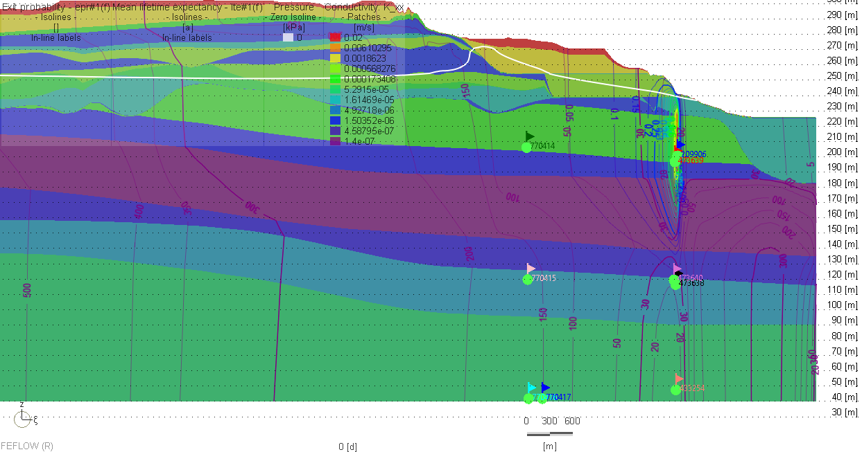
Mean Life-expectancy +EPR w6
Notes:
By examining exit probability in combination with the isolines for mean lifetime expectancy it is possible to determine the remaining travel time from a specific location within the capture zone to the outlet.

Slide 18
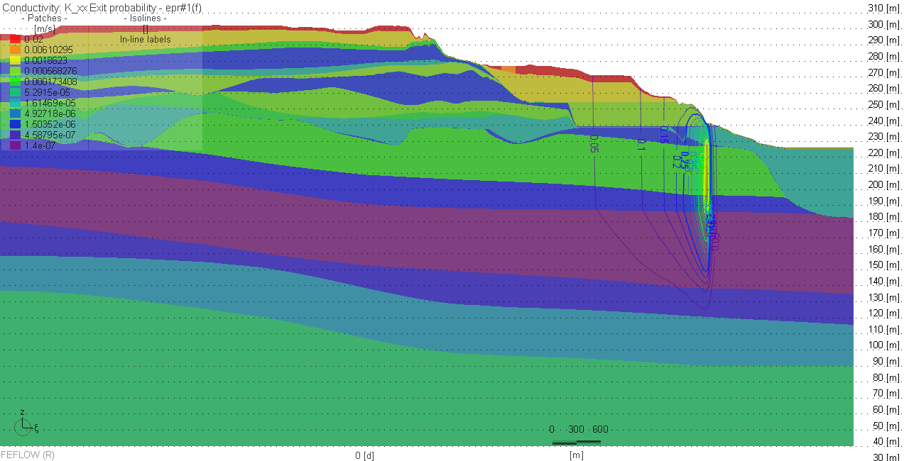
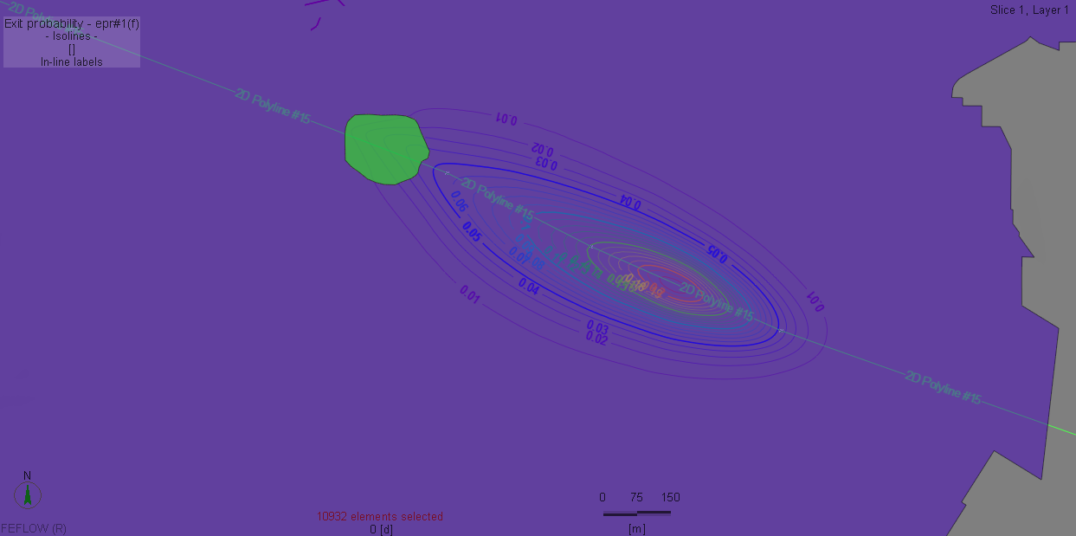
Exit Probability relative to w11 (Capture zone of)

Slide 19
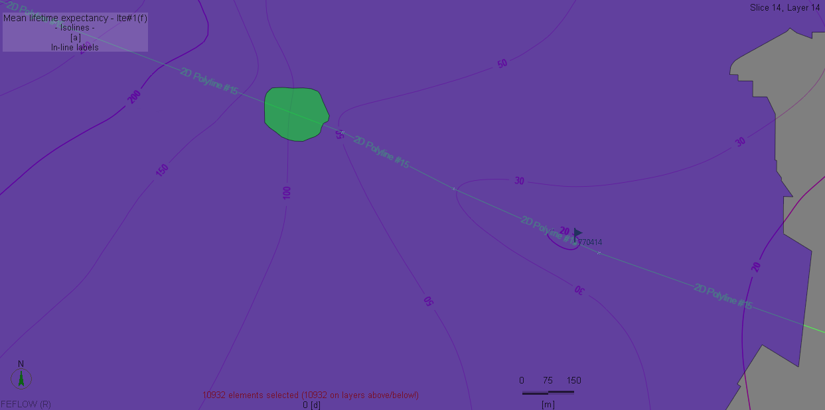
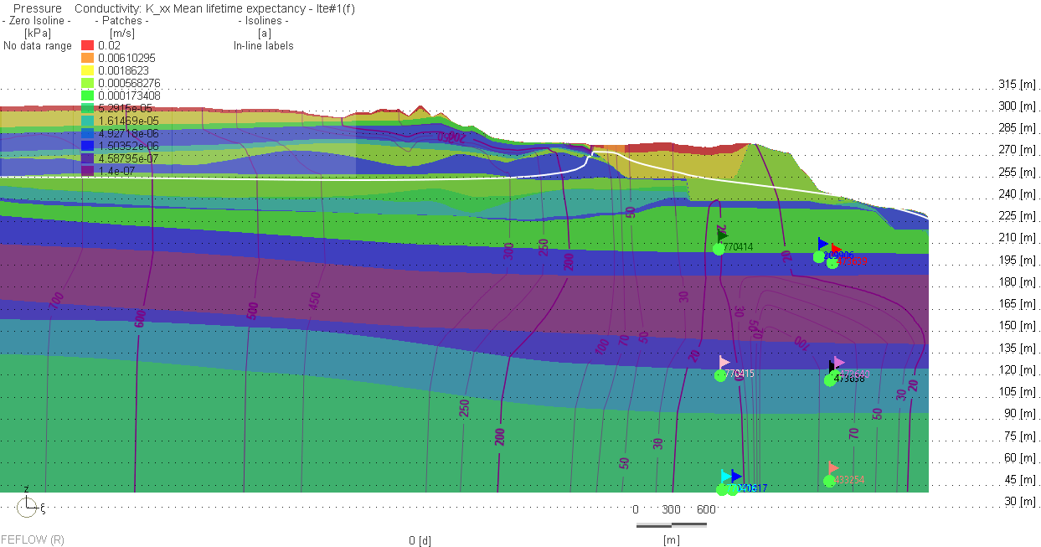
Mean Life-time Expectancy w11

Slide 20
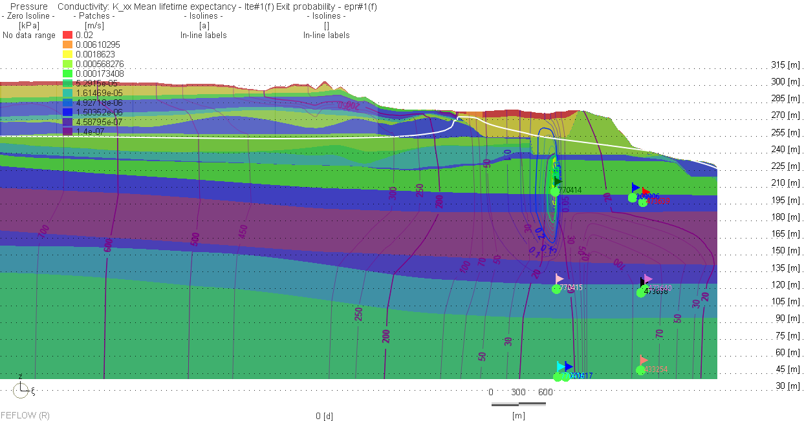
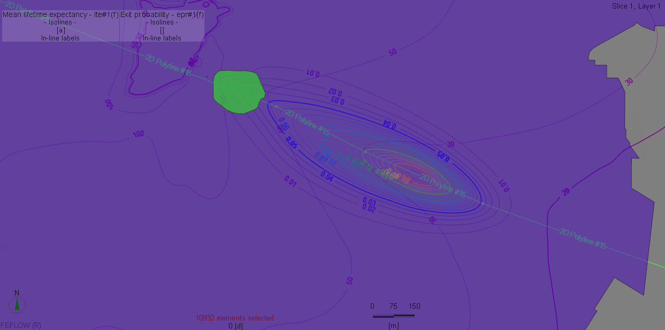
Mean Life-expectancy +EPR well 11

Slide 21
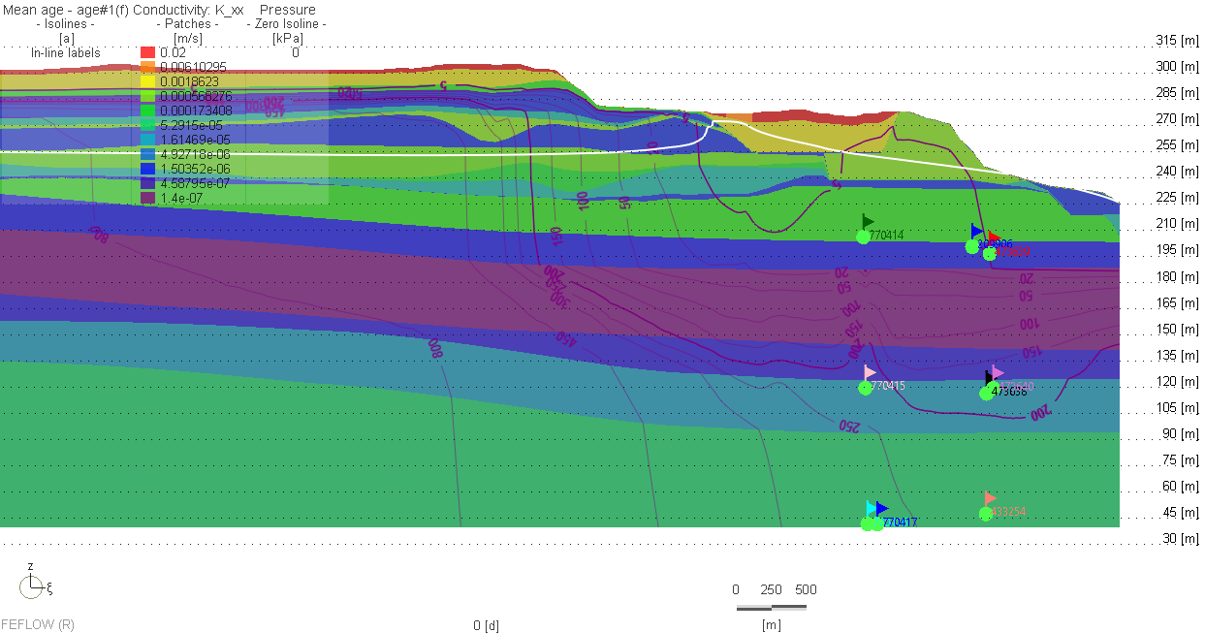
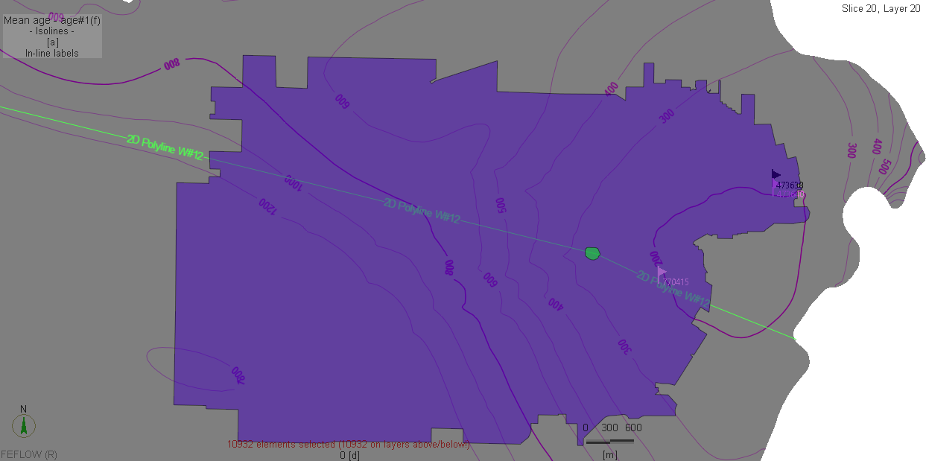
Mean Groundwater Age – w12

Slide 22
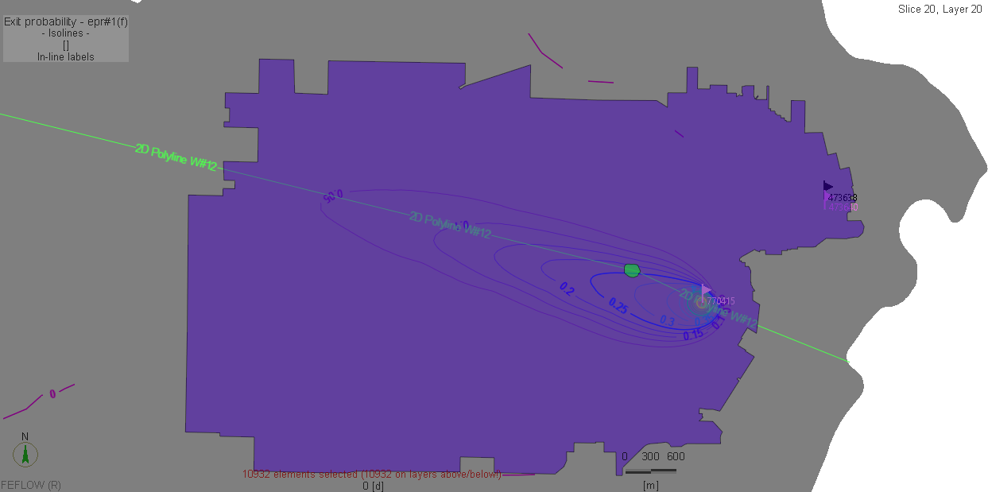
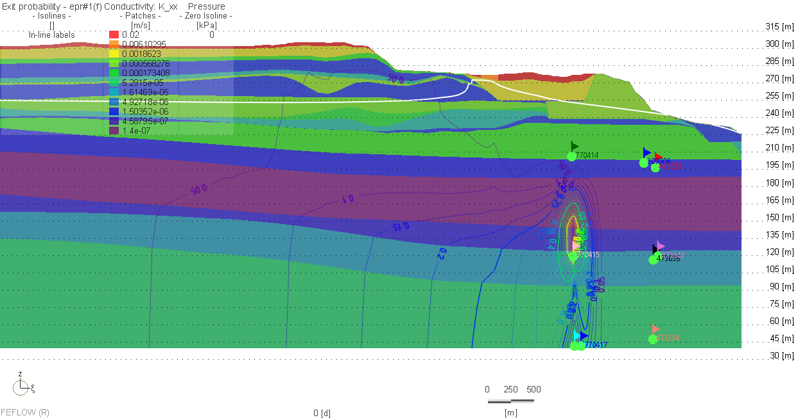
Exit Probability for w12 (Capture zone of)

Slide 23
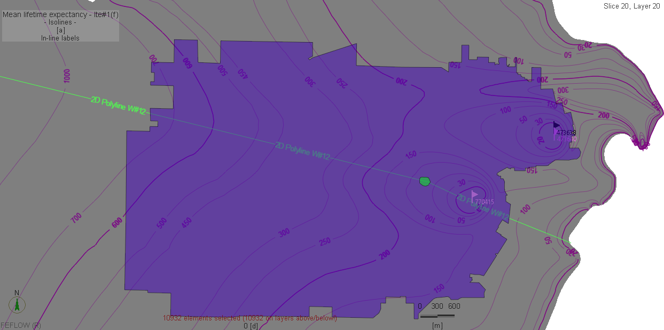
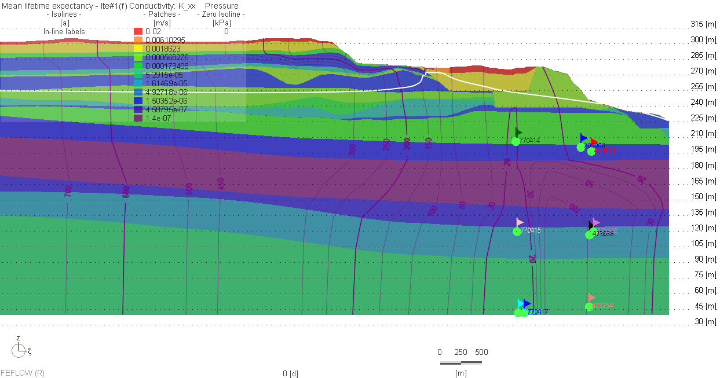
Mean Life-expectancy +Exit Prob well 12

Slide 24
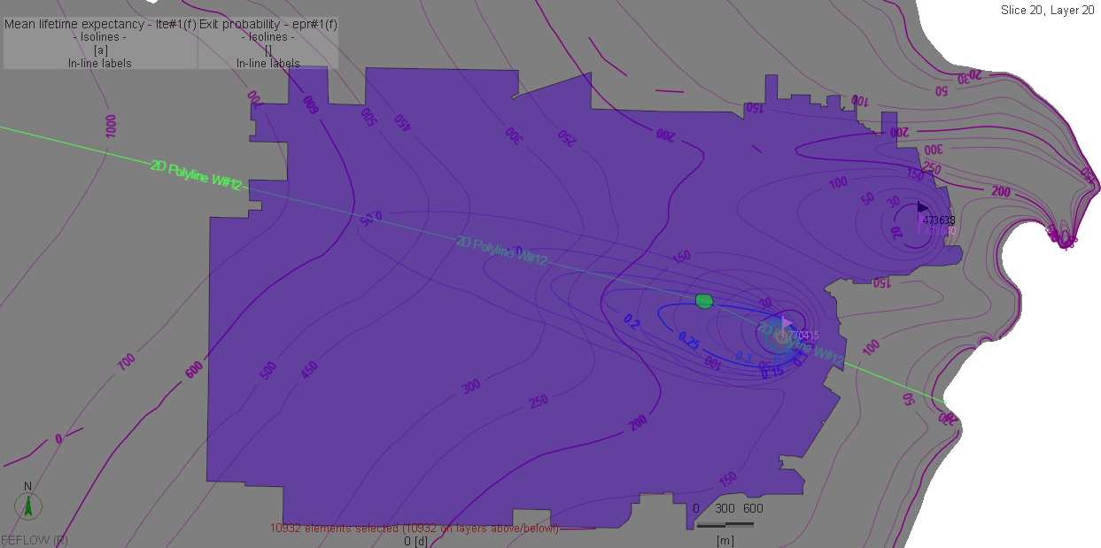
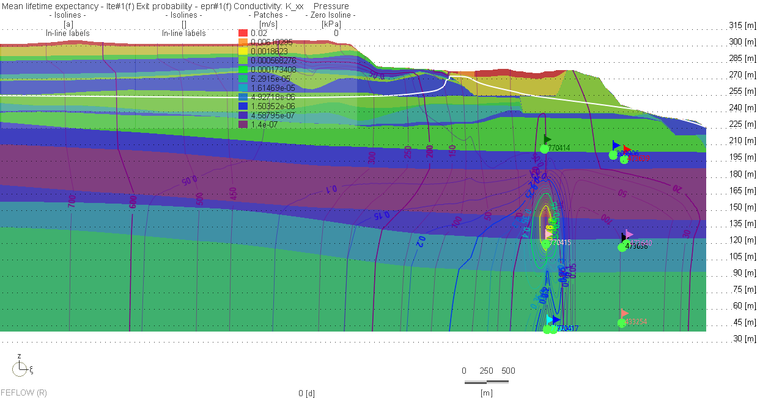
Mean Life Expectancy + EPR for wells 12

Slide 25
Proportions of the pumping-well rate with respect to their origin of infiltration
Well | Constant Head BCs (m³/d) | Transfer BCs (Pond and Focused Recharge Area) (m³/d) | Distributed Source (Recharge) (m³/d) | Net Total (m³/d)
Well 6 | 8.734x10⁻⁶ | 270.97 | 76.583 | 51.728
Well 11 | 6.1x10⁻⁶ | 732.21 | 29.957 | 445.65
Well 12 | 0.0022934 | 1058 | 262.65 | 704.66
Notes:
Assigning a probability boundary condition of 1 at a pumping-well location allows to delineate the capture zone of the well and also to determine the origin of the pumped water. By performing post-solution budgets of exit-probability along recharge area portions, one can directly assess the fractions of the outlet(s) flowrate according to their origin.

Slide 26
Conclusion
We developed a full transport hydrogeologic model that incorporate most of geologic features at the exact scales in part to characterize the flow field and the capture zones of the drinking supply in the St Peter DWSMA.
Clearly defined where our water is ‘born” and where it “dies” (in addition to flow BCs) to estimate the groundwater age .
We performed both manual and automated inversion analysis and produced reasonable matches between the observed head data and model predictions.
We used the groundwater mean age/life expectancy to estimate the travel times within the DWSMA. (Travel times = age+life expectancy).
Mass budget returning the proportions of the pumping-well rate with respect to their origin of infiltration.
At this point we were not interested in the exact scalar number of the travel times but simply to prove the applicability of the methods which we have shown.

Slide 27
Thank you again!
Dr Cliford Ndiweni

