Slide 1
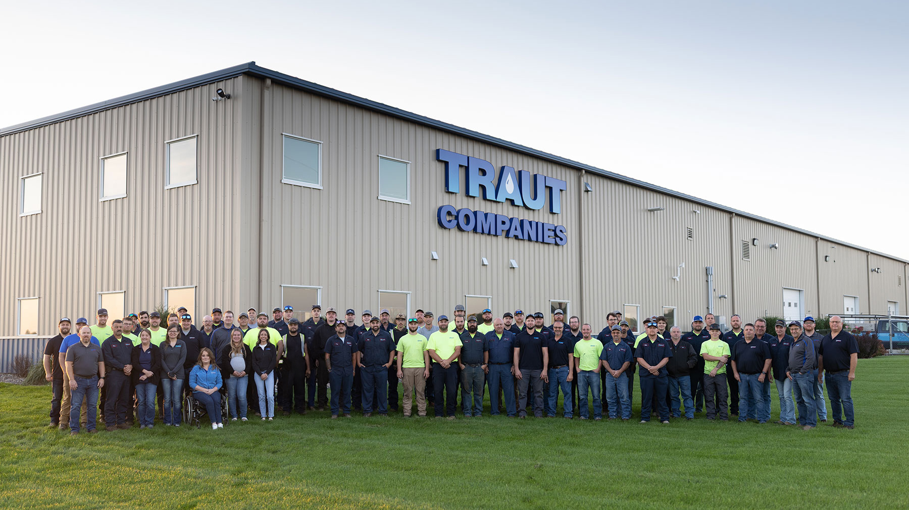
Traut Companies
Sonic Drilling Department
Innovative Soil Boring Methods for Municipal and Commercial Water Needs
MGWA Spring Conference 2026

Slide 2
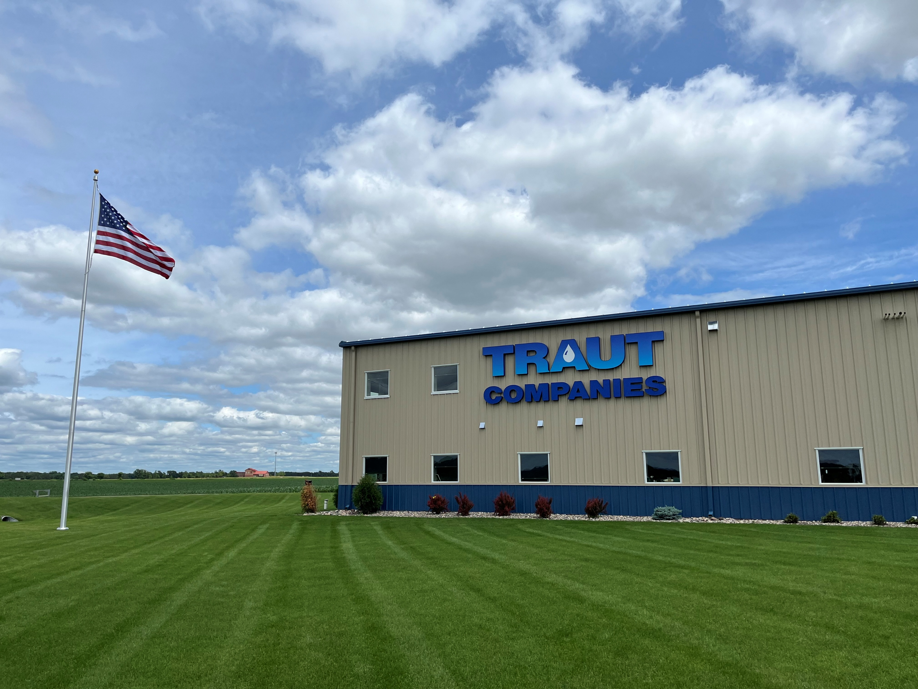
Traut Companies Departments &
Different Drilling Methods
Provide, Protect and Treat
Departments at Traut
Sonic
Geoprobe
Mud Rotary
Dual Rotary
Investment in Upfront Testing (Sonic)
Sonic test borings and test wells facilitate accurate evaluation of subsurface formations and aquifers
Reliable data assists engineers in designing optimal wells
Prevents unforeseen challenges, saving significant costs and ensuring efficient, effective final design.
Equipment & Rigs
2 Probe Rigs
3 Mud Rotary Rigs
4 Sonic Rigs
5 Dual Rotary Rigs
8 Small pump service trucks
4 Large Pump Service Trucks
Water treatment & full-service, State Certified Water Testing laboratory
Drilling Services
Monitoring Wells
Piezometer Wells
Soil Borings & Ground water exploration
Our capabilities extend to soil, mineral, and geological exploration, making us a trusted partner for a wide range of water and environmental projects.

Slide 3
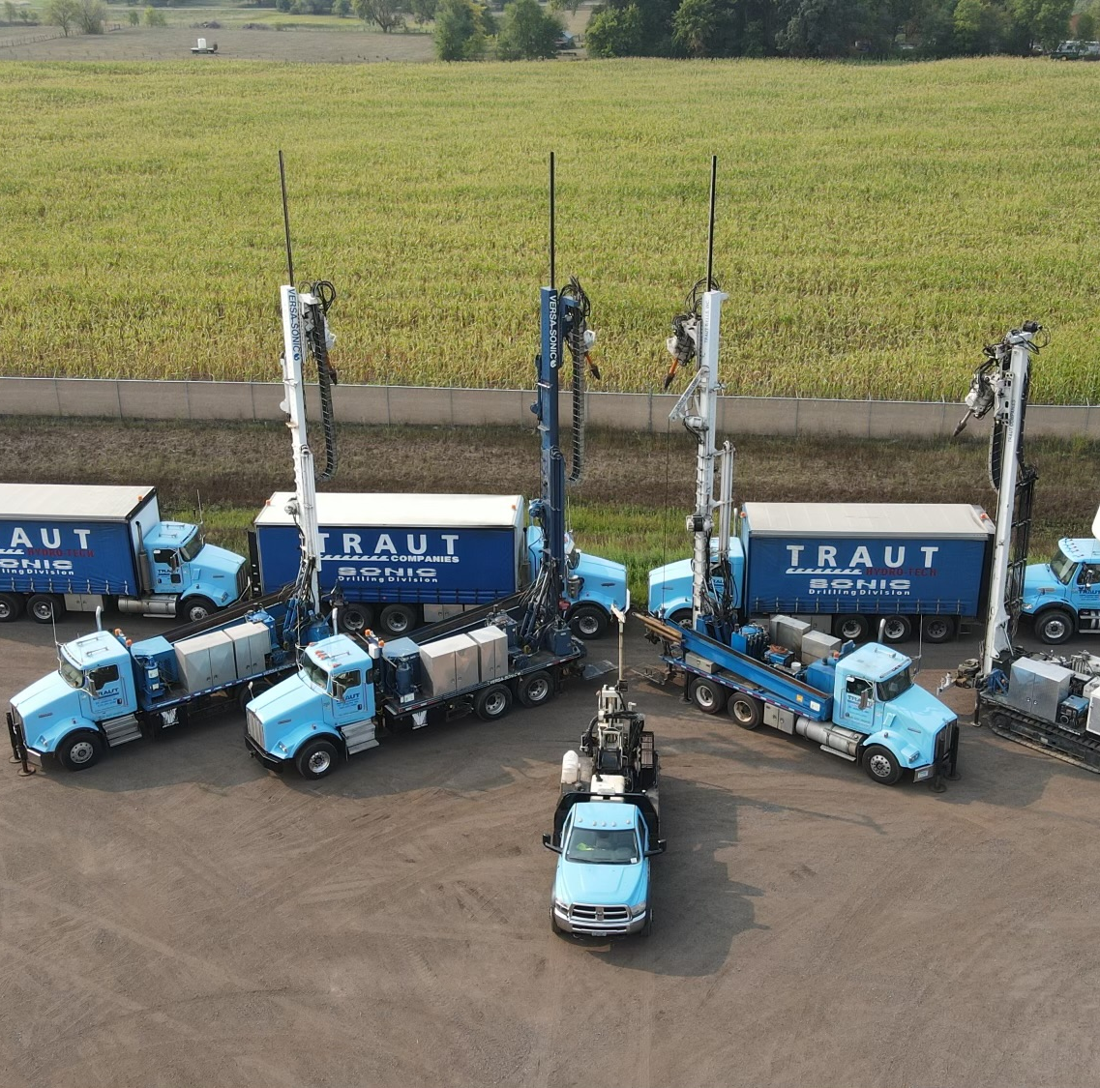
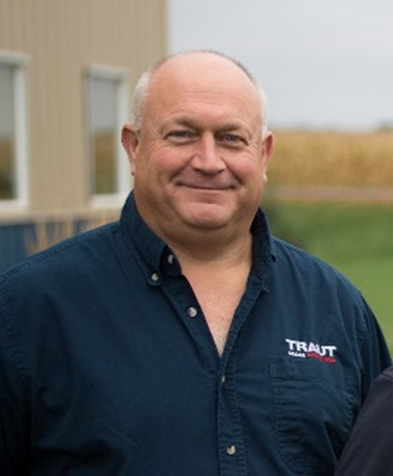
History of Sonic
Sonic Rig Fleet
Traut has been drilling with Sonic since 1998
Traut currently has 4 Sonic drill rigs
Daryl Karash has spent 25 years in the field learning sonic technology & has drilled in 22 states nationwide.
Daryl Karasch
President & Sonic Drilling Manager

Slide 4
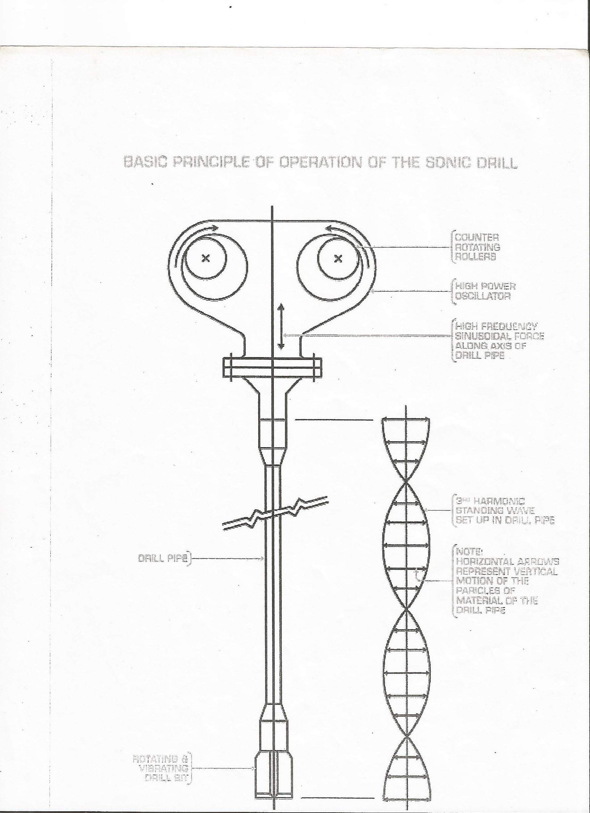
What is Sonic?
Four Rig Fleet: We operate three Versa-Sonic rigs with 50K heads mounted on Kenworth trucks, along with SonicDrill (SDC550) track-mounted large sonic rigs equipped with 50K heads. Skid loaders are also provided on job sites to support operations.
Capabilities:
Core samples can be taken up to 600 feet deep
4-inch and 6-inch diameter continuous cores in unconsolidated and solid formations
6-inch, 8-inch and 10-inch diameter temporary casing liner
4-inch x 5 feet Sonic Lexon liner cores
Install monitoring or temporary wells up to 6-inch diameter
Ability to do water profiling and vapor sampling
Well abandonment and overshoot capabilities
Test borings for municipal and high production wells
Temporary wells for capacity test
Support truck and rig can be separated to reconfigure for small locations
Specialize in artesian well control
Video camera, gamma logs, heat-pulse flow meter, and acoustic televiewer can be used on Sonic boreholes

Slide 5
What is Sonic Continued…
Sonic uses counterweight at high speed to create frequencies waves that will flow into the drill rods/casing and create vibration to advance your core barrel and Casing. 10,500 times a minute the drill head cycles through the drill casing, that is a lot of energy.
It has limitations (It does not cut anything like butter) and can create a lot of heat. Managing the frequency is the key to getting you quality samples and most efficient drilling time.
Sonic drill techniques commonly used for:
Soil Sampling
MW & Test Well Applications (from 1” to 8” wells) with positive displacement of the sand pack, seal, grouting of the annular space
Multiple aquifer soil sampling. (VAP) sampling of water in aquifers for all sorts of water quality checks, Test Holes for Municipalities for water quality and quantity.
Overshoot and abandonment of wells.
Dewatering wells & Artesian conditions in many forms

Slide 6
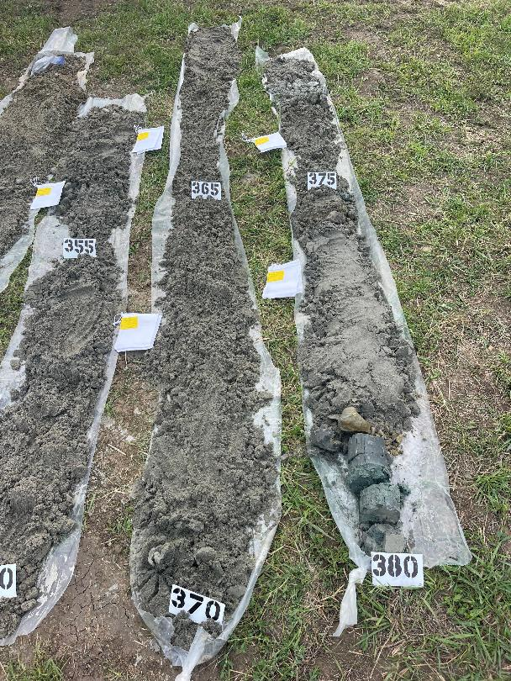
Soil Capabilities
And services

Slide 7
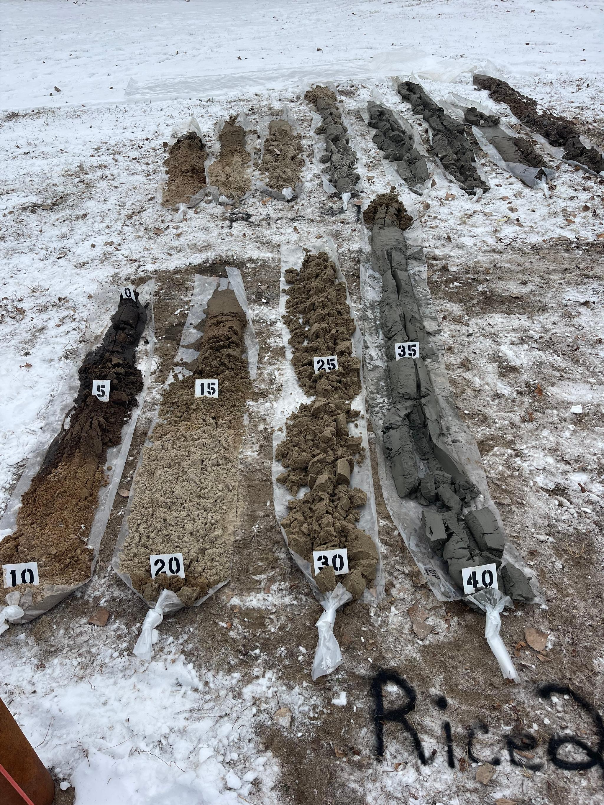
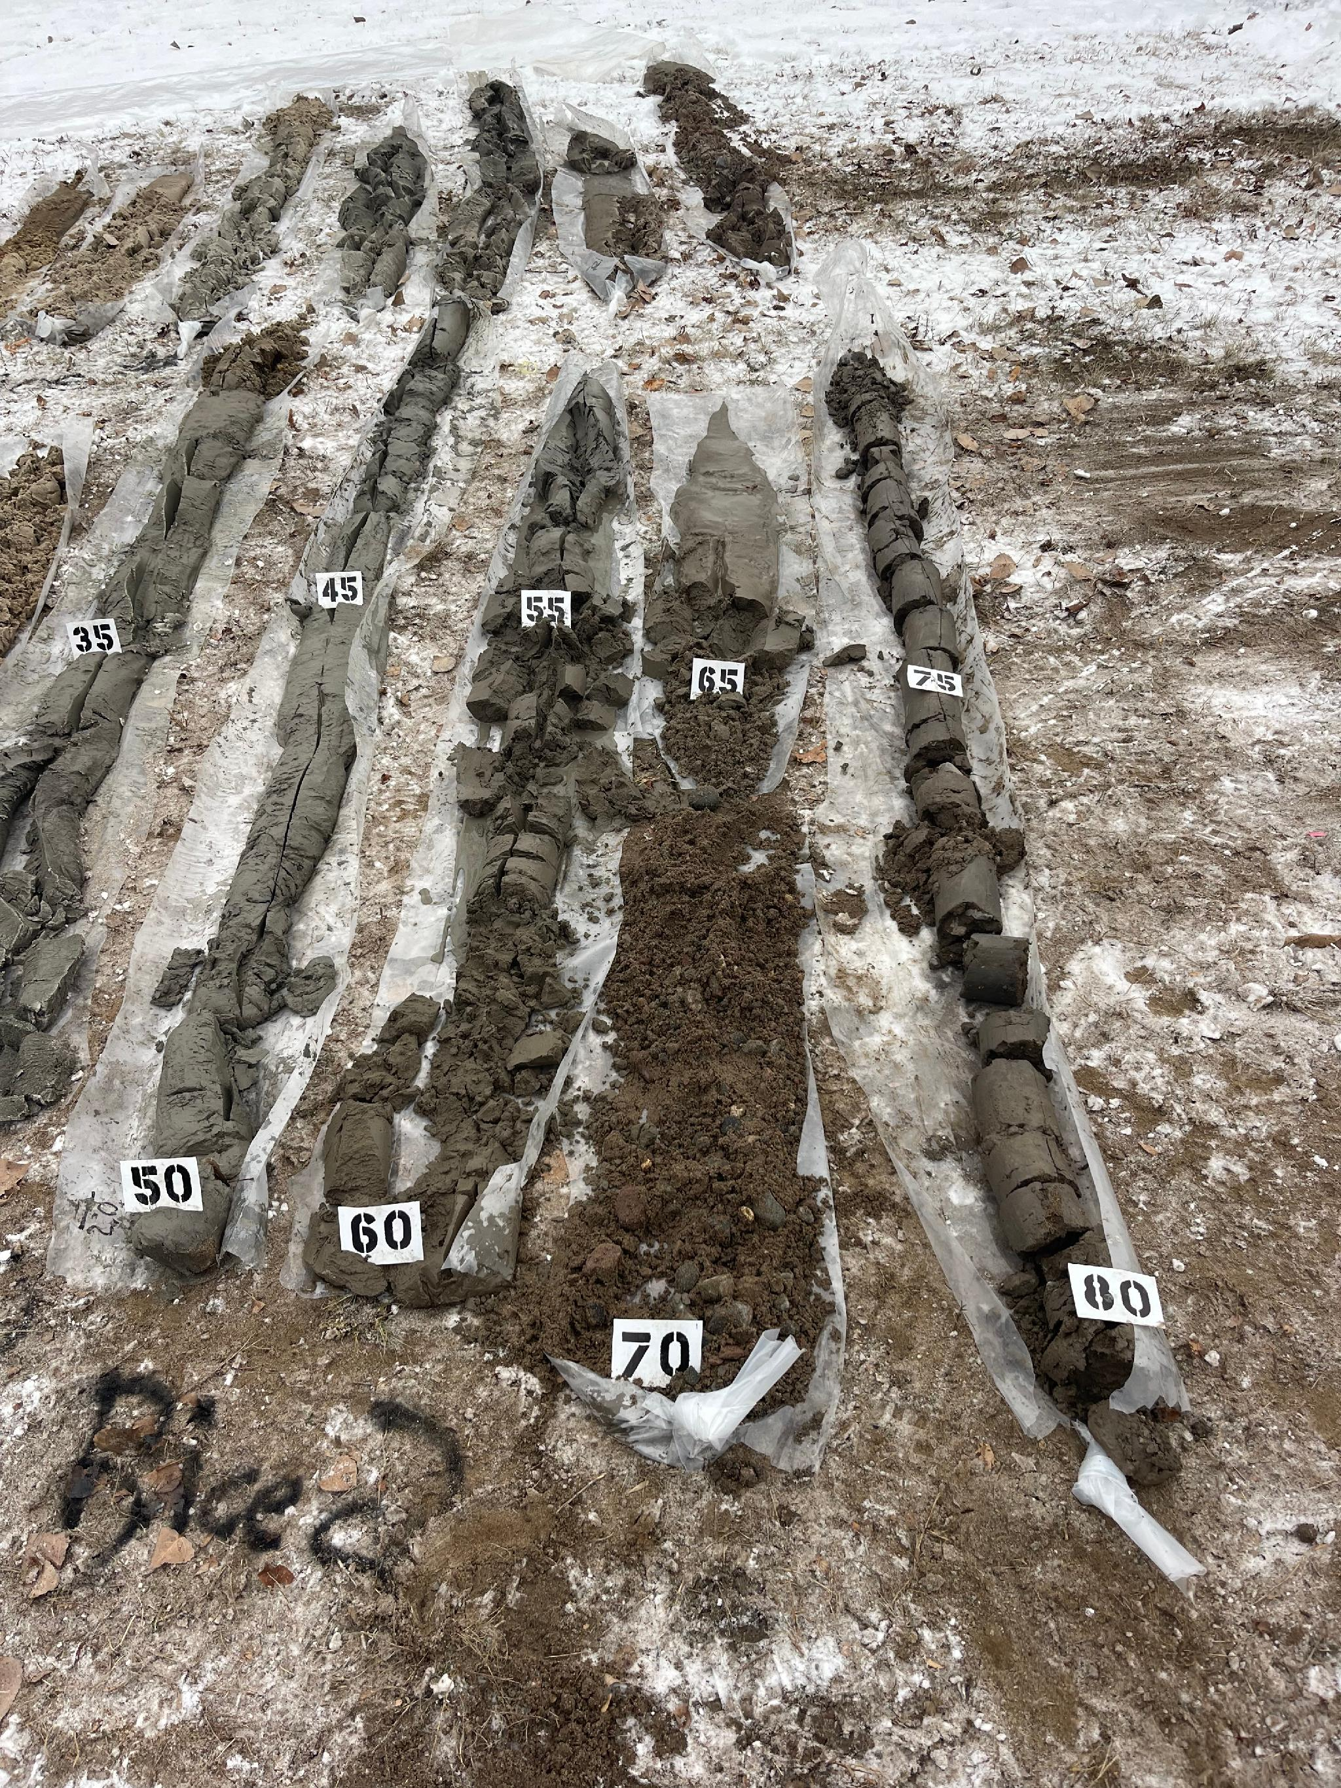
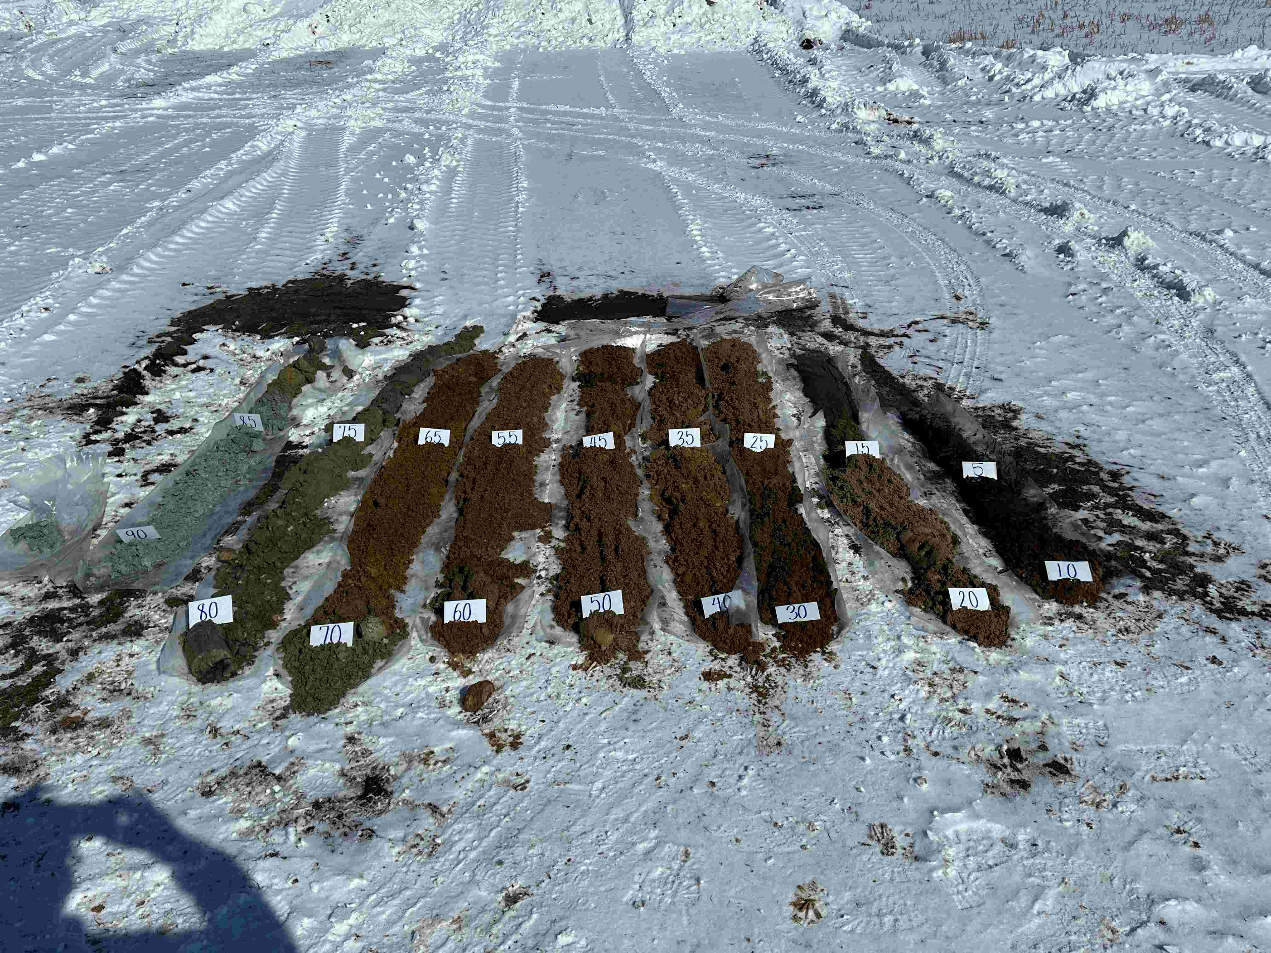
Standard Core
Mixed
Deep Sands
Mixed
Sand Formations
Unconsolidated formations (Fine Sand, Sands, Gravels, clays, tills, some shales. And Boulder infested formations) MN has it all. Dry condensed formations line silts and fine sands can be problematic to drill. Waxy clays and silty or swelling clays can be difficult to drill.

Slide 8
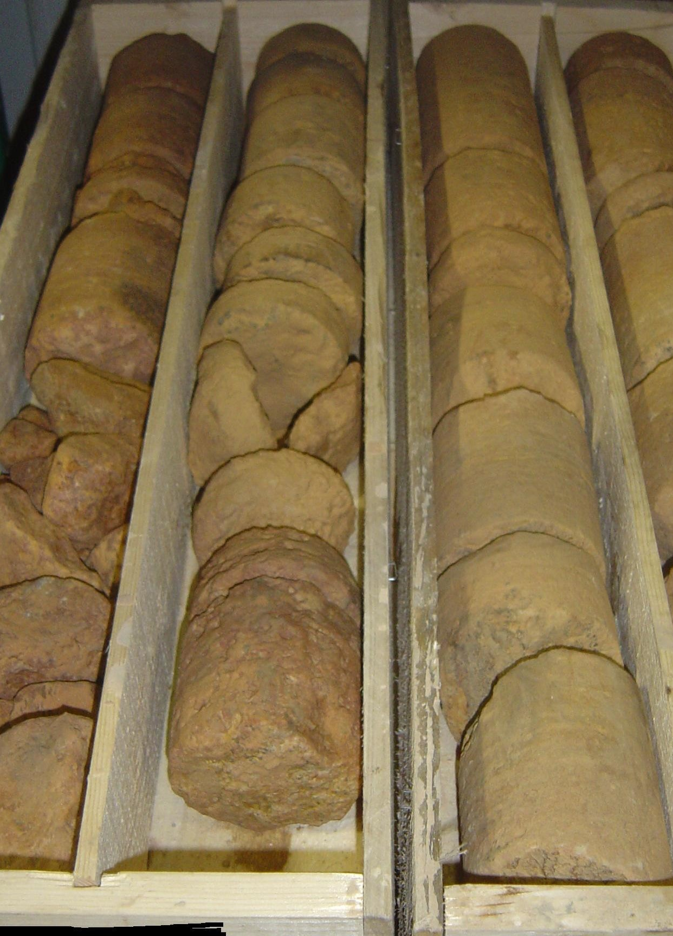
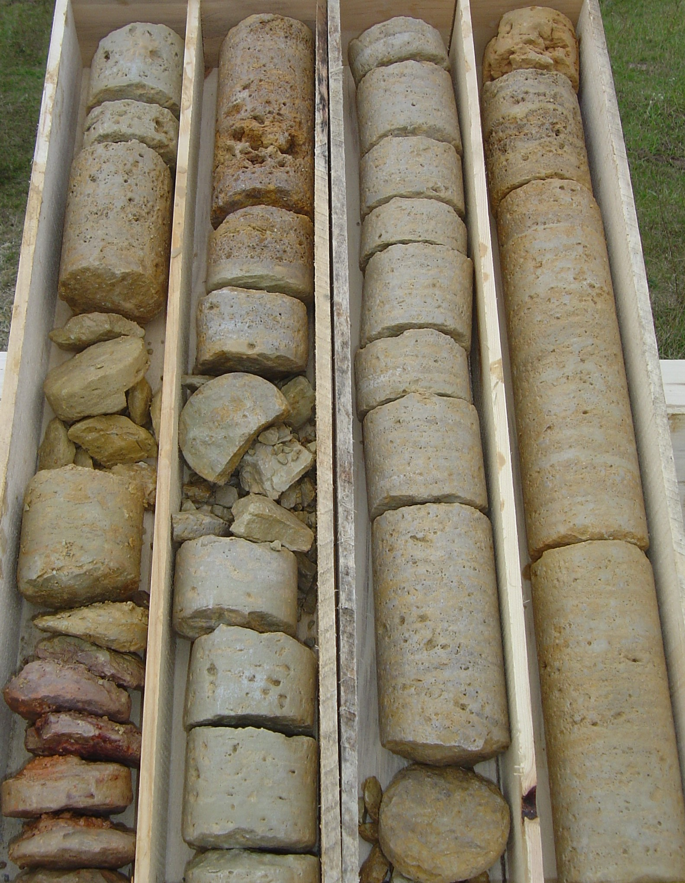
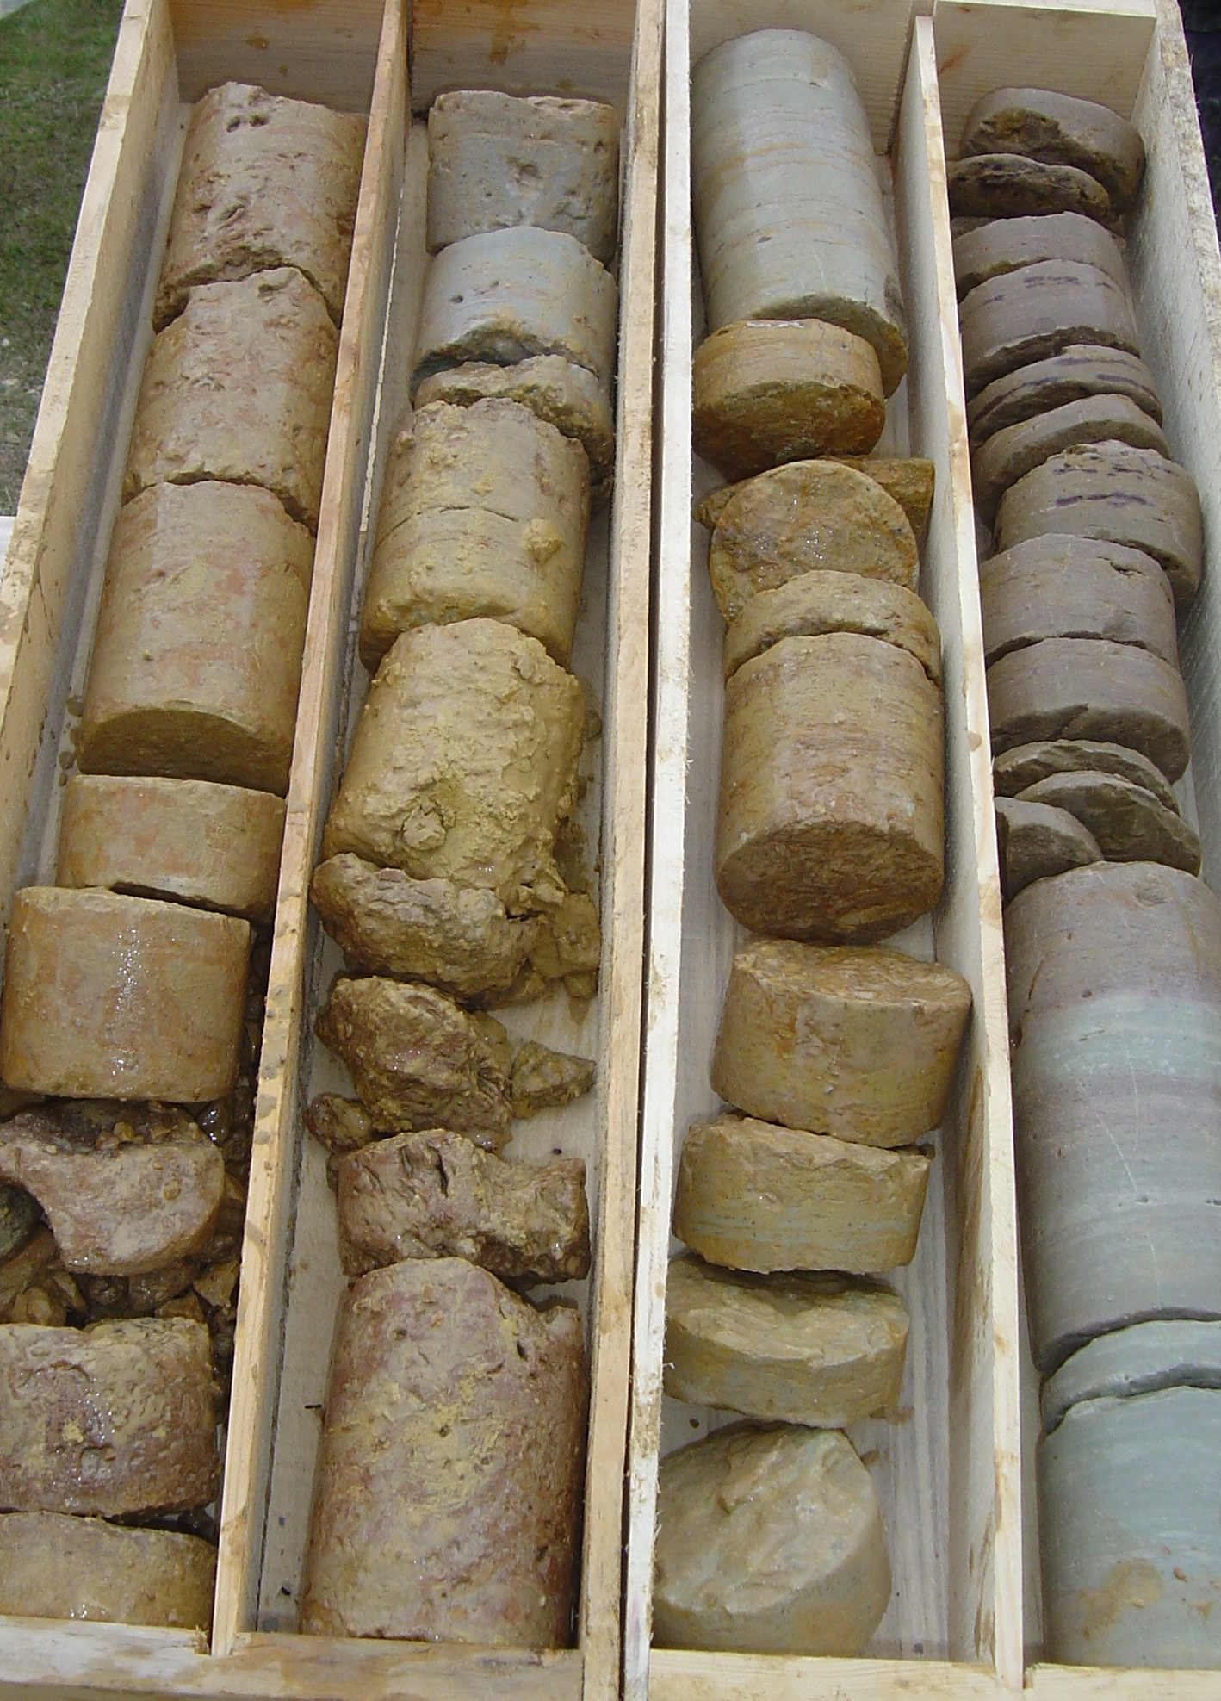
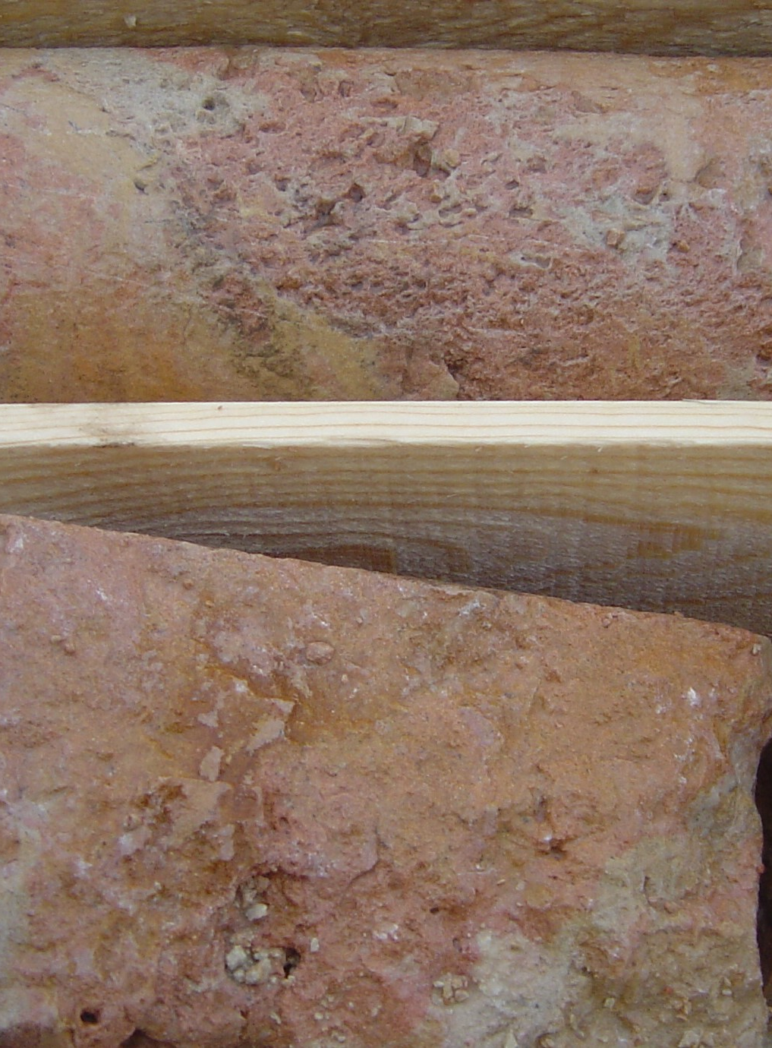
Rock Coring
Limestone Solution Cavities
Dolomite Core Recovery
Limestone Core Recovery
Limestone Core Color Change
Used in (Sandstones, Shales, Limestones, Dolomites, Marl and some course granites) It does not like some siltstones and quart formations around the Sandborn MN and finer granites and taconite

Slide 9
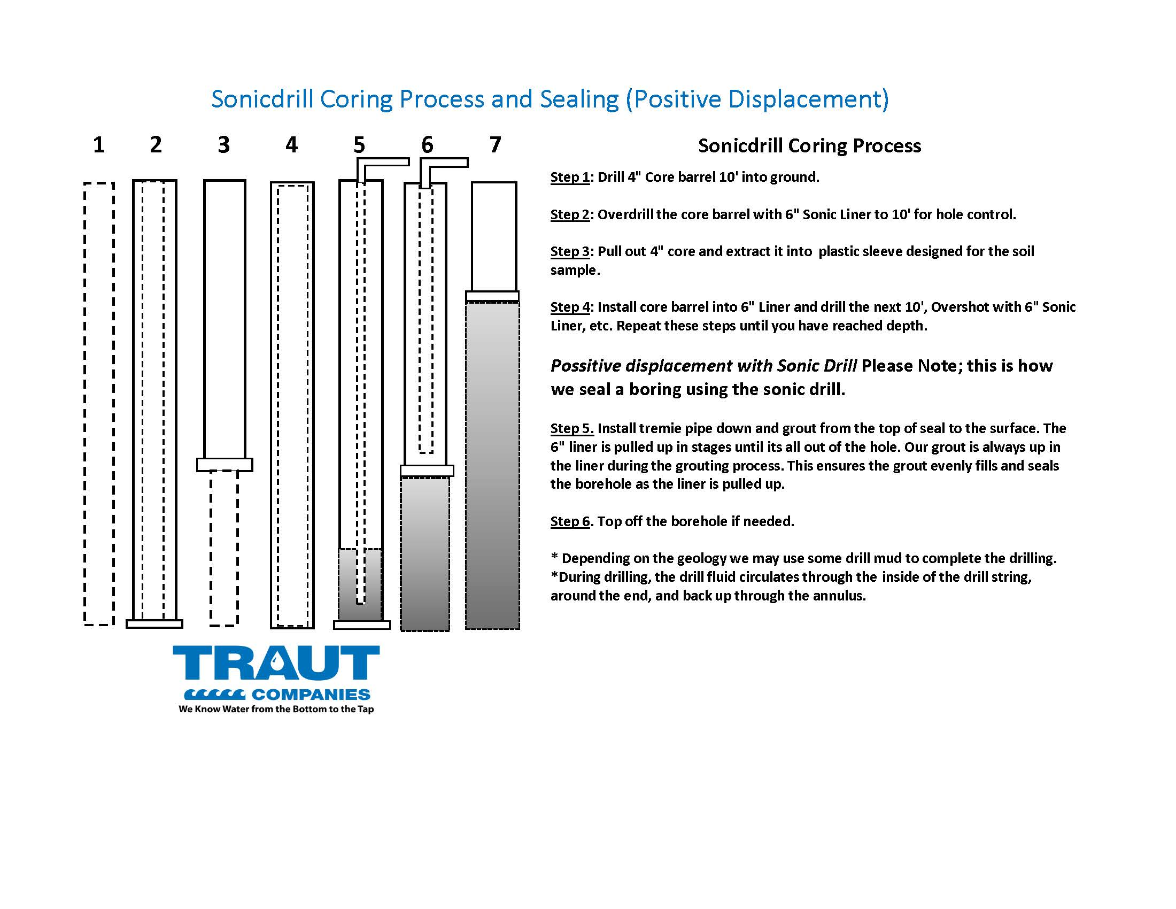
Coring Procedures
For Standard Core Process
Drilling Dry Process
Drilling Wet Process

Slide 10
Bedrock Coring
Core Process
(Same steps as standard core process but with the use of fluids depending on geology)
Our Rock coring has been developed by Traut to meet our client’s needs. Our system drills dry at the bit and uses fluid to displace the bit cuttings while we advance the core. This will give you a very accurate sample but not always dry because of the use of drill fluid.

Slide 11
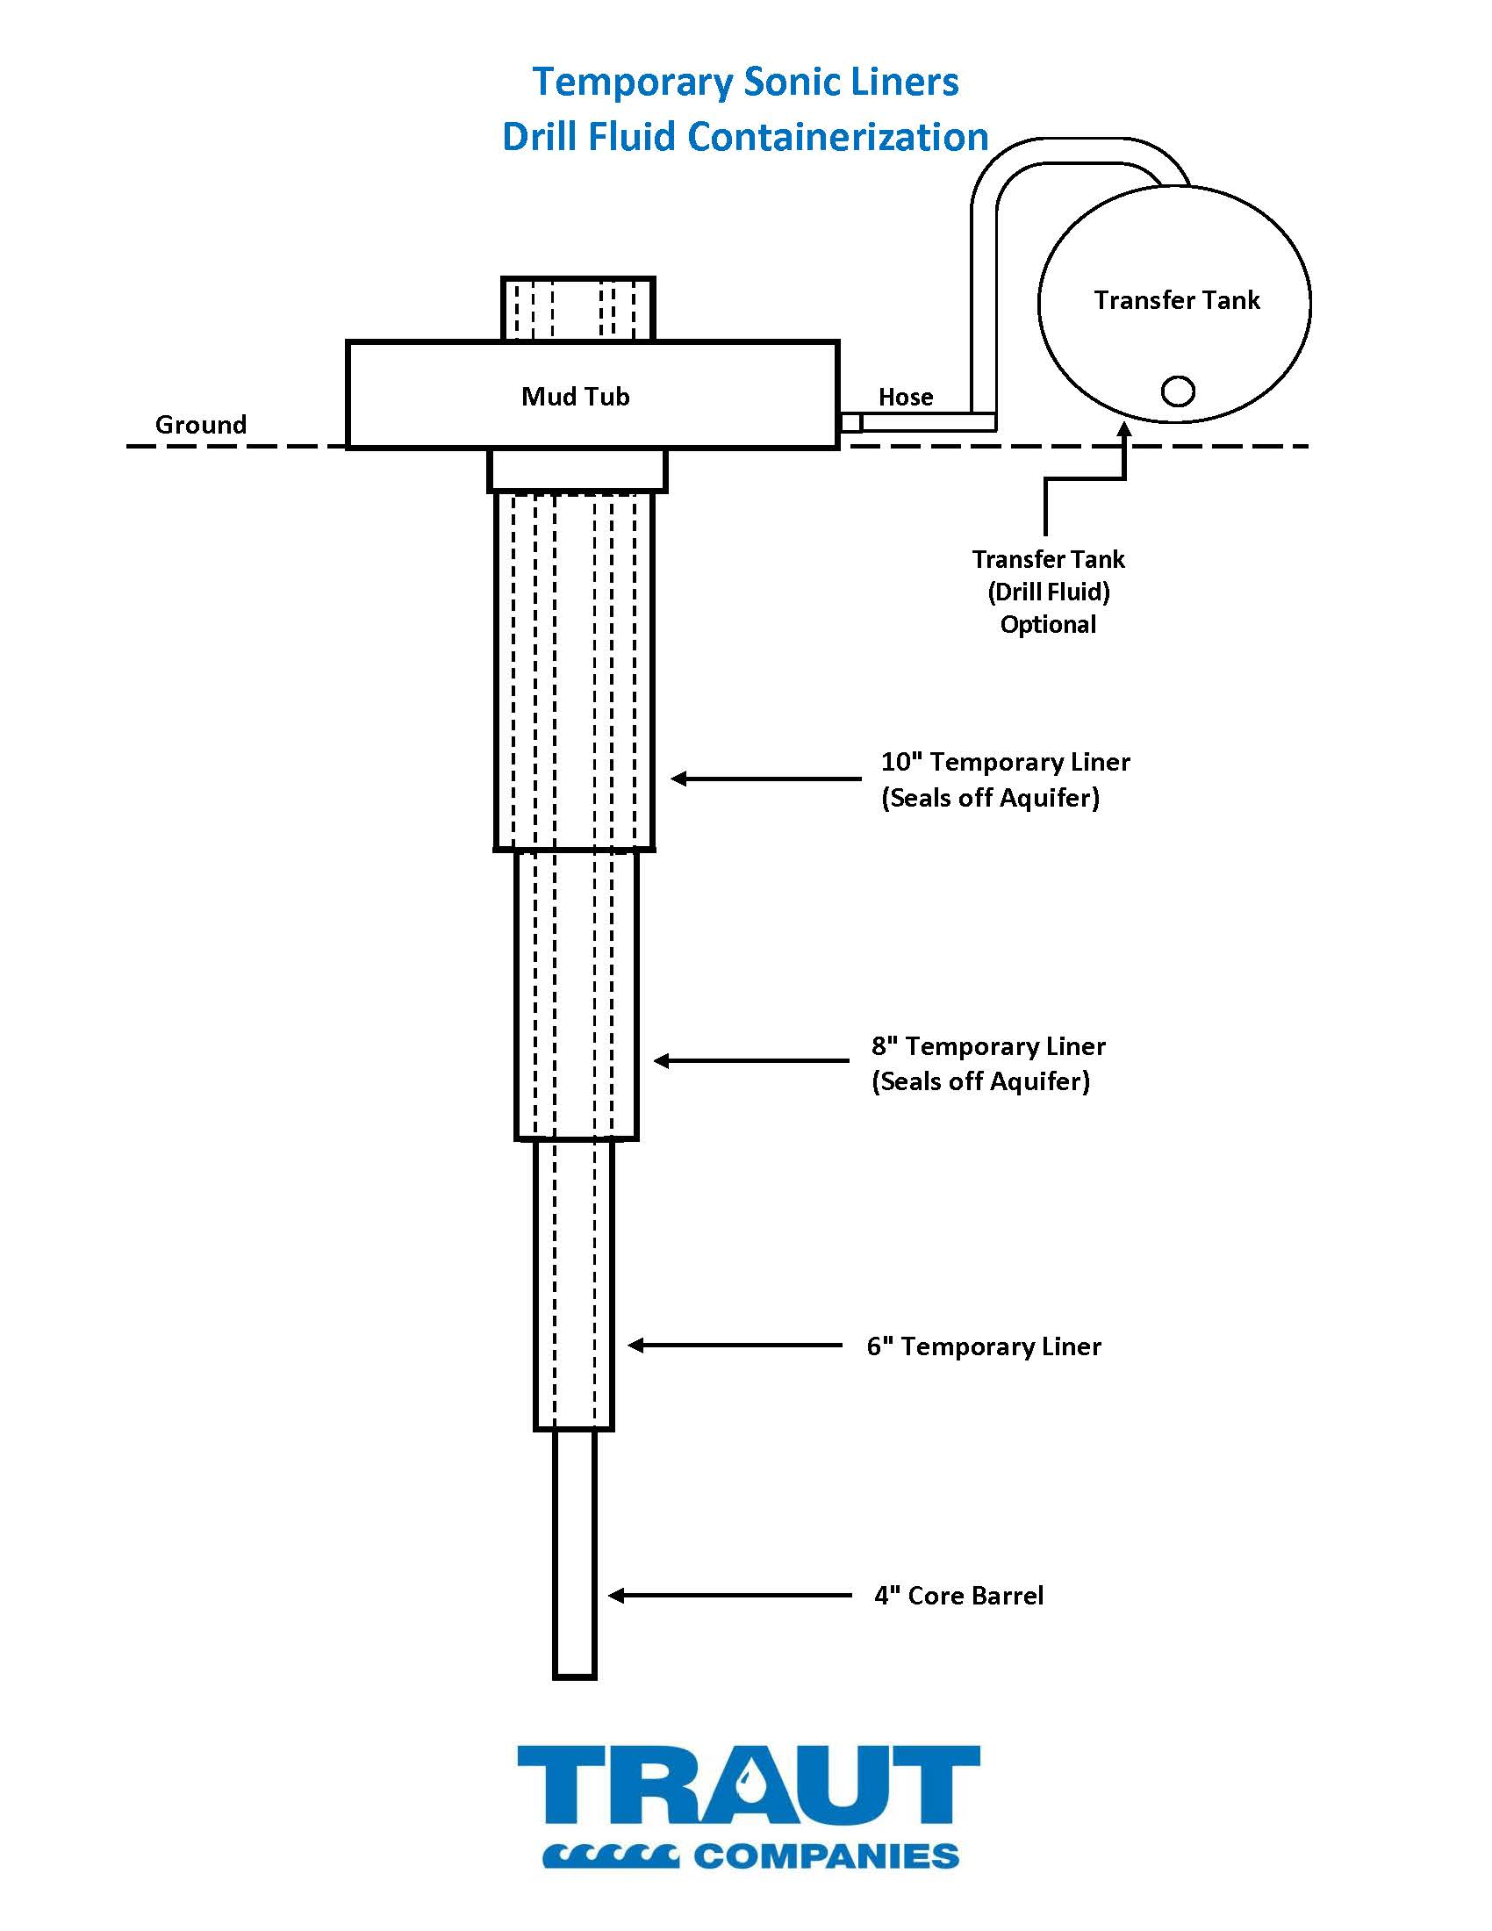
Containment of IDW Fluids & Cuttings Handling
Drill fluid is pumped into a 1000-gallon transfer tank and then to a dumpster for staging area transport.
Traut will be receiving a custom-designed unit (MUD PUPPY) for improved efficiency.
This unit is designed to separate soil particles from drill fluid directly at the borehole.
The entire drilling process can be contained for proper discharge and environmental compliance.

Slide 12
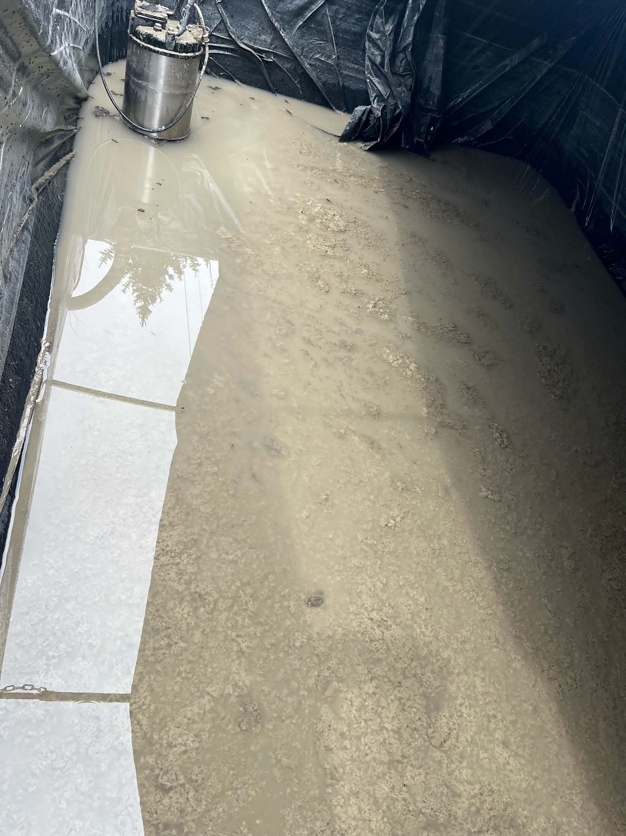
Drill fluid before processing

Slide 13
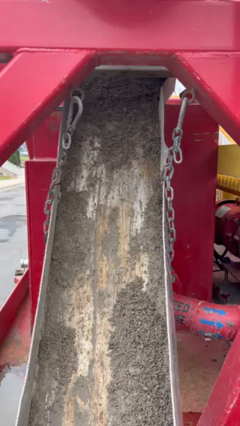
Solids from Centrifuge

Slide 14
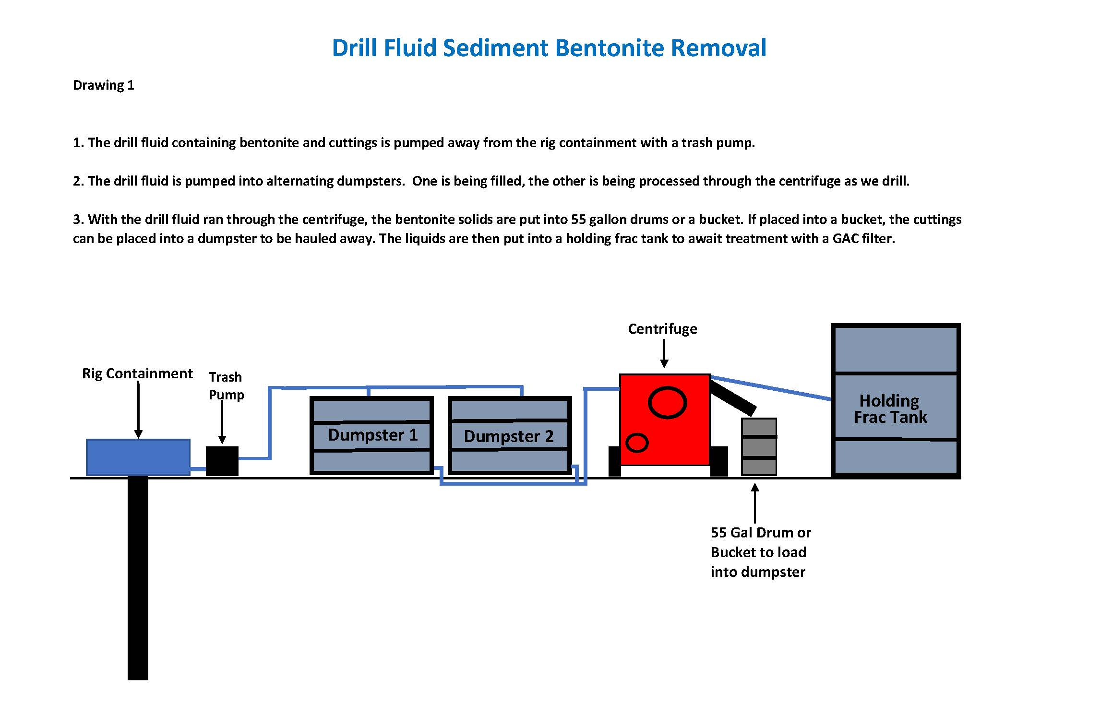
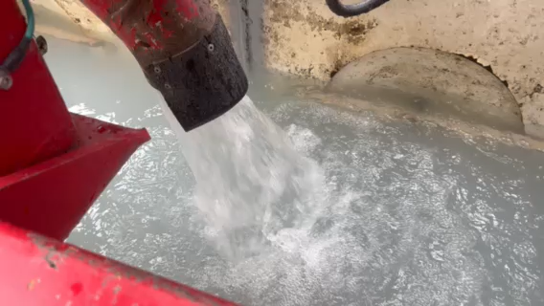
Drill fluid sediment & bentonite removal

Slide 15
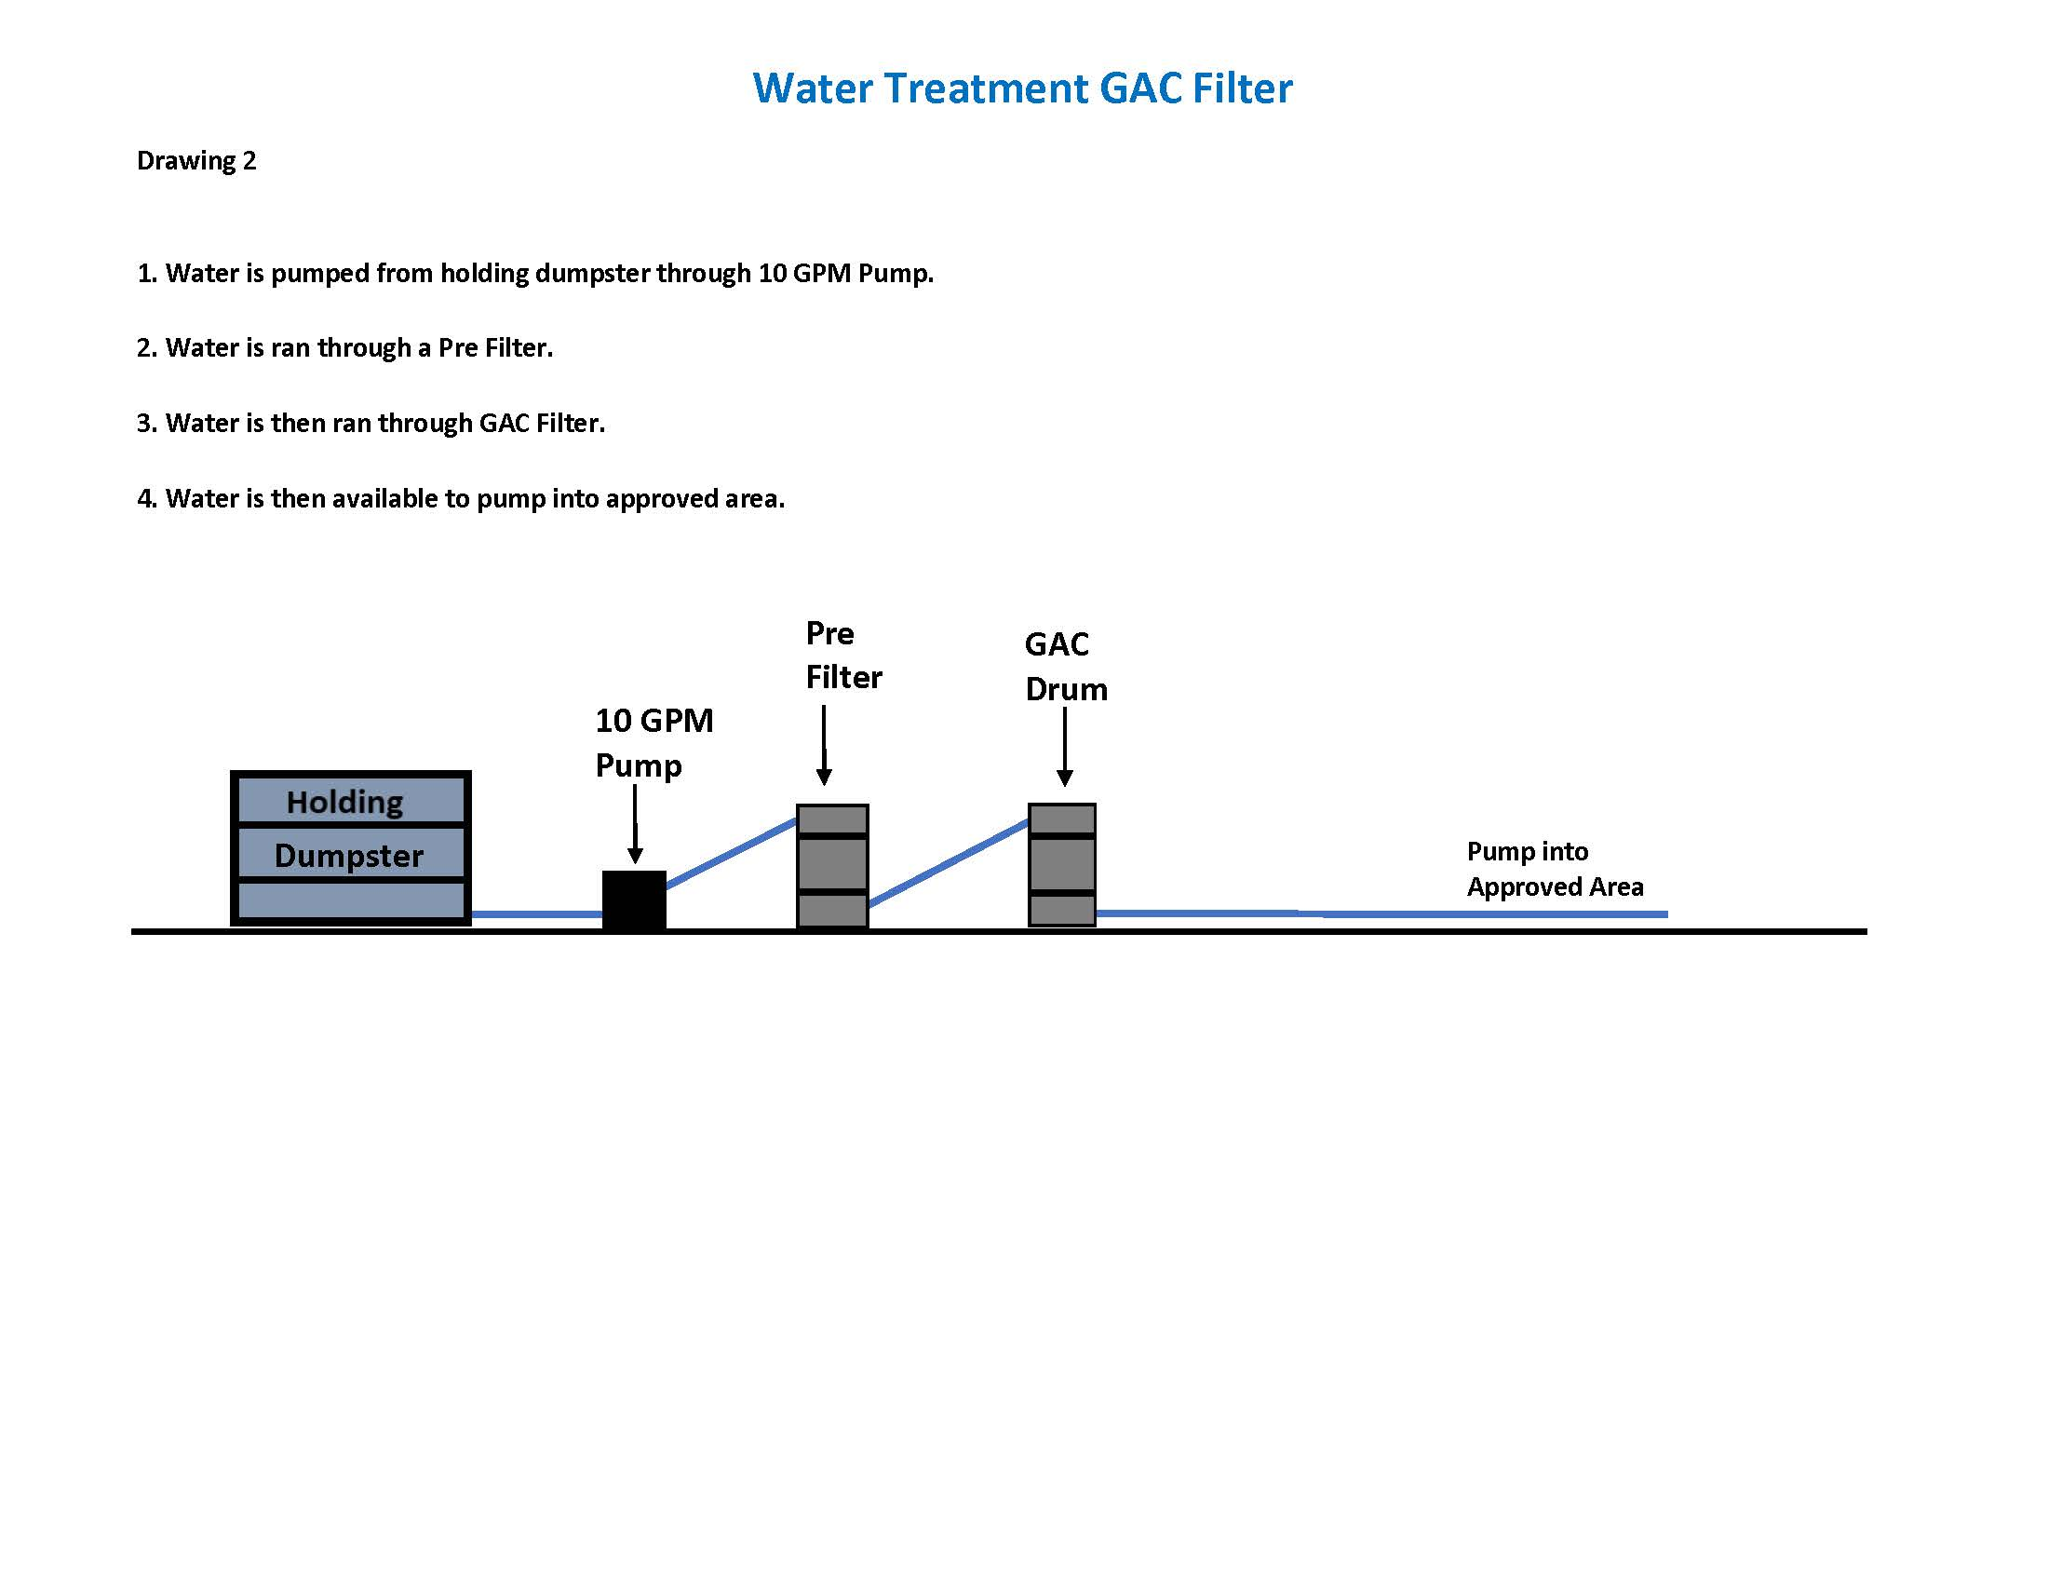
GAC Treatment process for PFAS

Slide 16
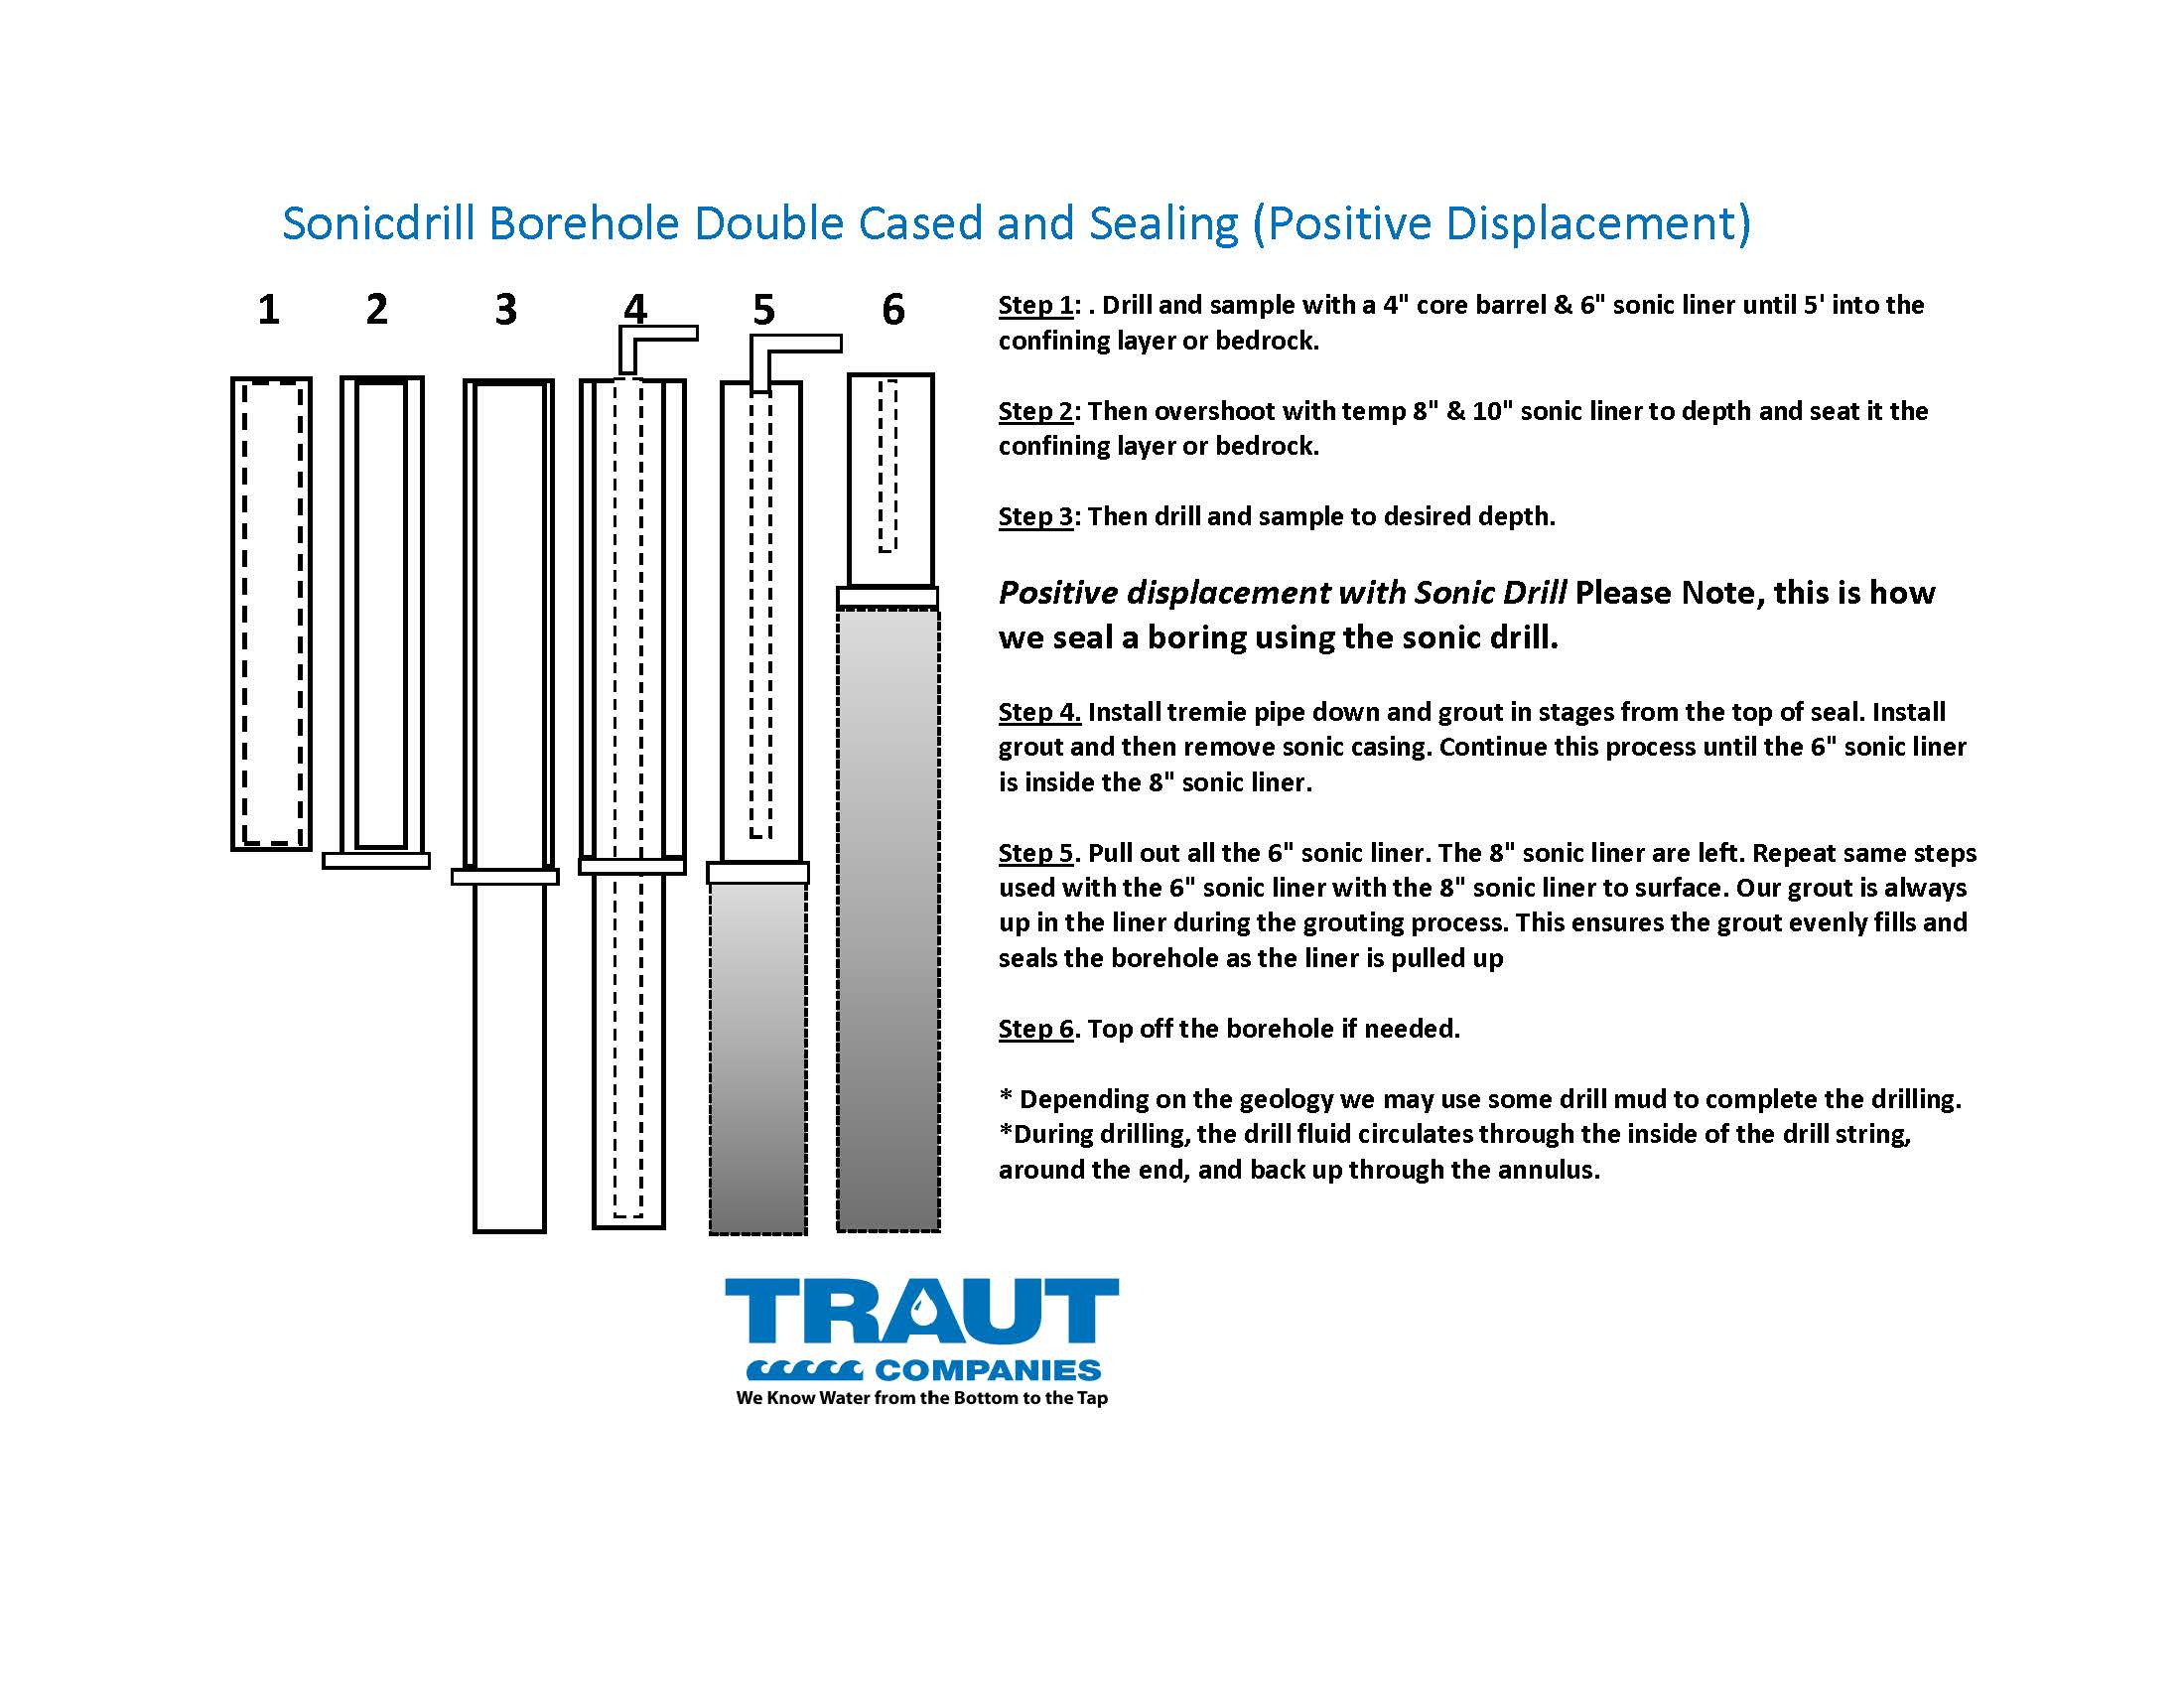
Sonic borehole with temp liner

Slide 17
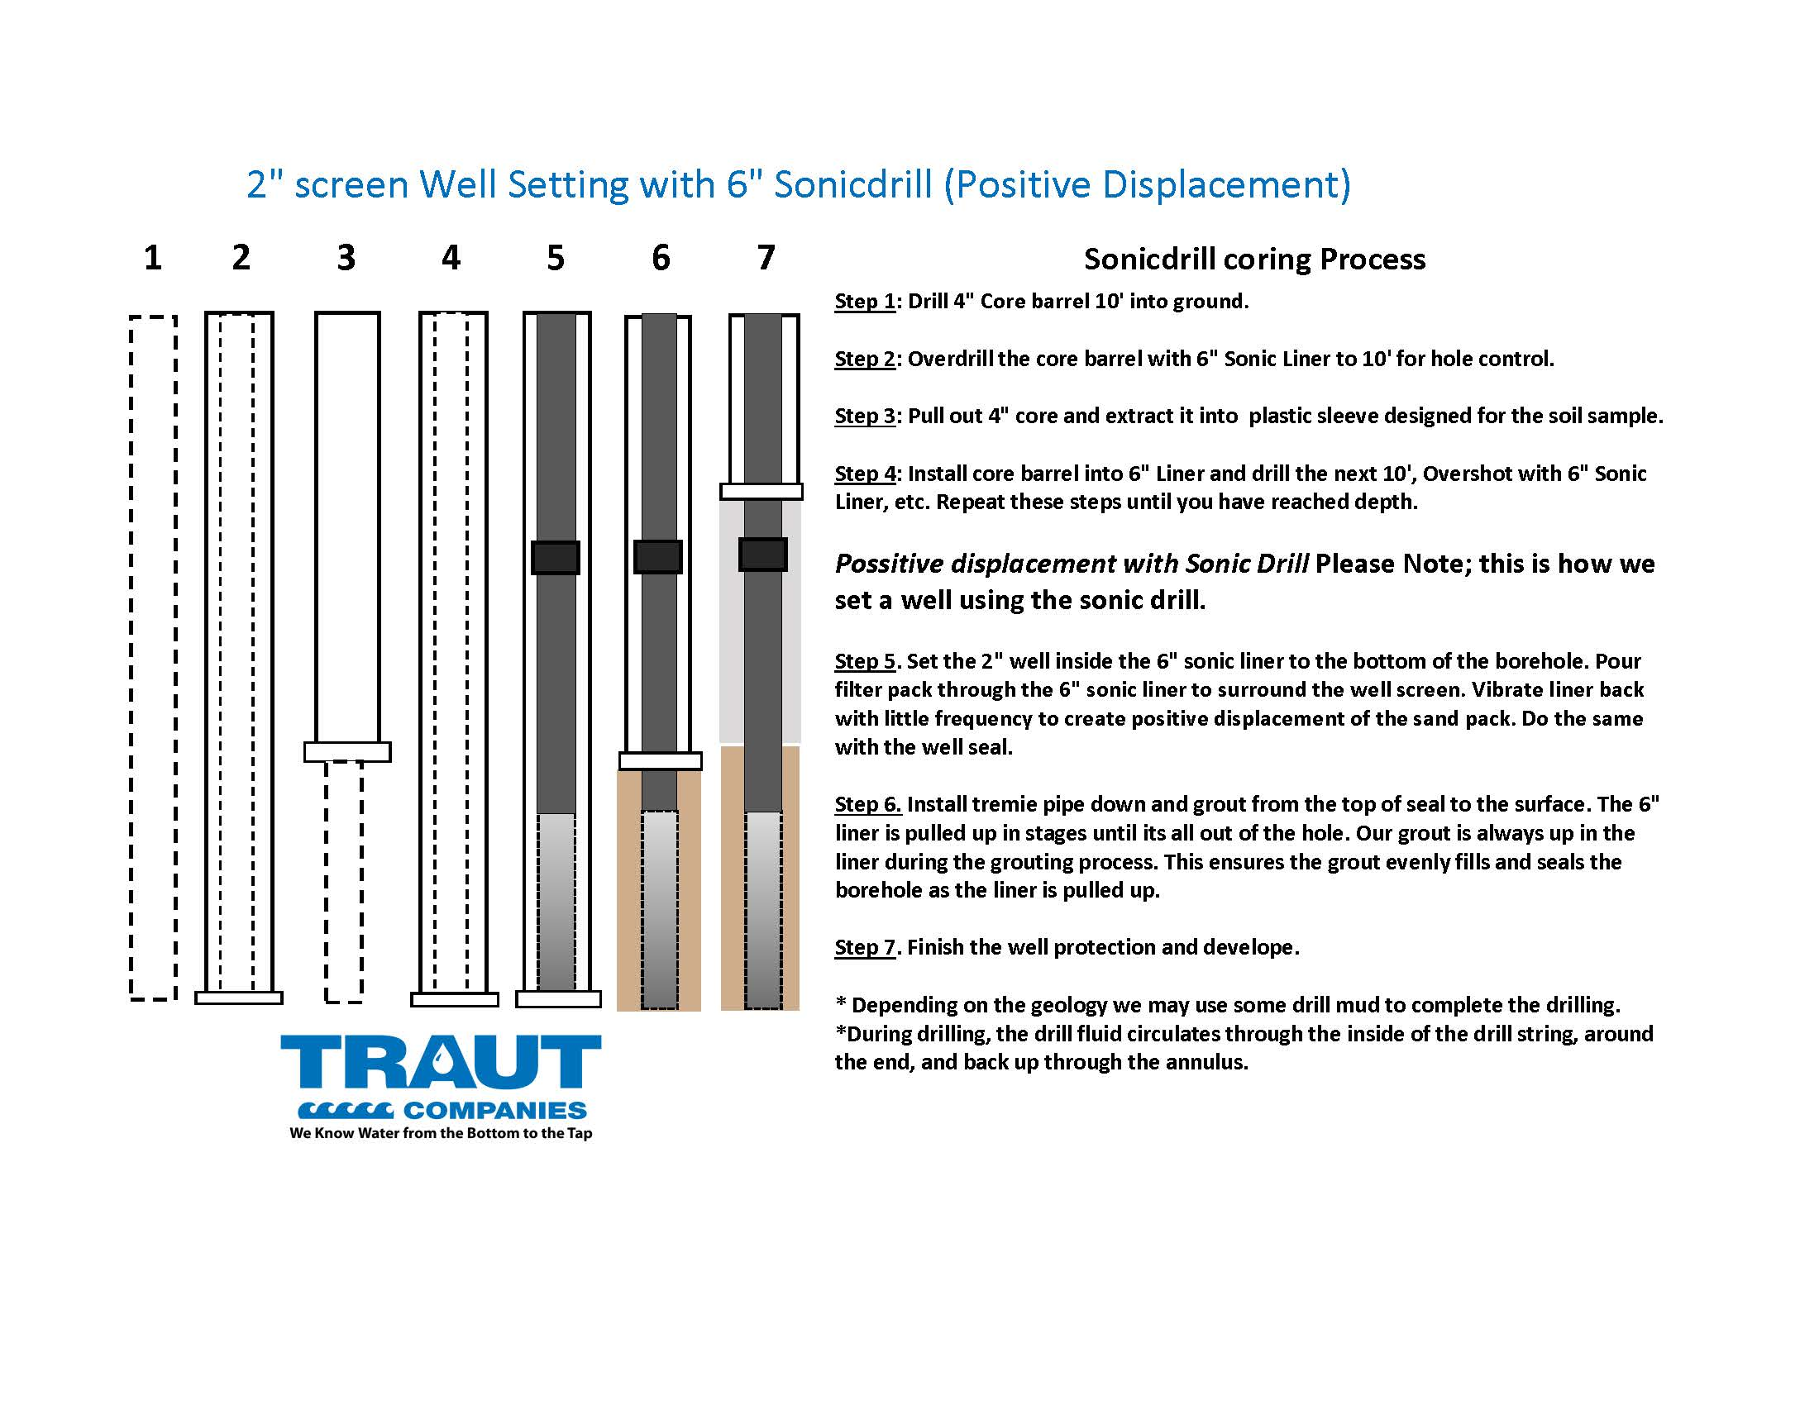
2” Well setting
(using positive displacement)

Slide 18
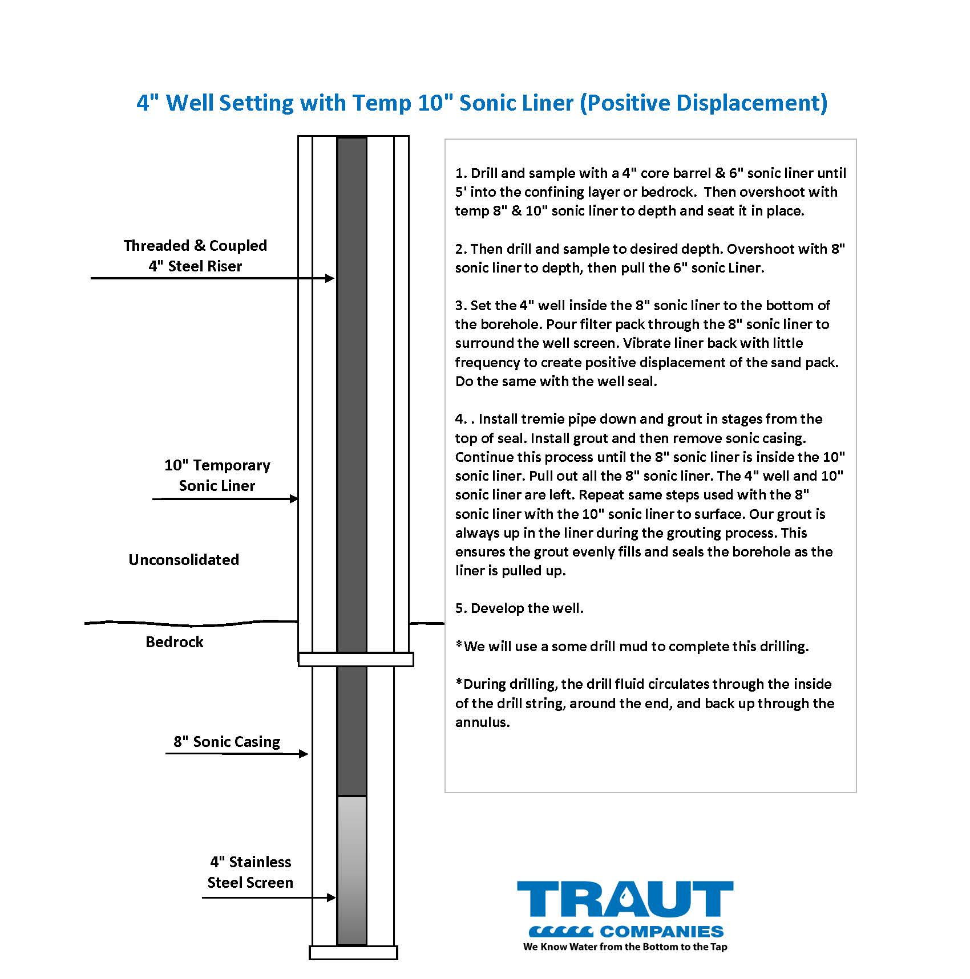
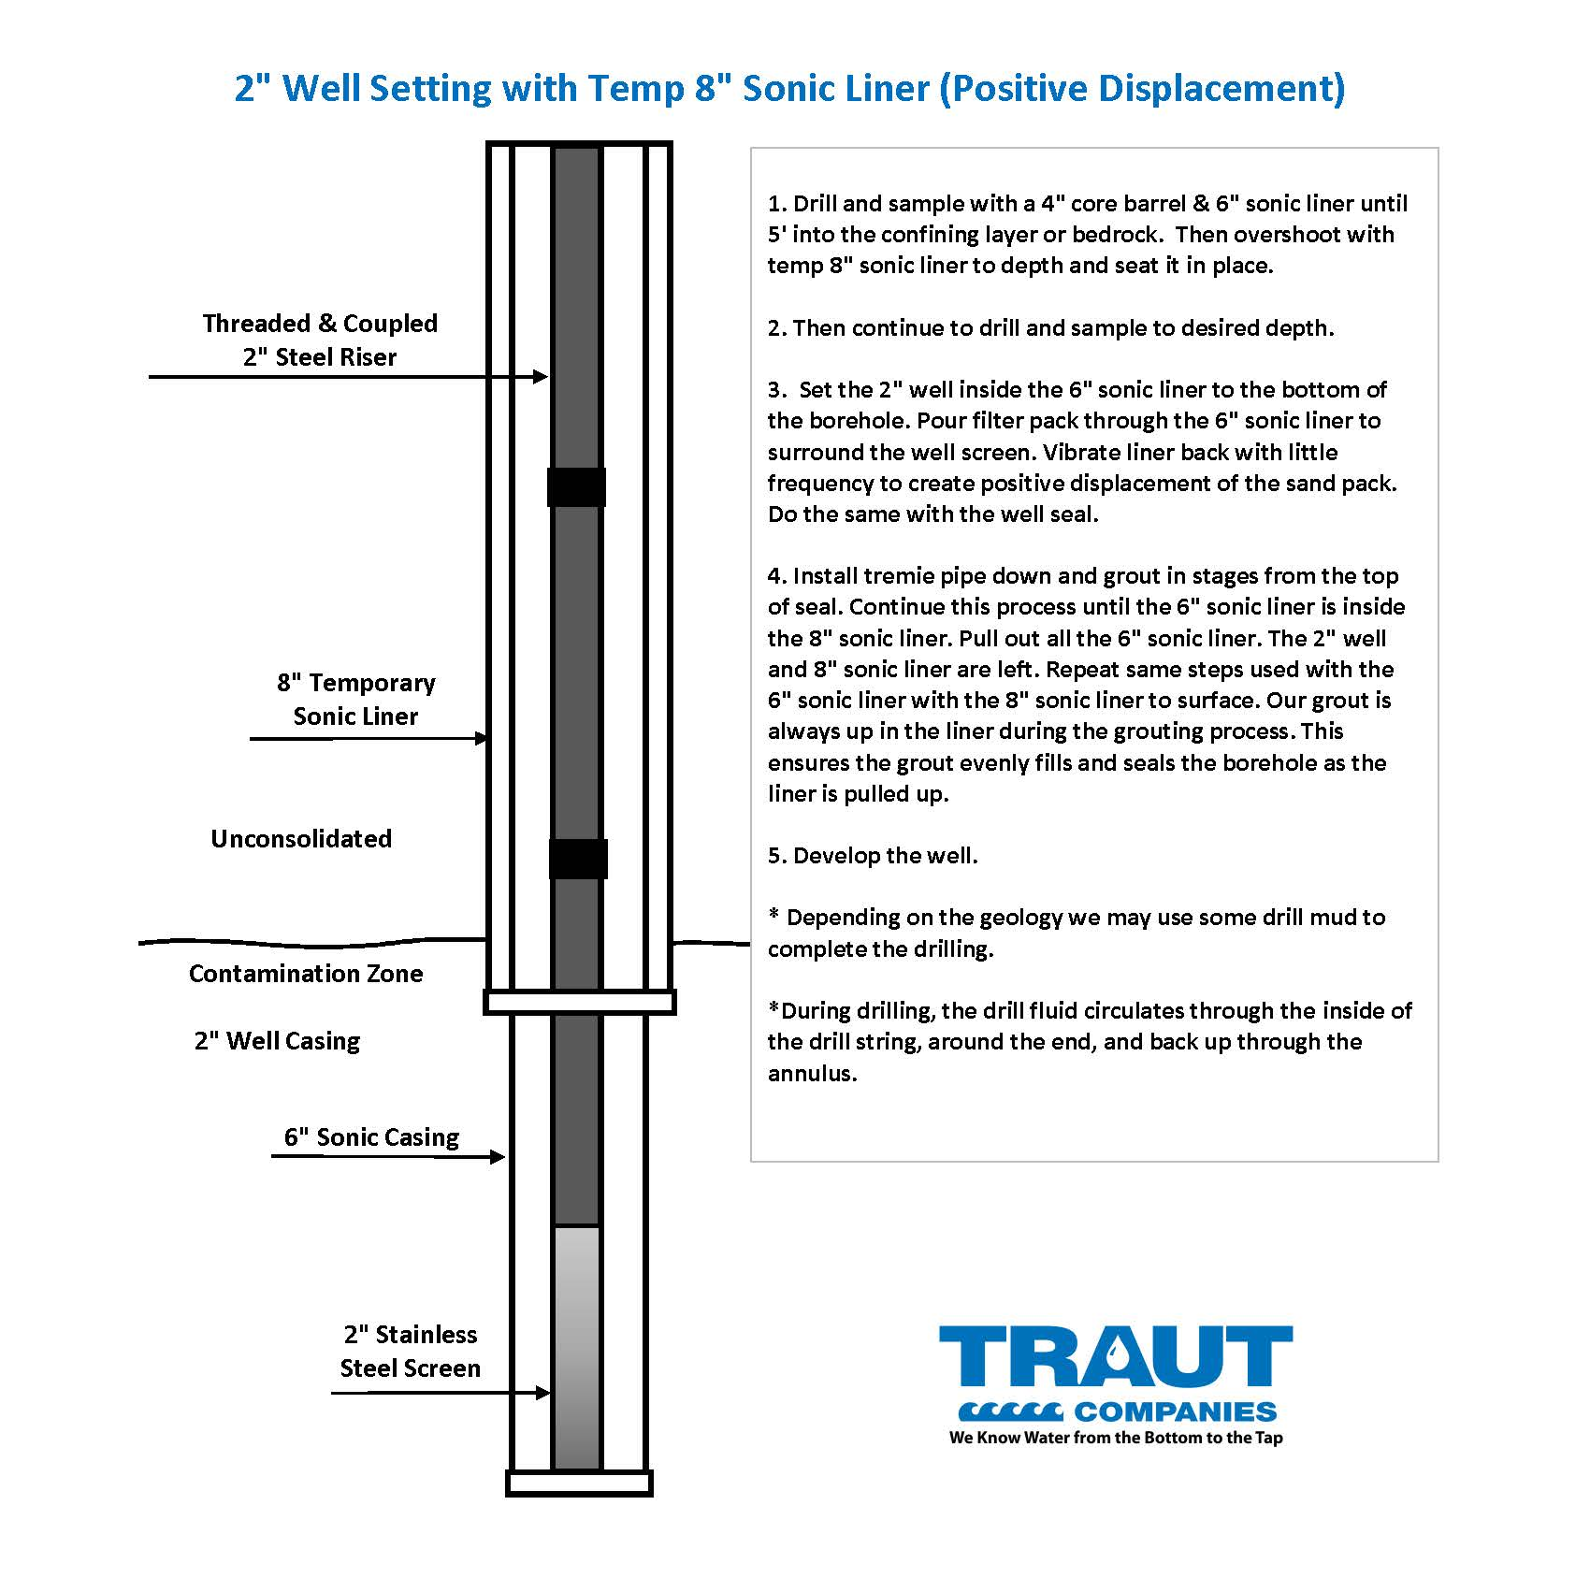
4” Well Setting
2” Well Setting

Slide 19
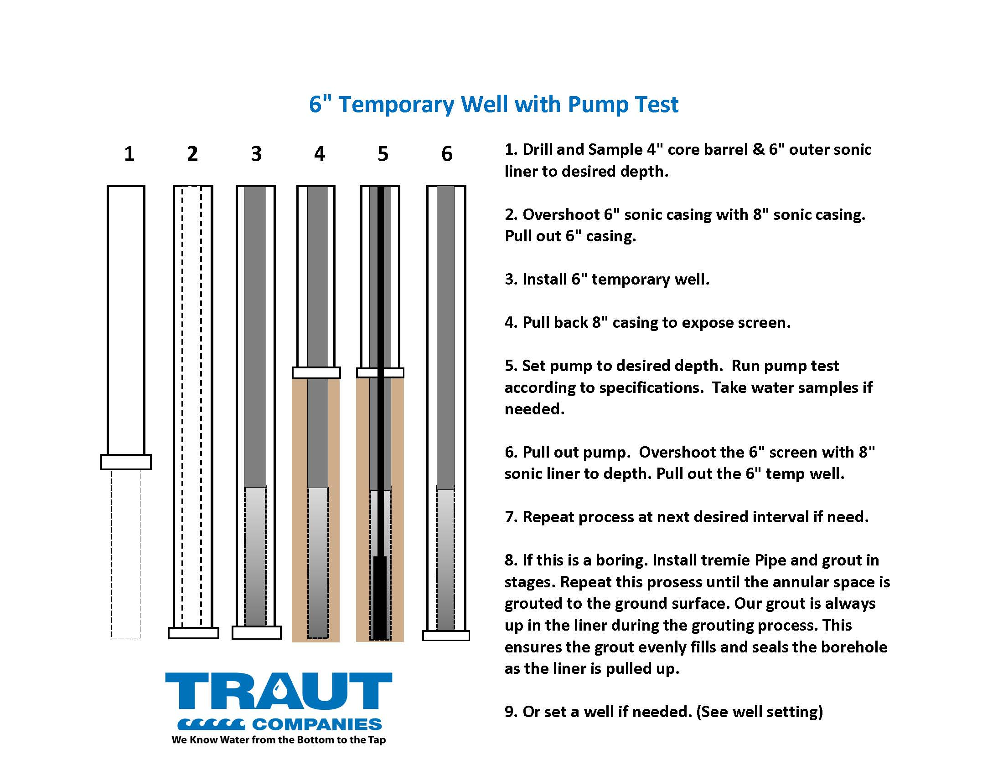

Slide 20
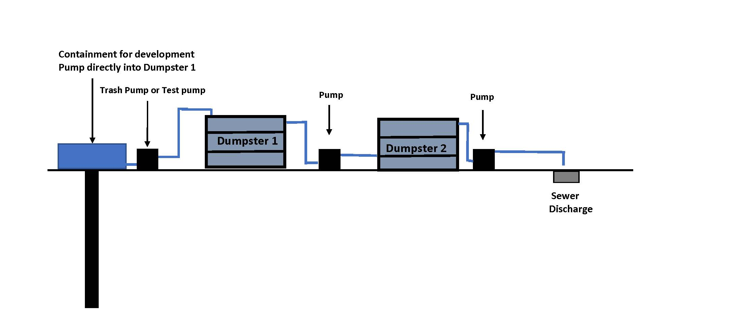

Slide 21
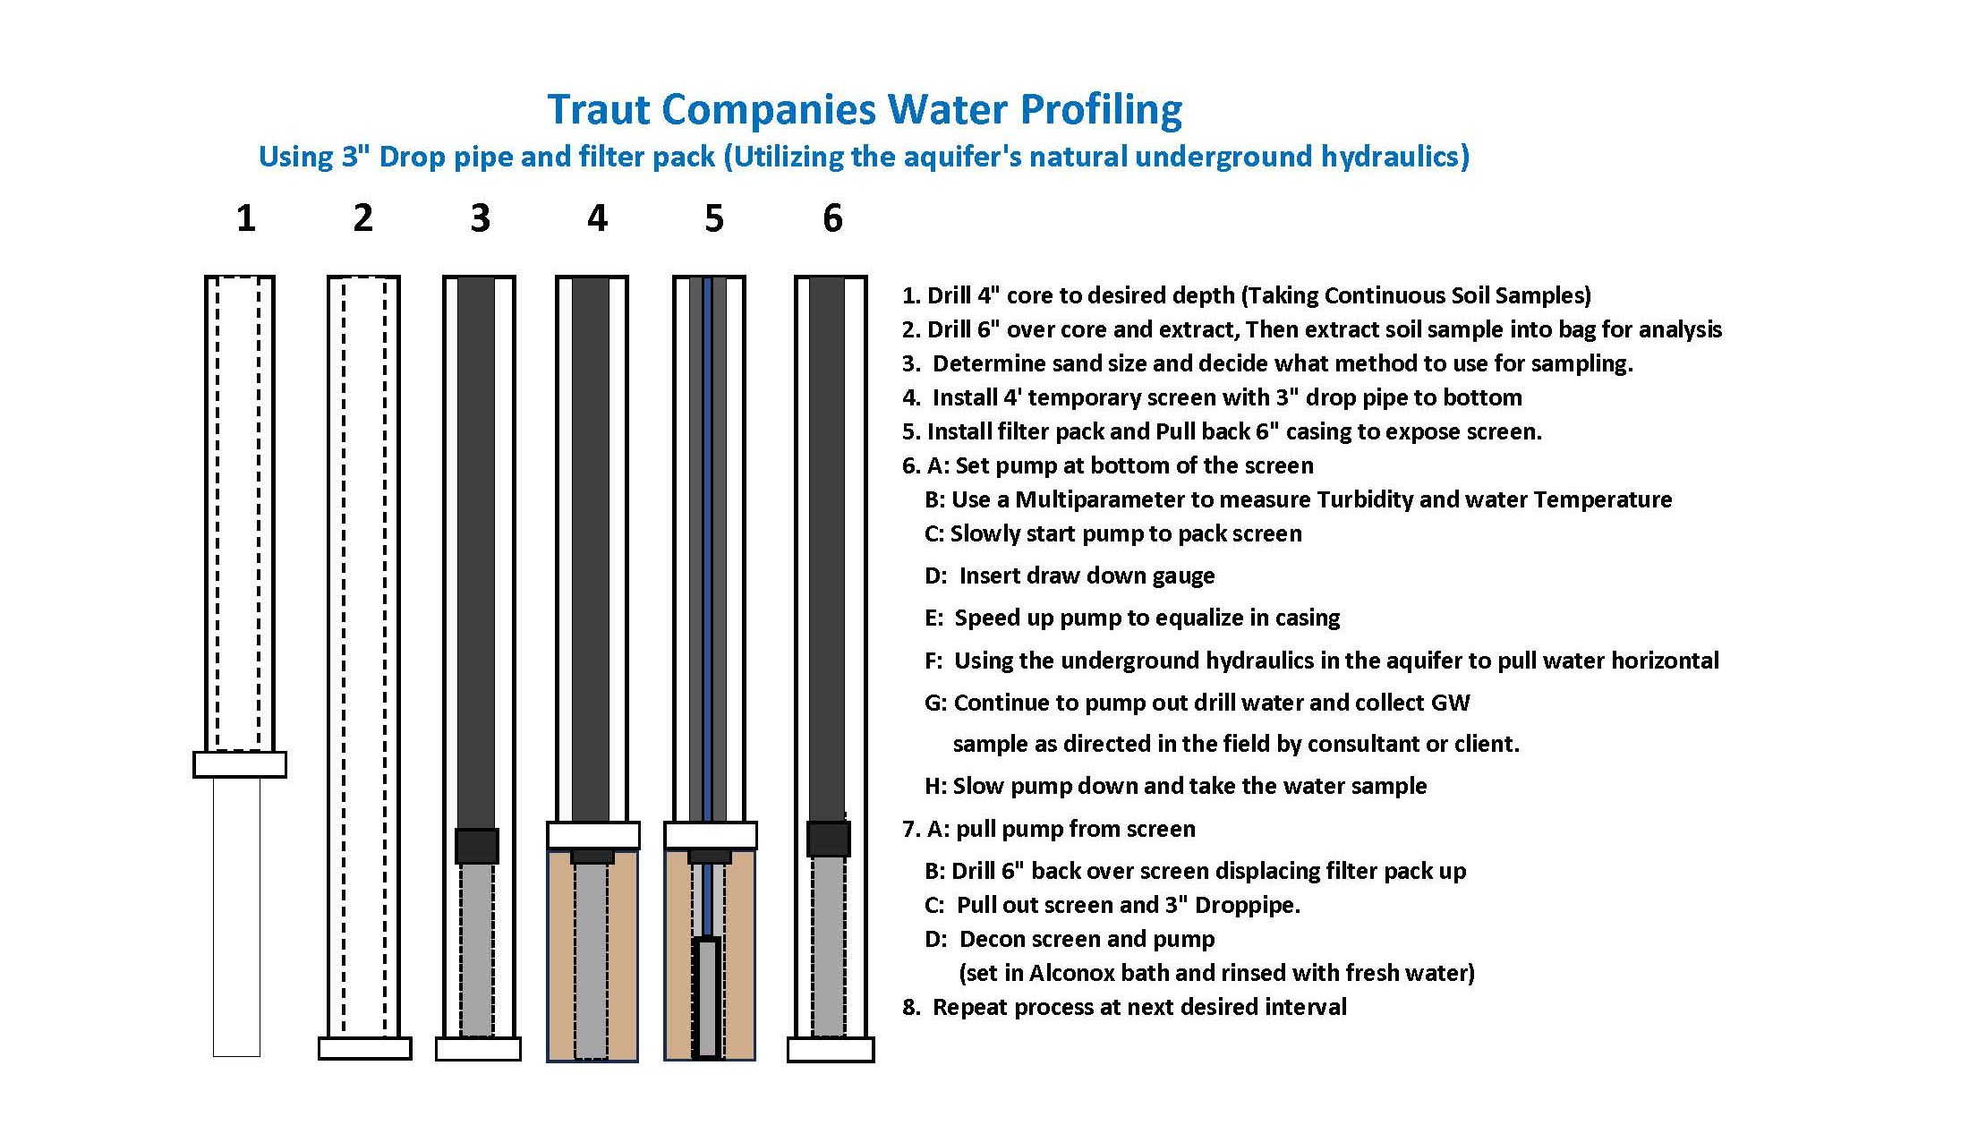

Slide 22

Meet Our Team

Slide 23
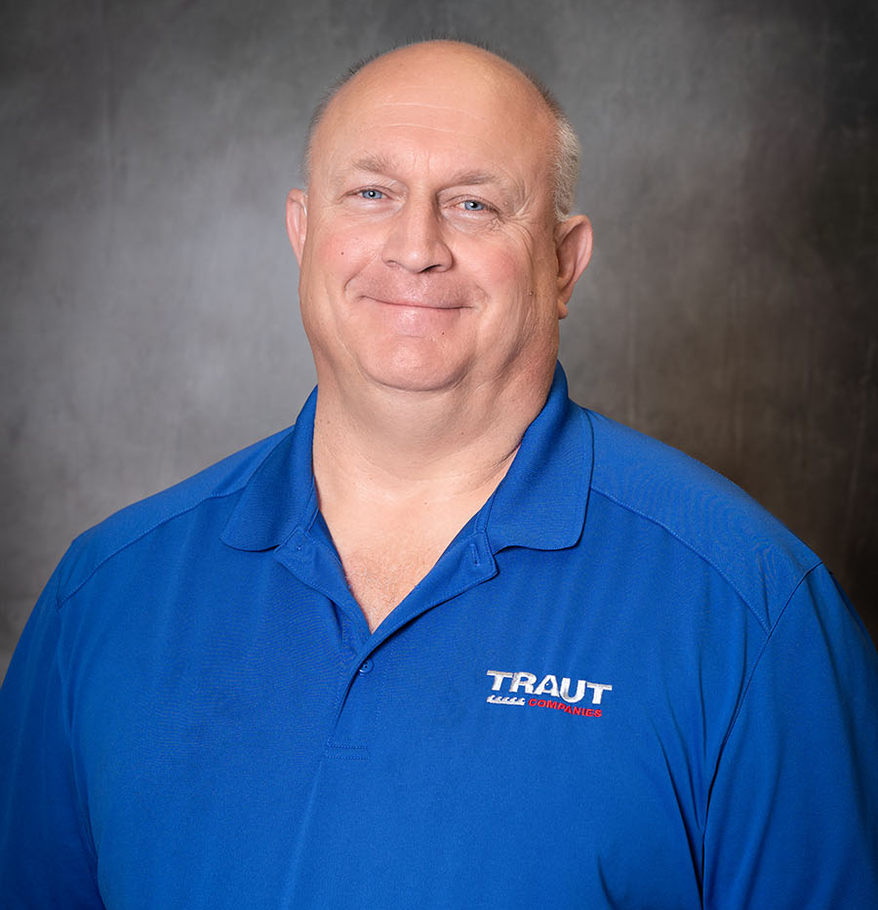
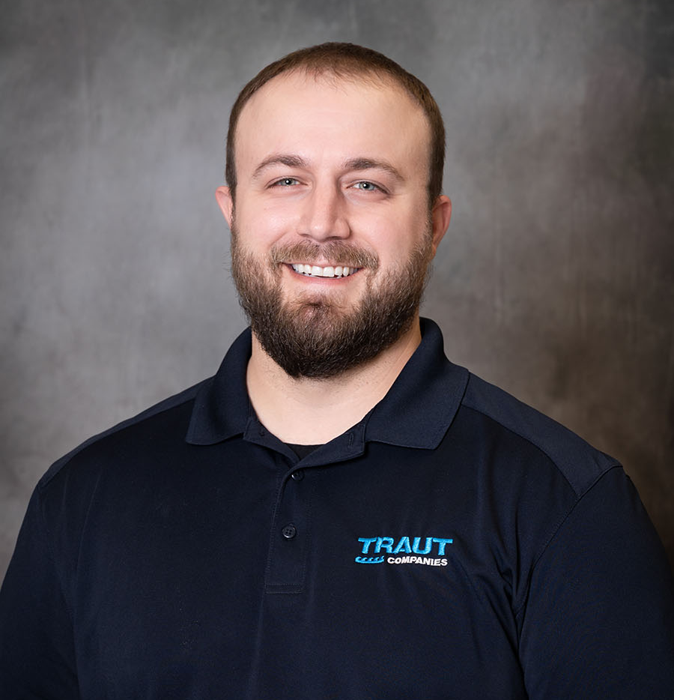
Daryl Karasch
President/Sonic Drilling Manager
Dan Karasch
Geoprobe Manager

Slide 24
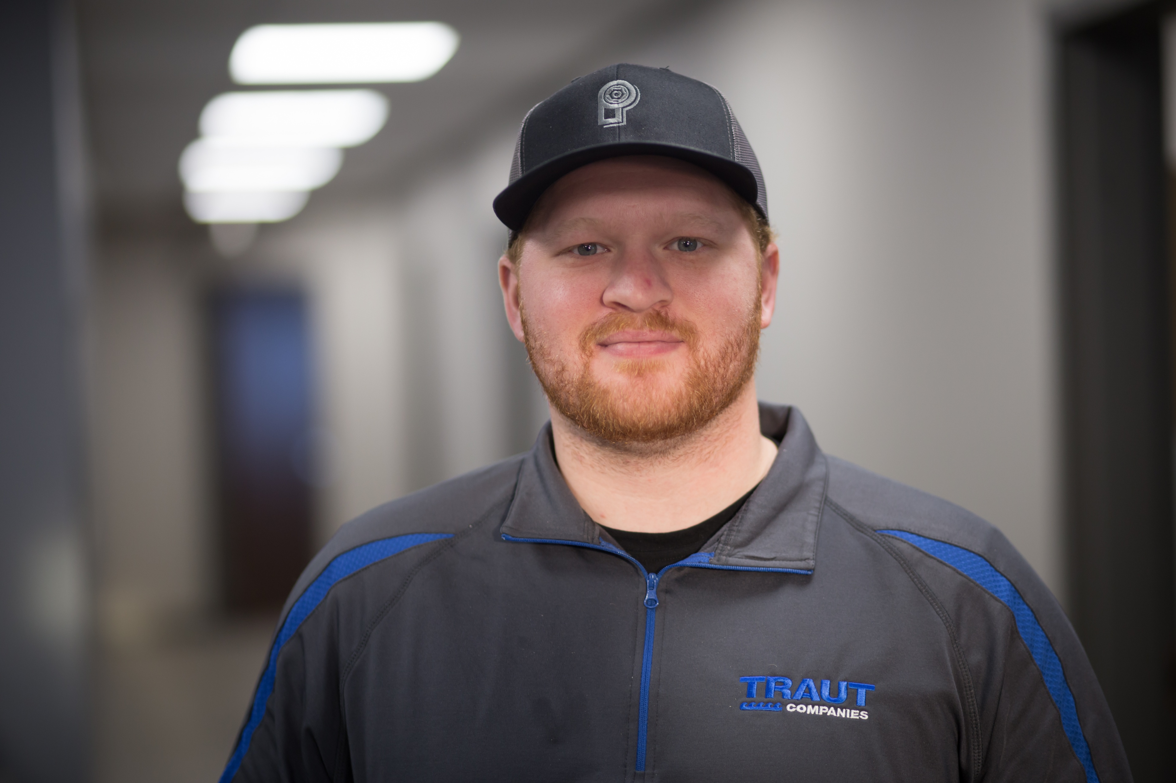
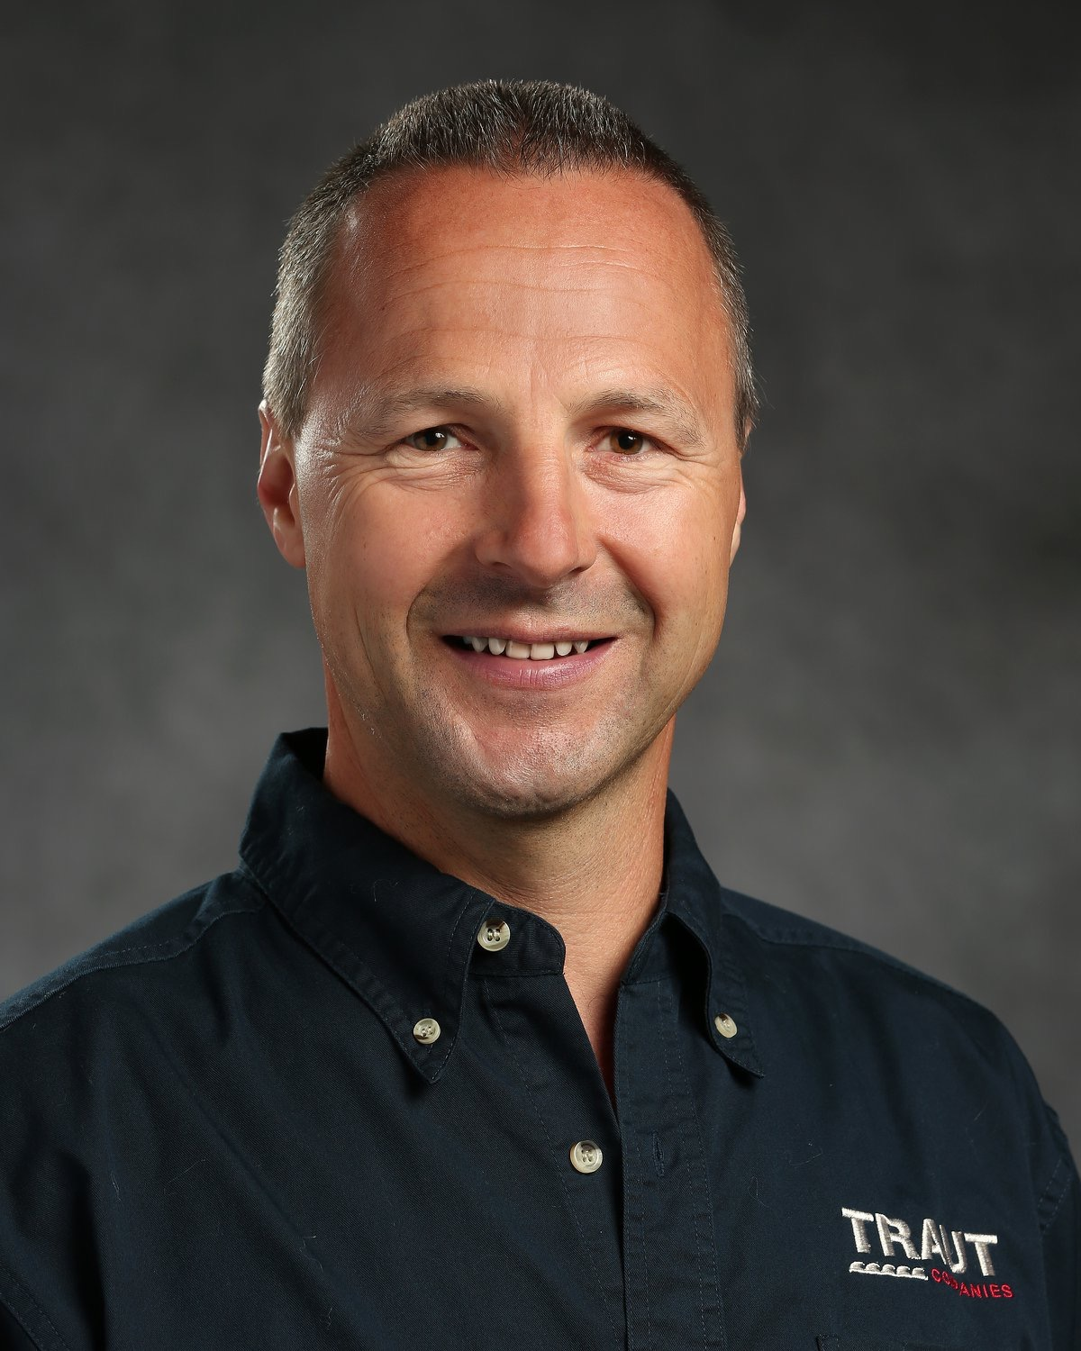
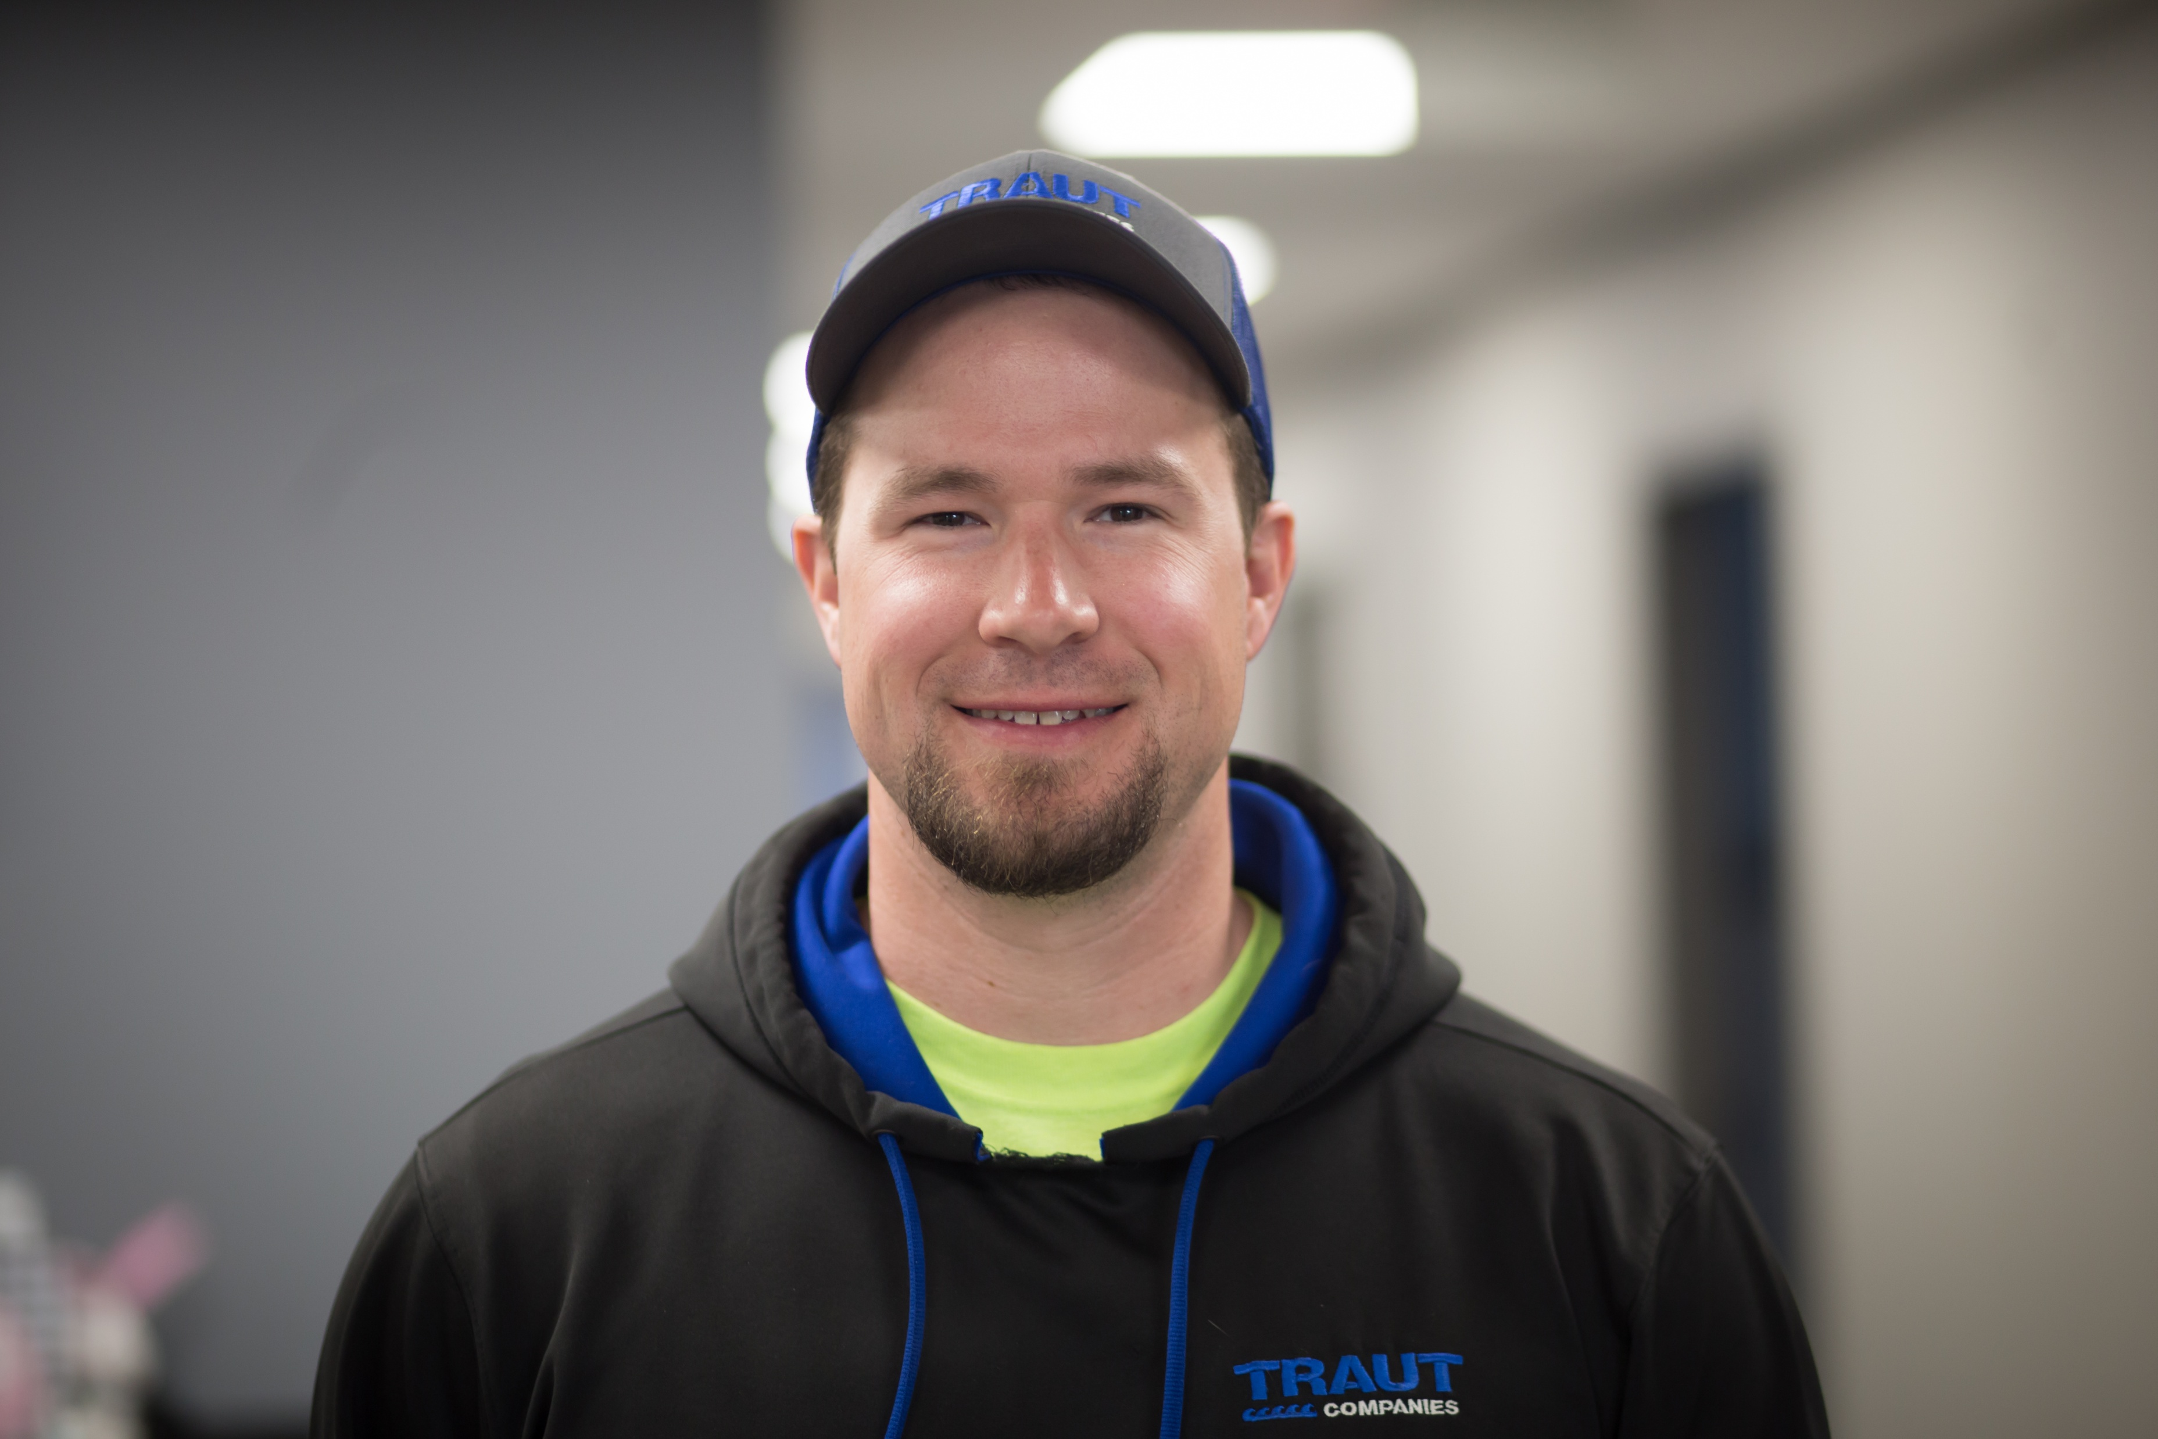
Jake Tomsche
Rotary Drilling Manager
Joe Traut
Municipal Pump Manager
Travis Traut
Dual Rotary Drilling Manager/Sales Engineer

