Slide 1
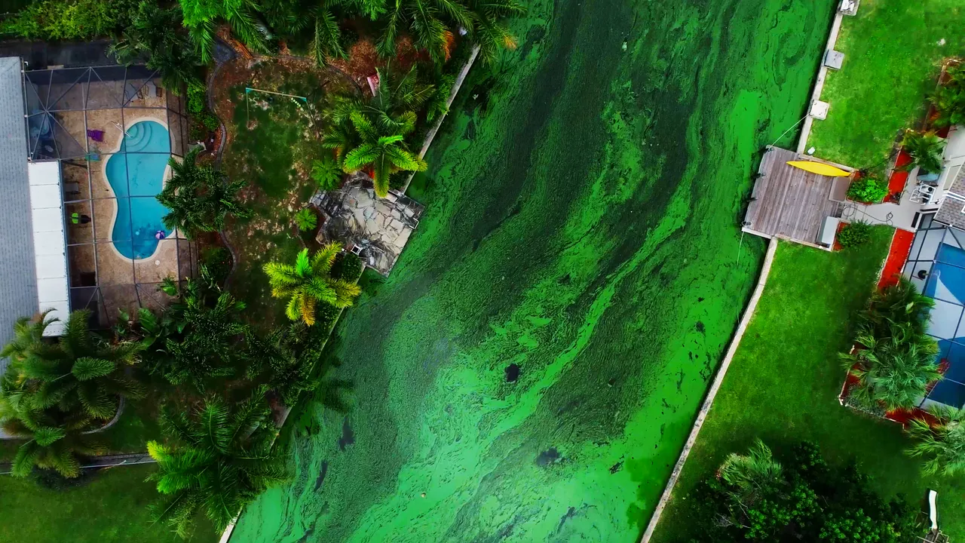



Beyond Conventional Nitrate Isotopes
Multi-isotope Fingerprinting Of Nutrient Contamination In South Florida Surface Waters
Arash Sharifi , Sean Ahearn, Zeneida Cernada, Kevin Reagan, Marlon Garcia, Keiran Swart and Stephany Rubin Mason
MGWA 2026
Isobarscience.com
info@isobarscience.com
Betalabservices.com
info@betalabservices.com
Notes:
Intro Slide
Top: Add Presentation Title, Bottom: Add Presenter Name(s) (Name, Affiliation)

Slide 2
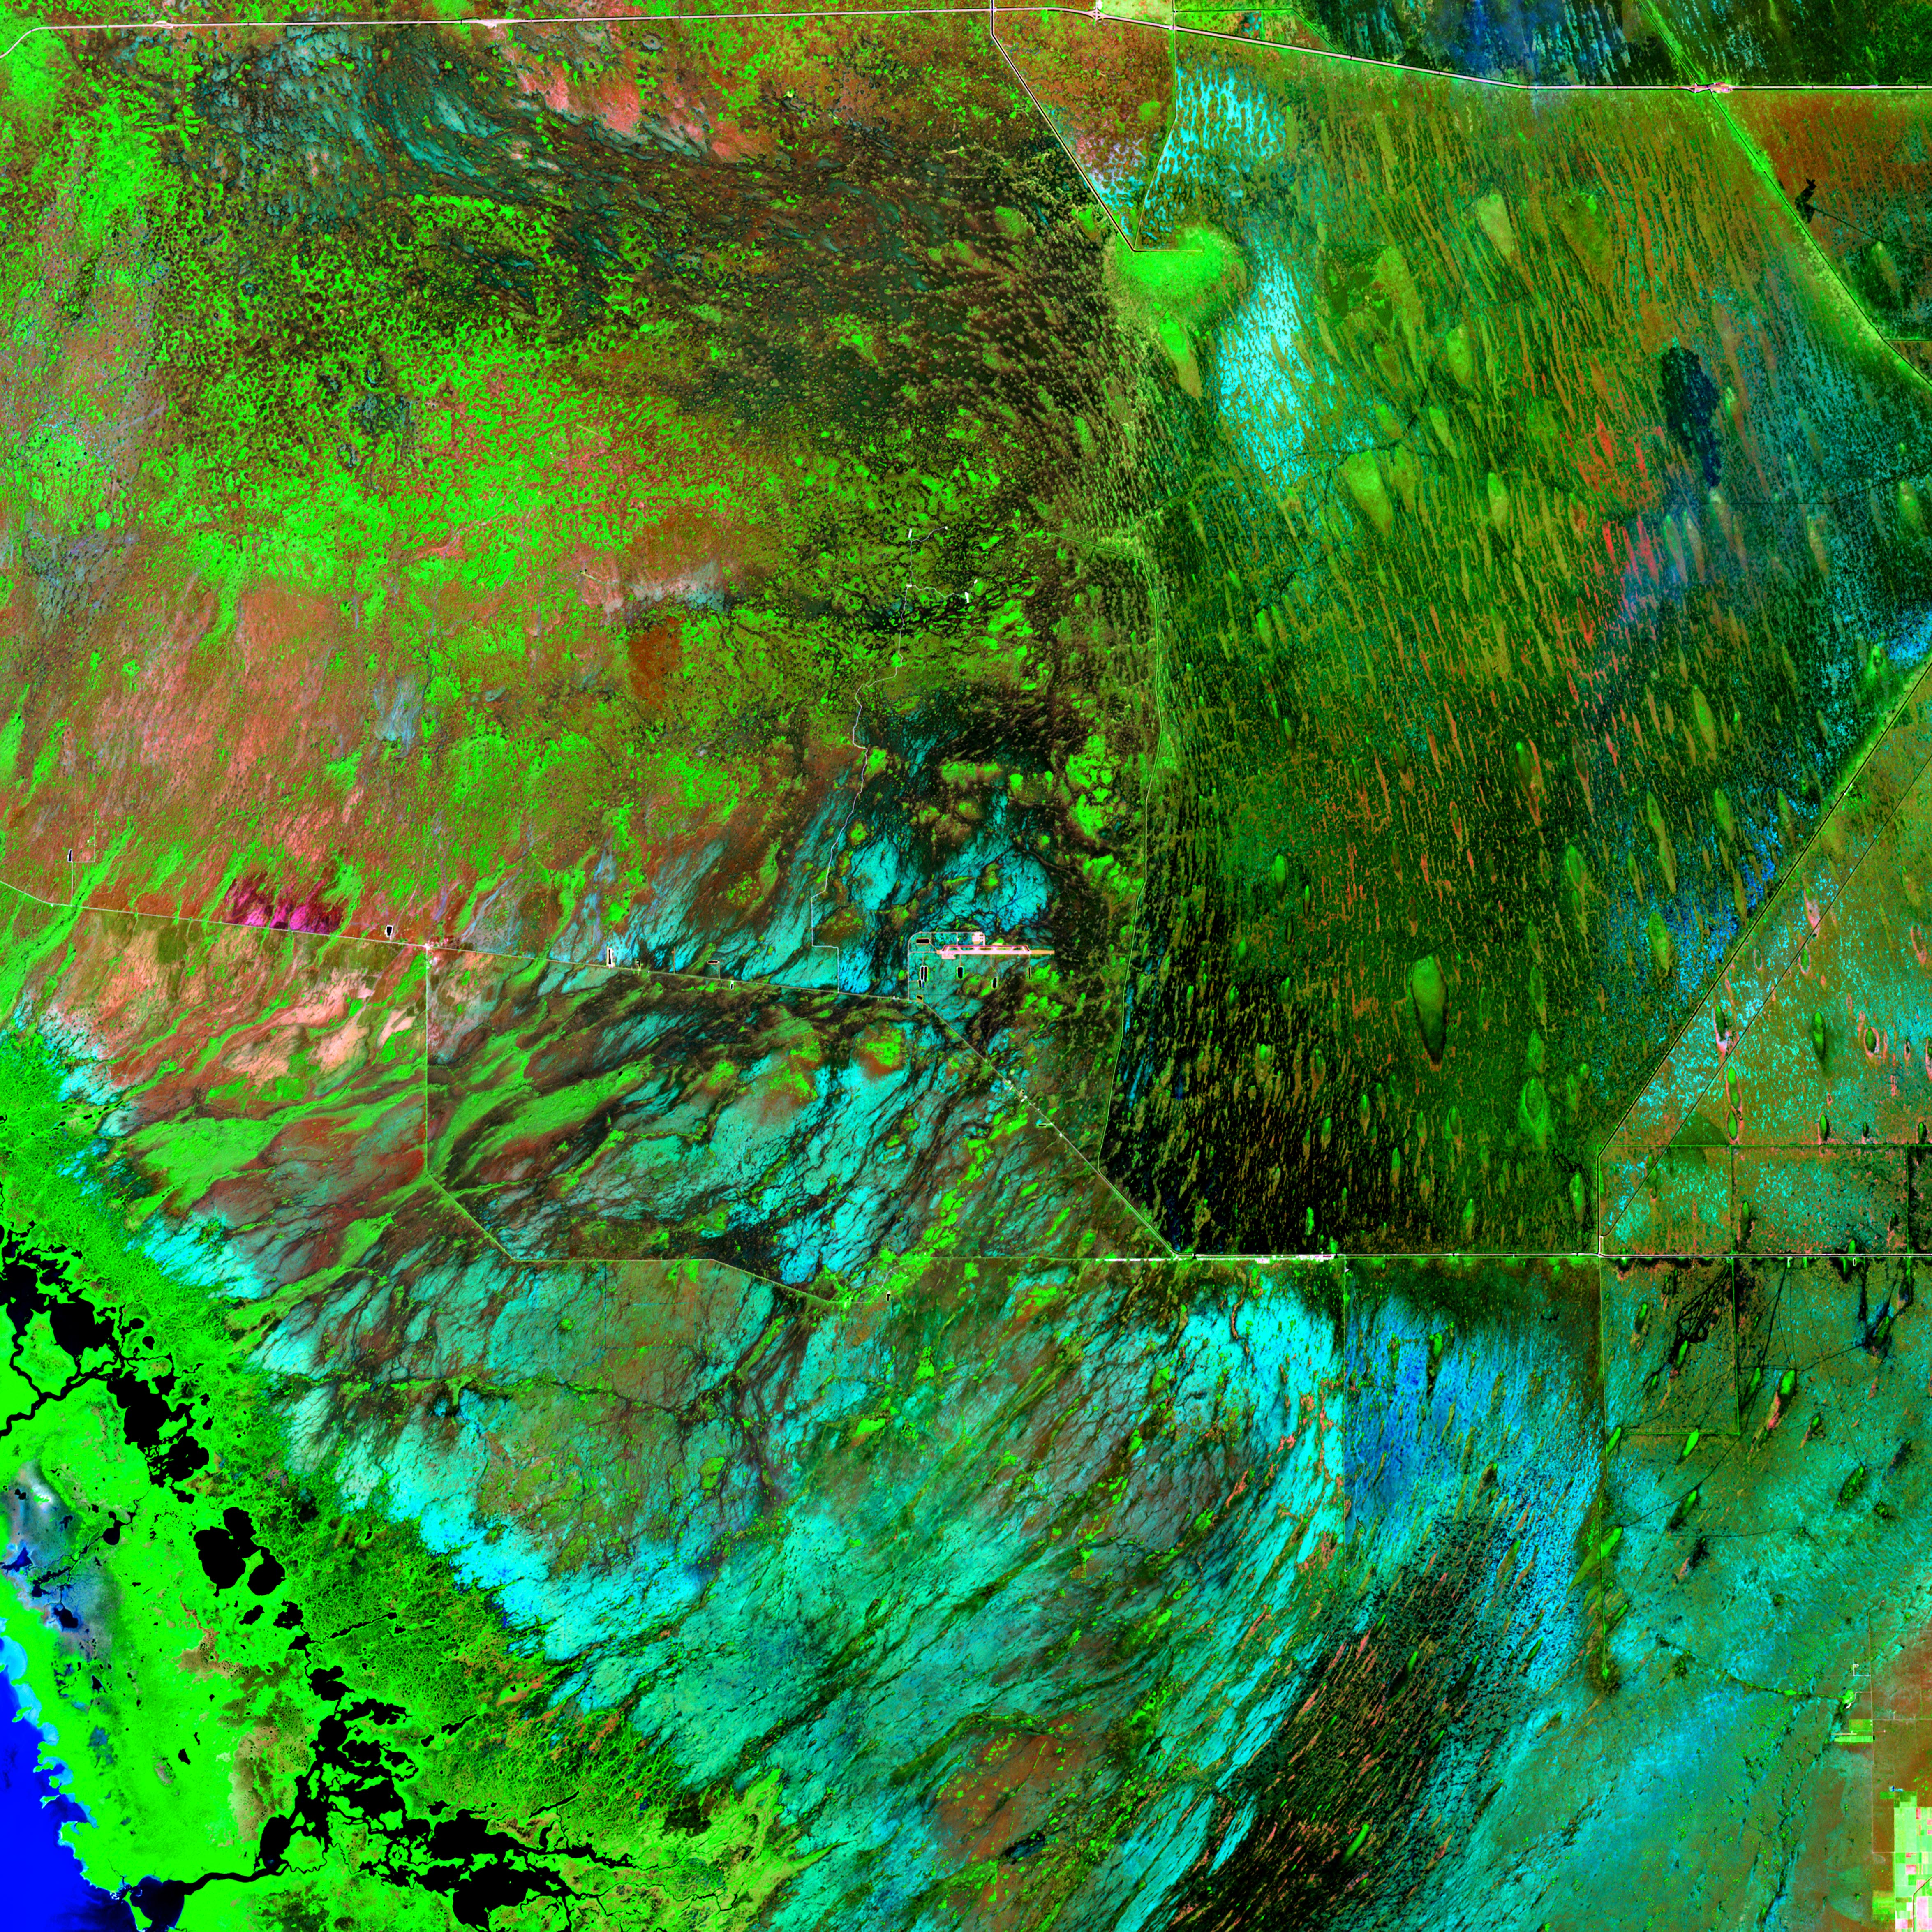
Outline
Background
Background
Crash course on Isotope systematics and notation
What is Isotope?
Isotope systematics and notation
Isotope in Environment
Florida’s Aquifer System
Climate and Human Impact
Sources of Contamination
Materials and Methods
Sampling Sites
Analytics
Results
Source Assessment
Water Characterization
Conclusion
Image Credit: Visible Earth, NASA
DISCLAIMER: This presentation is the property of SGS Isobar Science and may not be distribute, reproduced, or modified without the prior written consent from SGS Isobar Science.
Copyright ©2025. SGS Isobar Science. All Rights Reserved

Slide 3
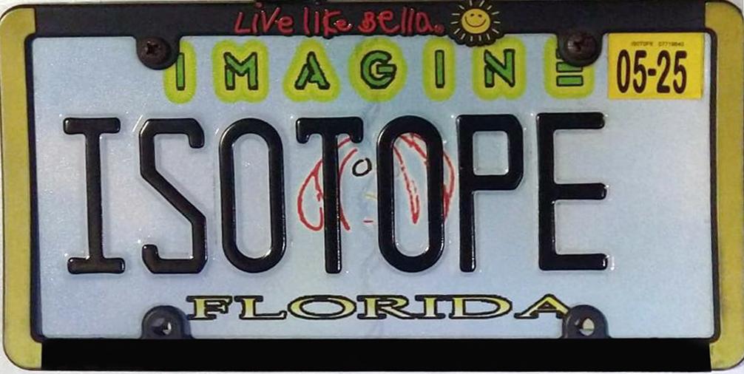
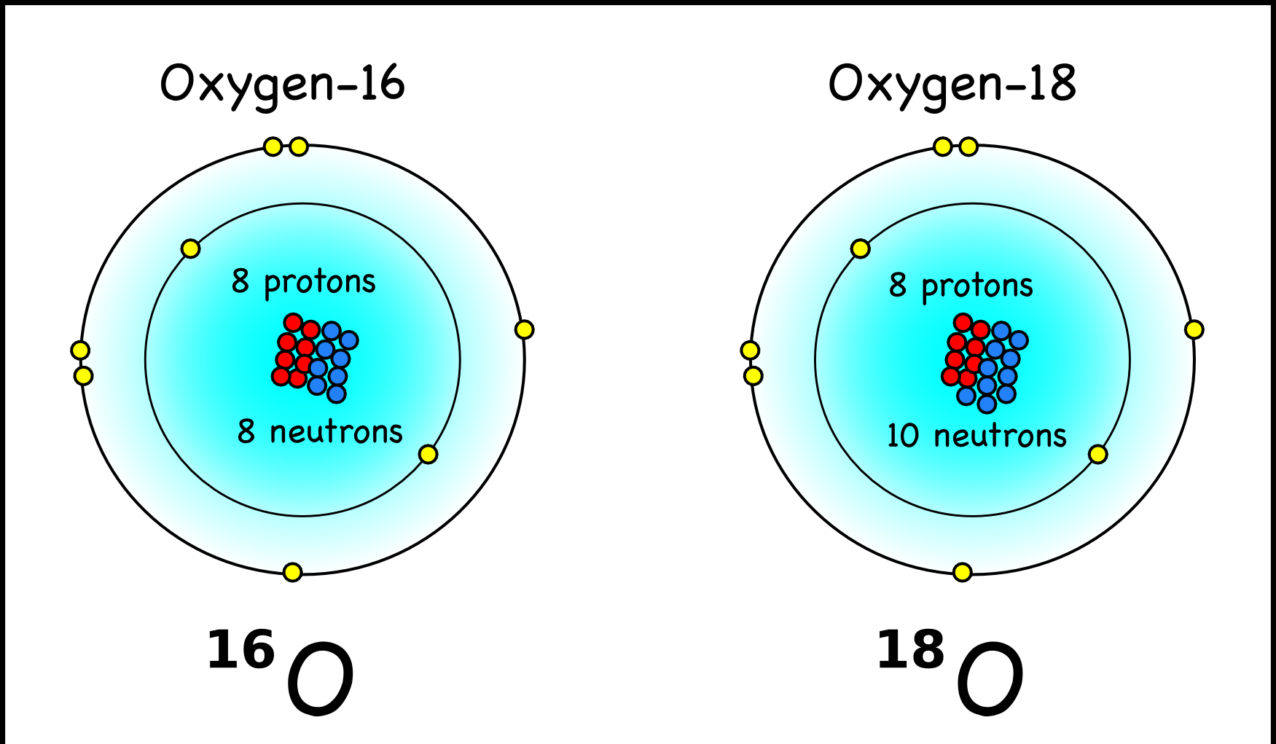
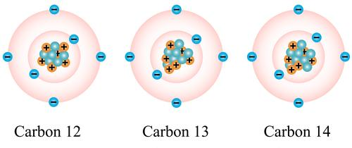
Background
What is Isotope?
Lighter isotopes (those with less neutrons) are generally more abundant in the environment.
Isotopes: isos (“equal”) + topos (“place)
Atoms with the same number of protons but different numbers of neutrons
Some isotopes are radioactive and unstable. they called Radioisotopes and they decay into more stable form
Some isotopes never been observed to decay radioactively and are referred to as Stable Isotopes

Slide 4
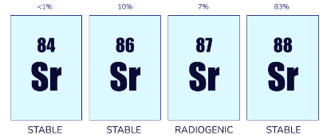
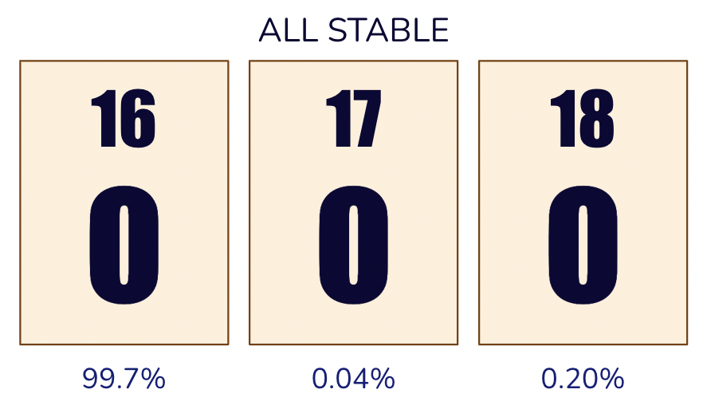
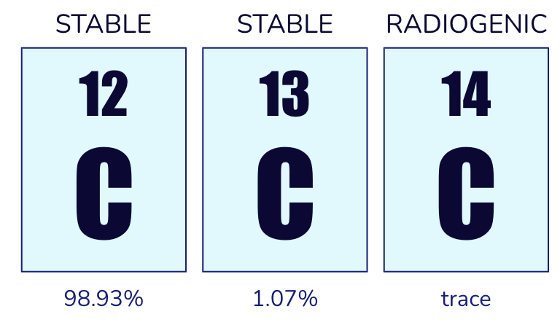
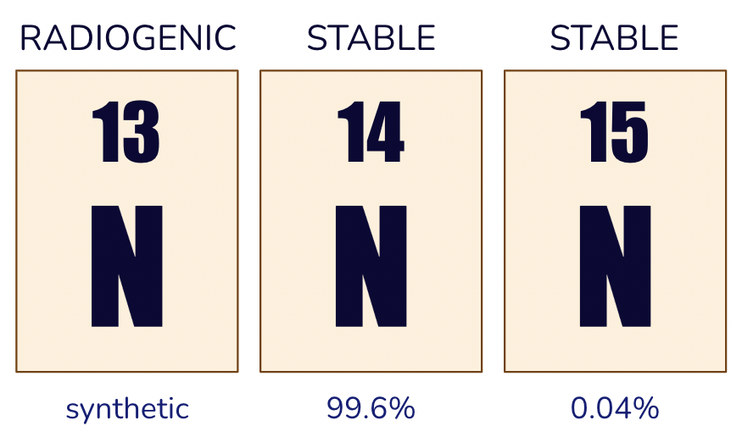
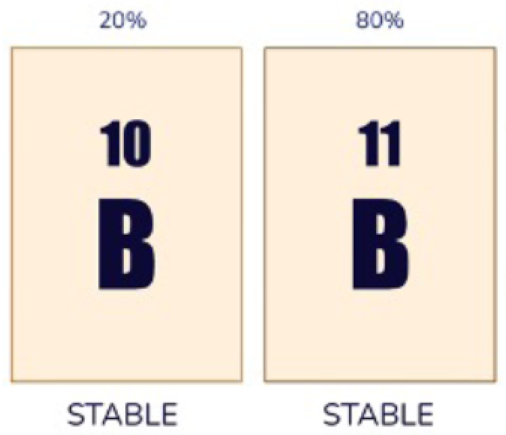
Backgrou(nd
Isotope systematics and notation
Abundance of different isotopes in the environment conventionally presented as a ratio relative to each other
⁸⁷Sr/⁸⁶Sr
Sometimes this ratios are compared to known international standards and presented with δ notation
Ratio (R) = ¹⁸O/¹⁶O
δ¹⁸O=[(R_{sample}/R_{standard})-1]×1000

Slide 5
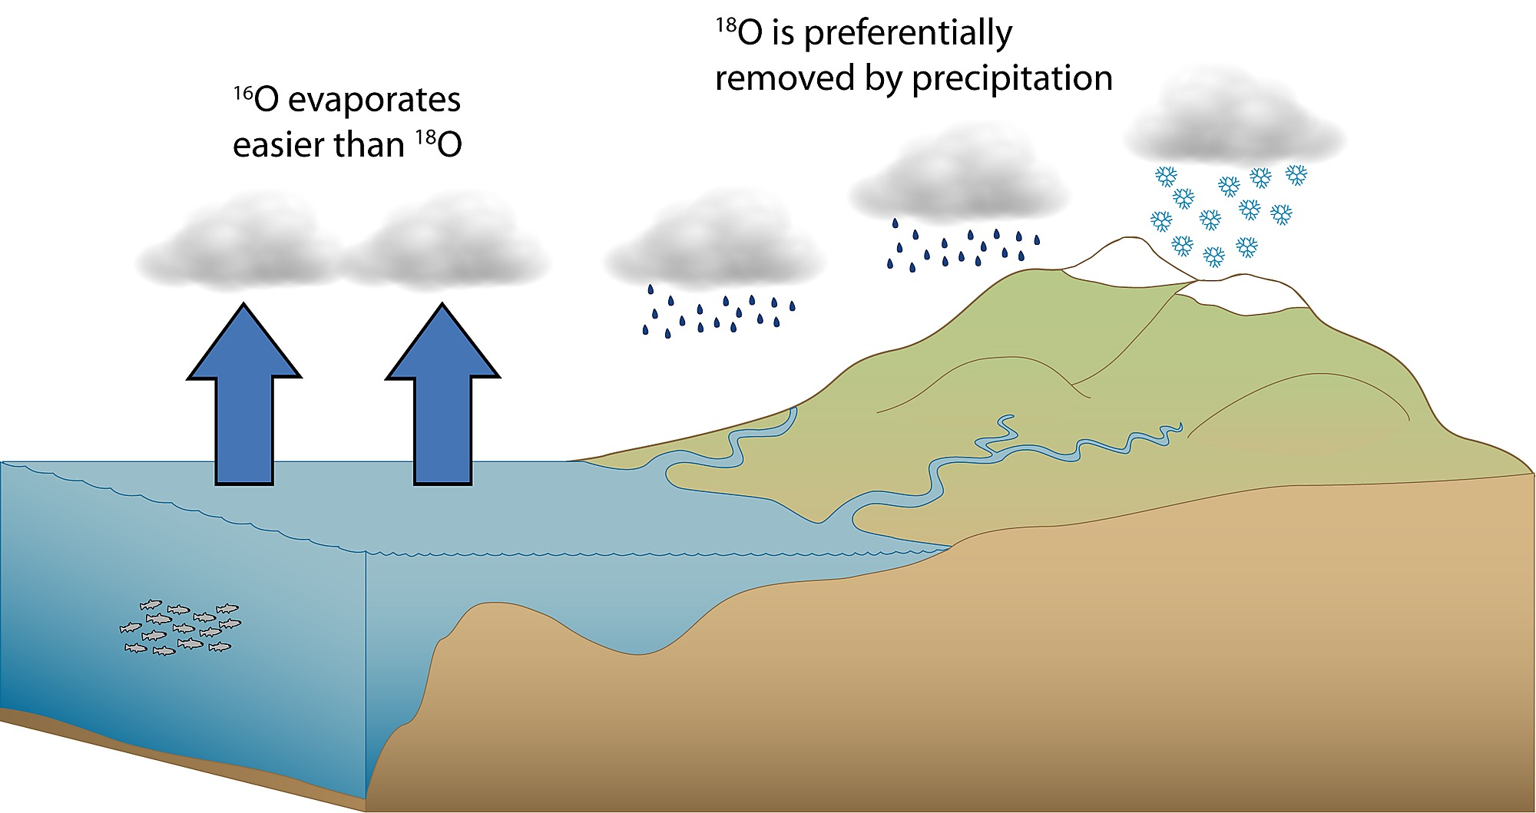
Background
Isotope in Environment
Rayleigh Distillation
δ¹⁸O_{v}=-17
δ¹⁸O_{v}=-21
δ¹⁸O_{v}=-15
Based on the atomic weights, some isotopes are behaving differently in the environment.
δ¹⁸O_{v}=-12
δ¹⁸O_{r}=-11
δ¹⁸O_{r}=-5
δ¹⁸O_{r}=-3
δ¹⁸O=0

Slide 6
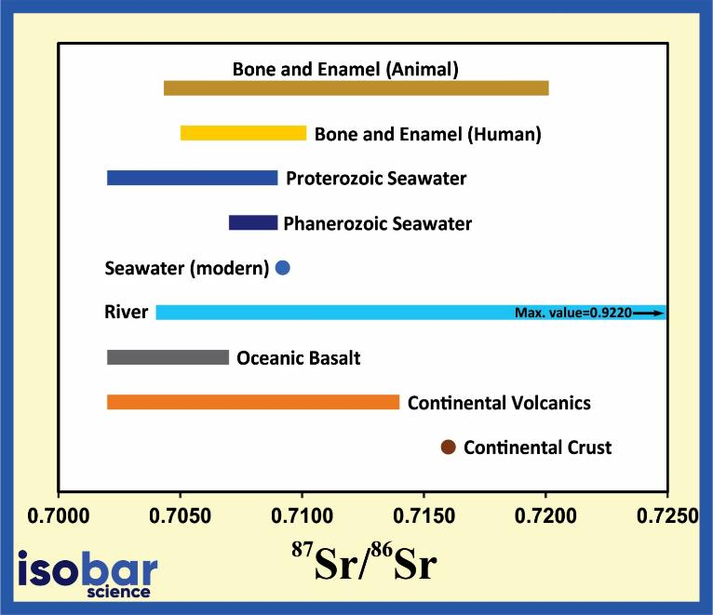
Background
Isotope in Environment
Isotopic ratios can have specific range for different materials

Slide 7
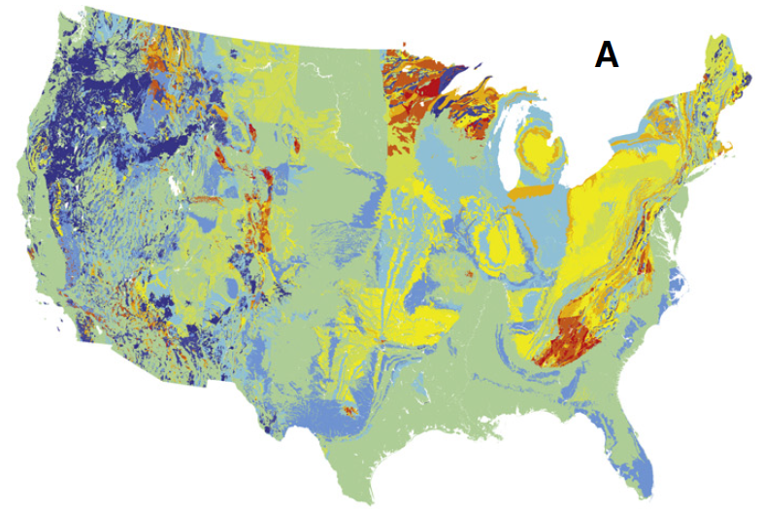
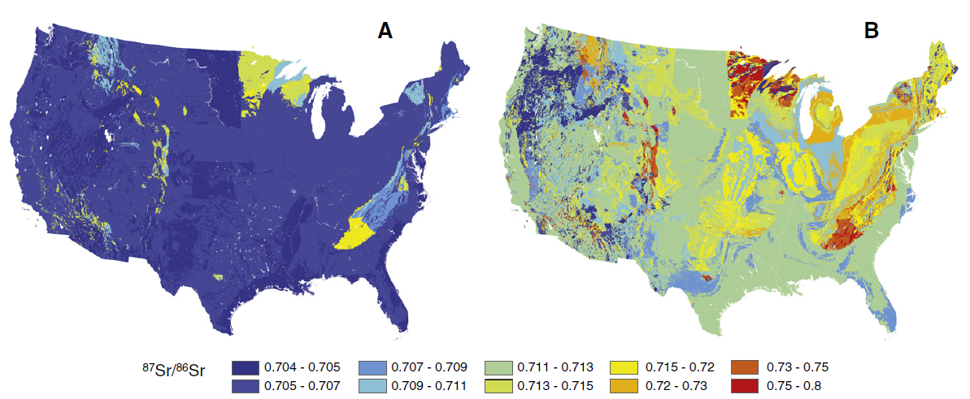
Background
Isotope in Environment
Geology
Groundwater
Bataille et al. 2012, Chem. Geology

Slide 8
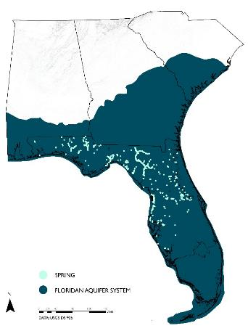
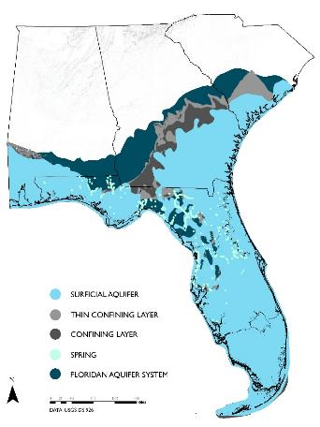
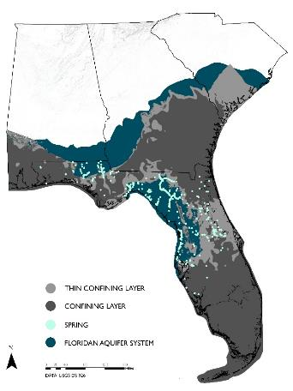

Background
Florida’s Aquifer System
Spans an area of 260,000 km²
Underling four states; FL, AL, GA, SC
Supply water to 11 million Floridians
Surficial Aquifer System
Floridan Aquifer System (Confined or unconfined)
DISCLAIMER: This presentation is the property of SGS Isobar Science and may not be distribute, reproduced, or modified without the prior written consent from SGS Isobar Science.
Copyright ©2025. SGS Isobar Science. All Rights Reserved

Slide 9
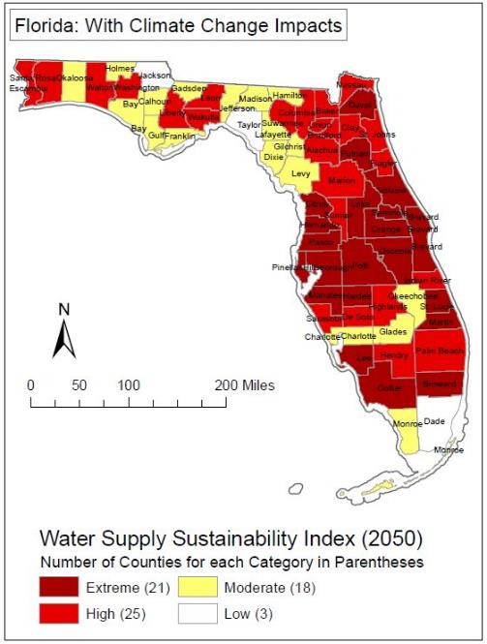
Background
Climate Impact
Under the climate change scenario, demand for agricultural irrigation will increase leading to water shortage across Florida and create conflicts over availability of freshwater
Devitt et al., 2012
DISCLAIMER: This presentation is the property of SGS Isobar Science and may not be distribute, reproduced, or modified without the prior written consent from SGS Isobar Science.
Copyright ©2025. SGS Isobar Science. All Rights Reserved

Slide 10
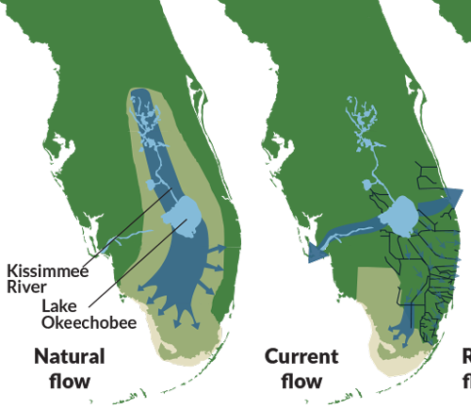
Background
Human Impact
Natural flow of water is disturbed to accommodate water supply for heavily populated areas and vast agricultural fields
DISCLAIMER: This presentation is the property of SGS Isobar Science and may not be distribute, reproduced, or modified without the prior written consent from SGS Isobar Science.
Copyright ©2025. SGS Isobar Science. All Rights Reserved

Slide 11
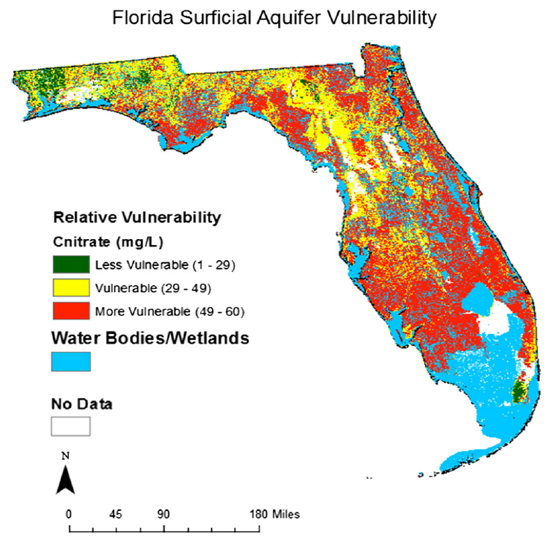
Background
Human Impact
Susceptible to contamination from land use practices
Vulnerable to nitrogen contamination
Shallow water table depth, high nitrate concentrations
Cui et al., 2016, Environ Earth Sci
DISCLAIMER: This presentation is the property of SGS Isobar Science and may not be distribute, reproduced, or modified without the prior written consent from SGS Isobar Science.
Copyright ©2025. SGS Isobar Science. All Rights Reserved

Slide 12
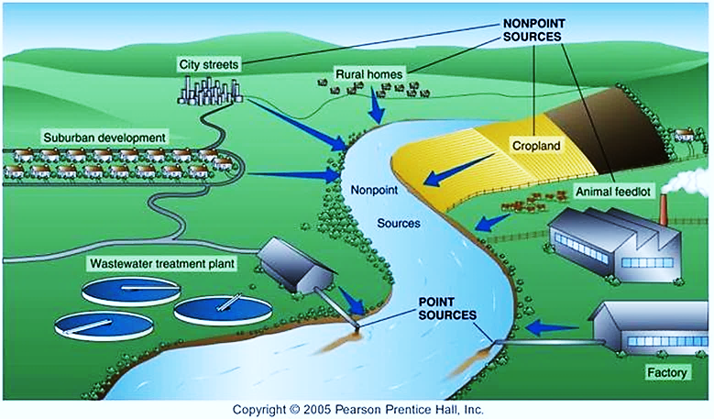
Background
Sources of Contamination
Nonpoint sources and point sources contamination can be difficult to distinguish.
When mitigating nutrients or developing wetland project it is necessary to understand the sources of nutrients into and out of a system.
DISCLAIMER: This presentation is the property of SGS Isobar Science and may not be distribute, reproduced, or modified without the prior written consent from SGS Isobar Science.
Copyright ©2025. SGS Isobar Science. All Rights Reserved

Slide 13
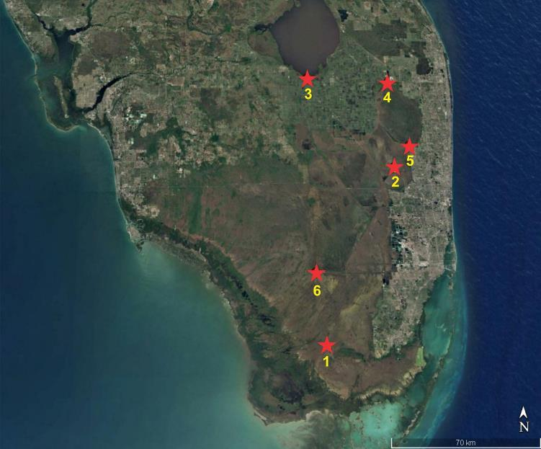
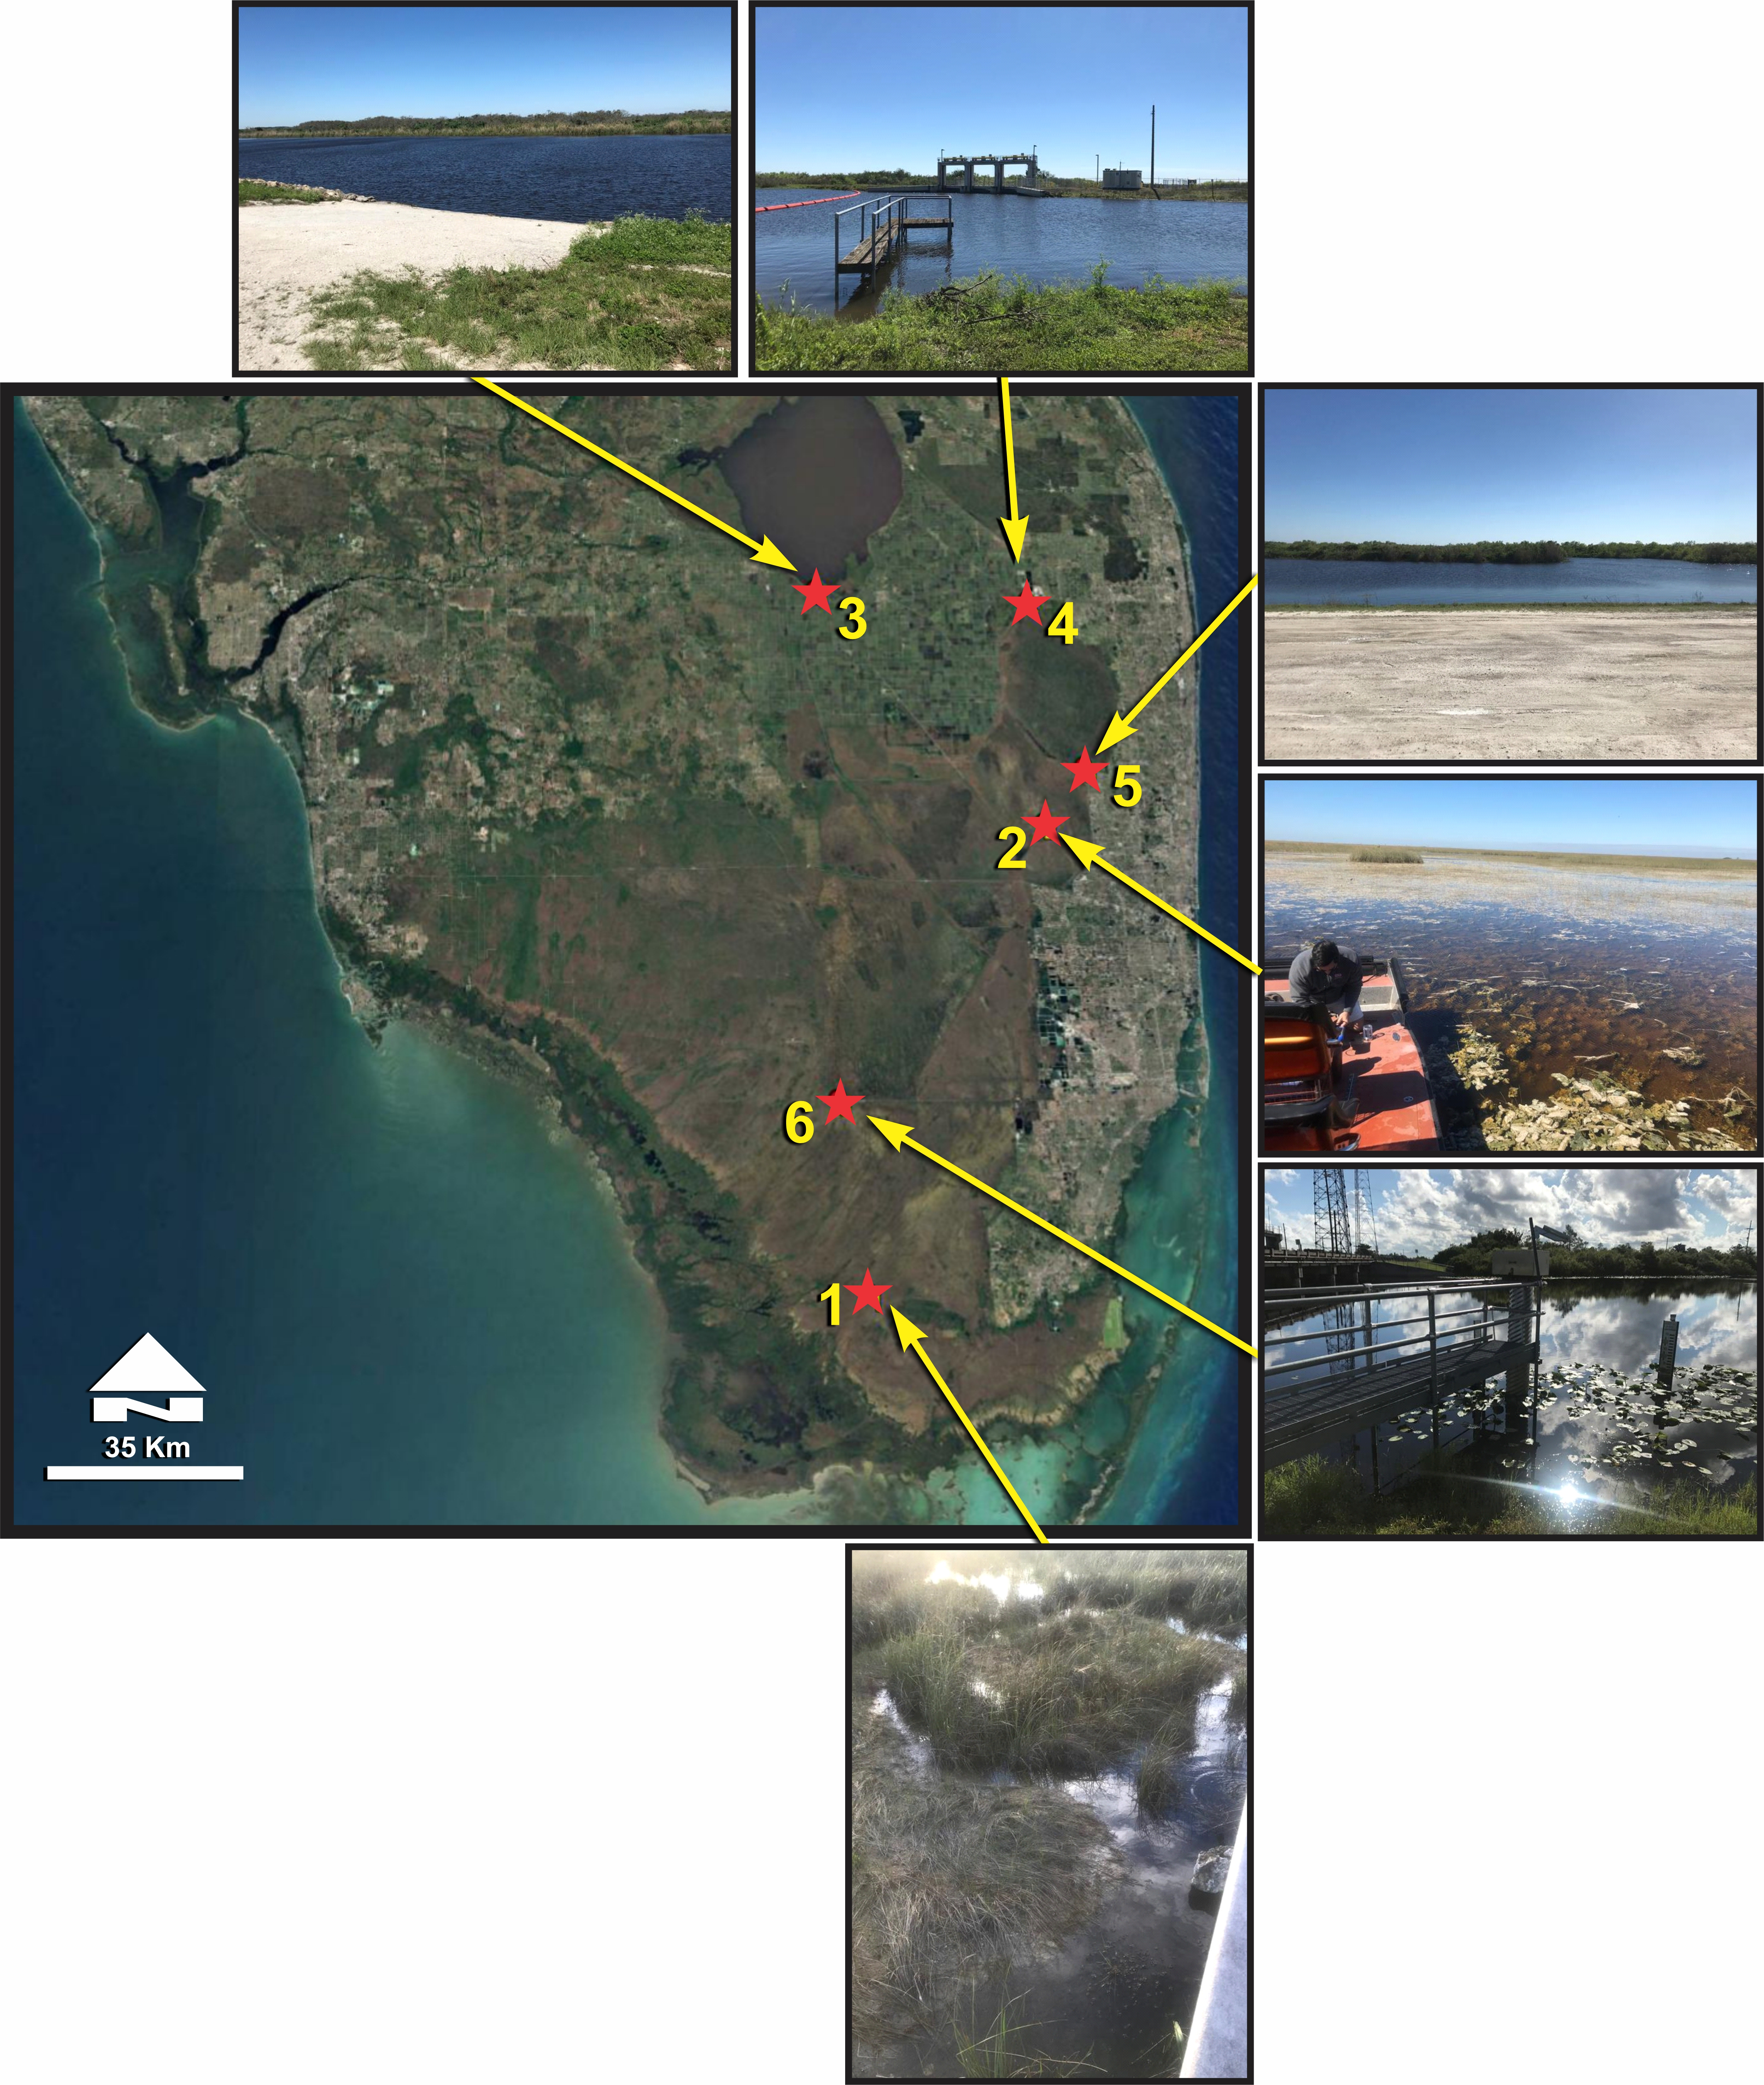
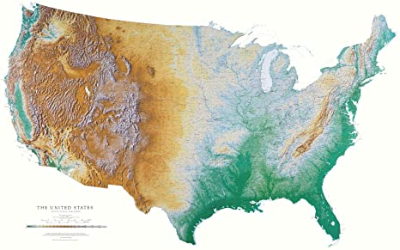
Materials and Methods
Six sites were randomly selected in S Florida
Water samples were analyzed for
δ¹⁸O
δ²H
δ¹⁸O_{NO3}
δ¹⁵N_{NO3}
δ¹⁸O_{PO4}
δ ¹¹B
⁸⁷Sr/⁸⁶Sr
DISCLAIMER: This presentation is the property of SGS Isobar Science and may not be distribute, reproduced, or modified without the prior written consent from SGS Isobar Science.
Copyright ©2025. SGS Isobar Science. All Rights Reserved

Slide 14

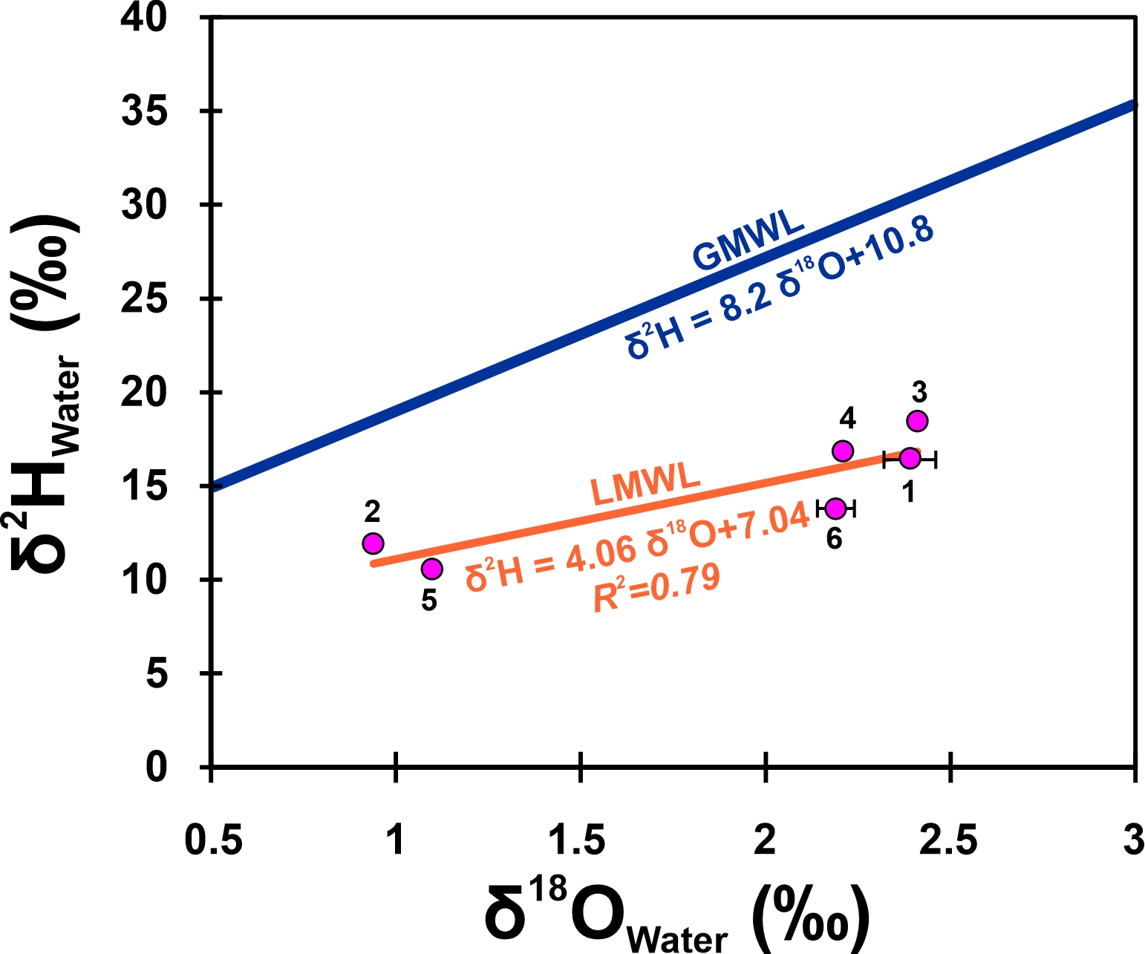
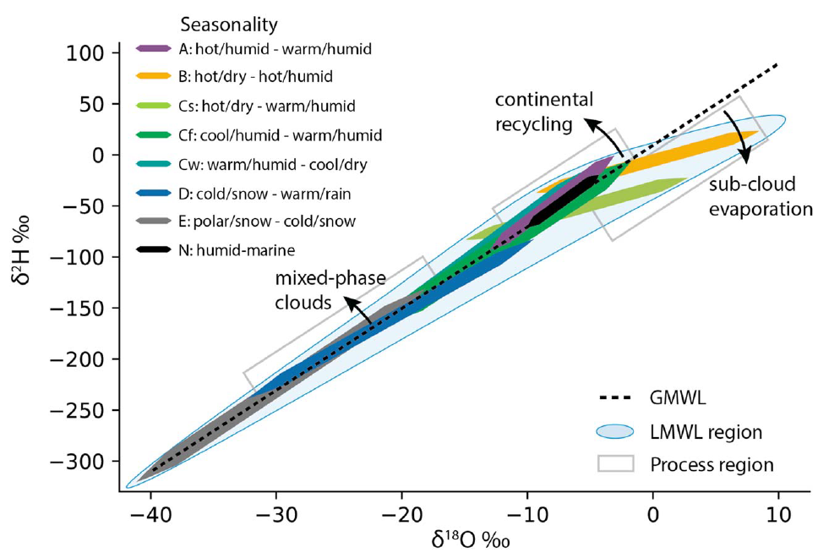
Results
Effect of hot and humid climate of the region on shaping the local meteoritic water line
Putman et al., 2019, WRR
DISCLAIMER: This presentation is the property of SGS Isobar Science and may not be distribute, reproduced, or modified without the prior written consent from SGS Isobar Science.
Copyright ©2025. SGS Isobar Science. All Rights Reserved

Slide 15
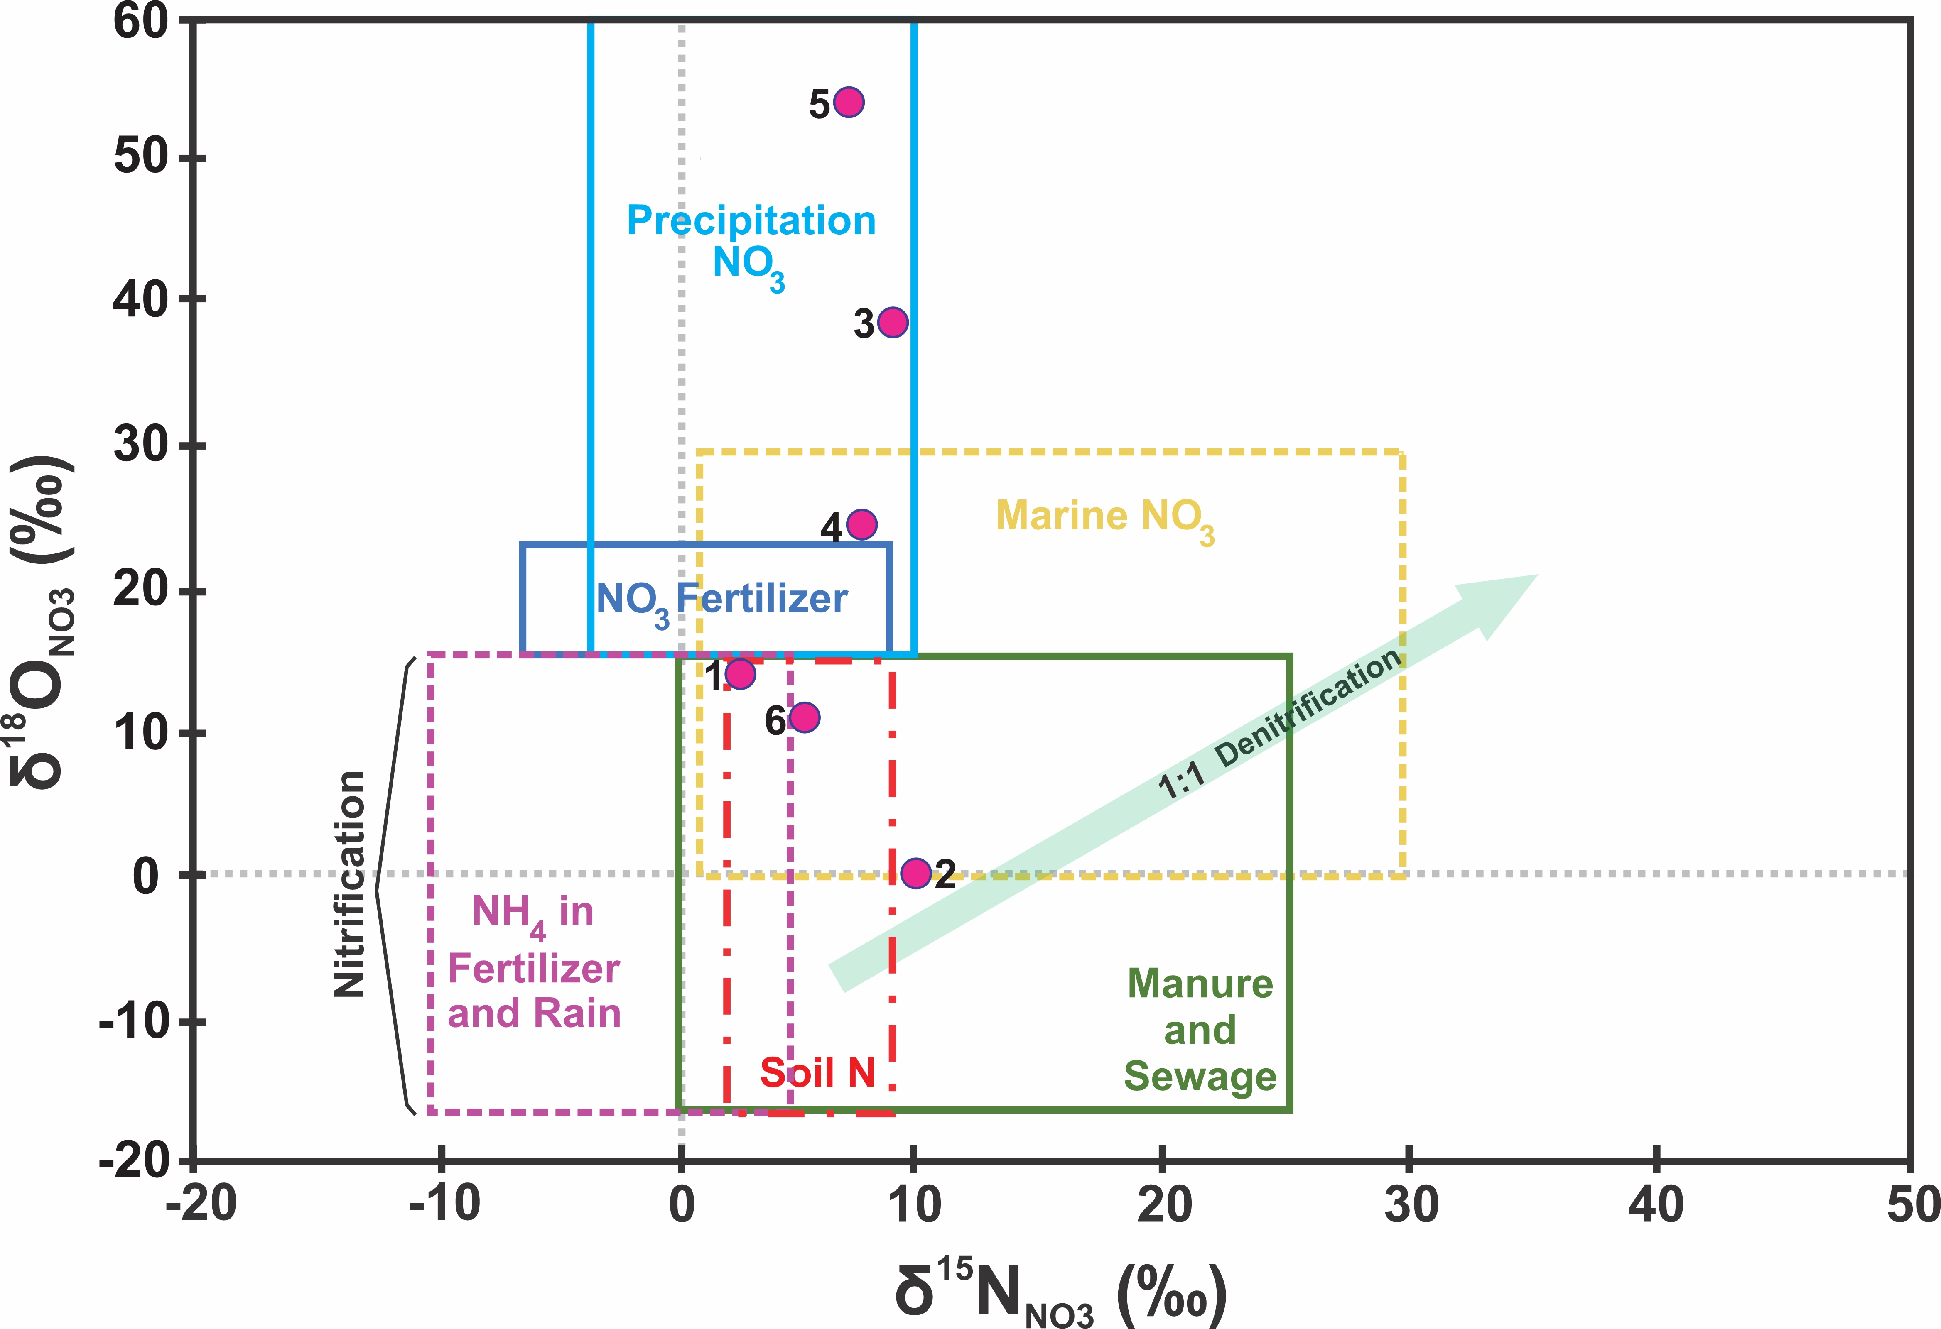
Results
Oxygen and nitrogen isotopes of nitrate can be used to trace the source of nitrate in water,
Source regions are greatly overlapped and is hard to pinpoint a contamination source
DISCLAIMER: This presentation is the property of SGS Isobar Science and may not be distribute, reproduced, or modified without the prior written consent from SGS Isobar Science.
Copyright ©2025. SGS Isobar Science. All Rights Reserved

Slide 16
Results
Boron isotope, tracer for source of contamination
DISCLAIMER: This presentation is the property of SGS Isobar Science and may not be distribute, reproduced, or modified without the prior written consent from SGS Isobar Science.
Copyright ©2025. SGS Isobar Science. All Rights Reserved

Slide 17
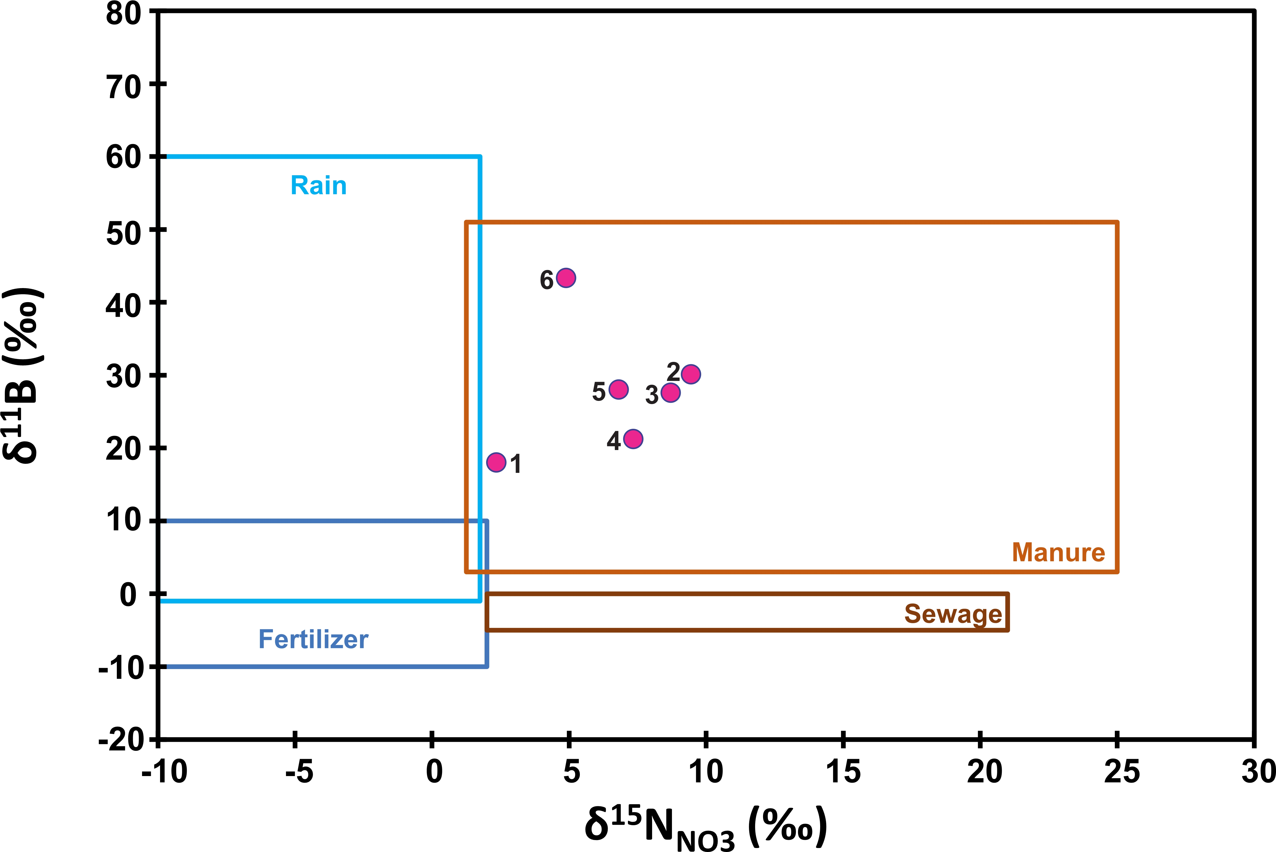
Results
Combining δ¹⁵N_{NO3} with δ¹¹B provides a better distinction between the sources of nutrients
DISCLAIMER: This presentation is the property of SGS Isobar Science and may not be distribute, reproduced, or modified without the prior written consent from SGS Isobar Science.
Copyright ©2025. SGS Isobar Science. All Rights Reserved

Slide 18
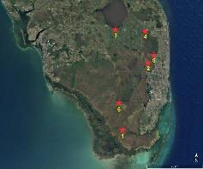
Results
Wide range of δ¹⁸O_{PO4}
Correlation with Sr isotope
Sr isotopic signature of pollutants must be established
DISCLAIMER: This presentation is the property of SGS Isobar Science and may not be distribute, reproduced, or modified without the prior written consent from SGS Isobar Science.
Copyright ©2025. SGS Isobar Science. All Rights Reserved

Slide 19
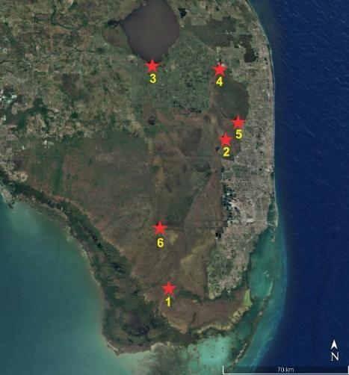
Results
Water samples can be characterized based on multiple isotopic values
DISCLAIMER: This presentation is the property of SGS Isobar Science and may not be distribute, reproduced, or modified without the prior written consent from SGS Isobar Science.
Copyright ©2025. SGS Isobar Science. All Rights Reserved

Slide 20
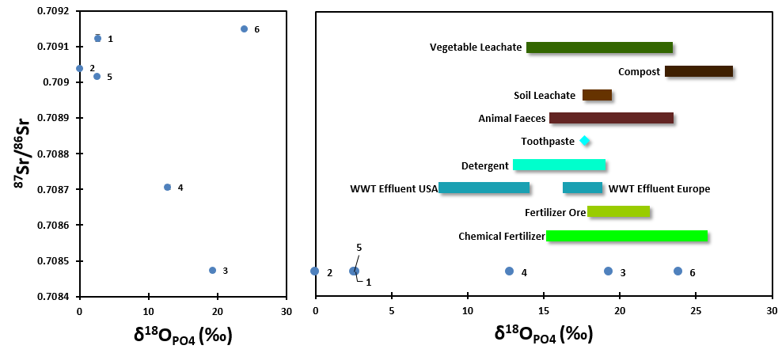
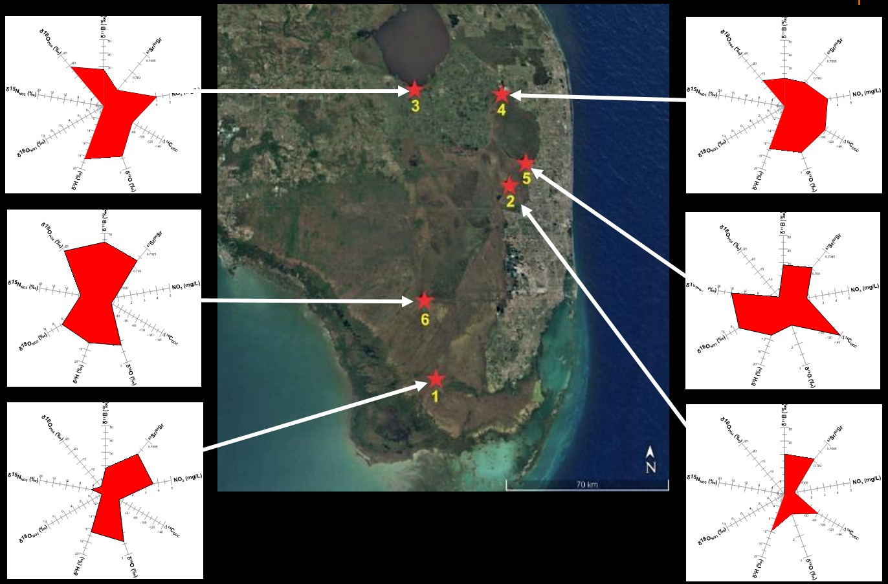
Conclusion
Pinpointing the source of contamination by adding boron isotope to the traditional O and N isotope
Oxygen isotope of dissolved phosphate and Sr isotopic ratio provide more information on type of the pollutants
Characterization of water based on multiple isotopic values

