Slide 1
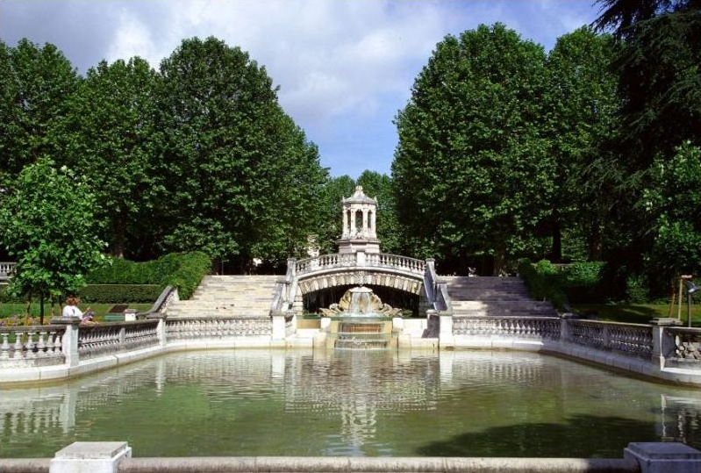

The Influence of Groundwater Modeling
on the Concept of groundwater Age
Parc Darcy
Dijon, France

Slide 2
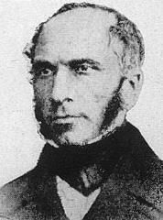
“Beneath the ground surface in stratified formations,
sometimes there are actual underground watercourses that flow with appreciable velocities in fissures, crevices, or natural cavities,
and sometimes there are aquifers derived from infiltration through sand that flow slowly between two impermeable beds.
I will not cite all the examples …. invoked in support of the existence of this double fact, which cannot be contested.”
Darcy 1856

Slide 3
Note that Darcy’s confined aquifers are the thin units, with high permeability
Unconfined (A) and Confined (B) Aquifers
Plate 22 Darcy 1856

Slide 4
Loss of hydraulic head in Paris Basin
Darcy and Dupuit observed a parabolic change in hydraulic head moving along the aquifer
If flow were laminar the loss of head downgradient would have been linear.
Dupuit 1867
Ground water flow is therefore occurring in conduits and porous media, not just porous media

Slide 5
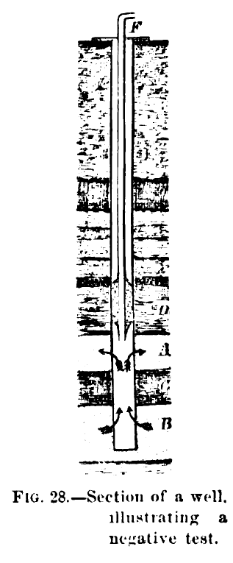
“There are two general methods by which water finds its way through the strata:
in the one—the rocks being close-textured—the water passes through fissures formed by fracture, or tubular channels formed by solution;
in the other—the rock being open-textured—the water seeps through the pores, permeating the whole bed.”
Chamberlin 1885
Notes:
Image for Tony – A negative test in this case is that this well is not “artesian”. Well is cased down to layer A. Higher artesian head from layer B is lost to layer A.

Slide 6
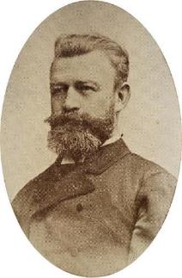
Dual/Triple Permeability
Höfer von Heimhalt noted not only that there is both matrix and fracture porosity in bedrock (plus cave porosity in carbonates and gypsum) but also that there will be exchange of water between them.
Höfer von Heimhalt
1912

Slide 7
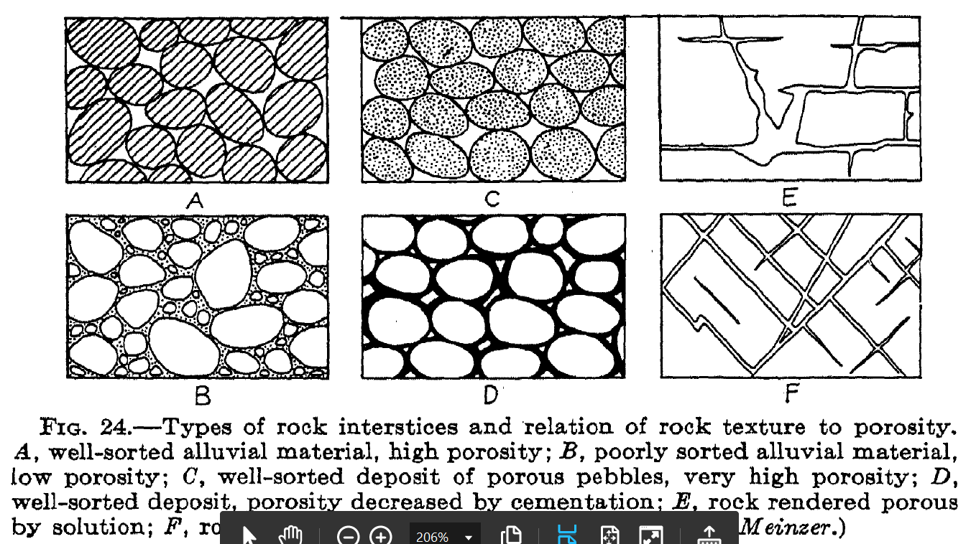
Three principal types of underground openings:
Pores – the characteristic openings of pervious granular materials, which are intricately interconnected and chiefly of capillary size [Pore Water]
Open fractures – occur chiefly in dense crystalline or cemented rocks, the master fractures fed by tributaries of capillary size [Fracture Water]
Large tubular or cavernous openings – solutional openings in limestone and flowage tunnels in lavas [Karst Water]
The key point is these are not separate and independent…
Groundwater is flowing in all three systems simultaneously.
(Tolman 1937)

Slide 8
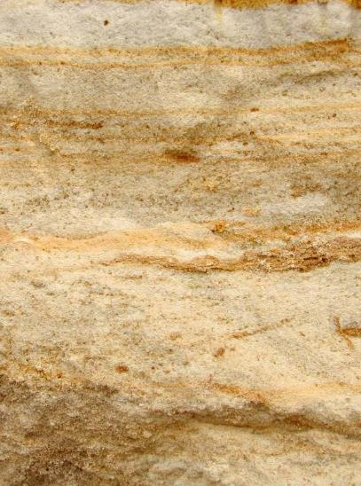
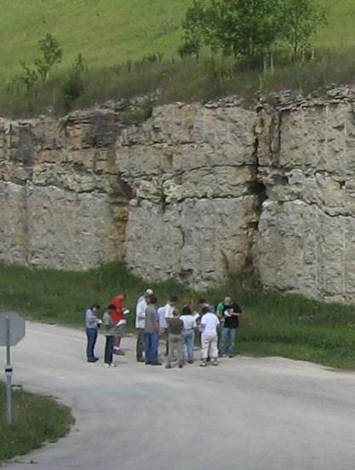
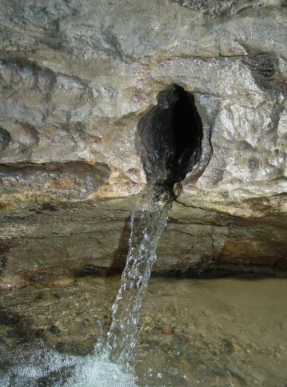
Active flow at all scales
Triple Porosity Aquifers
Matrix / Fractures & Bedding Planes / Conduits

Slide 9
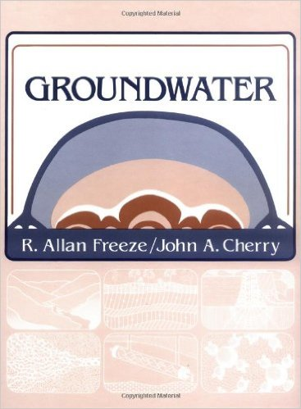
What happened?
Early and longstanding recognition of the importance
of multiple permeability pathways was lost.
Toth 1963
Notes:
Freeze and Cherry 1979 Textbook “Groundwater”. Was it a printing error a statement that the authors were overturning conventional logic.

Slide 10
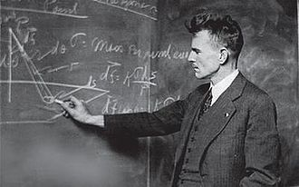
Since, for such flow, the velocity diminishes rapidly with distance from the well, then it is clear that only exceptionally will rates of flow in ground water be encountered that are outside the upper range of validity of Darcy's law.
M. King Huppert
1940

Slide 11
Isotropic Homogeneous Flow
M. King Huppert 1940

Slide 12
Three types of flow system: Local, intermediate, regional
Toth
1963
The flow system shown here is 38 miles wide and 2 miles deep. Of course it is all perfectly isotropic and homogeneous???
Notes:
The flow system shown here is 38 miles wide and 2 miles deep. Of course it is perfectly isotropic and homogeneous???

Slide 13

Aquifers
Idealized
Real
Single Porosity
Isotropic
Homogeneous
Mathematically Tractable
Multiple Porosities
Anisotropic
Inhomogeneous
Mathematically Challenging

Slide 14
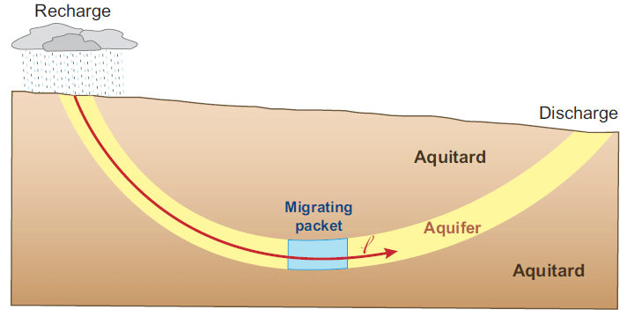
Piston Flow
Provides a consistent method to interpret tracer data
- But is only a starting point for age interpretation

Slide 15
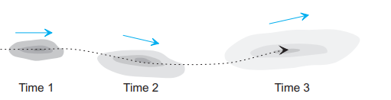
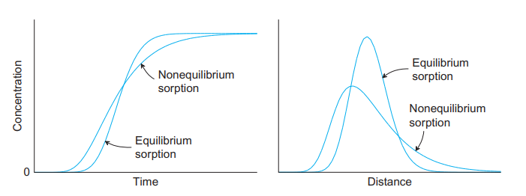
Advection and Dispersion
Tracer Adsorption/Retardation

Slide 16
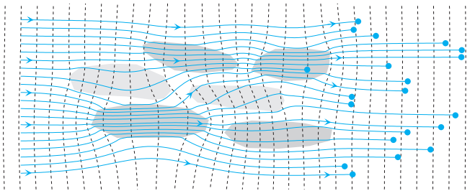
2-D flow with 6 heterogeneity domains
At a given time there is a range of travel distance

Slide 17
Challenges
Lithostratigraphic nomenclature presumes homogeneous sediments.
Aquifers are heterogeneous at the human scale. Aquifers are not isotropic and homogeneous at any useful scale.
Porous media models based on isotropic, homogeneous assumptions and currently dominate hydrogeologic theory, practice and regulation.
– Porous media is the default assumption.
Hydrogeologists need a fast, economical way to evaluate the assumption of porous media.

Slide 18
Real World Observations
Mathematical Solutions
Groundwater doesn’t care how fancy your computer model is
Computer Models
Identify Controlling Factors
Groundwater will flow thru all available pathways finding the optimal solution
Construct Better Models
and Reiterate

Slide 19
Computers are just a tool
Don’t let a computer program limit how you answer a question
E. Calvin Alexander, Jr.

