Slide 1
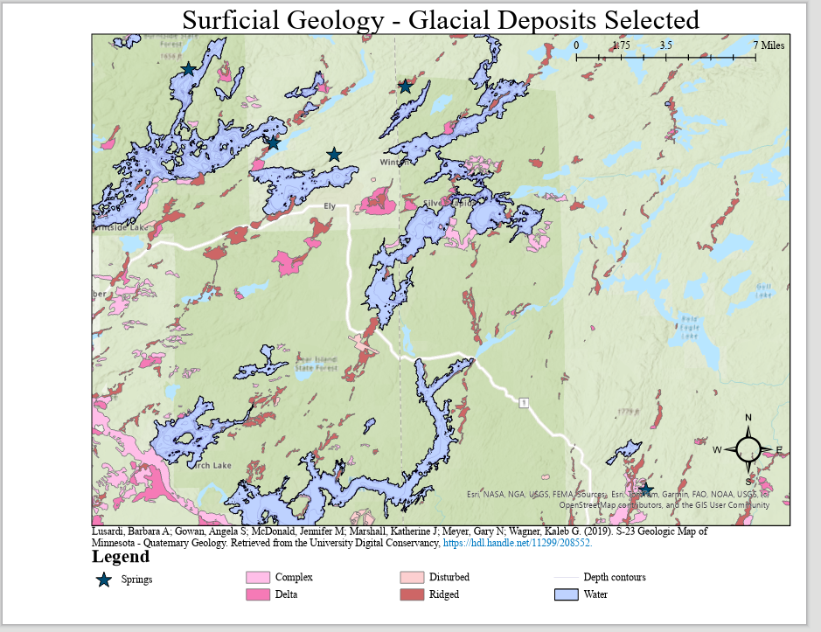
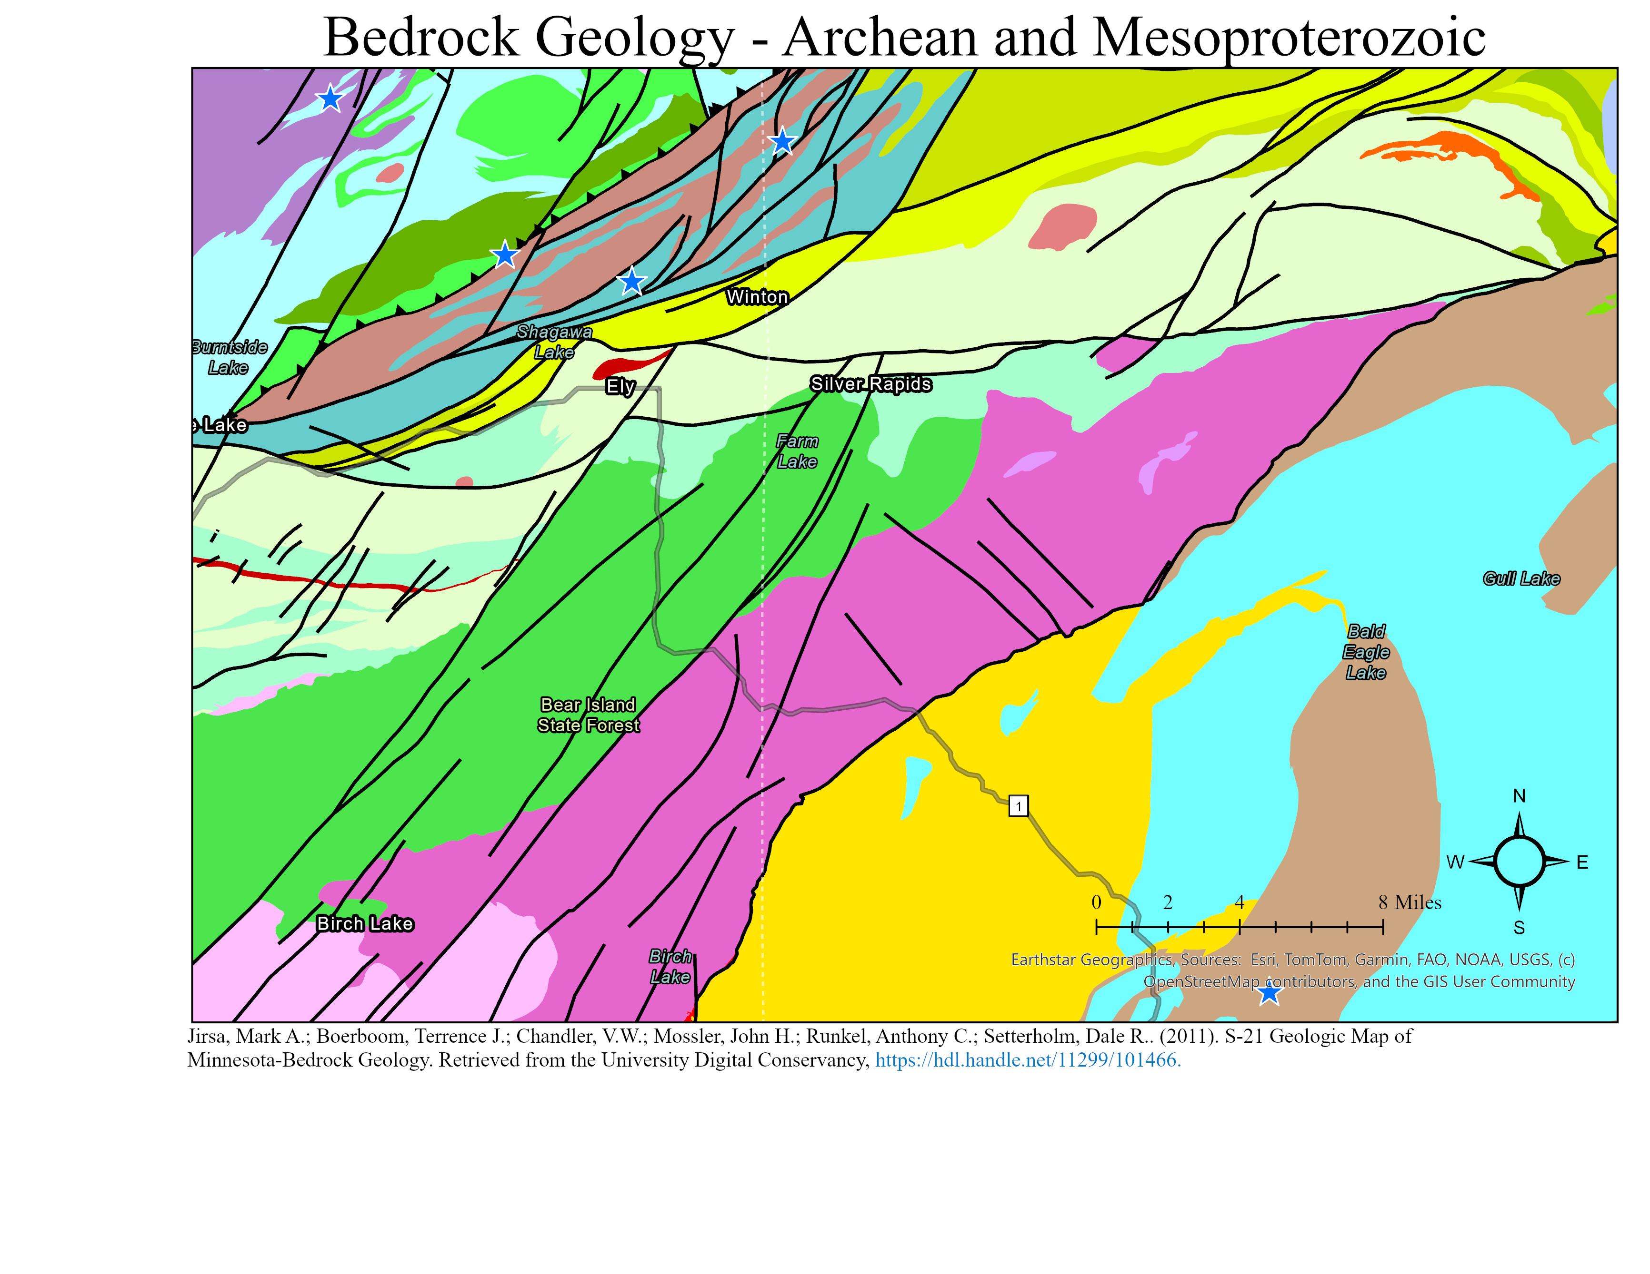
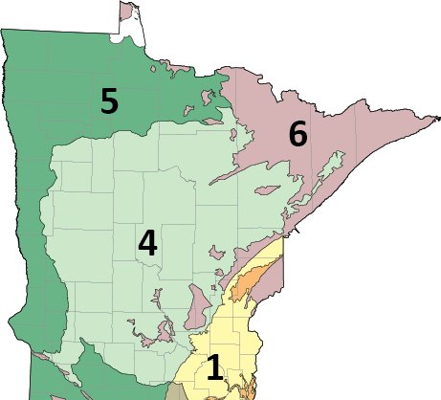
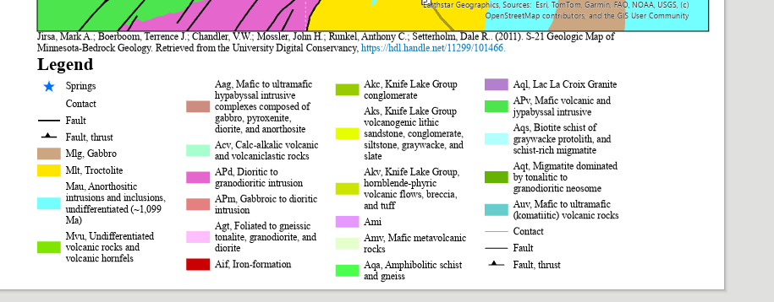
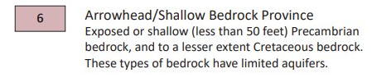
Understanding Groundwater Discharge in Northeastern Minnesota
Mikell Schoonover, Dr. Carl Isaacson, Dr. Miriam Rios - Sanchez
Fig 1. Surficial Geology Map with Study Sites
Fig 2. General Bedrock Geology Map with Study Sites
Notes:
https://files.dnr.state.mn.us/waters/groundwater_section/mapping/mha/hg02_report.pdf
https://www.dnr.state.mn.us/waters/groundwater_section/mapping/mn-hydro-atlas.html
https://www.dnr.state.mn.us/waters/groundwater_section/mapping/provinces.html
https://mngs-umn.opendata.arcgis.com/maps/UMN::depth-to-bedrock-vs-bedrock-topography/explore?location=46.130766%2C-93.213767%2C5&path= This map displays Minnesota's bedrock topography (elevation surface) and the depth (thickness of glacial till) under ground surface elevation.
https://files.dnr.state.mn.us/waters/groundwater_section/mapping/provinces/2021-provinces.pdf

Slide 2

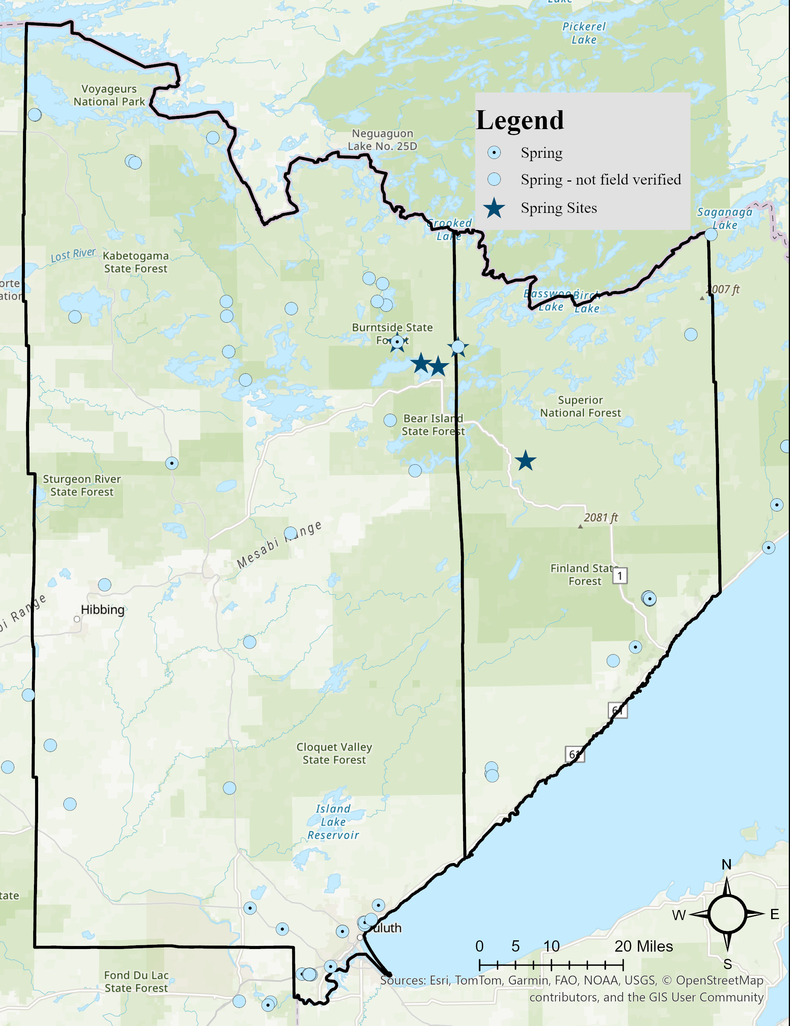

References:
Thank you!
Minnesota Department of Natural Resources (n.d.). Groundwater section. https://www.dnr.state.mn.us/waters/groundwater_section/index.html
Barry, John & Walsh, James & Runkel, Anthony & Aley, Thomas. (2023). Identifying Recharge and Flow in Fractured Crystalline Rock Using Karst Characterization Methods. ResearchGate. https://www.researchgate.net/publication/370016443
Carleton Hydrogeology Research. (2026, January 21). Surveying Springs in the Driftless [StoryMap].Esri. https://storymaps.arcgis.com/stories/9a1038096f134ab98be269f8004fe416
Special thanks to John Barry, Chloe Fandel, Mike Sibley, Thomas Boitz, Ken Hupila, and Brett Snitker for their time, support and encouragement.

