Slide 1
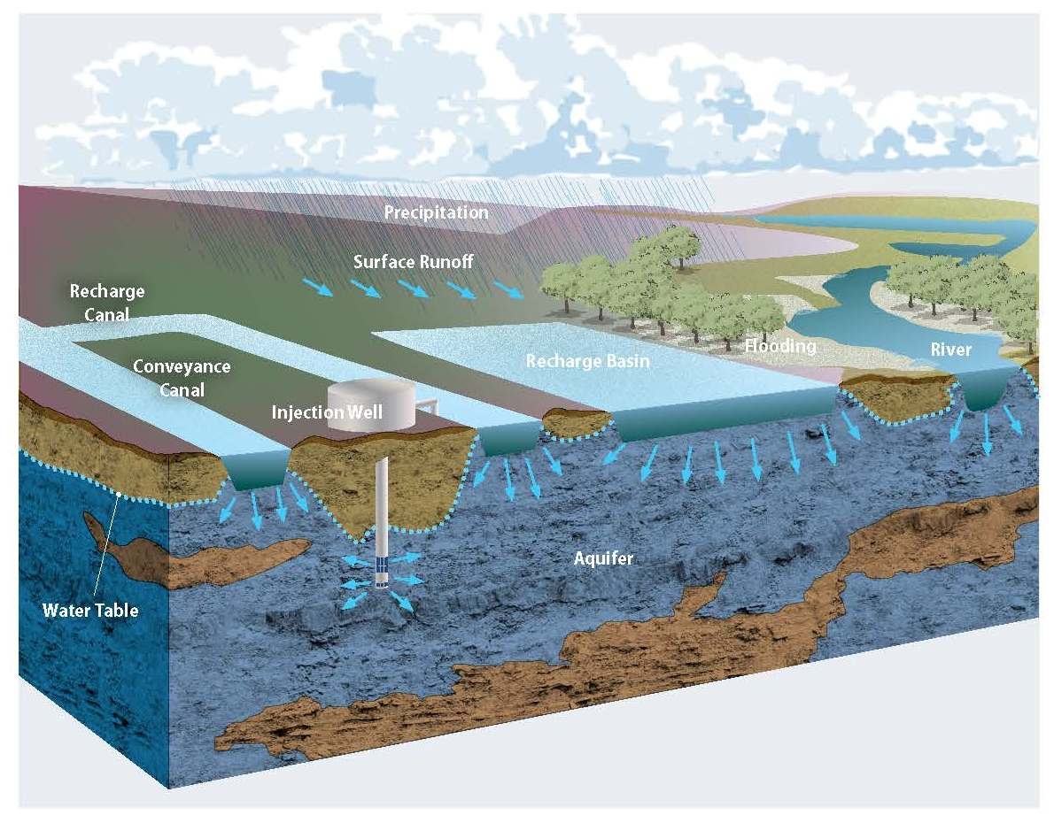
Source: groundwaterexchange.org
A GIS TOOL FOR MAPPING AQUIFER RECHARGE POTENTIAL
Presenter: Phillipe Lima*
Coauthors: Kramer*, J., Wei*, G., Runkel, A., Gulliver, J., Neiber, J., Jennings, J., Kang*, P. K.
Affiliation: University of Minnesota, Twin Cities

Slide 2
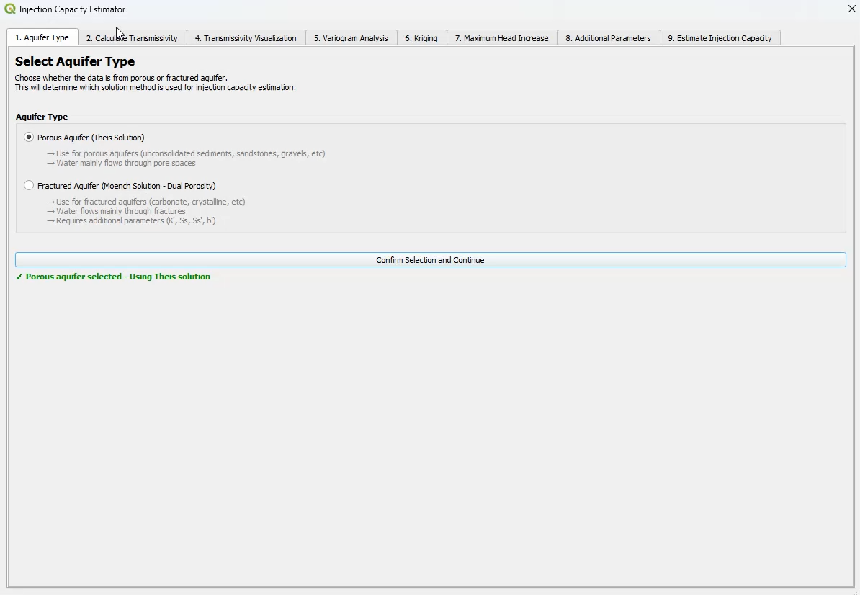
QGIS plugin tool can map the injection well-based aquifer recharge potential
Literature +
Public data
Literature
Public data
QGIS plugin demonstration
Ss
b
K
Initial head
Fracturing pressure level
S
T
Maximum head
Safety factor
Injection capacity map (based on Theis solution)
Well radius
Injection time
Operational parameters
Plugin can also map injection capacity for fractured aquifers

Slide 3
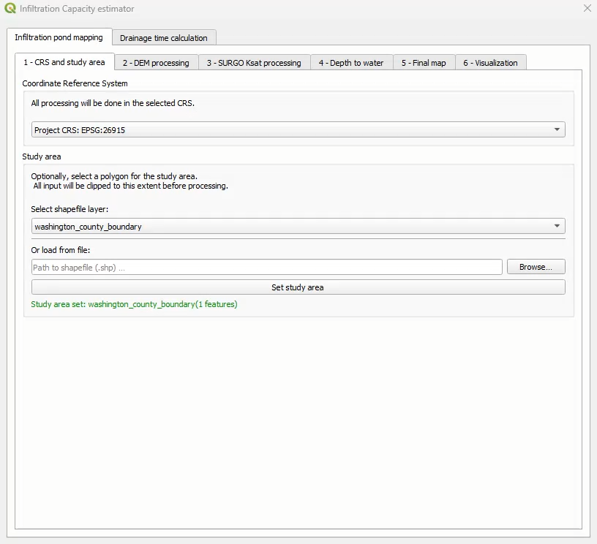
QGIS plugin tool can map the infiltration-based aquifer recharge potential
QGIS plugin demonstration
Public data
DEM
DTW
Soil Ksat
TWI
(optional)
landform classification
initial estimate
K
Basin selection
Ferrante equation
(based on Green-Apt equation, solving for time)
ψ
Time
∆
Operational parameters
Literature or public data
Max basin height for infiltration in 48 hours
Notes:
Public data: DEM (which provides TWI and TPI-based landform classification, DTW (from DNR, either state- or county-wide), soil Ksat (from SSURGO)
Literature or public data: K, psi, delta
Operational parameters: time, and basin area (user defined)
Notes DEM cell size has trade-off: smaller leads to better classification but takes significantly longer (hours for county-wide 3m)
Note that K, psi, delta can also be obtained with field data for more accurate estimation

