Slide 1
Time to update the regional groundwater flow model for the Twin Cities’ area
MN Ground Water Association Spring Conference | April 23, 2026 | Lanya Ross, Evan Christianson, Della Young

Slide 2
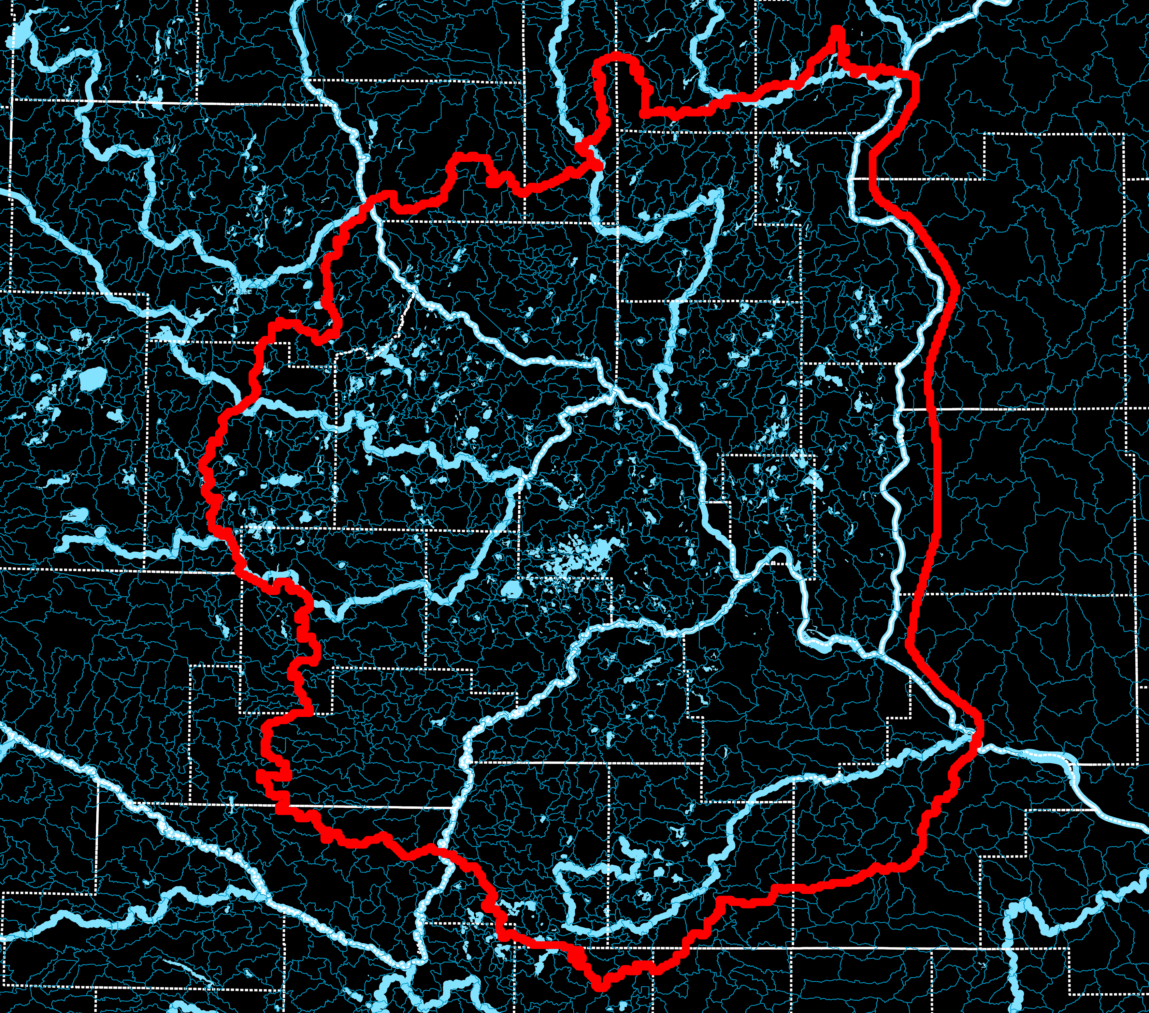
11+ Counties:
Anoka, Carver, Chisago, Dakota, Hennepin, Isanti, Ramsey, Scott, Sherburne, Washington, Wright and parts of their neighbors
8,350 Square Miles
Aquifers:
Quaternary, St. Peter, Prairie du Chien Group, Jordan, St. Lawrence, Tunnel City, Wonewoc, Mt. Simon-Hinckley
Adjustable Parameters: Pumping rates, climate, land use, recharge

Slide 3
Purpose
To help people understand how changes in development, population, water use, and climate affect groundwater
Supports long-term water planning by allowing users to:
Test different scenarios
Spot areas at risk
Make more informed, coordinated decisions
Designed to support broad-scale assessments of groundwater withdrawals, availability, and long-term sustainability across the region
Not intended for detailed local analysis without further refinement, but can be used as a starting point or a source of regional context
Learn more at https://metrocouncil.org/Wastewater-Water/Planning/Water-Supply-Planning/Planners/Metro-Model.aspx

Slide 4

Update in process
Why update the model?
The current model is over 10 years old. As data improves and the region changes, an updated model offers:
More accurate results
Better tools to explore future changes—like new development, higher water use, or a changing climate
What’s changing
Metro Model 3 was converted from the USGS’s MODFLOW-NWT to MODFLOW-6. New data is being incorporated and the model will be recalibrated, setting the stage for future planning and scenario applications.
Timeline
Phase 1 – Q4 2025: Conversion to MODFLOW 6
Phase 2 – 2026/2027: Recalibration, scenario analysis, tool development
Phase 3 – Ongoing: Continued updates and stakeholder support

Slide 5
Thank you!
Agency interviews and Technical Advisory Group participants
Minnesota Department of Natural Resources
U.S. Geological Survey
Minnesota Department of Agriculture
Minnesota Geological Survey
St. Paul Regional Water Services
Minnesota Pollution Control Agency
Minnesota Department of Health
University of Wisconsin – River Falls
Browns Creek Watershed District
City of Bloomington
Dakota County
Kelton Barr Consulting
EOR
Minnehaha Creek Watershed District
South Washington Watershed District
Valley Branch Watershed District
Washington County
Metropolitan Council

Slide 6
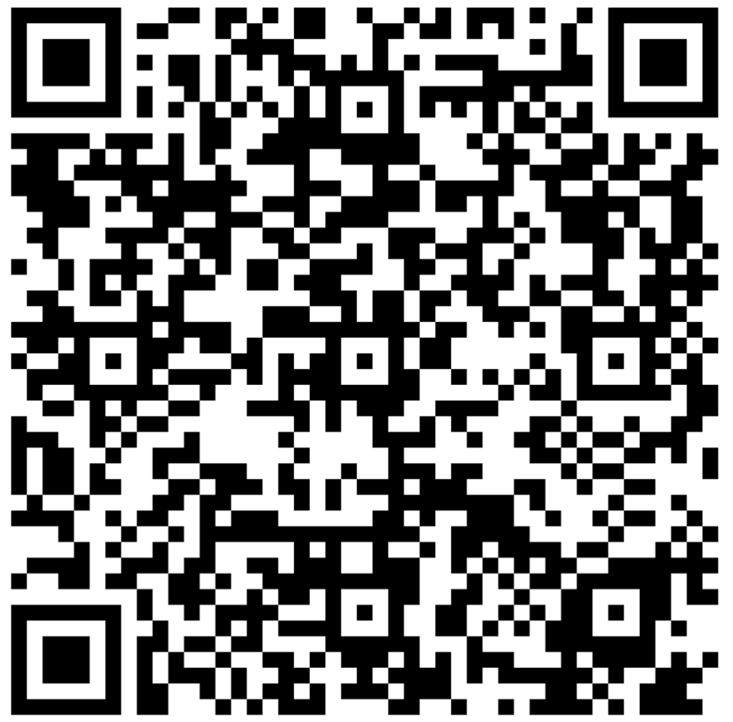
SURVEY:
What changes are you interested in evaluating?
Let us know if you have data to contribute!

Slide 7


Thank you
Lanya Ross
Environmental Analyst, Water Resources Policy & Planning
Metropolitan Council
Evan Christianson
Vice President, Senior Hydrogeologist
Barr Engineering Co.
Della Young
Founder and Chief Executive Officer
Young Environmental Group, LLC

