Slide 1
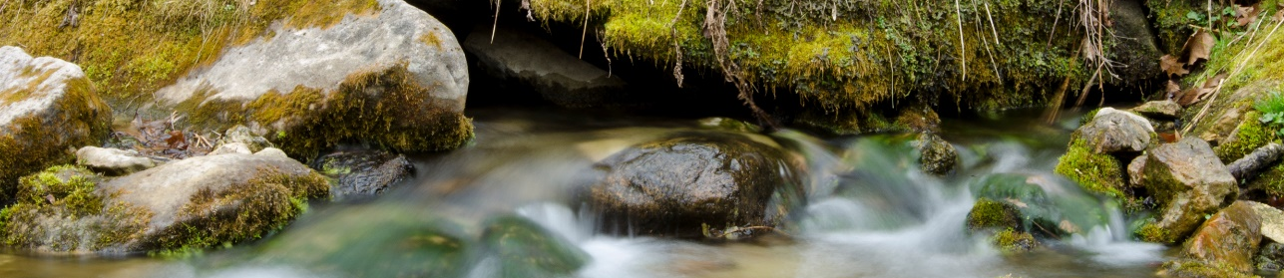


Groundwater Atlas Program Residence Time Data
John Barry | Kayla Nelson
MGWA | Spring 2026 Conference | April 23, 2026

Slide 2
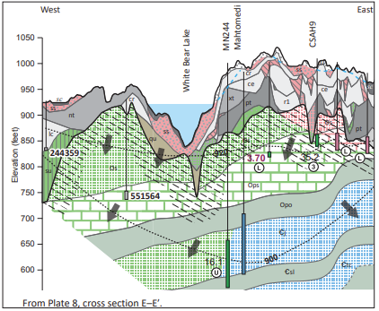
Groundwater Atlas Overview
Report
Hydrogeology and groundwater flow
Water chemistry
Groundwater pollution sensitivity
Groundwater use
Plates
Water chemistry
Hydrogeologic cross sections
Electronic files
Report and plates
GIS files
Notes:
There are 9 people on the County Groundwater Atlas team, including hydrogeologists and production staff.
Typically, once the Part A atlas is completed by the MGS, we begin sampling wells in that county the following year.

Slide 3
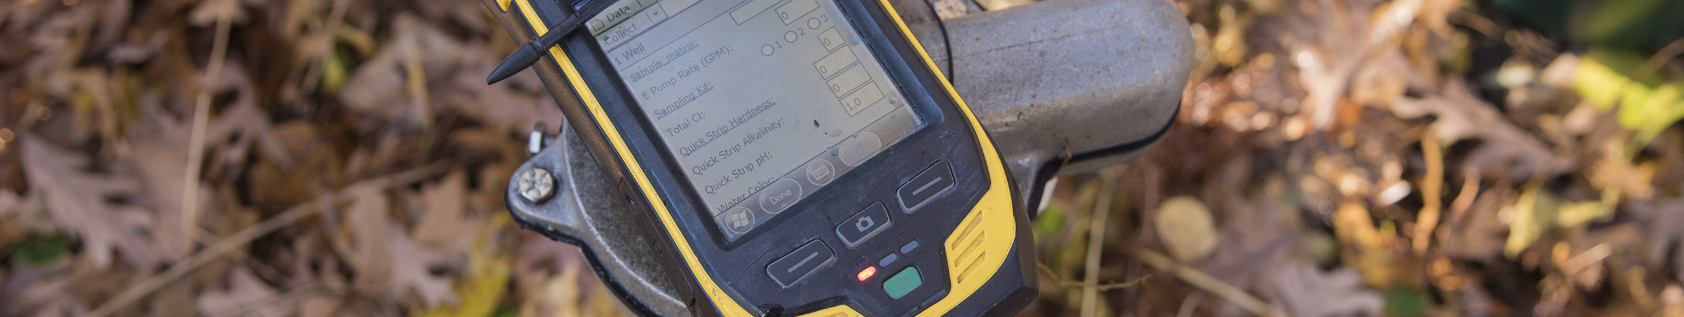
Locating Groundwater Atlas Products

Slide 4
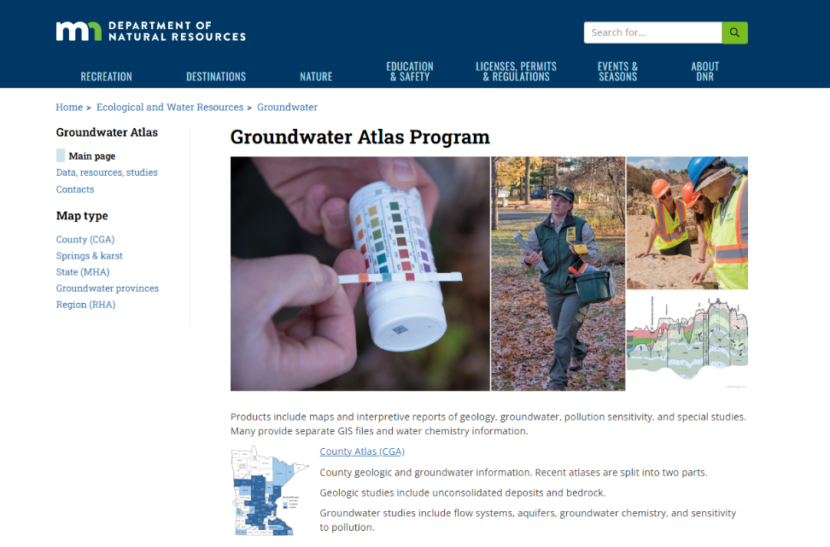

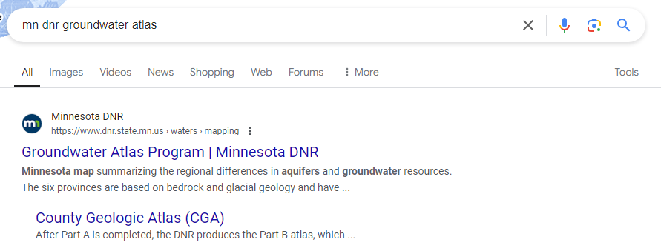
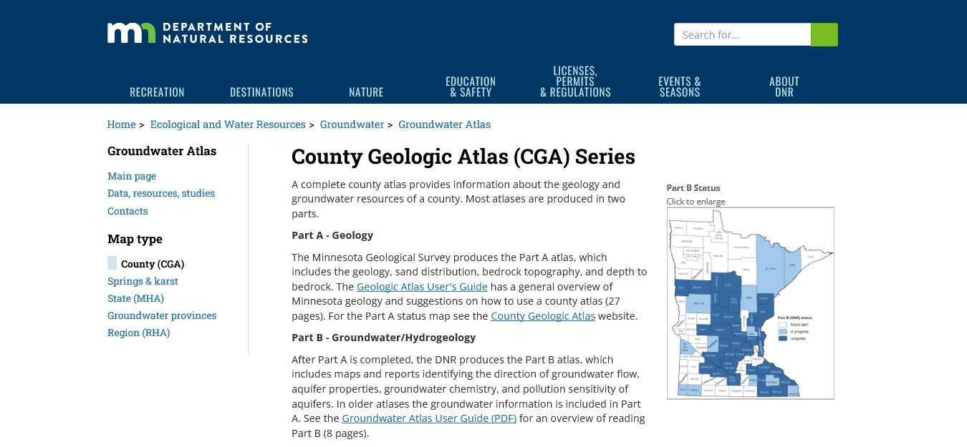
Groundwater Atlas Program
Go to mndnr.gov/groundwatermapping
or search for “mn dnr groundwater atlas”
Notes:
Type the URL: mndnr.gov/groundwatermapping in your browser. It will automatically redirect to our main program page. Then, click County Atlas (CGA) for our status map and listings by county.
Or you can enter “MN DNR groundwater atlas” in your preferred search engine and click on the appropriate search results to navigate to our webpages shown on the screen.

Slide 5
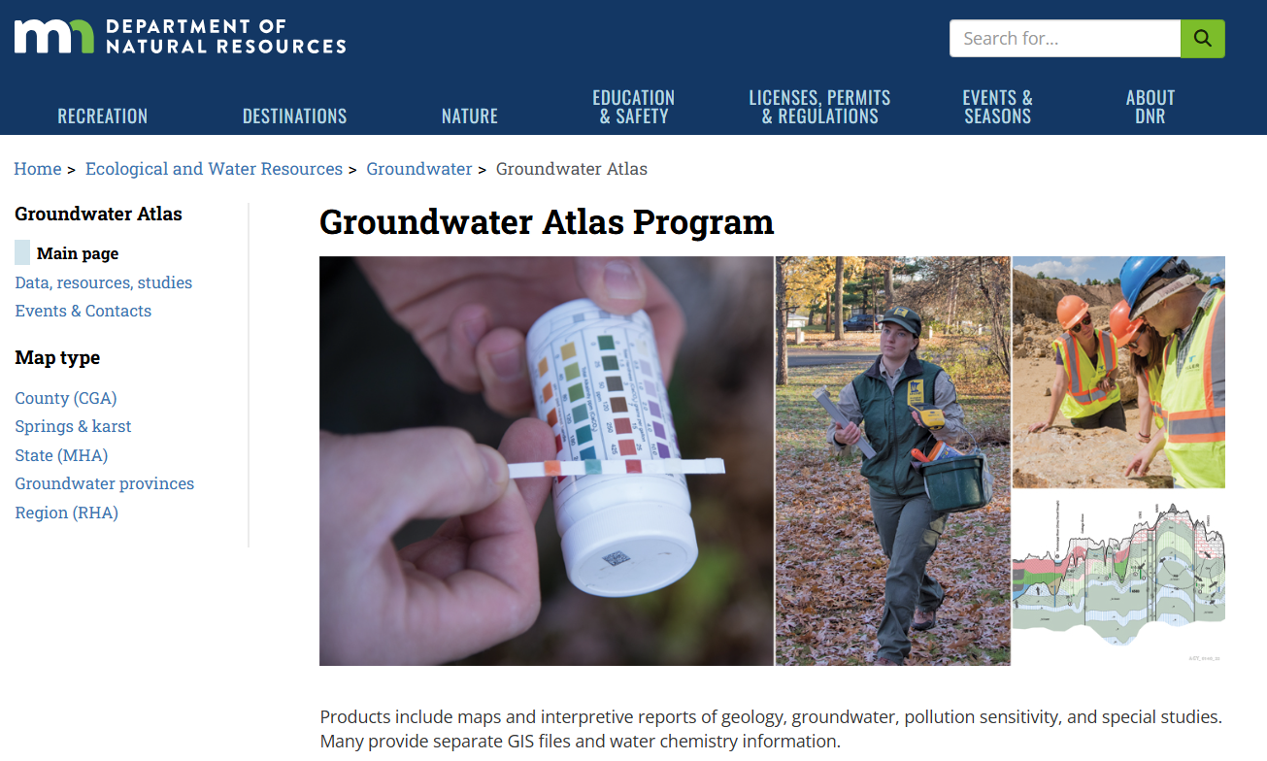
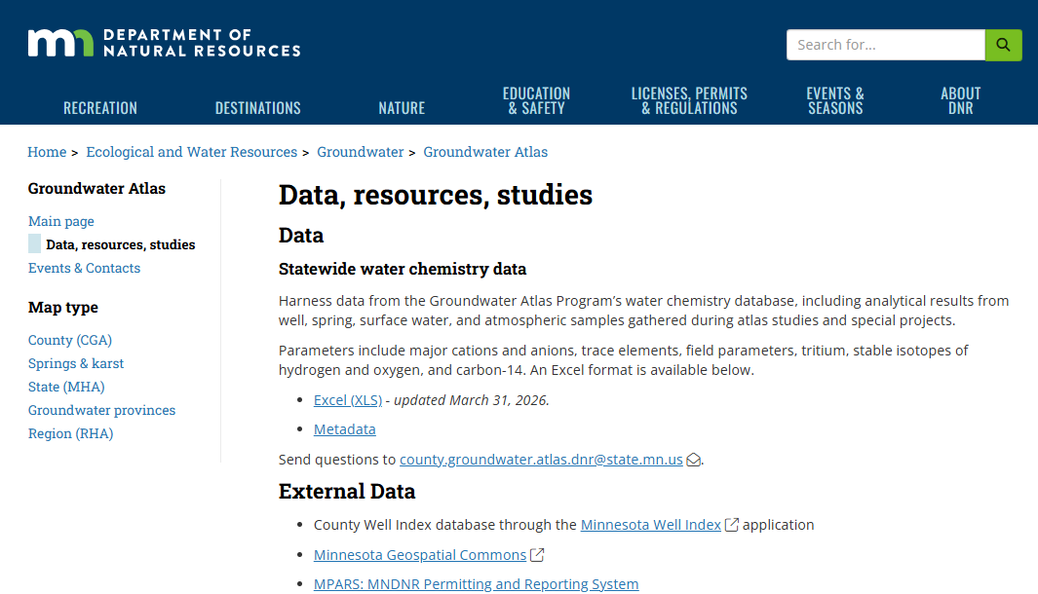
Accessing Atlas Program Data

Slide 6
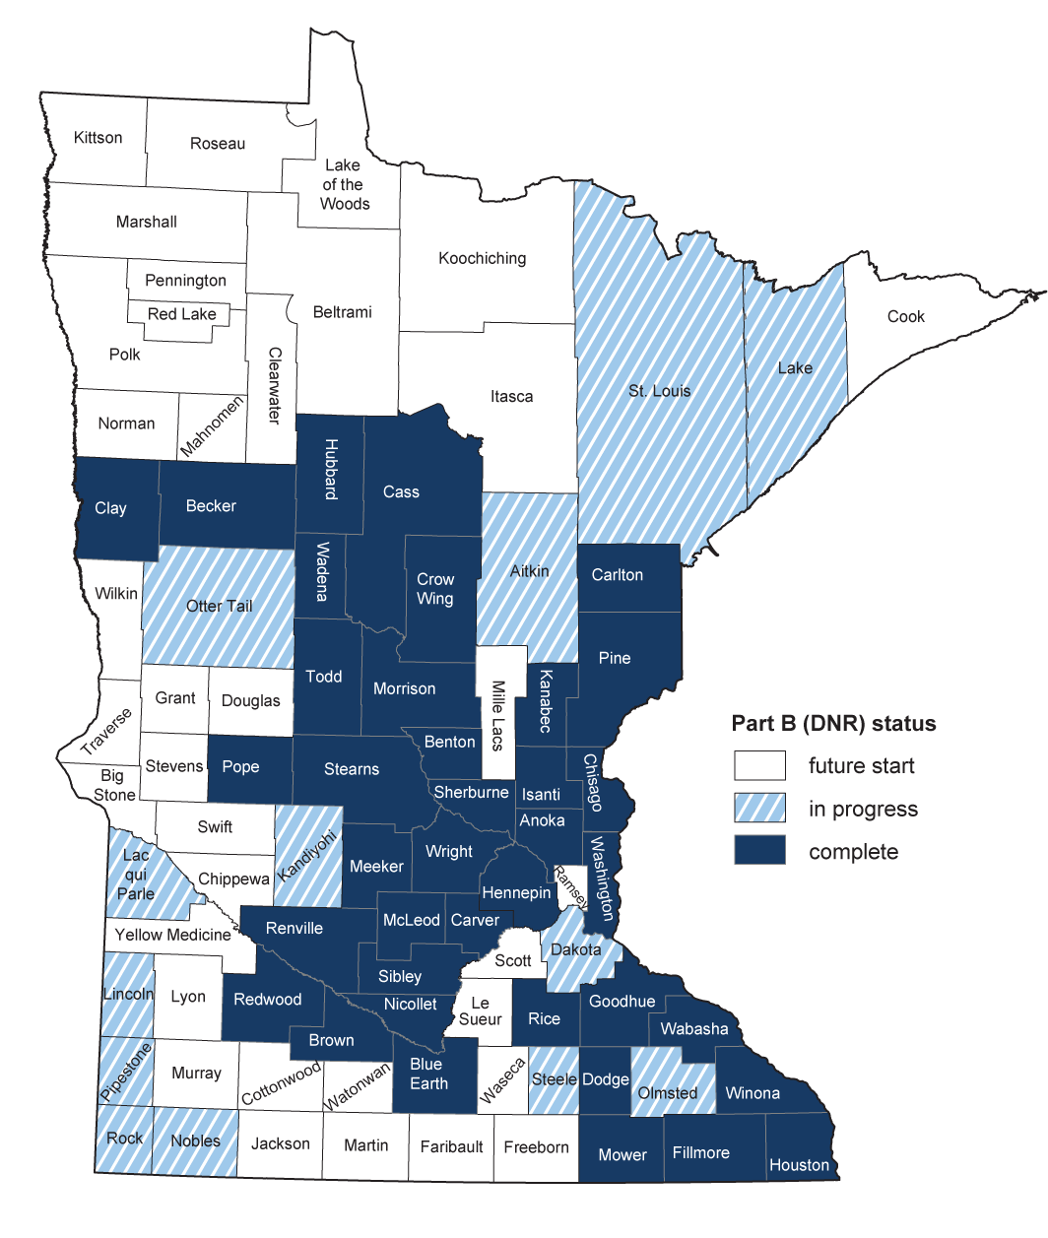
Groundwater Atlas Status Map
38 counties are complete (dark blue)
13 counties are in progress (blue stripes)
36 counties are not started (white)
Statuses are current as of April 2026.
Notes:
This map shows the current Part B atlas status for each of Minnesota’s 87 counties.
Dark blue counties are complete
Blue striped counties are in progress
We’ve not started work on the white counties

Slide 7
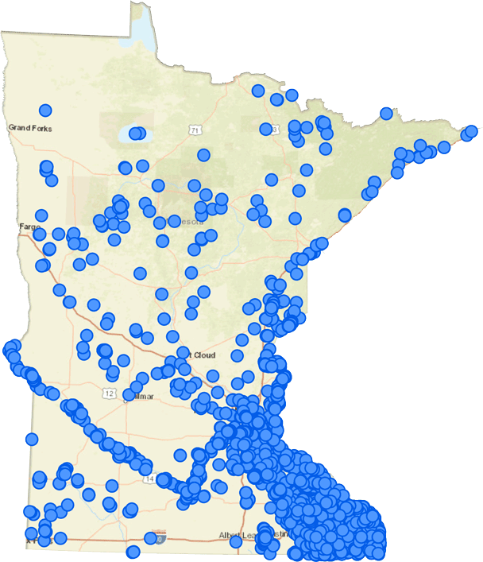
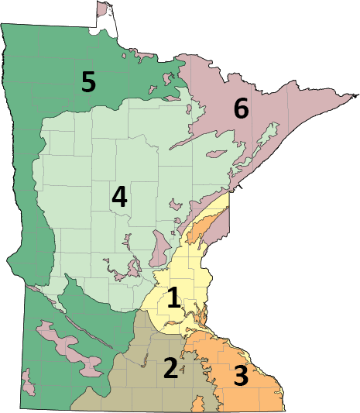
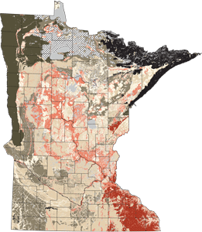
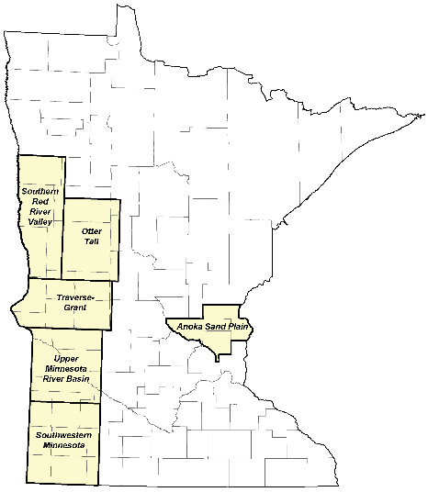
Other Groundwater Atlas Program Products
Groundwater Provinces
Six provinces, based on glacial and bedrock geology, summarize regional differences in groundwater sources and availability.
Springs, Springsheds, and Karst
Karst-related information and web maps, including the Minnesota Spring Inventory, Minnesota Groundwater Tracing Database, and Karst Feature Inventory.
Hydrogeology Atlas
Pollution sensitivity of near-surface materials, pollution sensitivity of the bedrock surface, and water-table elevation and depth to water table.
Regional Hydrogeologic Assessments
Large scale assessments with less detail than a Groundwater Atlas. Available for the Anoka Sand Plain, Southwestern Minnesota, Southern Red River Valley, Upper Minnesota River Basin, Otter Tail, and Traverse-Grant.
Notes:
Minnesota groundwater provinces
East-central
South-central
Karst
Central
Western
Arrowhead/shallow bedrock

Slide 8
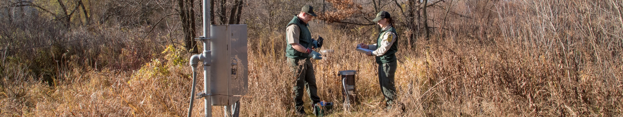
Groundwater Residence Time

Slide 9
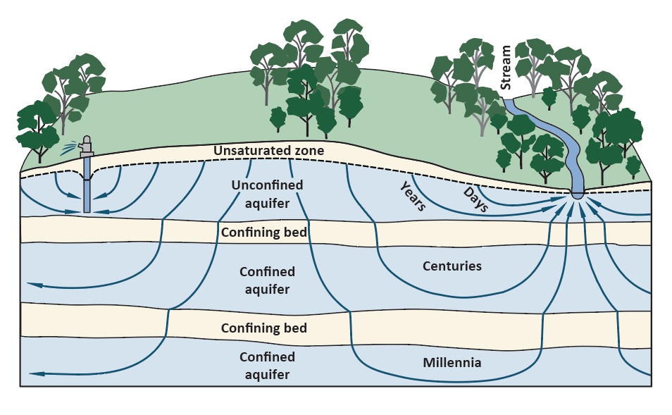
Understanding Groundwater Residence Time
Mixtures – bulk ages
Residence time
Age
Travel time
Residence time – a measure of how long groundwater has been in an aquifer.

Slide 10
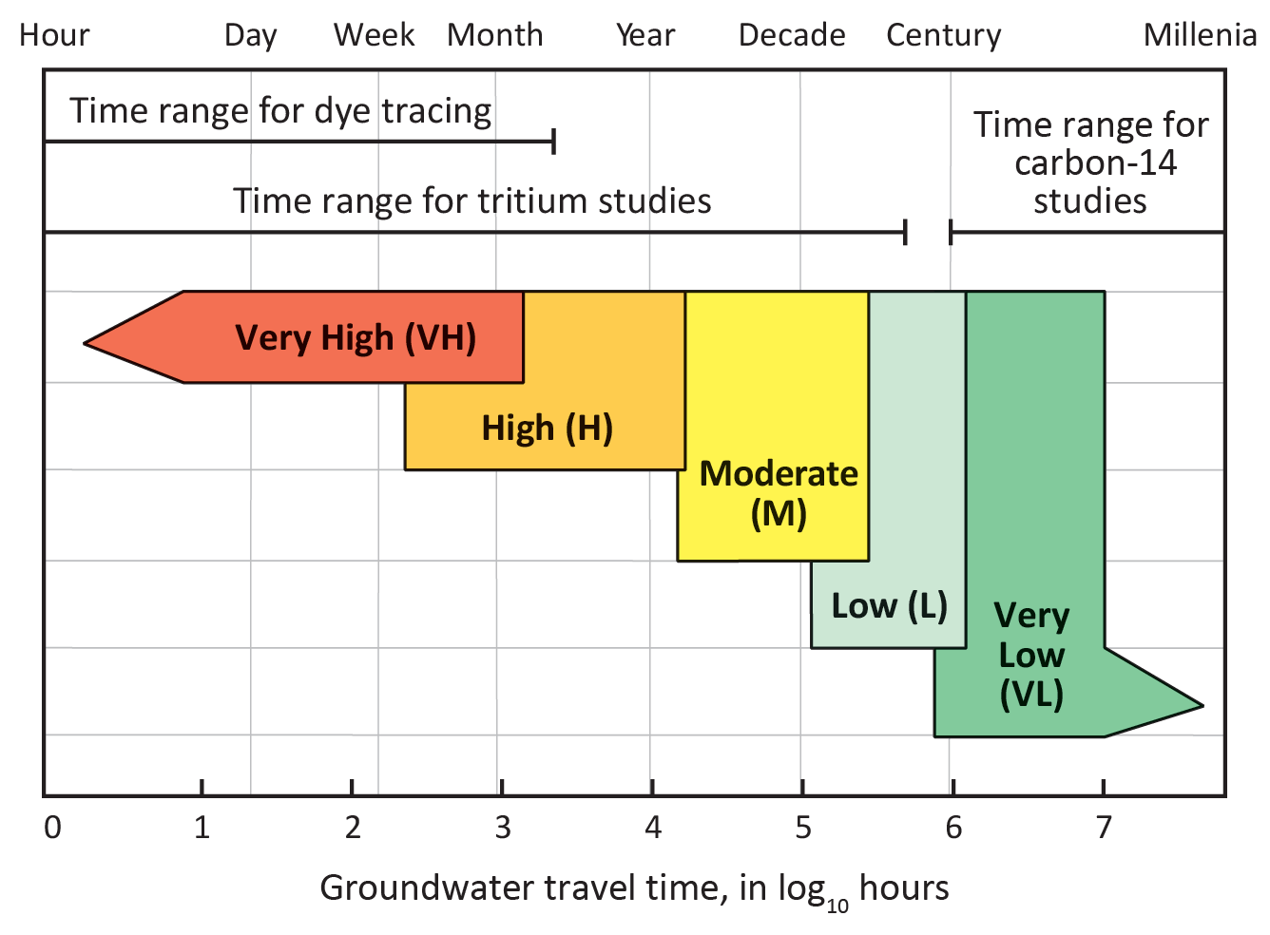
Groundwater Atlas Data
Travel time continuum

Slide 11
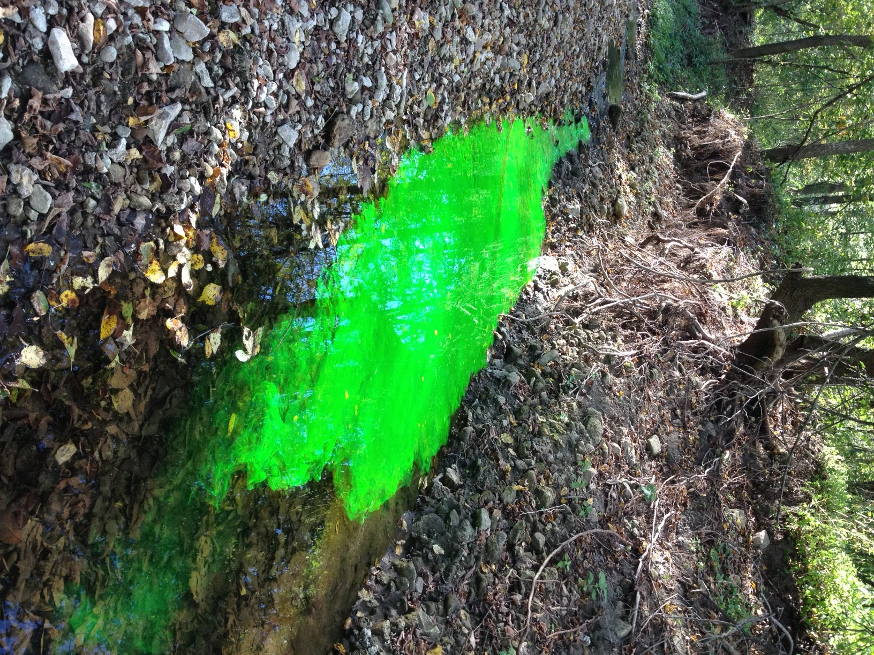
Dye Tracing

Slide 12
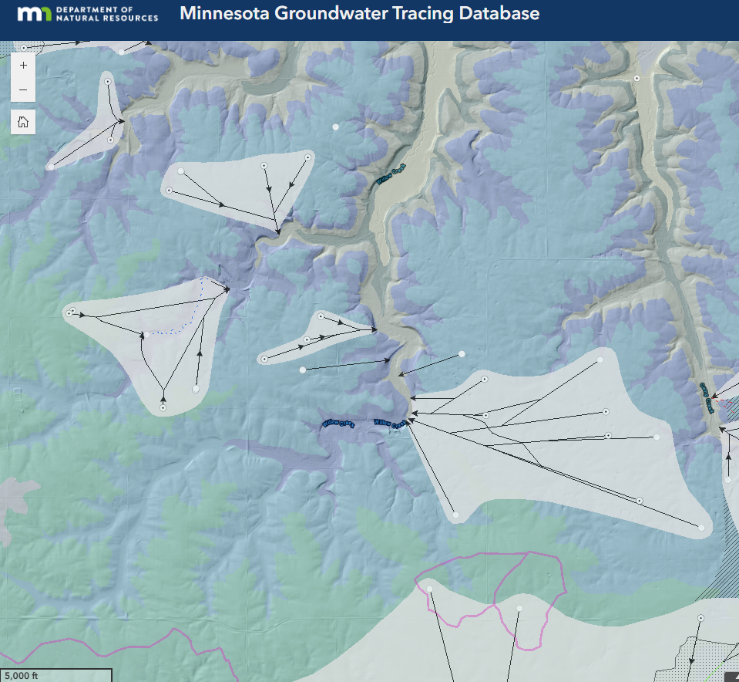
Minnesota Groundwater Tracing Database
Webpage/web application of dye traces
Focused on southeastern Minnesota karst

Slide 13
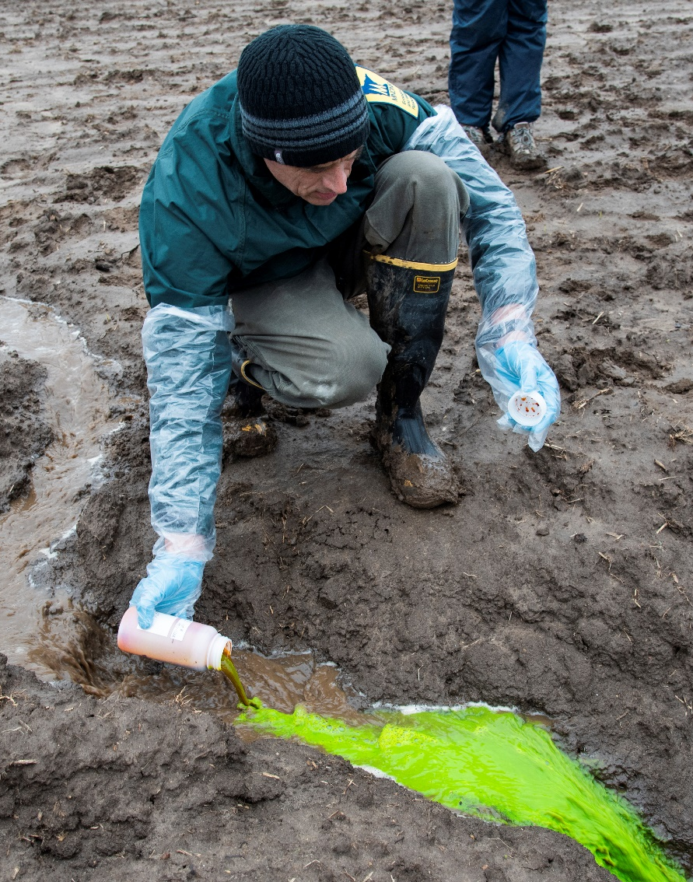
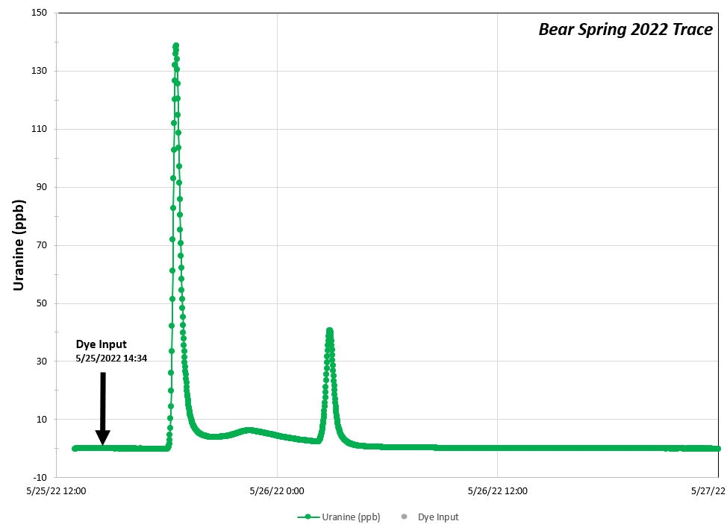
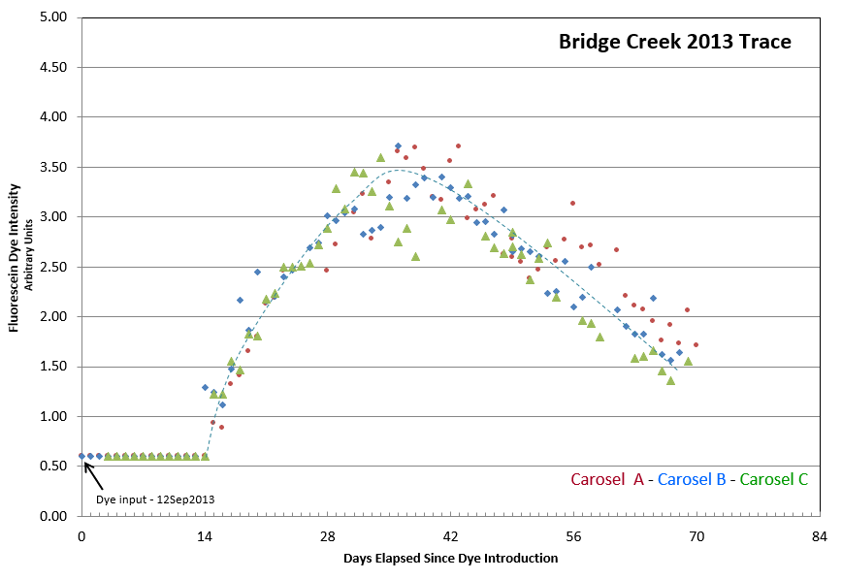
Breakthrough Curves
Galena Karst, dye traveled ~ 1.3 miles in 3.5 hours
St. Lawrence – Tunnel City (siliciclastic pseudokarst), dye traveled ~ 4.5 miles
in 15 days

Slide 14

Tritium

Slide 15
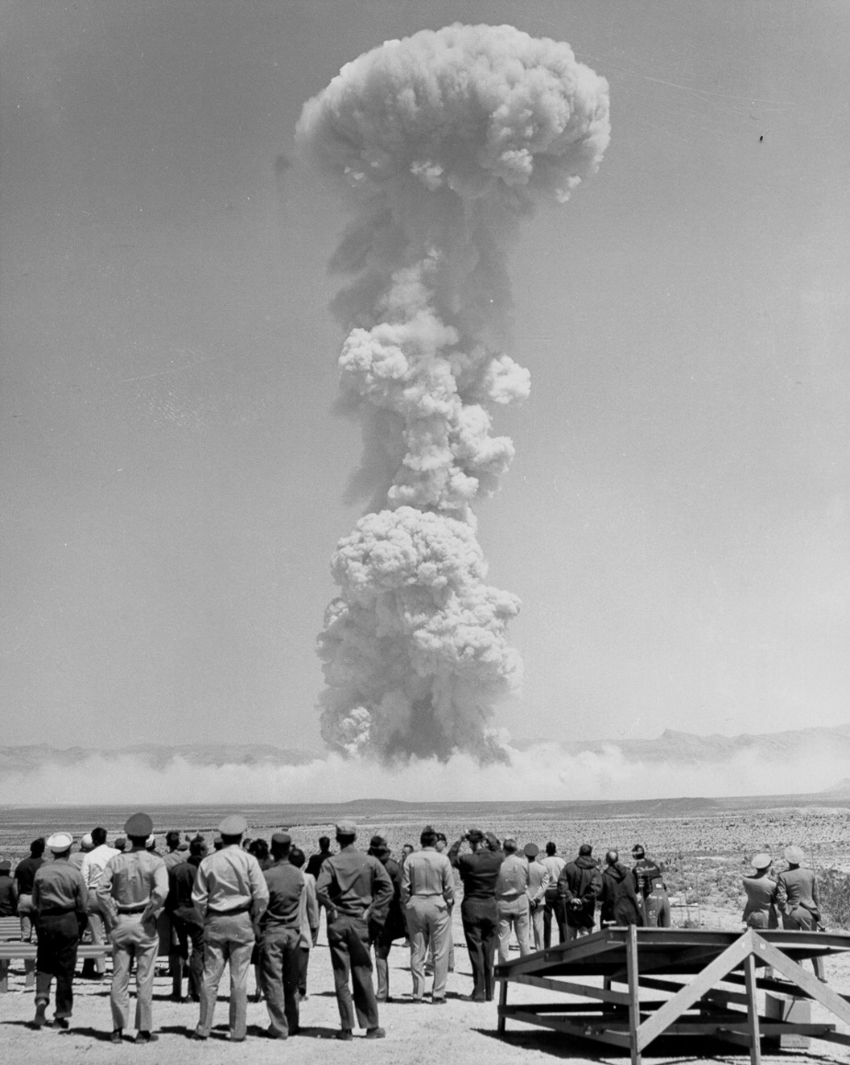
Understanding Tritium
³H – radioactive isotope of hydrogen
Occurs naturally, above ground hydrogen bomb testing, produced in nuclear reactors
Short half life of 12.32 years
Photo: Galerie Bilderwelt/Getty Images

Slide 16
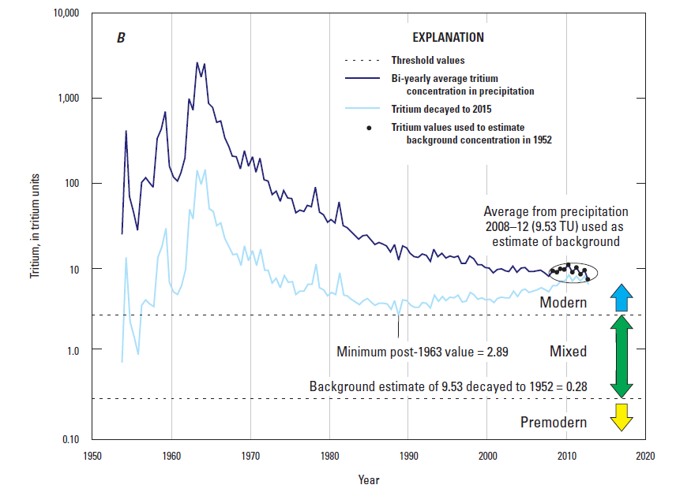
Tritium Decay
Enriched bomb-spike tritium values approaching natural levels (prebomb testing)
USGS - Scientific Investigations Report 2019–5090

Slide 17
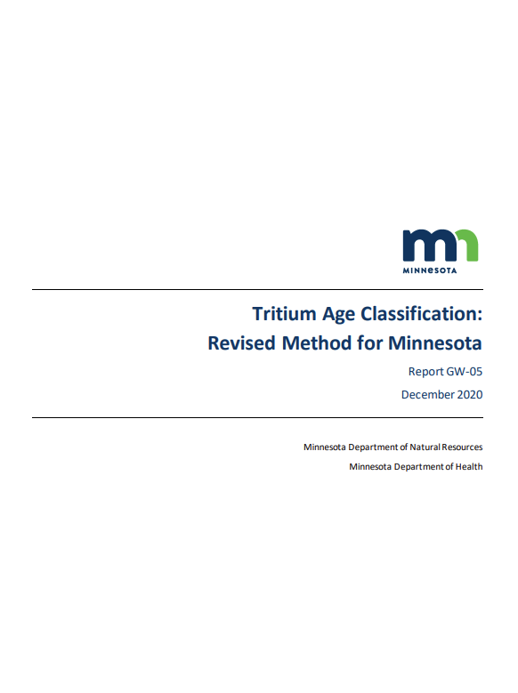
Tritium Age Classification – GW-05
Modern: water entered the ground since about 1953.
Mixed: water is a mixture of modern and premodern.
Mostly premodern: tritium not detected and the premodern threshold below the detection limit.
Premodern: water entered the ground before 1953.

Slide 18
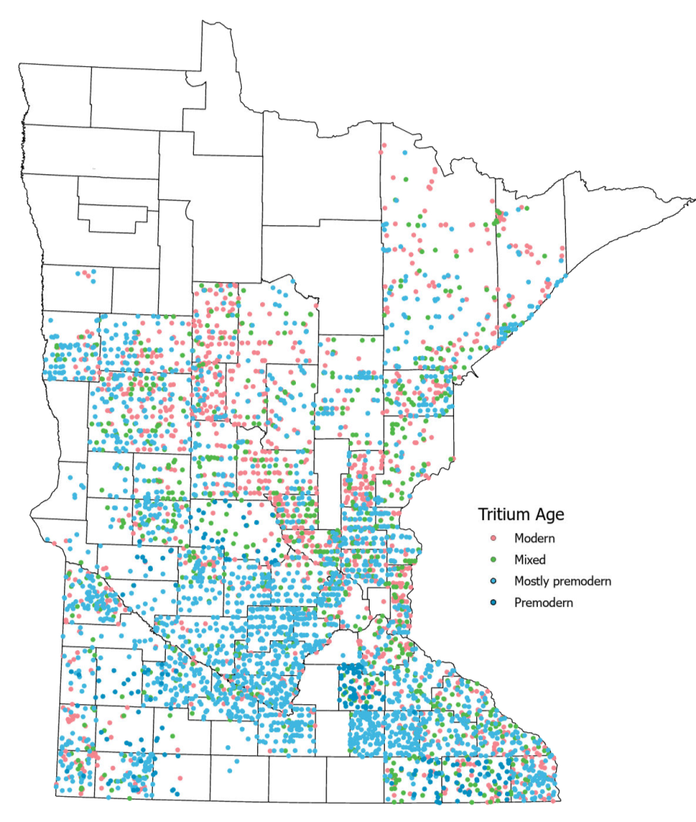
Tritium Samples
Wells = 4,885
Springs = 82
Surface waters = 50
Atmospheric = 31

Slide 19
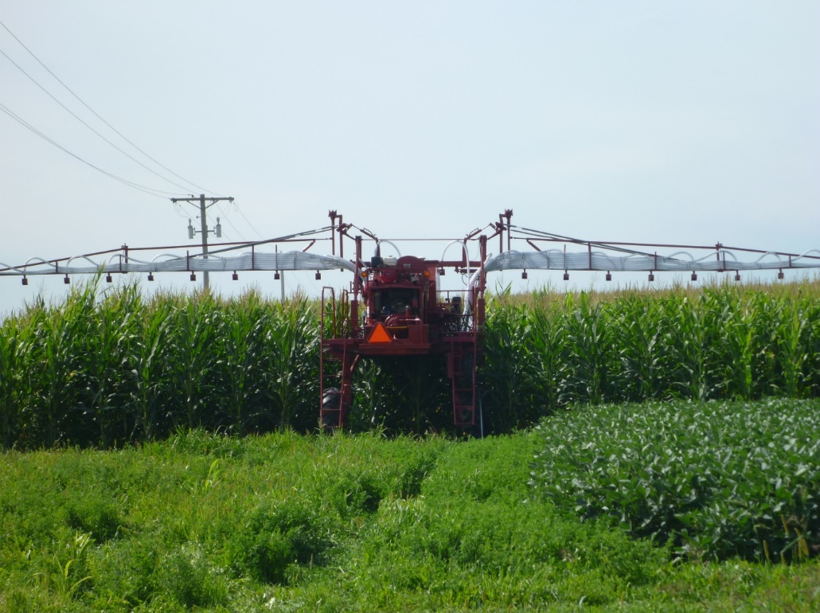
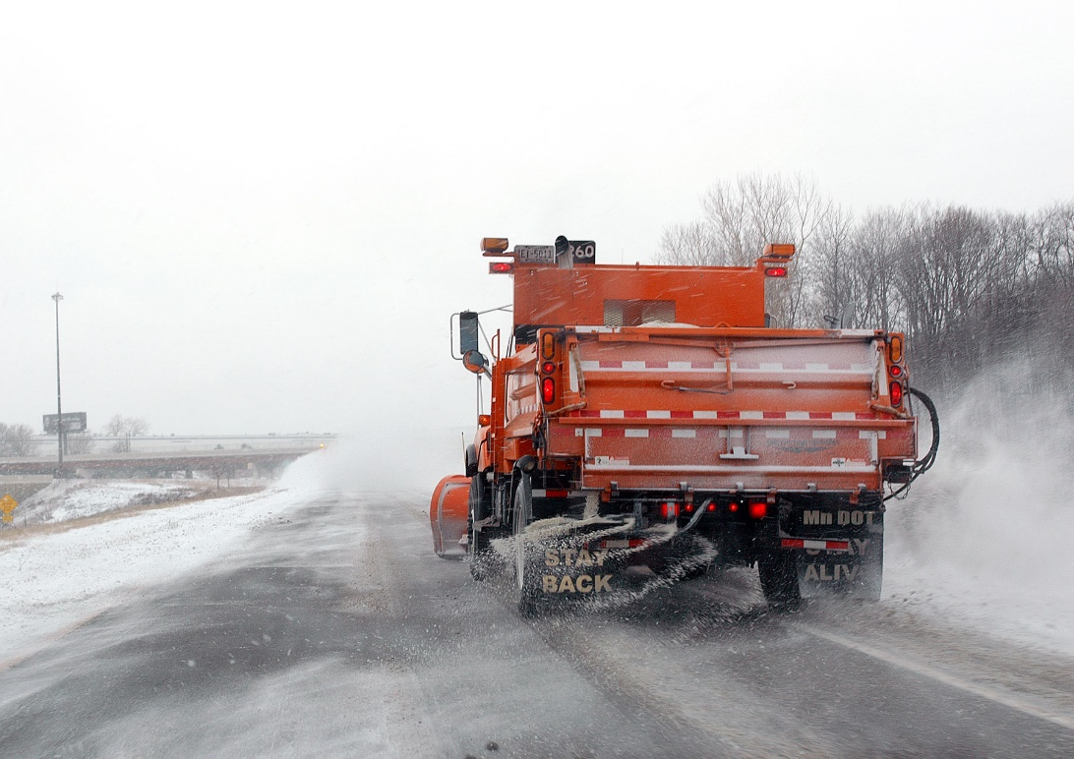
Anthropogenic Indicators: Nitrate and Chloride
Photo: Martin Larsen
Photo: David R. Gonzalez, Minnesota Department of Transportation
Fertilizer and animal or human waste
Concentrations > 1 ppm* (*MGS Information Circular 48: Updated Nitrate Guidance for Minnesota)
Road salt, water softener salts, and fertilizers
Anthropogenic if chloride ≥ 5 ppm; chloride/bromide ratio ≥ 300

Slide 20
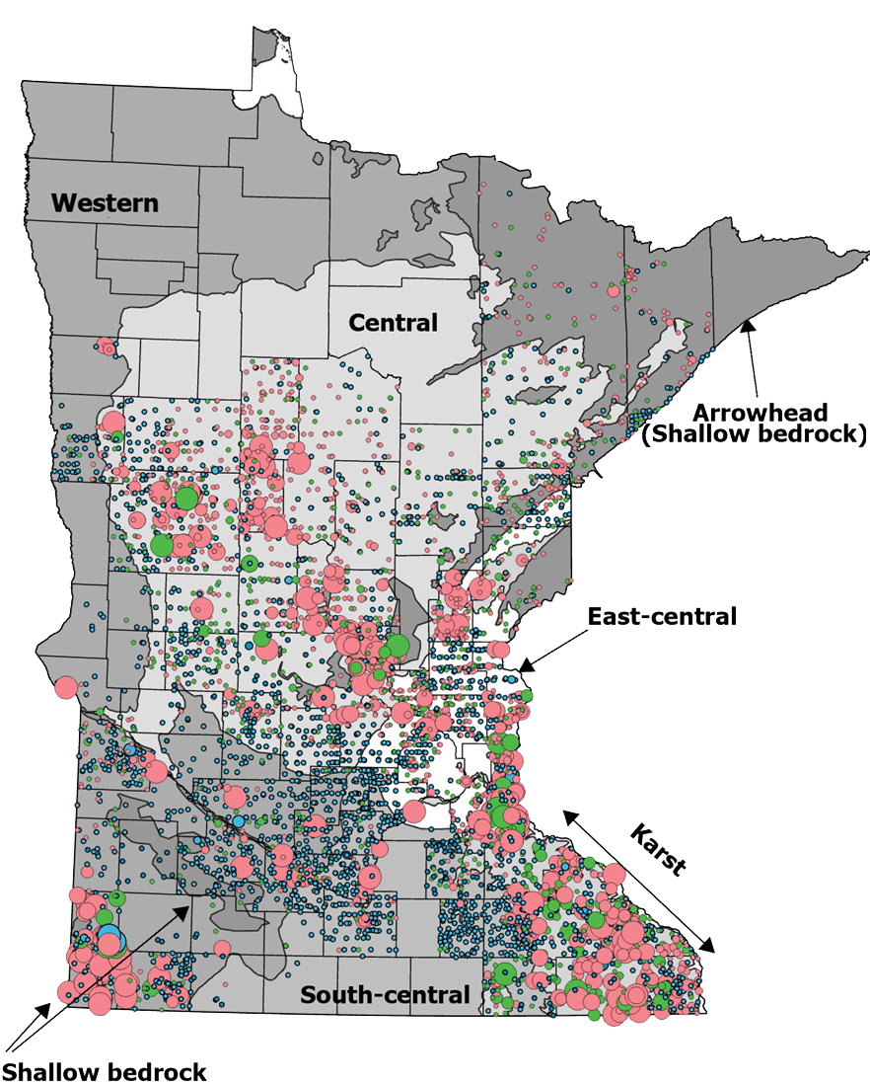
Tritium-Nitrate Data
Enriched tritium – Nitrate > 1 mg/L
Wells = 554
Springs = 61
Surface waters = 0

Slide 21
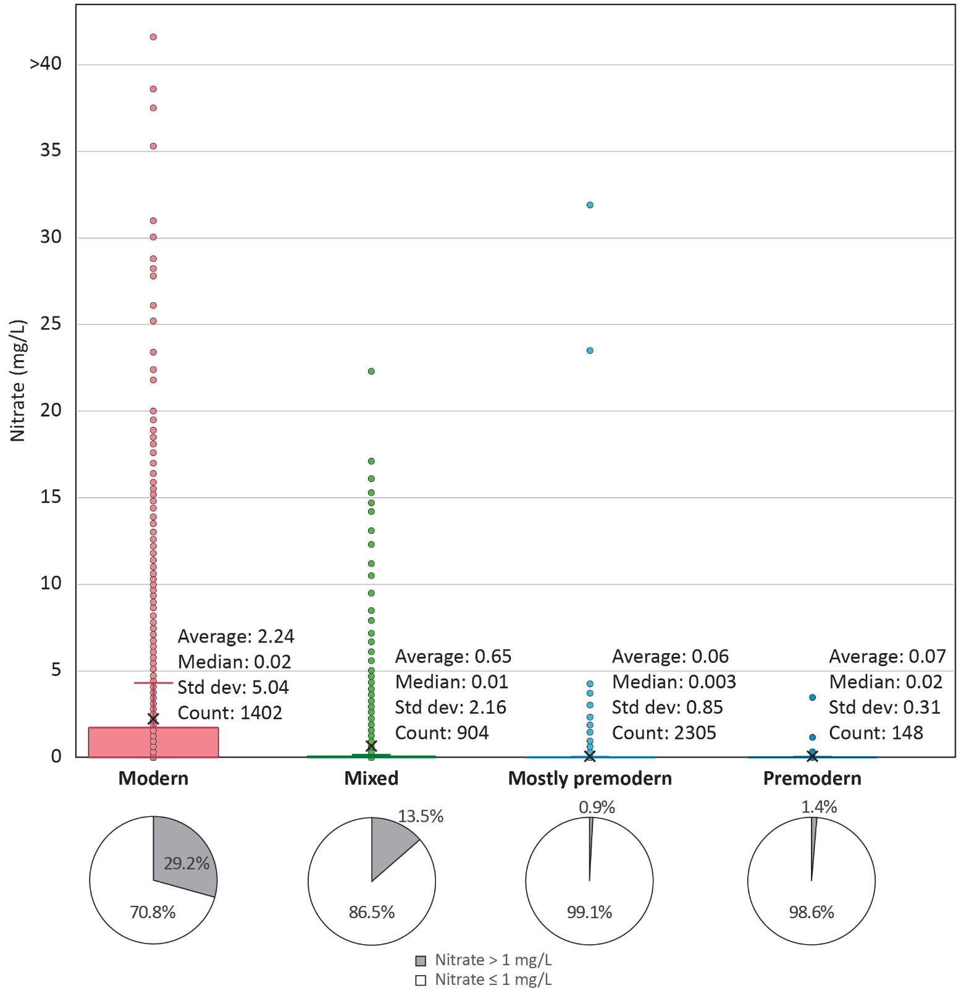
Tritium-Nitrate: Wells
Most wells with nitrate > 1 mg/L
are modern or mixed
22 of 2,453 mostly premodern and premodern have nitrate > 1 mg/L
(0.9% of combined samples)

Slide 22
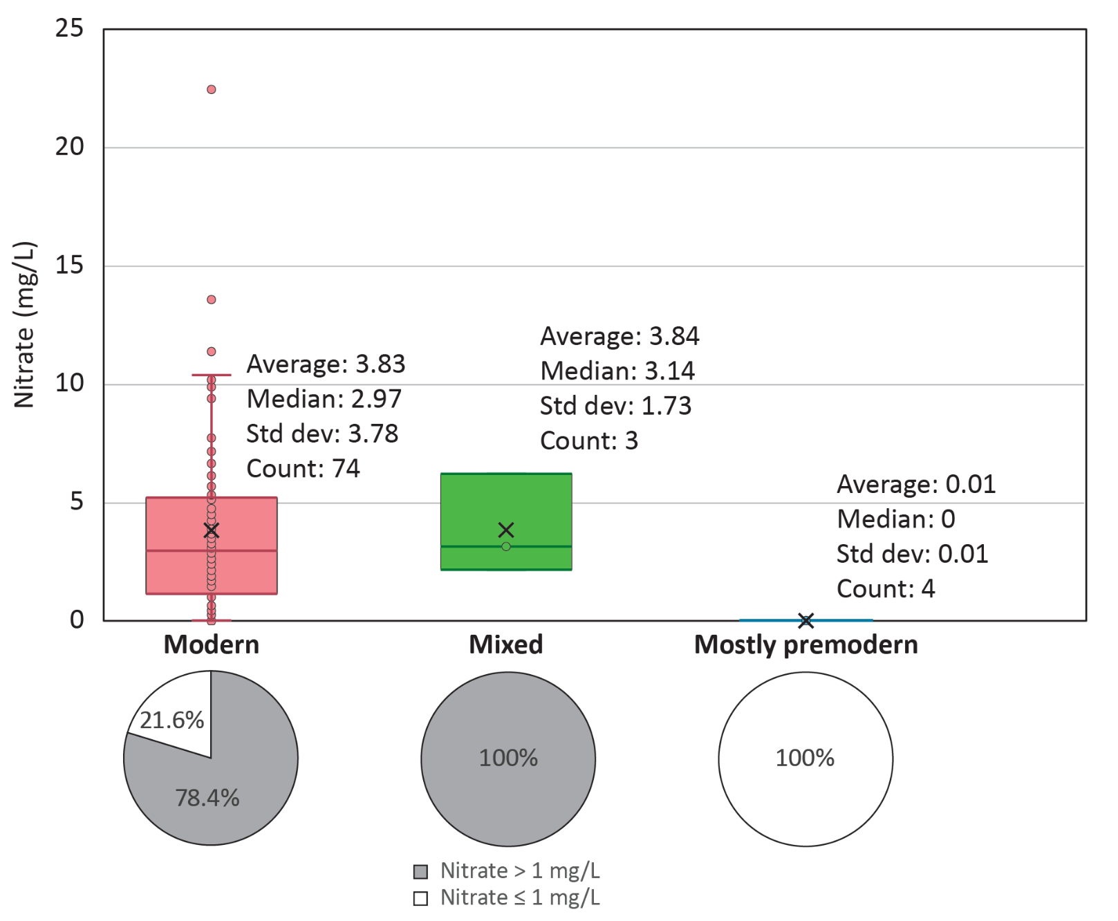
Tritium-Nitrate: Springs
Modern and mixed with nitrate > 1 mg/L
61 of 77 (79% of combined samples)

Slide 23
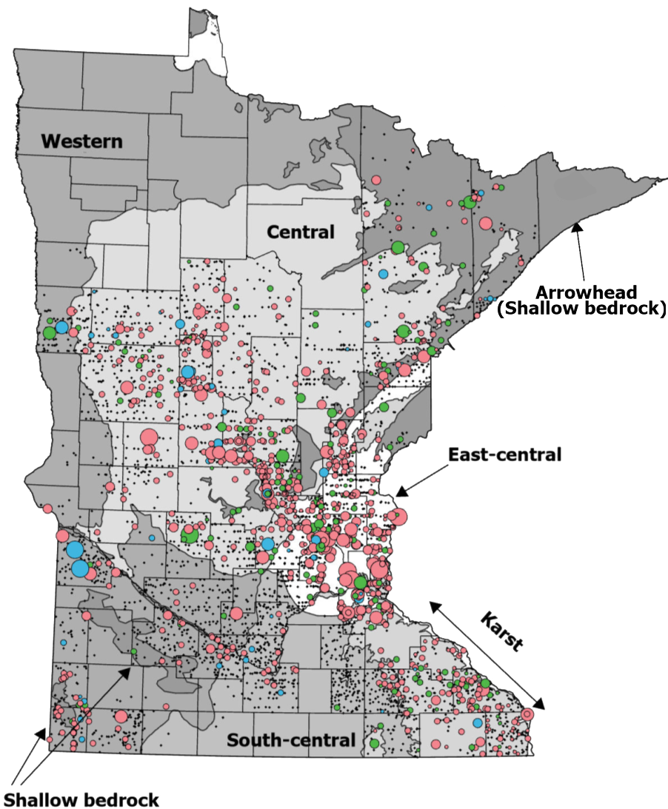
Tritium-Chloride Data
Enriched tritium – Anthropogenic chloride (Chloride ≥ 5 ppm, chloride/bromide ratio ≥ 300)
Wells = 922
Springs = 52
Surface waters = 0

Slide 24
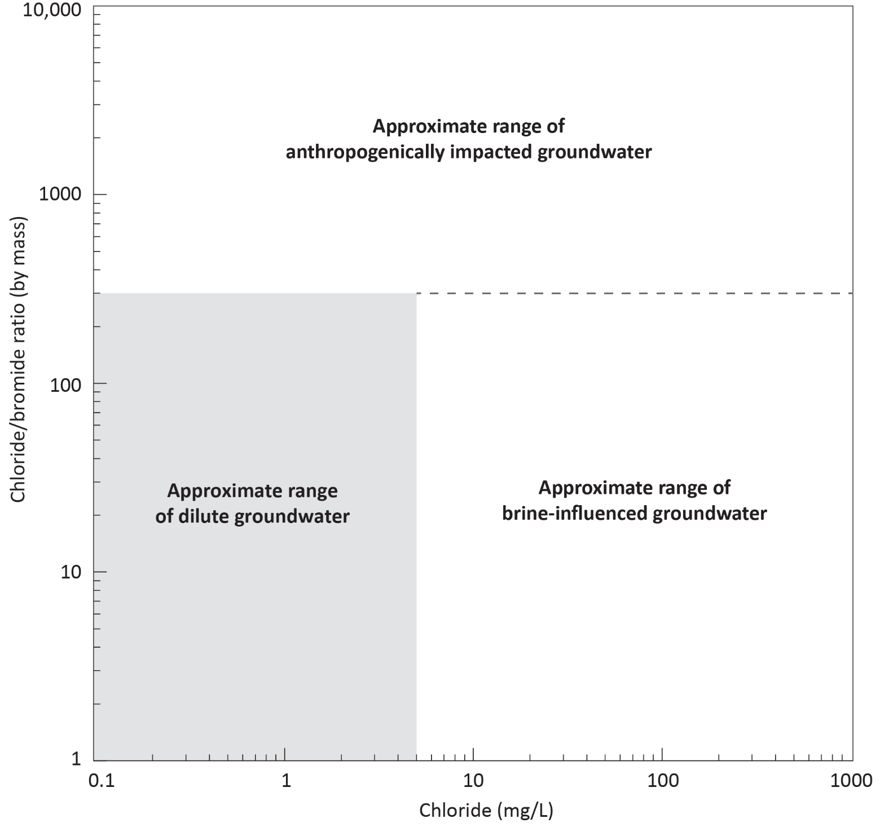
Chloride/Bromide vs. Chloride
Approximate range of dilute groundwater Cl/Br < 300 and chloride <5 mg/L
Chart modified from USGS – Scientific Investigations Report 2011–5229
Cl:Br from Whittemore, 1988; Davis and others, 1998; and others

Slide 25
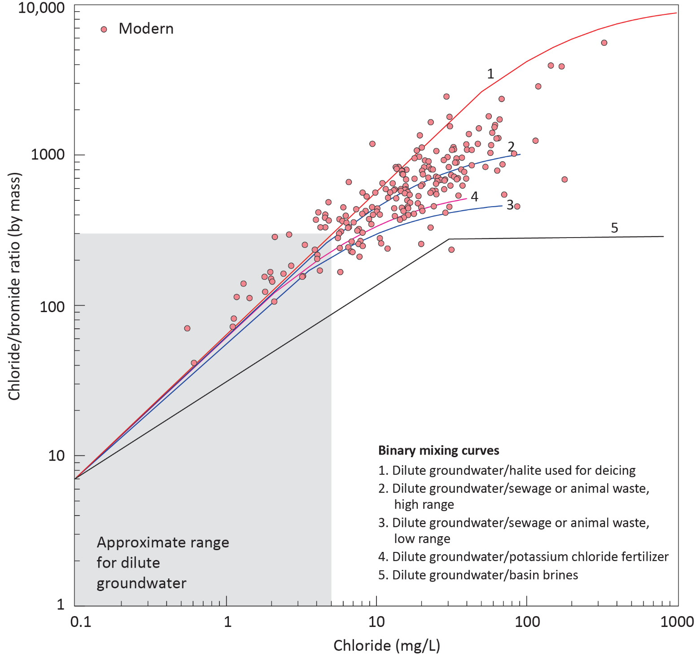
Modern Tritium Cl/Br
Paleozoic wells
Anthropogenically impacted – 80%
Dilute groundwater – 12%
Brine influenced – 8%
Binary mixing curves from USGS - SIR 2011–5229

Slide 26
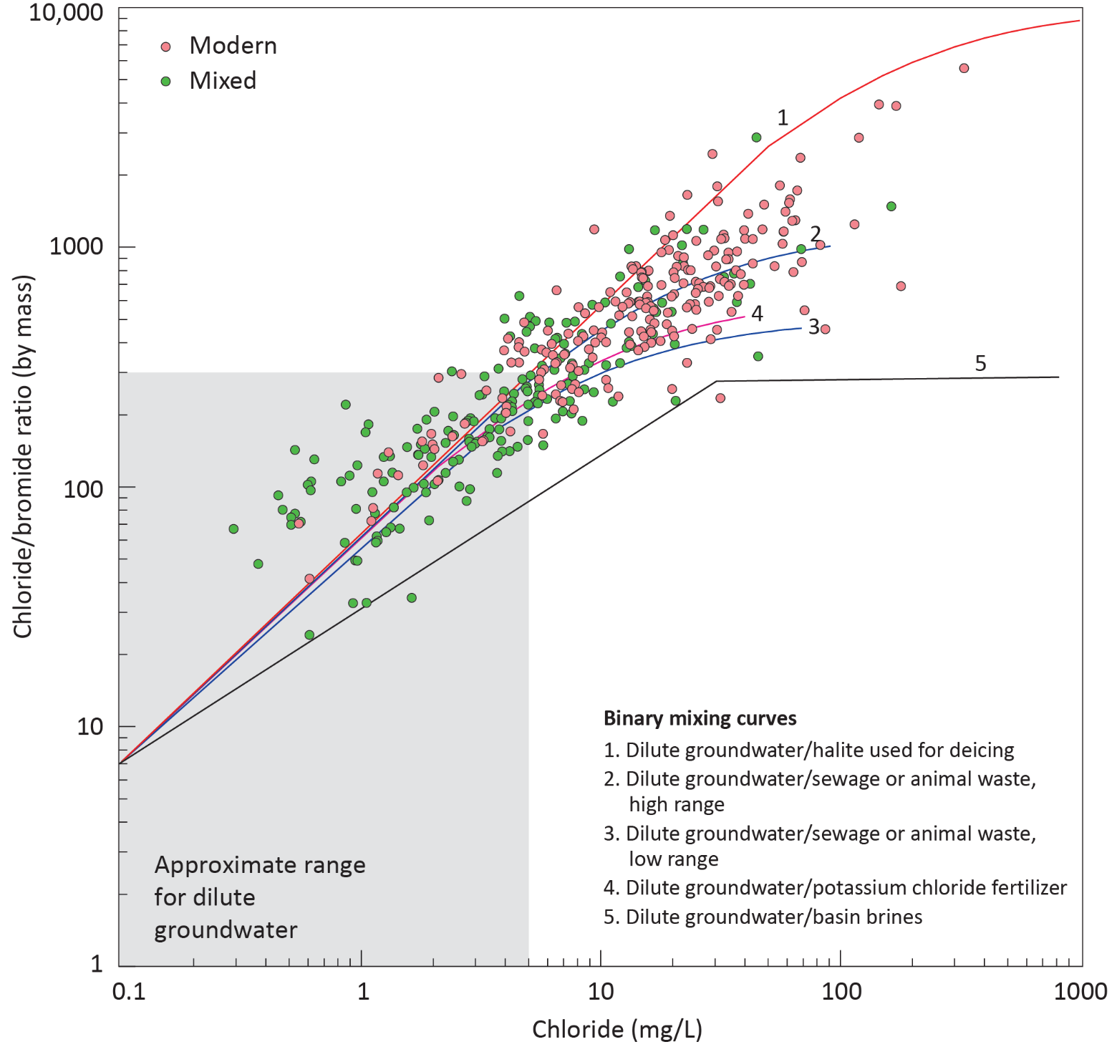
Mixed Tritium Cl/Br
Paleozoic wells
Anthropogenically impacted – 32%
Dilute groundwater – 56%
Brine influenced – 12%

Slide 27
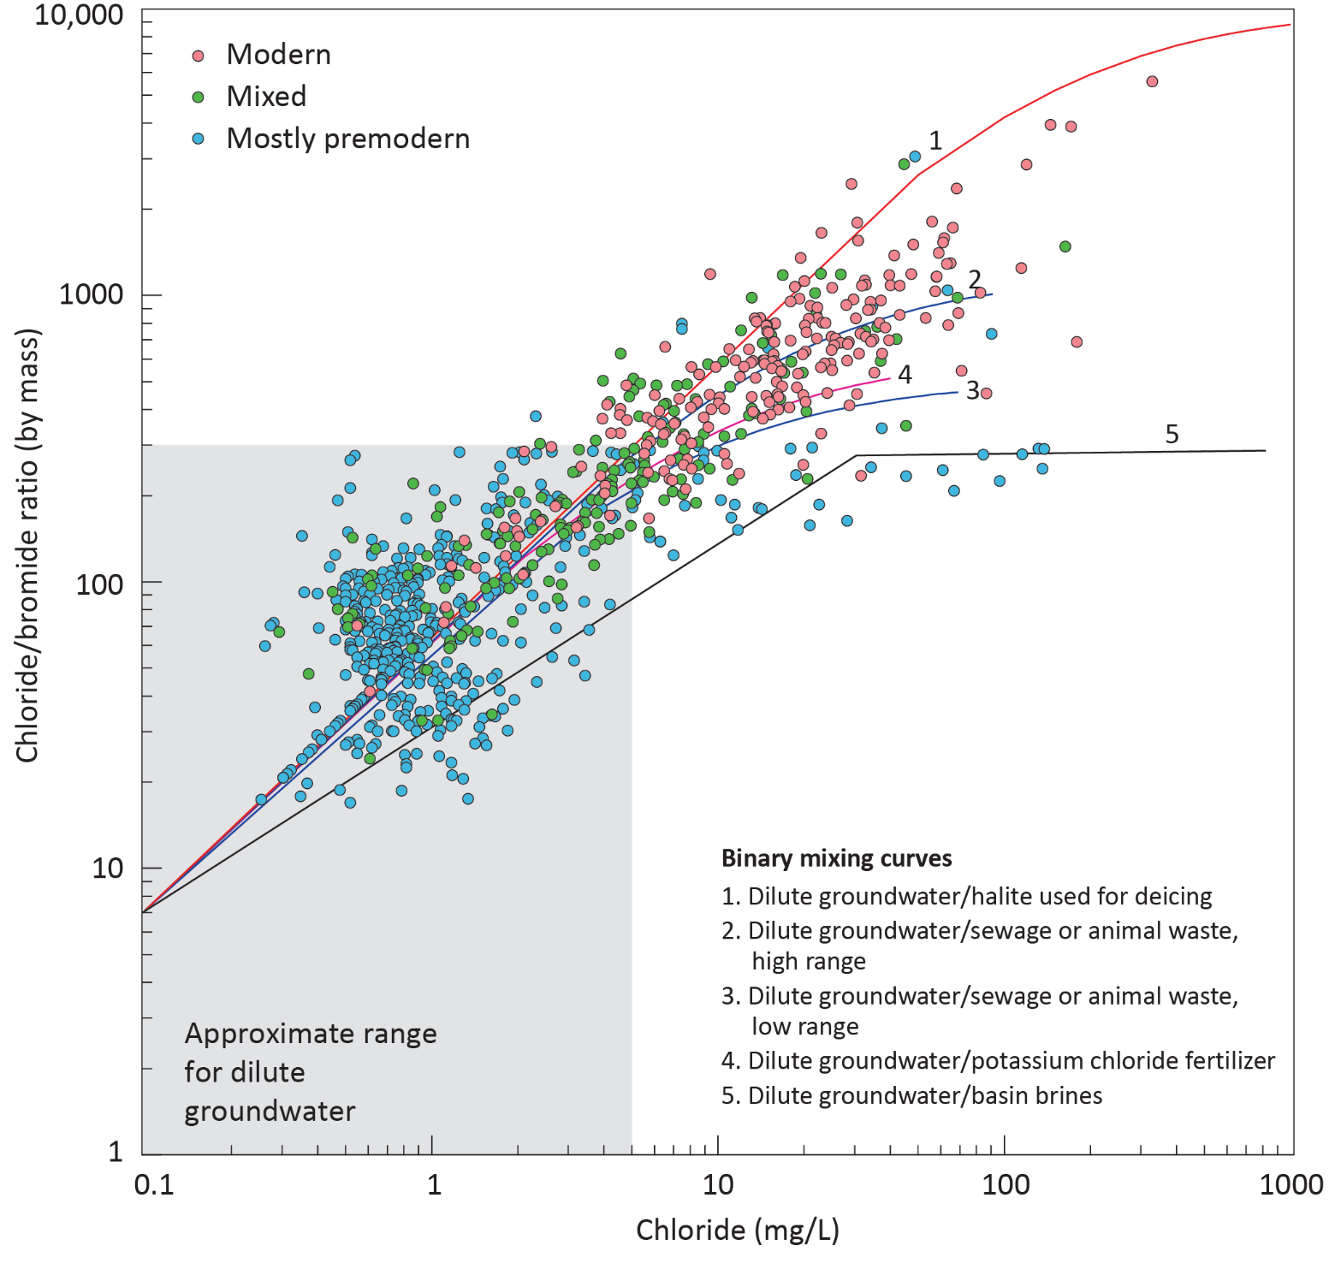
Mostly premodern Tritium Cl/Br
Paleozoic wells
Anthropogenically impacted – 2%
Dilute groundwater – 90%
Brine influenced – 8%

Slide 28

Premodern Tritium Cl/Br
Paleozoic wells
Anthropogenically impacted – 0%
Dilute groundwater – 94%
Brine influenced – 6%

Slide 29
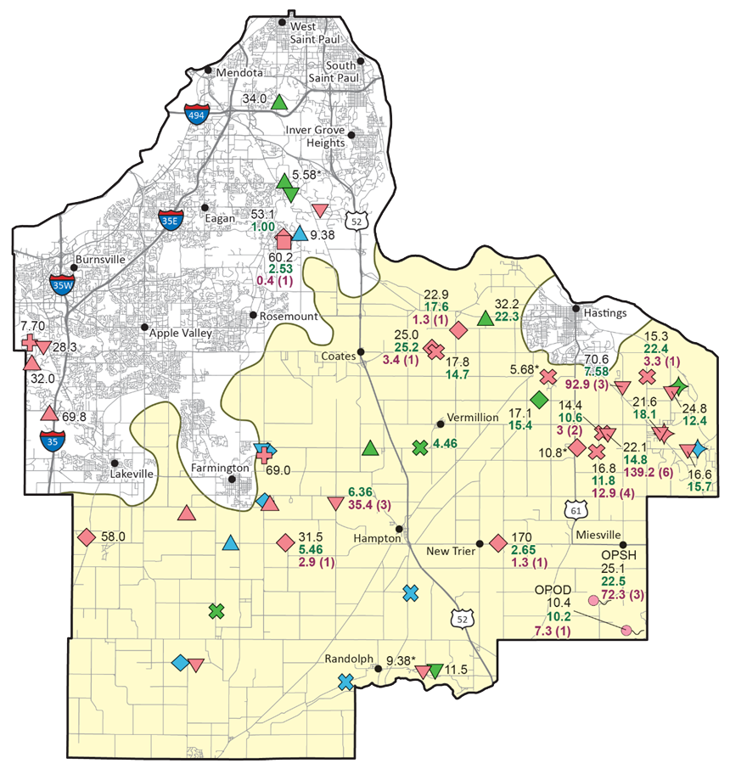
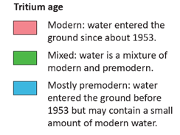
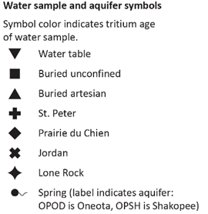
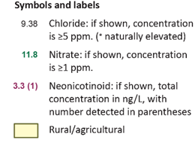
Tritium + Pesticides
Dakota County Atlas: Special Project
Neonics in 13 of 31 modern samples
12 from rural/agricultural region also had elevated nitrate, elevated chloride, and elevated Cl/Br
18 modern with no neonics; neonics are not ubiquitous in the environment
5 modern samples had elevated nitrate and no neonics

Slide 30
Ultra-Low Tritium
Well | Enriched tritium (TU) | Enriched classification | Ultra-low tritium (TU) | ULT classification
141041 | < 0.80 | Mostly premodern | < 0.10 | Premodern
160819 | < 0.80 | Mostly premodern | < 0.10 | Premodern
227562 | < 0.80 | Mostly premodern | 0.3 | Mixed
493936 | < 0.80 | Mostly premodern | 0.6 | Mixed
528641 | < 0.80 | Mostly premodern | 0.5 | Mixed
559644 | < 0.80 | Mostly premodern | 0.3 | Mixed
631460 | < 0.80 | Mostly premodern | 0.5 | Mixed
638020 | < 0.80 | Mostly premodern | 0.2 | Premodern
638784 | < 0.80 | Mostly premodern | < 0.10 | Premodern
662292 | < 0.80 | Mostly premodern | 0.6 | Mixed
Enriched vs. ultra-low comparison
19 wells resampled for ultra-low tritium analysis
11 Mostly Premodern classifications were resolved to Premodern
8 classifications were resolved to Mixed
Ultra low analysis cost is ~ 3X greater than enriched

Slide 31
Carbon-14

Slide 32
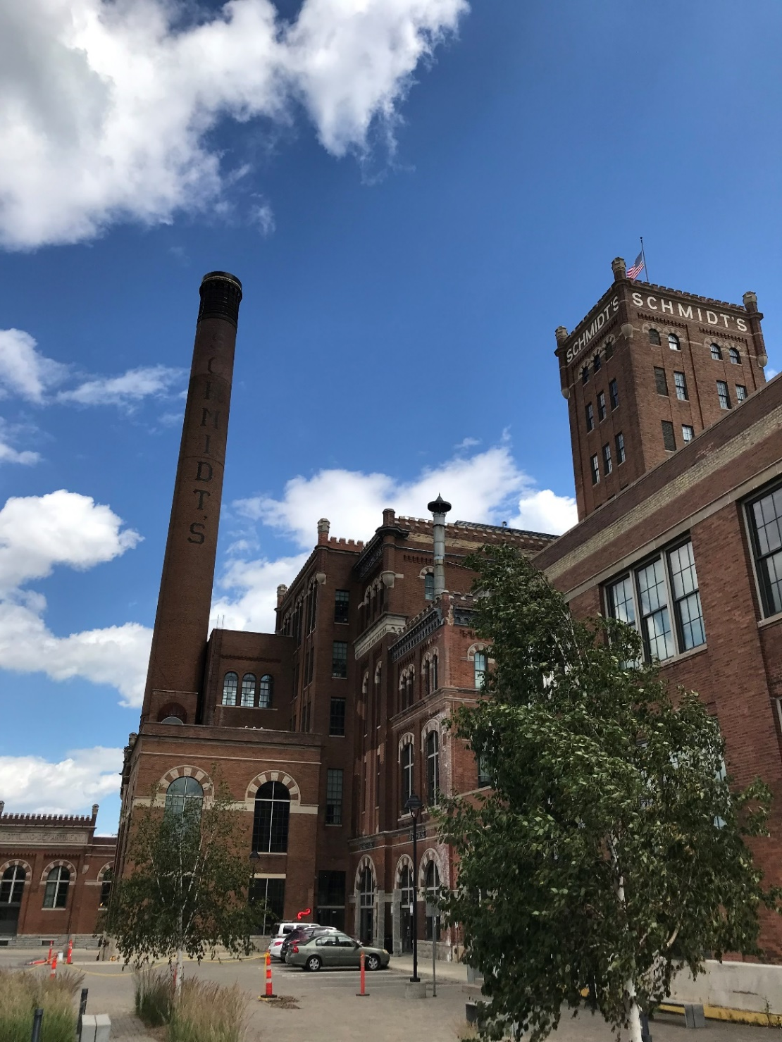
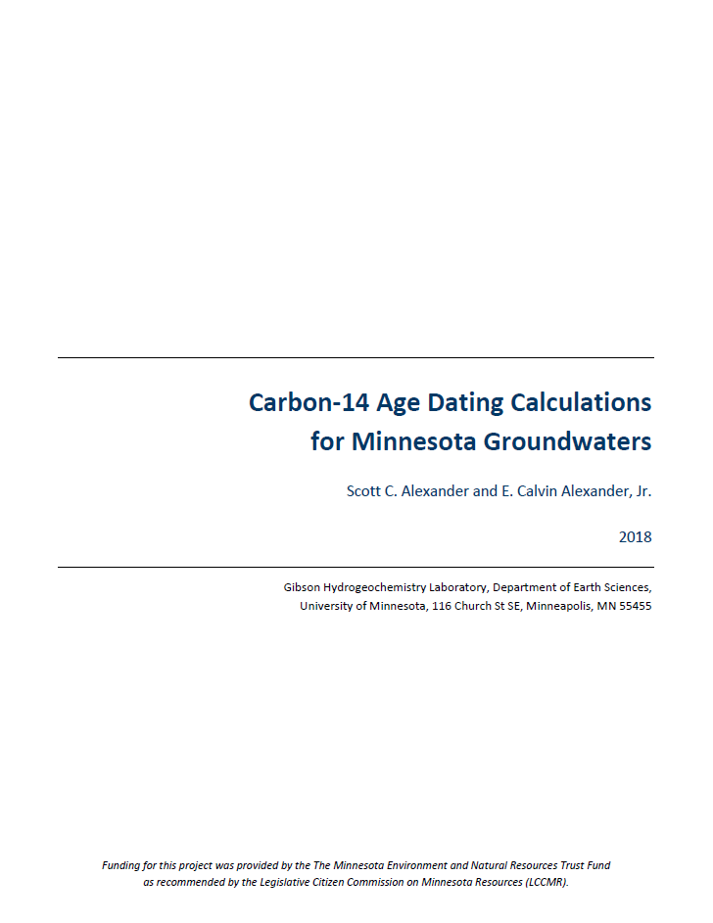
Carbon-14 History and Methodology

Slide 33
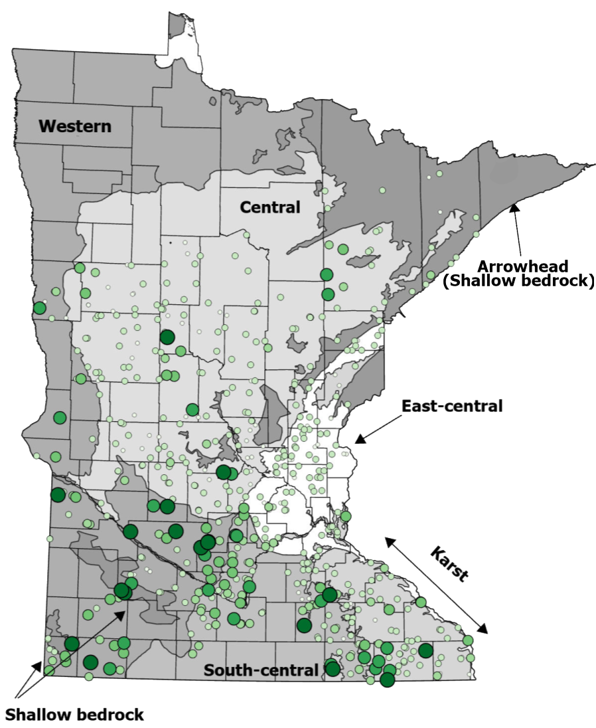
Carbon-14 Sample Locations
Groundwater Atlas C-14 = 602
Other projects C-14 = 200

Slide 34
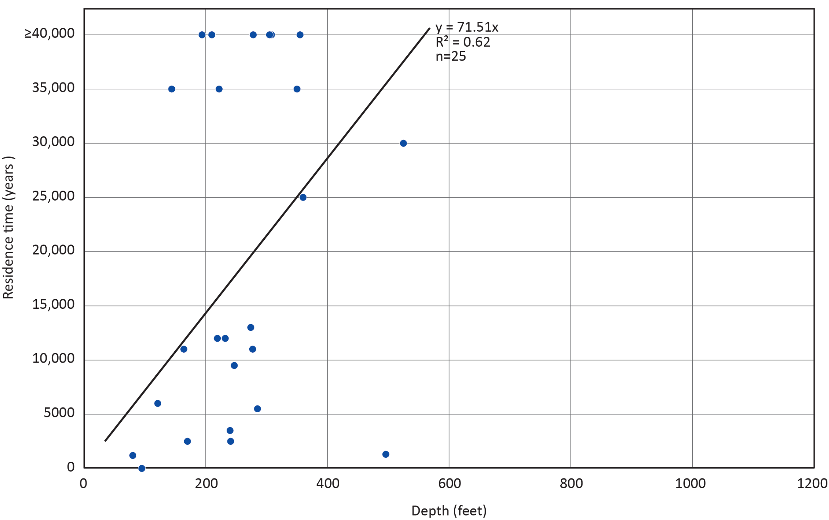
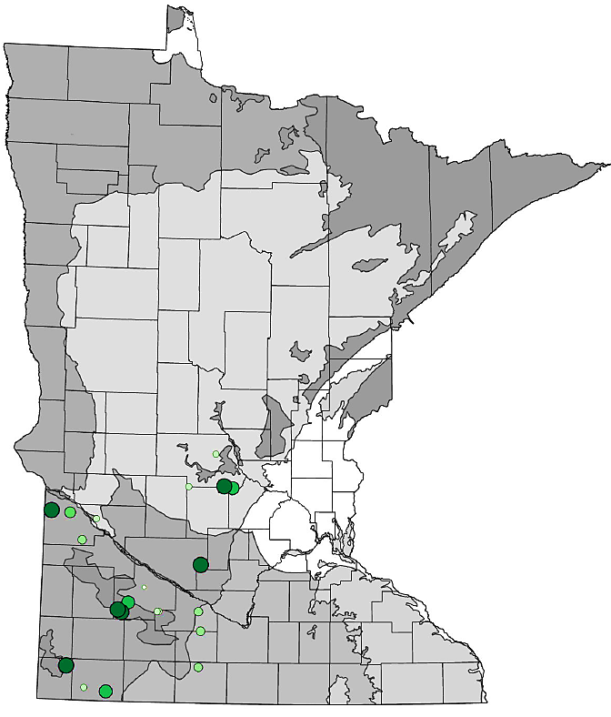
Carbon-14 vs. Depth: Cretaceous Wells

Slide 35
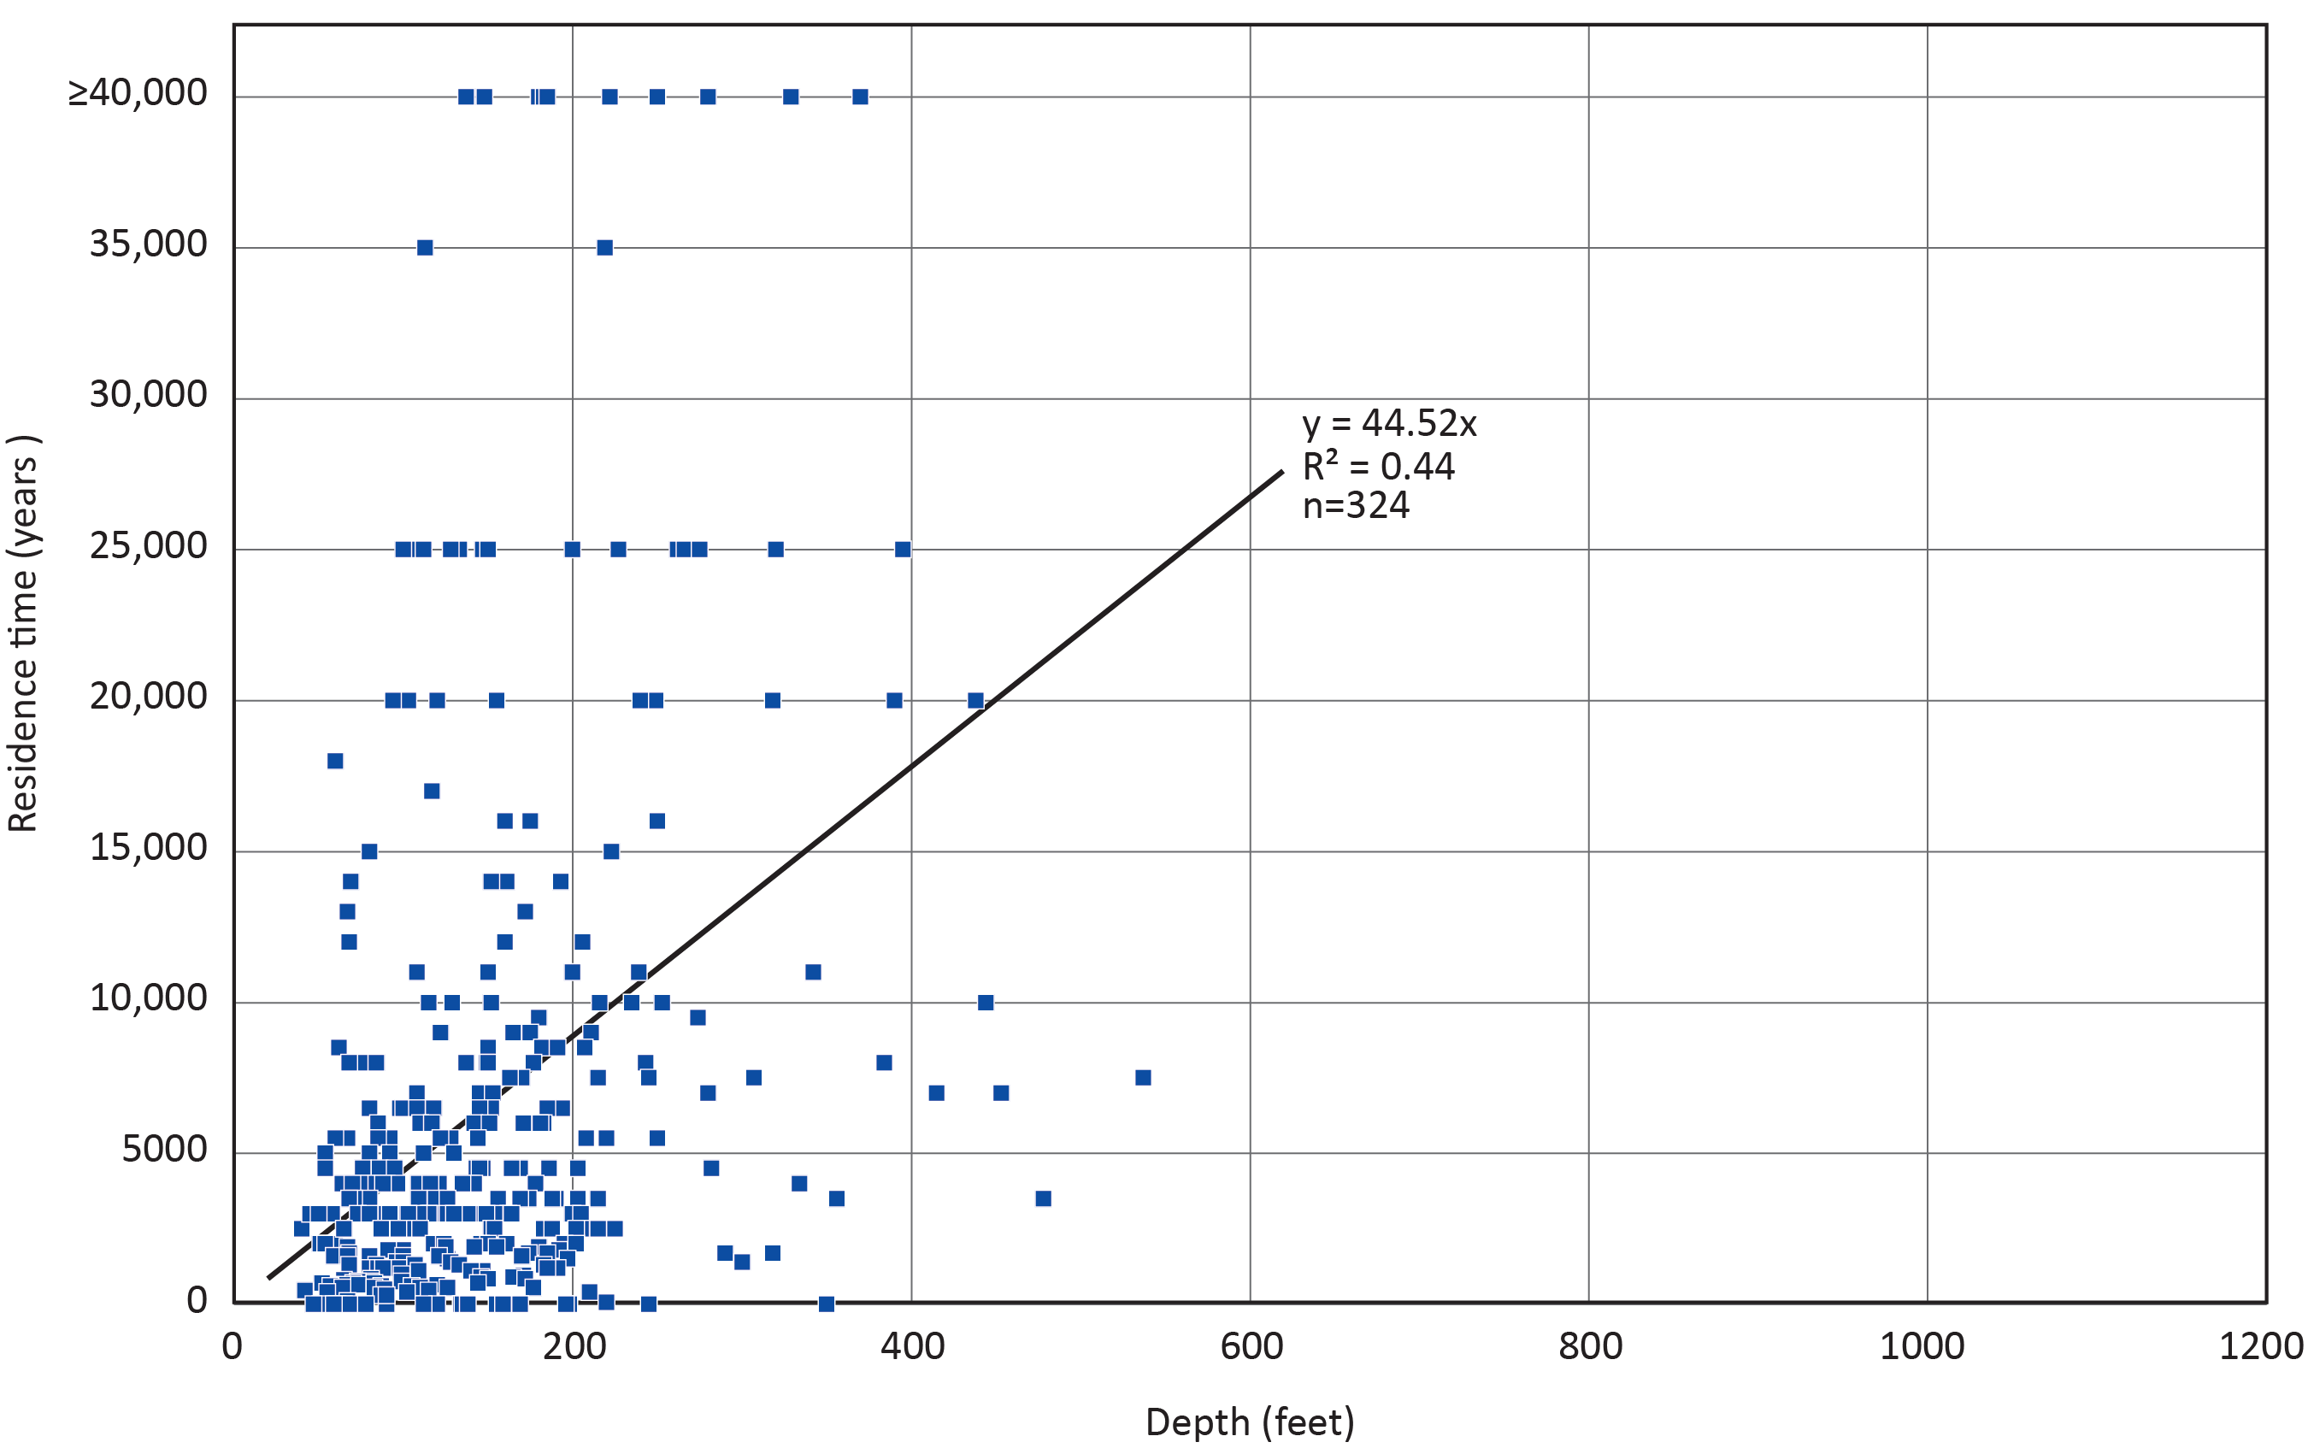
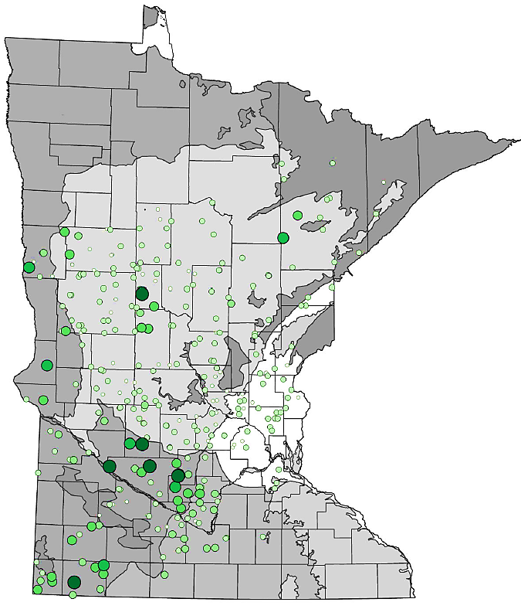
Carbon-14 vs. Depth: Quaternary Wells
Mostly buried artesian

Slide 36
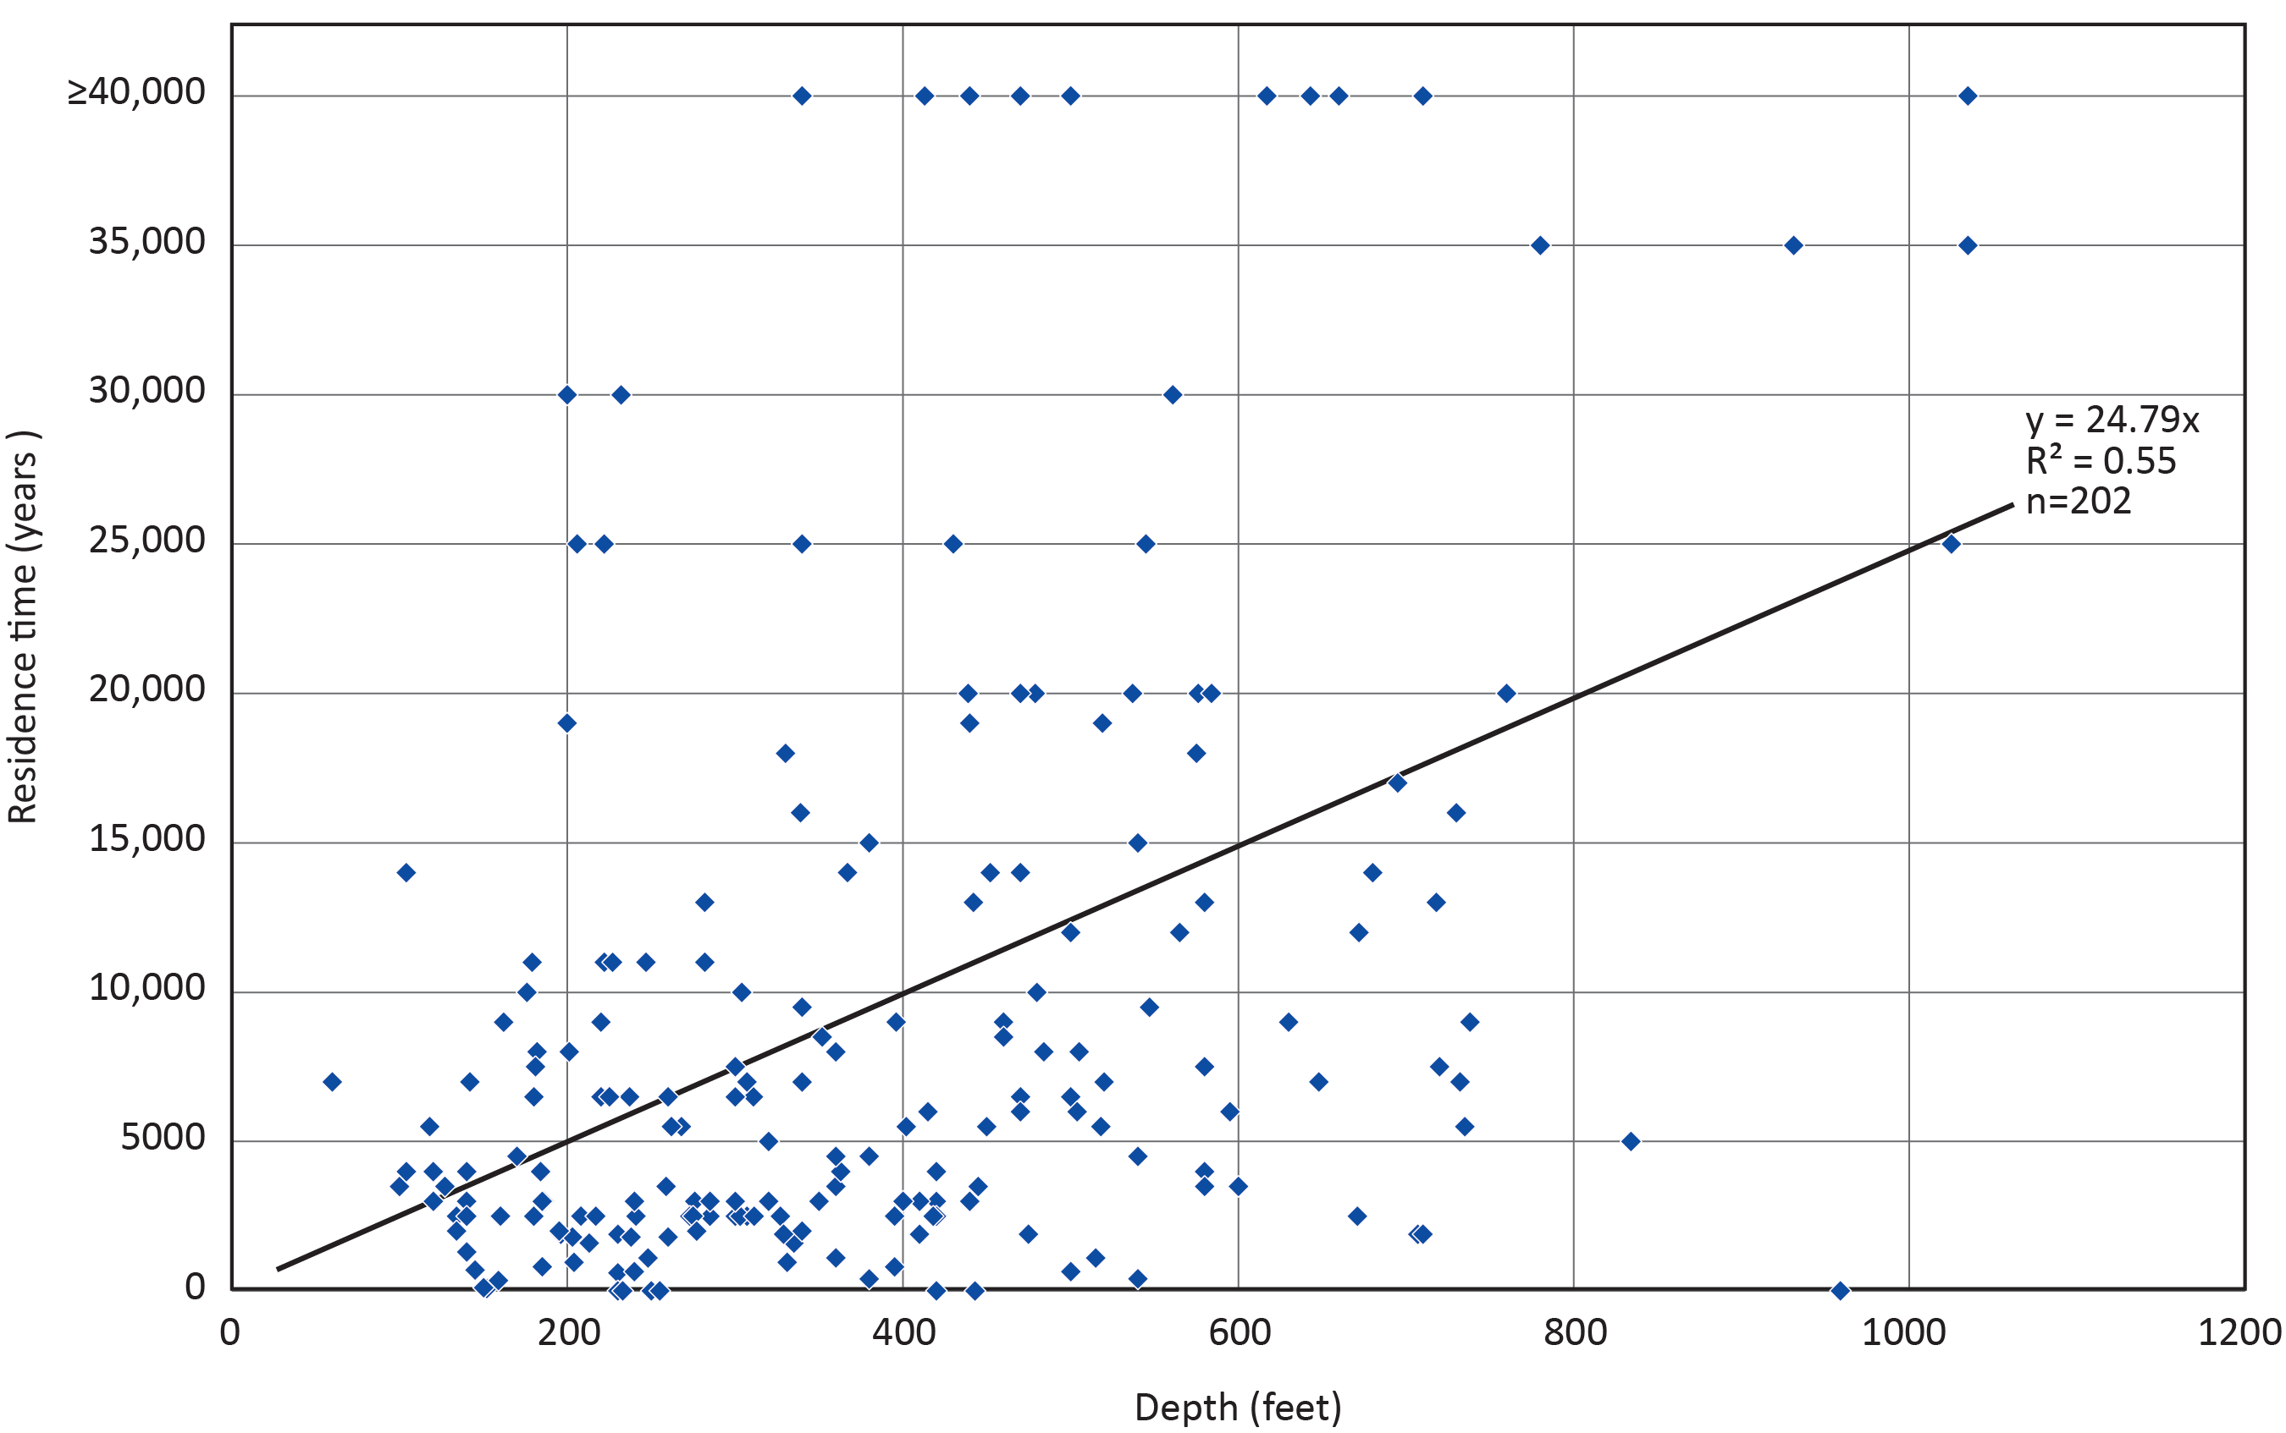
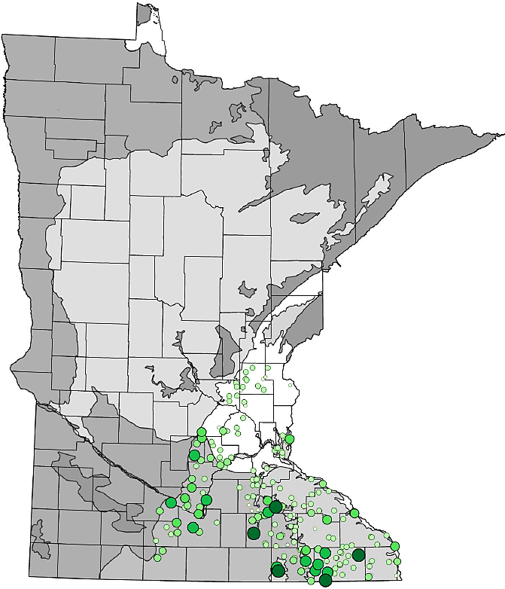
Carbon-14 vs. Depth: Paleozoic Wells

Slide 37
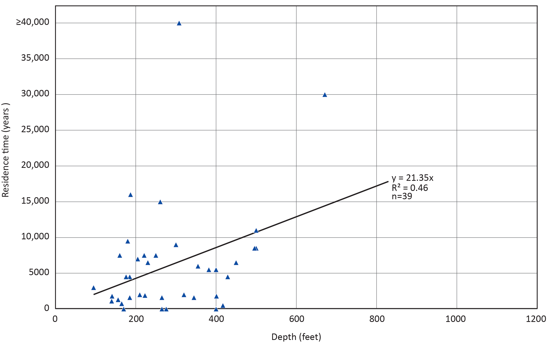
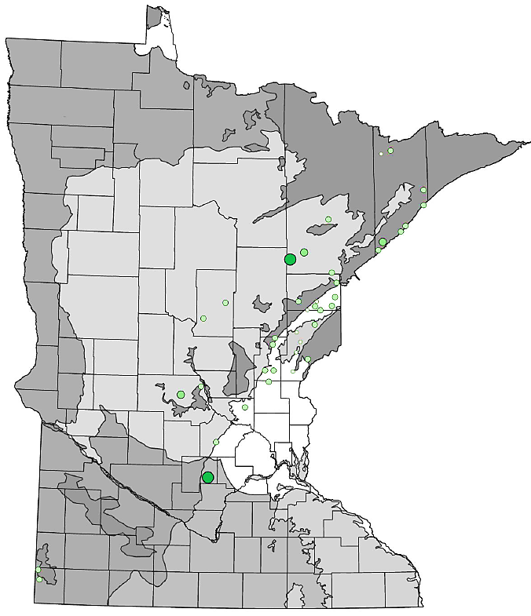
Carbon-14 vs. Depth: Precambrian Wells

Slide 38
Thank You!
John Barry and Kayla Nelson
county.groundwater.atlas.dnr@state.mn.us
mndnr.gov/groundwatermapping

Slide 39

Using Groundwater Age as a Tool for Groundwater Management in Moorhead, Minnesota
Jennifer L. Rose, Michele Walker | Hydrogeologists
Groundwater Technical Analysis Unit
Notes:
Photo from Google https://share.google/b2UKIrIKHkSQGtMGk
Using groundwater age as a tool for groundwater management in Moorhead, Minnesota
Abstract
The Minnesota Department of Natural Resources uses groundwater age as a tool to manage groundwater near Moorhead, in Clay County, Minnesota. In this area, groundwater availability is limited in Quaternary buried artesian aquifers and moderate in surficial sands. Clay County has both types of aquifer systems: 1) the Moorhead aquifer is a confined aquifer with vintage aged (pre-1953) glacial ice meltwater, and 2) the Buffalo aquifer transitions from unconfined to confined and thus has both recent (post 1953) and mix of recent and vintage water, depending on the location.
These aquifer systems have different responses to high-capacity pumping and recharge. Groundwater level trends depend on the amount of groundwater that is pumped, and which aquifer is used the most heavily. The Moorhead aquifer does not fully recover with decreased water use, while the Buffalo aquifer does. The age dating of these two systems tells us why there is a disparity in recovery; the ancient Moorhead aquifer water is very slow to recharge while the Buffalo aquifer recharges faster. By understanding the age of these aquifers, along with long term monitoring of groundwater levels and use data, we can holistically manage the aquifer system sustainability.

Slide 40


Groundwater Provinces
Minnesota Groundwater Provinces 2021
https://www.dnr.state.mn.us/waters/groundwater_section/mapping/provinces.html
Clay County
Notes:
The Minnesota Department of Natural Resources is the State agency tasked with regulating groundwater quantity.
The DNR uses groundwater age as a tool to manage groundwater near Moorhead, in Clay County, Minnesota. In this area, groundwater availability is limited in Quaternary buried artesian aquifers and moderate in surficial sands.

Slide 41


Clay County Atlas Part B Hydrogeology
Moorhead Aquifer
Buffalo Aquifer
Western portion of
cross section D to D’
https://files.dnr.state.mn.us/waters/groundwater_section/mapping/cga/c29_clay/clay_plate7.pdf
Bedrock
Notes:
Clay County has both confined and unconfined types of quaternary aquifer systems. Examples of these aquifers include the:
Moorhead aquifer which is a confined aquifer with vintage aged (pre-1953) glacial ice meltwater (shown in blue color), and
Buffalo aquifer that transitions from unconfined to confined and thus has both recent (post 1953 in pink color) and mix of recent and vintage water (shown in green color), depending on the location.
These aquifer systems have different responses to high-capacity pumping and recharge.

Slide 42

Moorhead Aquifer: Older Water
~200 feet head loss
No recovery after decreased use
Water levels from
Moorhead wellfield (241492)
Water use for municipal supply
42
Notes:
Groundwater level trends depend on the amount of groundwater that is pumped, and which aquifer is used the most heavily. The Moorhead aquifer, which has older water, does not fully recover with decreased water use, while the Buffalo aquifer does.

Slide 43

Buffalo Aquifer: Newer Water
Recovery after decreased use
Water levels from DNR wells 841555, 243695
Water use for municipal supply and irrigation
Notes:
The age dating of these two systems tells us why there is a disparity in recovery; the ancient Moorhead aquifer water is very slow to recharge while the Buffalo aquifer recharges faster.
By understanding the age of these aquifers, along with long term monitoring of groundwater levels and use data, we can manage the aquifer system sustainability.

Slide 44
Thanks!
Jennifer Rose
jennifer.rose@state.mn.us
Michele Walker
michele.walker@state.mn.us

